Slide 1
Parkinson’s Disease
Updates
Mitesh Lotia, MD
Medical Director,
Movement Disorders
AdventHealth Neuroscience
Institute
January 13-16, 2024
Key Largo, Florida

Slide 2
Disclosures
Consulting Fee (e.g., Advisory Board): Orphalan Contracted Research (Principal Investigators must provide information, even if received by the institution): Roche, Intracellular Therapies, Biogen Speakers' Bureau: Abbott

Slide 3
Learning Objectives
Describe clinical updates and new treatments related to hypokinetic (i.e. Parkinson’s disease) and hyperkinetic movement disorders.

Slide 4
Parkinson’s Disease – A Disease or a Syndrome

Slide 5
How common is Parkinson’s Disease
>10 Million Worldwide
~ 1 Million in USA
Estimated 90,000
Americans diagnosed
every year (up from
60,000)
165 new patients every
day!

Slide 6
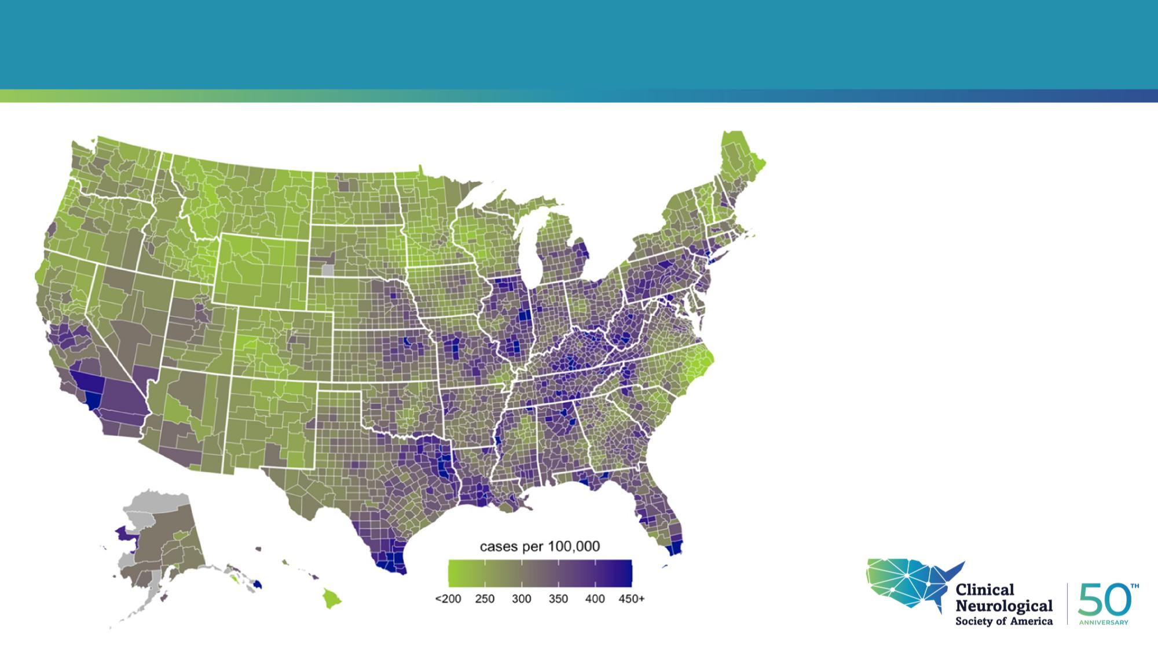
Incidence and Geographical variation in PD
90,000 patients with PD every year
1.5 times higher than previous estimates
Rust Belt – SoCAL, South Texas, NE, FL
Willis, A.W., Roberts, E., Beck, J.C. et al. Incidence of Parkinson disease in North America. npj Parkinsons Dis. 8, 170 (2022). https://doi.org/10.1038/s41531-022-00410-y

Slide 7
Genetic and Environmental Factors
Genetic Factors
GBA
LRRK2
PRKN
SNCA

Slide 8
Clinical Diagnosis
Bloem BR, Okun MS, Klein C. Parkinson's disease. Lancet. 2021 Jun 12;397(10291):2284-2303. doi: 10.1016/S0140-6736(21)00218-X. Epub 2021 Apr 10. PMID: 33848468.

Slide 9
Clinical Diagnosis
Bloem BR, Okun MS, Klein C. Parkinson's disease. Lancet. 2021 Jun 12;397(10291):2284-2303. doi: 10.1016/S0140-6736(21)00218-X. Epub 2021 Apr 10. PMID: 33848468.

Slide 10
Skin Biopsy
Gibbons CH, Freeman R, Bellaire B, Adler CH, Moore D, Levine T. Synuclein-One study: skin biopsy detection of phosphorylated α-synuclein for diagnosis of synucleinopathies. Biomark Med. 2022 May;16(7):499-509. doi: 10.2217/bmm-2021-0646. Epub 2022 Mar 11. PMID: 35272481; PMCID: PMC9169016.

Slide 11
Diagnosis Alpha- synuclein Seed Amplification Assays (SAAs)
N Specificity (95% CI) Sensitivity (95% CI)
Tcxt
Differentiate PWP from Healthy controls
Bullct
PPMI cohort – well defined largest cohort of
PWP, healthy controls, prodromal individuals
Healthy controls 163 96·3% (93·4-99·2) NA
SWEDD 54 90·7% (83·0-98·5) NA
All Parkinson’s disease
545 NA 87·7% (84·9-90·5)
cases
and non-manifesting carriers
CSF samples of PPMI Cohort
Hyposmic 390 NA 97·2% (95·5-98·8)
Normosmic 146 NA 63·0% (55·2-70·8)
Sporadic
Parkinson’s disease
373 NA 93·3% (90·8-95·8)
LRRK2 mutation Parkinson’s disease
123 NA 67·5% (59·2-75·8)
GBA mutation Parkinson’s disease
49 NA 95·9% (90·4-100·0)
LRRK2 mutation Parkinson’s disease
Male participants 65 NA 78·5% (68·5-88·5)
Female participants 58 NA 55·2% (42·4-68·0)
Hyposmic 69 NA 89·9% (82·7-97·0)
Normosmic 49 NA 34·7% (21·4-48·0)
Siderowf, Andrew et al. “Assessment of heterogeneity among participants in the Parkinson's Progression Markers Initiative cohort using α-synuclein seed amplification: a cross-sectional study.” The Lancet. Neurology vol. 22,5 (2023): 407-417. doi:10.1016/S1474-4422(23)00109-6
Normosmic and female participants
24 NA 12·5% (4·3-31·0)

Slide 12
Diagnosis Alpha- synuclein Seed Amplification Assays (SAAs)
Highest positive results in Sporadic PD with hyposmia
Lower in LRRK2 variant carriers with normal olfaction
Highest in Genetic variant carrier GBA variants
Prodromal / At-risk individuals RBD+, DAT+ were α-synuclein SAA positive
RBD+, Hyposmia+ but DAT -ve were α-synuclein SAA positive
Immediate Implications on Clinical Trials
For LRRK2-targeted therapies – stratification based on alpha-synuclein SAA results
For GBA-targeted therapies – exclude SAA negative patients
Combine the α-synuclein and AD pathology, classify individuals with mixed pathology
For planned clinical trials for at-risk population – identify people in earliest stages

Slide 13
Braak Hypothesis – Disease Progression
Text
Bullet

Slide 14
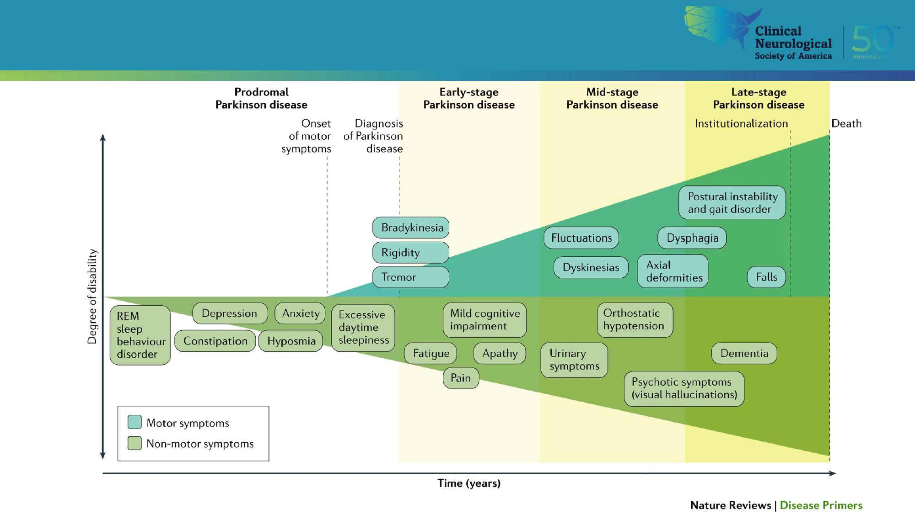
Parkinson’s Progression

Slide 15
Treatment Objectives
Text
Bullet

Slide 16
Myth or Fact
One should delay the dopaminergic therapy for as long
as possible
Levodopa stops working after a few years of working
and therefore should be delayed as long as possible

Slide 17
Myth or Fact

Slide 18
Objectives

Slide 19
Medication Management of Motor Symptoms of Parkinson’s Disease

Slide 20
Motor Complications

Slide 21
Medication Management of Motor Symptoms of Parkinson’s Disease
Medications to treat Motor fluctuations Medications to treat Levodopa Induced Dyskinesia
Levodopa Adjuncts Dopamine Agonists Safinamide Istradefylline Levodopa Extenders Entacapone Opicapone | Amantadine Carbidopa/ Levodopa
Levodopa formulations Carbidopa/ Levodopa Levodopa Powder

Slide 22
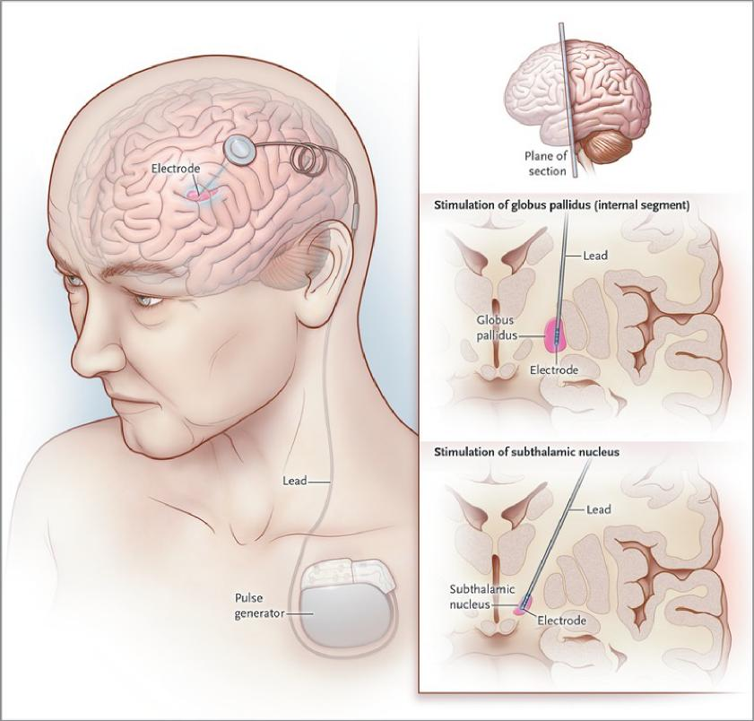
Deep Brain Stimulation
 | PD Subthalamic Nucleus (STN) Globus Pallidus (Gpi) ET TD-PD Ventral intermediate Nucleus (ViM)
Deep Brain Stimulation for Parkinson’s Disease, Okun, N Engl J Med 2012;367:1529-38.

Slide 23
Deep Brain Stimulation
At least 30% improvement on
OFF/ON testing
Treatment Resistant Tremor
Expectations with the patients
Improvement
Tremors
Motor Fluctuations
Levodopa induced dyskinesia
No Improvement
Cognition, speech
Cautious discussion
Gait
Deep Brain Stimulation for Parkinson’s Disease, Okun, N Engl J Med 2012;367:1529-38.

Slide 24
Lesional Surgery
TD-PD
Does not help
with
bradykinesia or
dyskinesia

Slide 25
Lifestyle Modifications

Slide 26
Current and novel infusion therapies
Antonini A, D'Onofrio V, Guerra A. Current and novel infusion therapies for patients with Parkinson's disease. J Neural Transm (Vienna). 2023 Nov;130(11):1349-1358. doi: 10.1007/s00702-023-02693-8. Epub 2023 Sep 6. PMID: 37672049; PMCID: PMC10645652.

Slide 27
New Medications to look forward to

Slide 28
New Medications to look forward to

Slide 29
Proposed Care Model – The patient is the Sun

Slide 30
AdventHealth Neuroscience Institute
Movement Disorders Neurologists
Anwar Ahmed, MD Mitesh Lotia, MD
Functional Neurosurgeon
Chandan Reddy, MD, MS, FAANS
Leadership
Craig Brubaker, PhD
Jennifer Zerba,
Jahaira Barbot - Jimenez
Movement Disorders APP
Nigam Reddy, APRN
Movement Disorders Clinic Staff
Kayle Liner, LPN
Jenna Lloyd, CCMA
Anaiya Crutchfield, CMA
Neuropsychology Jodi Nadler, PhD Claire Varga, PhD
Psychiatry
Bibi Azka Nabi, MD, MRCPsych
Murtaza Syed, MD
Movement Disorders Social Work / Outreach
Karita Anderson, MSW Gayle Shepherd, RN
Rehabilitation services
Laura Patrick, PT, DPT Amanda Saylor, OT Jessica Ares, SLP
Genetic CounselorJennifer Pagano, MMSc, CGC
Nurse Navigator
Referral Coordinator Hallie Peyton, RN, CPN
Louis Mariano

Slide 31
Questions

