Slide 1


Atypical Parkinsonism:
“When is it NOT Parkinson’s Disease”
Monday, January 15, 2024
David J. Houghton, MD, MPH
Ochsner Health
New Orleans, LA
January 13-16, 2024
Key Largo, Florida

Slide 2
Disclosures
No pertinent financial disclosures

Slide 3
Objectives
Counsel management of treatable symptoms
Determine the best workup necessary to differentiate conditions
Guide management of treatable symptoms

Slide 4
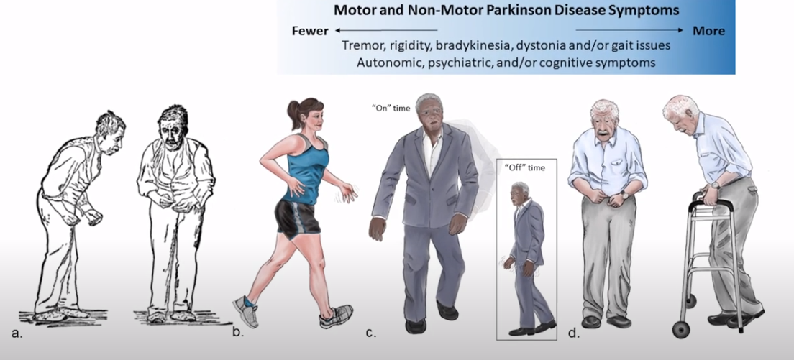
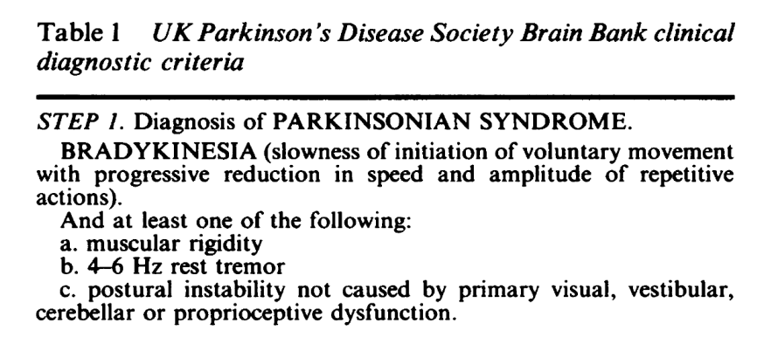
What IS Parkinson’s disease?
Motor features
Tremor = 3 – 6 hz, rest more than action
Bradykinesia = slowed, stuttering, smaller
Rigidity = cogwheeling across joints
Postural Instability = retropulsion, inability to stop
Stooped posture
Soft, hoarse voice
Masked face (hypomimia)
Gait festination
Diminished arm swing
Micrographia
Asymmetrical onset
Expected ldopa response

Slide 5
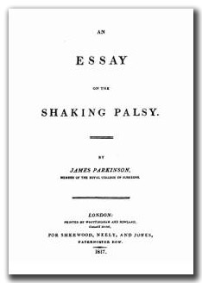
What else is Parkinson’s disease?
Non-motor features
“the sleep becomes much disturbed…”
“…constant sleepiness…and other marks of extreme exhaustion…”
“…the power of articulation is lost…”
“…saliva…trickling from the mouth…”
“…the food is with difficulty retained in the mouth…
“…the bowels, which had been all along torpid, now, in most cases, demand stimulating medicines of very considerable power: the expulsion of the feces from the rectum sometimes requiring mechanical aid…”

Slide 6
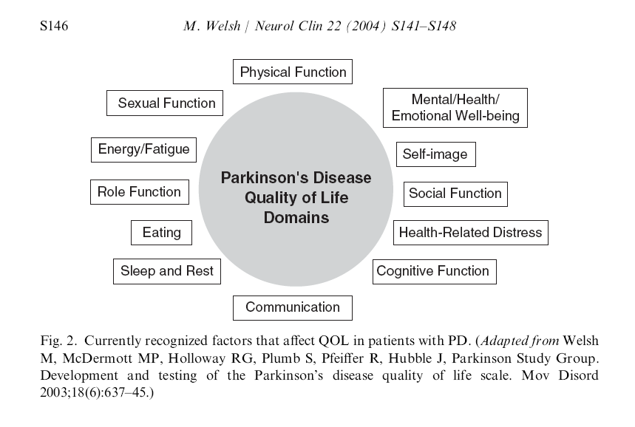
What else is Parkinson’s disease?
Non-motor features
Disorders of smell
Sleep disorders
Mood changes
Autonomic disorders
Memory changes
Speech disorders
Weight loss/gain
Sensory changes

Slide 7
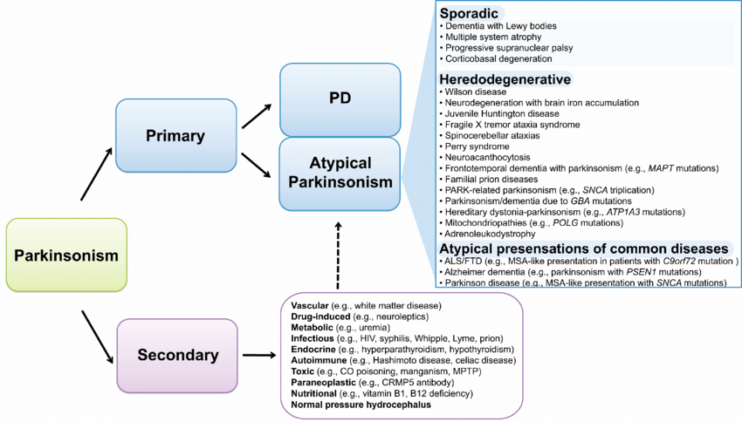
Parkinsonism: the differential diagnosis
Scholz, Sonja & Bras, Jose. (2015). Genetics Underlying Atypical Parkinsonism and Related Neurodegenerative Disorders. International journal of molecular sciences. 16. 24629-24655. 10.3390/ijms161024629.

Slide 8
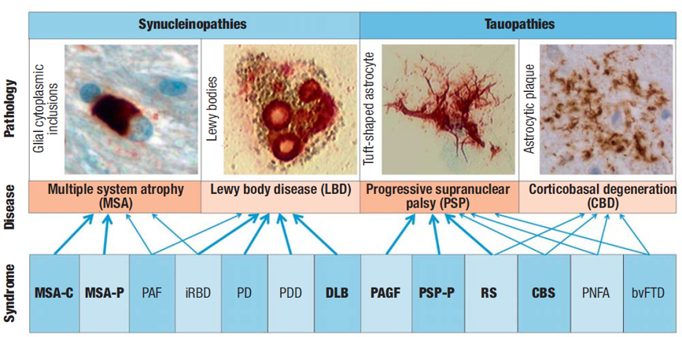
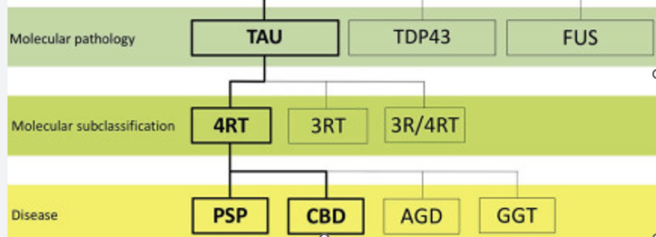
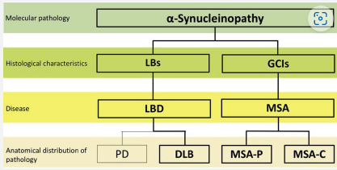
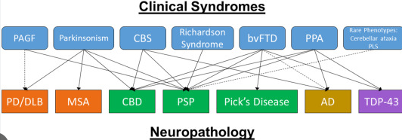
Neuropathology and syndromic classification
Respondek G, Stamelou M, Höglinger GU. Classification of atypical parkinsonism per pathology versus phenotype. Int Rev Neurobiol. 2019;149:37-47.
Parkinsonism and Related Disorders, 2020-04-01, Volume 73, Pages 105-116
Dtsch Arztebl Int 2016; 113: 61-9. DOI: 10.3238/arztebl.2016.0061

Slide 9
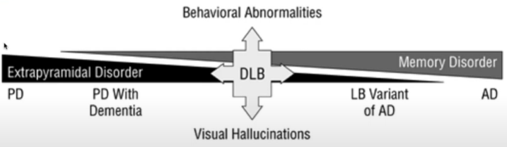
DLB: the basics
Clinical symptoms:
= non-motor (syncope or other transient episodes of unresponsiveness, constipation, orthostatic hypotension, urinary incontinence, excessive daytime sleepiness, hyposmia, hallucinations, delusions, apathy, anxiety, and depression)
= motor (parkinsonism, sensitivity to antipsychotic agents, postural instability, repeated falls)
Prevalence: 5% of general pop, 30% of all dementias
* More common than previously thought, 1/3 of cases misdiagnosed as Alzheimer’s disease
Mean age at disease onset: mid-70s
Disease course: 5-8 years average, but can be decades
https://www.uptodate.com/contents/epidemiology-pathology-and-pathogenesis-of-dementia-with-lewy-bodies
Arch Neurol. 2001;58(2):186-190. doi:10.1001/archneur.58.2.186

Slide 10
DLB: “red flags” and presentation
Rapid clinical deterioration
• Gait impairment requiring regular use of a wheelchair within 5 years
• Wheelchair dependent within 10 years
• Parkinsonism (typically symmetrical without tremor) poorly responsive to levodopa
Limb abnormalities
• Tremulous movements during ballistic aiming movements
Axial dysfunction
• Severe dysarthria and dysphagia within one year of onset
• Decreased ten-step tandem gait performance
• Loss of cycling ability
Cognitive, neuropsychiatric and behavioral dysfunction
• Early dementia (within one year of the appearance of parkinsonism)
• Fluctuating cognition
• Early and prominent visual hallucinations
Bhidayasiri R, Sringean J, Reich SG, Colosimo C. Red flags phenotyping: A systematic review on clinical features in atypical parkinsonian disorders. Parkinsonism Relat Disord. 2019 Feb;59:82-92.

Slide 11
DLB: McKeith Criteria (updated 2017)
○ Central feature: Essential for a diagnosis of DLB
Dementia. In the early stages, prominent memory impairment may not occur, but deficits of attention, executive function, and visuoperceptual ability may be prominent.
○ Core clinical features (The first 3 typically occur early and may persist throughout the course)
Fluctuating cognition with pronounced variations in attention and alertness
Recurrent visual hallucinations that are typically well formed and detailed
Rapid eye movement (REM) sleep behavior disorder (RBD), which may precede cognitive decline
One or more spontaneous cardinal features of parkinsonism: bradykinesia, resting tremor, or rigidity
○ Supportive clinical features
Severe sensitivity to antipsychotic agents; postural instability; repeated falls; syncope or other transient episodes of unresponsiveness; severe autonomic dysfunction (e.g., constipation, orthostatic hypotension, or urinary incontinence); hypersomnia; hyposmia; hallucinations in other modalities; systematized delusions; and apathy, anxiety, and depression
○ Indicative biomarkers
Reduced dopamine transporter uptake in basal ganglia demonstrated by SPECT/PET
Abnormal (low uptake) 123I-MIBG myocardial scintigraphy
Polysomnographic confirmation of REM sleep without atonia
○ Supportive biomarkers
A relative preservation of medial temporal lobe structures on CT/MRI scan; generalized low uptake on SPECT/PET perfusion/metabolism scan with reduced occipital activity ± the cingulate island sign on FDG-PET imaging; prominent posterior slow-wave activity on EEG with periodic fluctuations in the pre-alpha/theta range
Probable DLB
a. Two or more core clinical features are present, or
b. Only one core clinical feature is present, but with one or more indicative biomarkers
Possible DLB
a. Only one core clinical feature, or
b. One or more indicative biomarkers is present, but there are no core clinical features
Bhidayasiri R, Sringean J, Reich SG, Colosimo C. Red flags phenotyping: A systematic review on clinical features in atypical parkinsonian disorders. Parkinsonism Relat Disord. 2019 Feb;59:82-92.

Slide 12
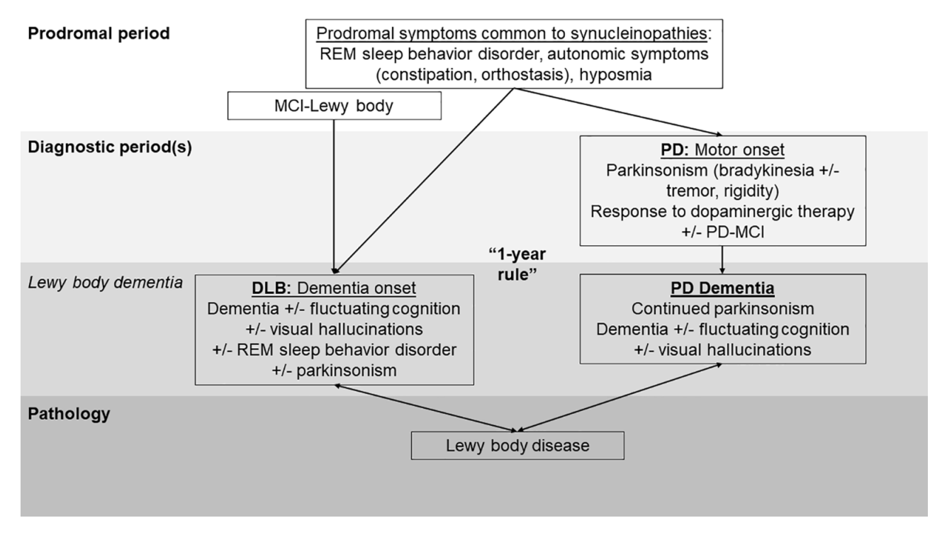
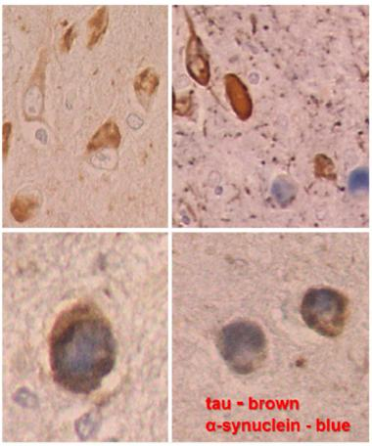


DLB & “THE LEWY BODY DISEASE CONTINUUM”
Non-motor
Motor
https://www.alzforum.org/news/conference-coverage/dementia-lewy-bodies-sharper-image-formerly-blurry-disease

Slide 13
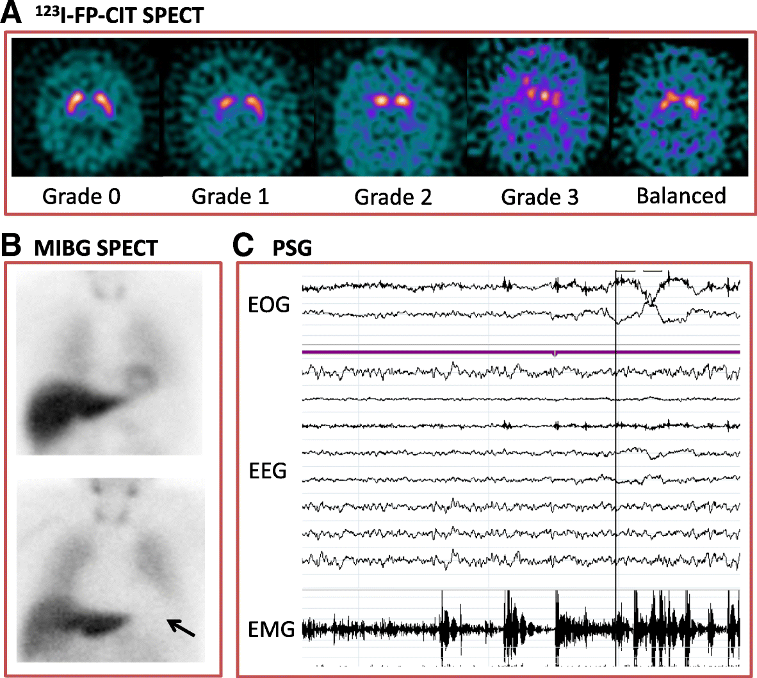
DLB: radiographic and diagnostic pearls
Axial images from FP-CIT SPECT (DaTscan) at the level of the striatum. Balanced bilateral loss in the caudate and putamen is often seen.
Cardiac Meta-iodobenzylguanidine (MIBG SPECT) Imaging. The bottom image is abnormal with no visible cardiac outline
Polysomnography (PSG) recording demonstrating episodes of REM sleep without atonia on electro-oculogram (EOG) measuring eye movements, electroencephalogram (EEG) and electromyogram (EMG) measuring chin movement.
Outeiro, T.F., Koss, D.J., Erskine, D. et al. Dementia with Lewy bodies: an update and outlook. Mol Neurodegeneration 14, 5 (2019). https://doi.org/10.1186/s13024-019-0306-8

Slide 14
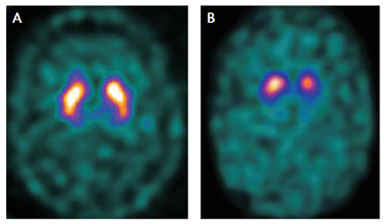
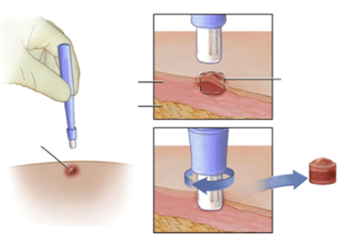
DLB: DatSCAN® vs SYN-ONE TEST®
DaTscan ®: PD vs ET
Sensitivity = 80-98% / Specificity = 93-100%
DaTscan ®: DLB vs AD
Sensitivity = 80% / Specificity = 92%
Syn-One ®: synucleinopathy vs normal controls
Sensitivity = 95.5% / Specificity = 96.7%
for DLB, sensitivity = 96.0%...but not tested against PD or AD as the control
https://www.parkinsons.org.uk/sites/default/files/2017-07/RD2734%20DaTCAT%20accuracy.pdf
Papathanasiou ND, Boutsiadis A, Dickson J, Bomanji JB. Diagnostic accuracy of 123I-FP-CIT (DaTSCAN) in dementia with Lewy bodies: A meta-analysis of published studies. Parkinsonism and Related Disorders. 2012;18(3):225-9.
Urval N, Bortan E, Dagostine M, et al. Clinical utility of skin biopsy compared to DaTscan in diagnosing synucleinopathies. Poster presented at: American Academy of Neurology Annual Meeting; April 22-27, 2023; Boston, MA
Gibbons C, Levine T, Bellaire B, et al. The Synuclein-One Study: Skin Biopsy Detection of Phosphorylated alpha-synuclein for Diagnosis of the Synucleinopathies. Presented at: AAN Annual Meeting; April 22-27, 2023; Boston, MA and Virtual. Presentation 6545.

Slide 15
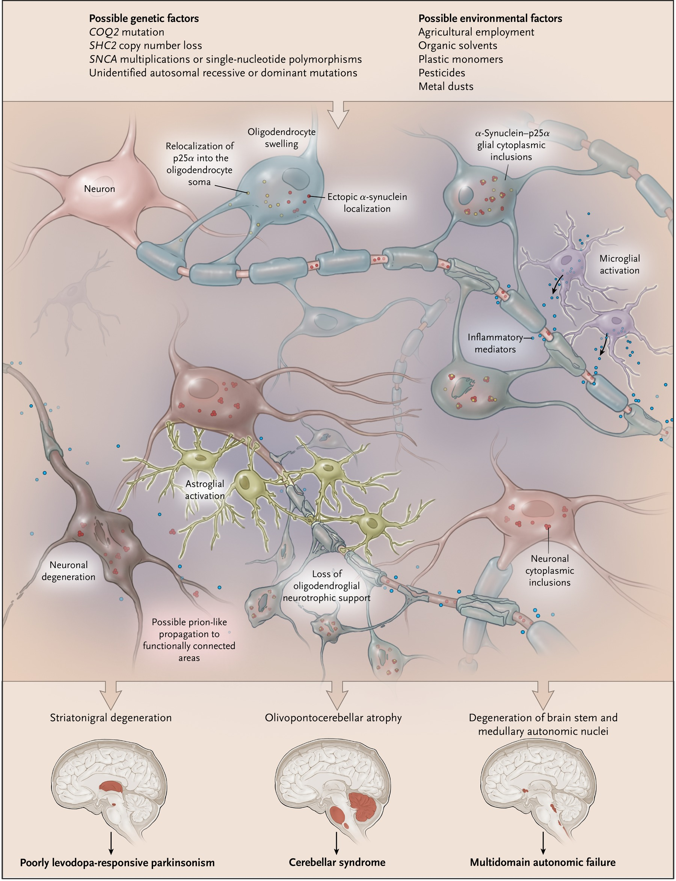
MSA: the basics
Clinical symptoms:
= dysautonomic symptoms are an obligatory component of MSA—especially urinary incontinence, erectile dysfunction, or orthostatic hypotension. Isolated pure autonomic failure (PAF) may precede the motor impairments in MSA.
= MSA-P with predominant parkinsonism
= MSA-C with predominant cerebellar sxs
Prevalence: 5/100 000.
Mean age at disease onset: 50s
Disease course: 6 to 10 years, patients die mostly from aspiration or cardiac arrest
N Engl J Med 2015; 372:249-263

Slide 16
MSA: “red flags” and presentation
Rapid clinical deterioration
• Wheelchair within 5 yrs, dependent 10 yrs
• Early postural instability and recurrent falls within 3 years
Eye movement abnormalities
• Gaze-evoked, downbeat and rebound nystagmus
Abnormal facial appearances
• Orofacial dystonia
Limb abnormalities
• Tremulous movements during ballistic aiming movements
• Jerky postural tremor
• Striatal hands
• Contracture of hands and feet
Axial dysfunction
• Severe dysarthria / dysphagia
• Anterocollis, Chin-on-chest posture
• Camptocormia, lateral flexion or Pisa
• Freezing of gait within three years of onset
• A wide-based gait, decreased ten-step tandem gait performance
• Loss of cycling ability
Autonomic dysfunction
• Early severe autonomic dysfunction
• Autonomic dysfunction before Pdism
• Inspiratory stridor or sighs
• Cold hand signs
Cognitive, neuropsychiatric
• Emotional incontinence
Other non-motor symptoms
• Coat hanger pain
Bhidayasiri R, Sringean J, Reich SG, Colosimo C. Red flags phenotyping: A systematic review on clinical features in atypical parkinsonian disorders. Parkinsonism Relat Disord. 2019 Feb;59:82-92.

Slide 17
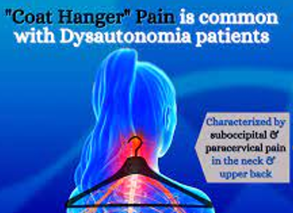

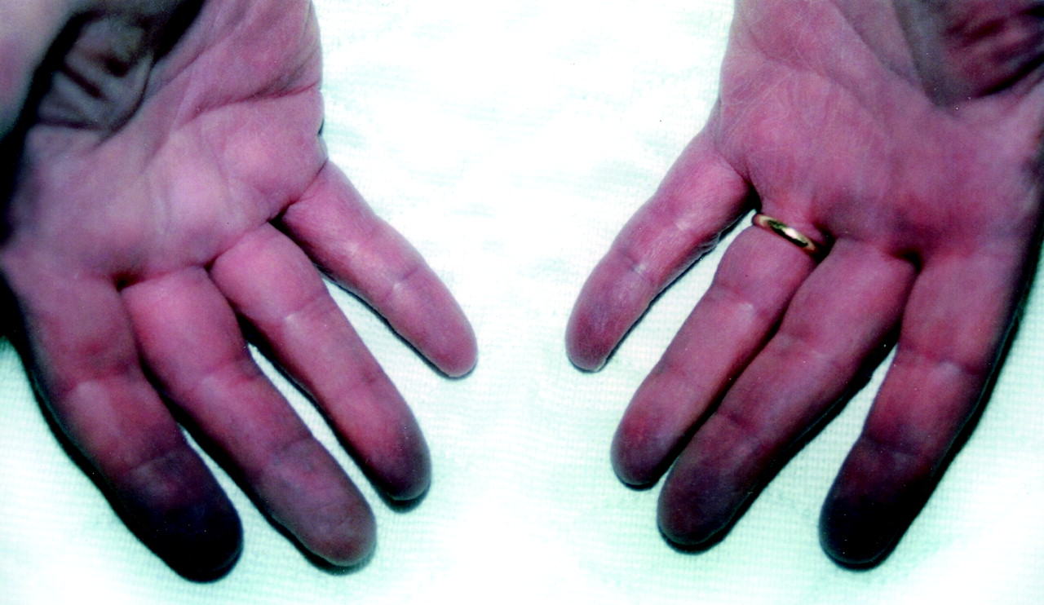
MSA: clinical pearls
= Often misdiagnosed as a spinal or fibromyalgia
= Believed to be caused by poor blood flow in the large muscles of the upper back and neck, caused by disrupted autonomic neurovascular control.
= helps to distinguish MSA from PD
= consists of cold, dusky, violaceous hands with delayed capillary refill after blanching

Slide 18
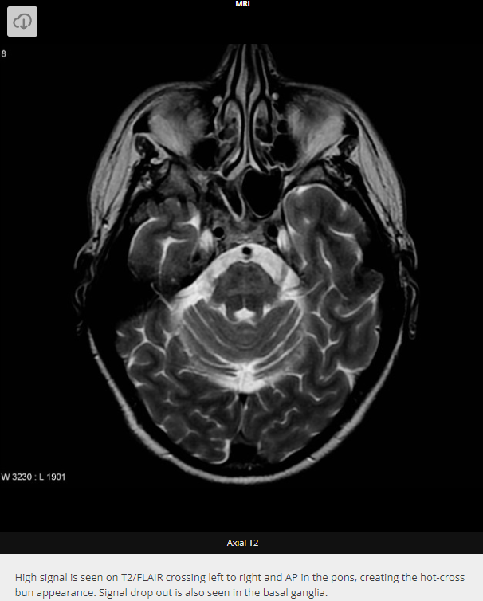
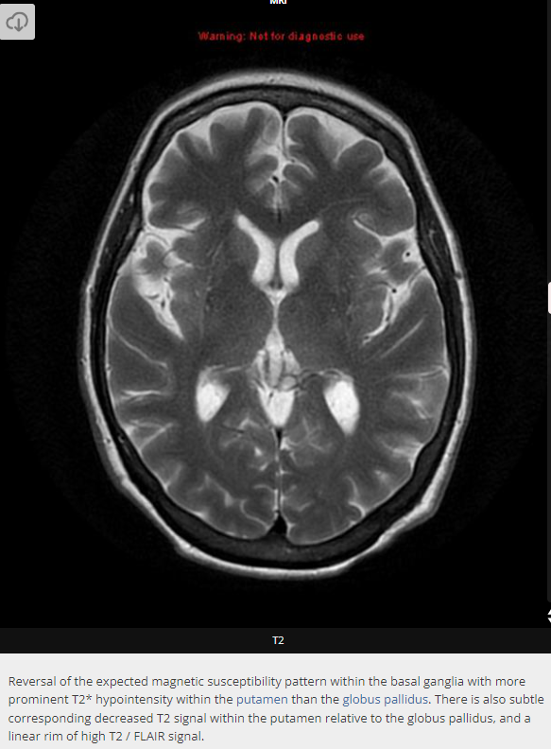
MSA: radiographic pearls
Hot cross bun
Hyperintense putaminal rim

Slide 19
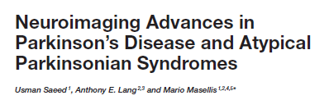
MSA: radiographic pearls
Hot cross bun
MCP Sign
Olivoponto-cerebellar
atrophy (OPCA)

Slide 20
MSA: treatment tips and tricks
For prognosis? Palliative Care
For parkinsonism? Levodopa > amantadine > dopamine agonists
For dystonia? Amantadine + botulinum toxins
For ataxia? PT/OT, no meds
For choking/stridor? Speech therapy + sialorrhea tx (1% atropine, Botox)
For neurogenic bladder? Mirabegron, anti-cholinergics, catheters
For orthostasis?
Non-Rx: 1) avoid rapid postural change, heavy meals, straining while coughing or passing stool, & hot temperatures. 2) add leg crossing, increasing water and salt intake, keeping the head of the bed raised, and using compression stockings or binders
Rx: 1) droxidopa, midodrine, fludrocortisone, pyridostigmine
For reactive hypertension? Short acting clonidine, vasodilators like Nitro paste

Slide 21
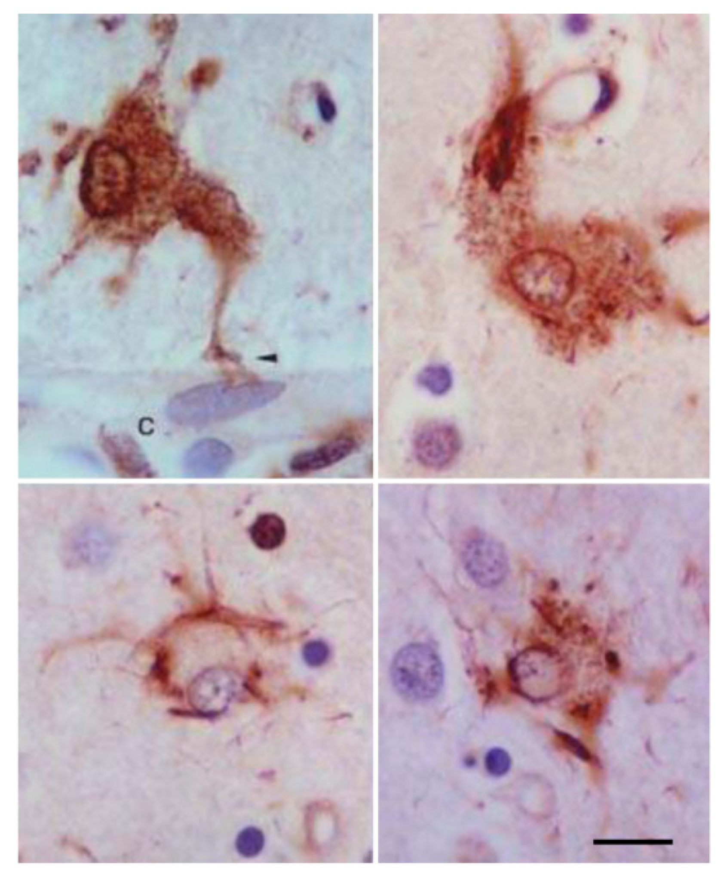
PSP: the basics
Clinical symptoms:
= levodopa-resistant akinetic-rigid symptoms affecting the axial muscles
= tendency to fall backwards
= vertical gaze paresis
= frontal lobe syndrome → apathy, impaired executive functions, and a “applause sign”
MAY HAVE SOME INITIAL asymmetric levodopa-responsive parkinsonism (PSP-P, about 20%) which is clinically indistinguishable from Parkinson’s disease, until the later onset of vertical gaze paresis….
Prevalence: 5–10/100 000 persons
Mean age at disease onset: 60s
Disease course: “rule of odds”
1) year 1, falls
2) year 3, gaze palsy
3) year 5, cognitive
4) years 7-9, near death, die from aspiration or falls
Need reference for slides

Slide 22
PSP: “red flags” and presentation
Rapid clinical deterioration
• Wheelchair in 5 yrs, dependent in 10 (like MSA)
• Falls within the first year
Eye movement abnormalities
• Giant or macro square wave jerks
• Curved trajectory vertical saccades (Round-the-house sign)
• Slow vertical saccades
• Supranuclear vertical gaze palsy
Abnormal facial appearances
• Dystonic wrinkling of the glabellar region (Procerus or corrugator sign)
• Blepharospasm (& apraxia of eyelid opening)
• Lid retraction (‘Reptilian stare’)
• Transient head deviation
Limb abnormalities
• Tremulous movements during ballistic aiming movements
Axial dysfunction
• Retrocollis with extended body posture
• Freezing of gait within three years of onset
• Robotic voice, dysarthria and dysphagia
• A wide-based gait, lateral instability
• Decreased ten-step tandem gait
• Loss of cycling ability
Cognitive, neuropsychiatric
• Executive dysfunction and apathy within three years of onset
• Apathy and impulsivity (Rocket’s sign)
• Emotional incontinence
• Non-fluent aphasia
Other non-motor symptoms
• Decreased pain sensitivity
• Absent of autonomic symptoms
Bhidayasiri R, Sringean J, Reich SG, Colosimo C. Red flags phenotyping: A systematic review on clinical features in atypical parkinsonian disorders. Parkinsonism Relat Disord. 2019 Feb;59:82-92.

Slide 23
PSP: clinical phenotypes (most lumping)
Richardson's Syndrome (RS)
most common subtype of PSP, accounting for about 70% of all cases
Classic triad of symptoms: postural instability, supranuclear gaze palsy, and
PSP-Parkinsonism (PSP-P)
subtype of PSP that is characterized by a combination of Parkinsonian features, such as tremors, rigidity, and bradykinesia, along with the classic PSP features
Greater ldopa response initially, often misdiagnosed as Parkinson's disease
PSP-Corticobasal Syndrome (PSP-CBS)
subtype combo of PSP and Corticobasal features
more rigidity, apraxia, and myoclonus; earlier dementia
PSP-Pure Akinesia with Gait Freezing (PSP-PAGF)
rare subtype of PSP that is characterized by severe akinesia (inability to initiate voluntary movements) and gait freezing
Multiple sources

Slide 24
PSP: clinical phenotypes (most splitting)
2017 MDS variant PSP clinical presentations with initial predominance
ocular motor dysfunction (PSP-OM)
postural instability (PSP-PI)
parkinsonism resembling idiopathic Parkinson’s disease (PSP-P)
frontal lobe cognitive or behavioral presentations (PSP-F, + bvFTD)
progressive gait freezing (PSP-PGF)
corticobasal syndrome (PSP-CBS)
primary lateral sclerosis (PSP-PLS)
cerebellar ataxia (PSP-C)
speech/language disorders (PSP-SL, + nfaPPA)
progressive apraxia of speech (AOS).
Höglinger GU, Respondek G, Stamelou M, Kurz C, Josephs KA, Lang AE, Mollenhauer B, Müller U, Nilsson C, Whitwell JL, Arzberger T, Englund E, Gelpi E, Giese A, Irwin DJ, Meissner WG, Pantelyat A, Rajput A, van Swieten JC, Troakes C, Antonini A, Bhatia KP, Bordelon Y, Compta Y, Corvol JC, Colosimo C, Dickson DW, Dodel R, Ferguson L, Grossman M, Kassubek J, Krismer F, Levin J, Lorenzl S, Morris HR, Nestor P, Oertel WH, Poewe W, Rabinovici G, Rowe JB, Schellenberg GD, Seppi K, van Eimeren T, Wenning GK, Boxer AL, Golbe LI, Litvan I; Movement Disorder Society-endorsed PSP Study Group. Clinical diagnosis of progressive supranuclear palsy: The movement disorder society criteria. Mov Disord. 2017 Jun;32(6):853-864.

Slide 25

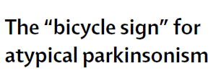


PSP: clinical pearls
At presentation:
111 patients rode a bicycle
-- 45 developed PD
-- 64 developed atypical Pdism
At median 30 months:
-- 43/45 PD patients still rode
-- 30/64 aPD patients still rode
Sensitivity = 52%
Specificity = 96%
= may be the result of the decreased ability to plan a specific program of three claps (because of the frontal dysfunction) associated with an inability to stop an automatic activity once it has been released (because of the dysfunction of the basal ganglia).
“As a result of the frontal lobe disturbance the PSP patient may jump to his or her feet from a sitting position without thinking only to topple backwards into the chair because of postural instability. This is known as the ‘rocket sign’.”
Dubois, B. , Slachevsky, A. , Pillon, B. , Beato, R. , Villalponda, J. M. & Litvan, I. (2005). “Applause sign” helps to discriminate PSP from FTD and PD. Neurology, 64 (12), 2132-2133. doi: 10.1212/01.WNL.0000165977.38272.15.
www.thelancet.com Vol 377 January 8, 2011
Rehman HU. Progressive supranuclear palsy. Postgrad Med J. 2000 Jun;76(896):333-6. doi: 10.1136/pmj.76.896.333. PMID: 10824045; PMCID: PMC1741619.

Slide 26
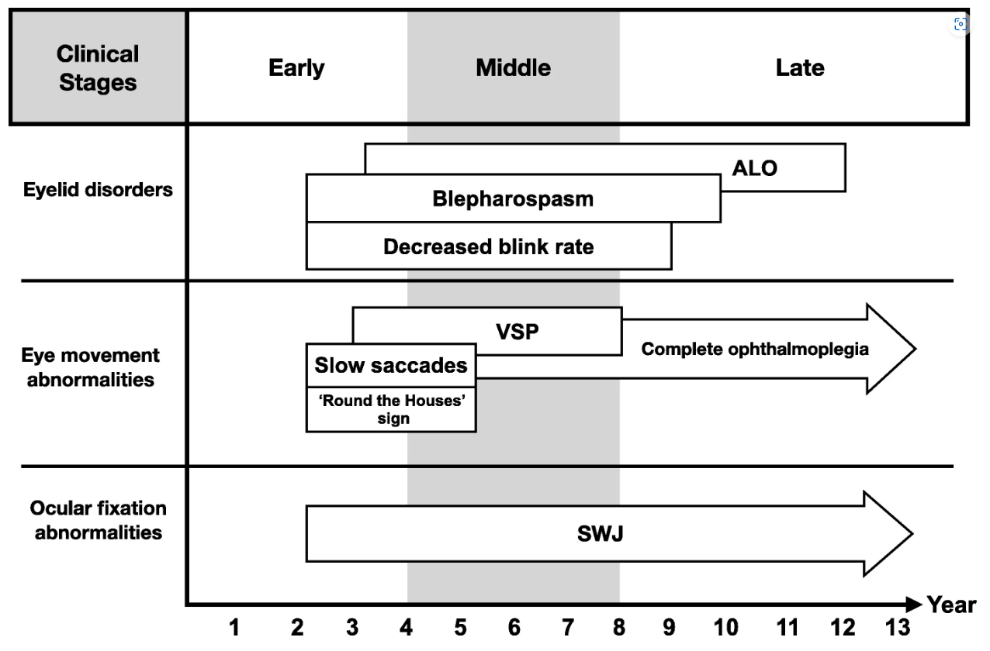
PSP: notable ocular problems
Phokaewvarangkul, O., Bhidayasiri, R. How to spot ocular abnormalities in progressive supranuclear palsy? A practical review. Transl Neurodegener 8, 20 (2019).

Slide 27
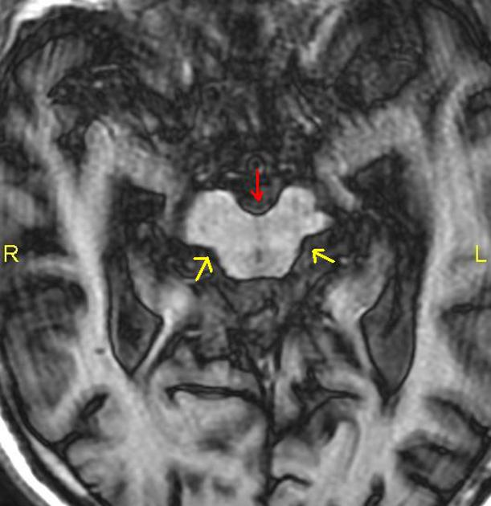
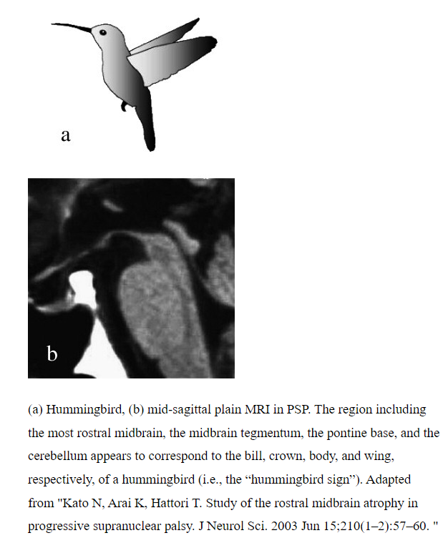
PSP: radiographic pearls
Mickey Mouse appearance: reduction of anteroposterior midline midbrain diameter, at the level of the superior colliculi on axial imaging (from interpeduncular fossa to the intercollicular groove: <12 mm) ^{6,8}
https://radiopaedia.org/articles/progressive-supranuclear-palsy-1?lang=us

Slide 28
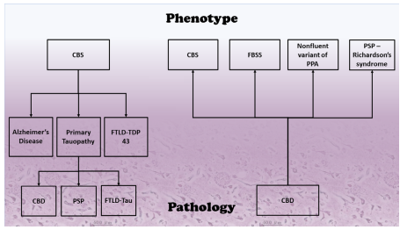
CBD/CBS: the basics
Corticobasal degeneration (CBD) is reserved for the neuropathological diagnosis. Clinically, CBD mostly manifests with a corticobasal syndrome (CBS)…
Clinical symptoms:
= progressive constellation of symptoms that comprise functional damage to the basal ganglia and the cerebral cortex and appear asymmetrically.
= think akinesia, rigidity, dystonia, and myoclonus, typically resistant to levodopa. Tremor may be present, which is superimposed on myoclonus and therefore appear irregular and jerky.
= with progression, see “alien limb phenomenon” the characteristic, fixed dystonia-related posture of the affected arm. Includes apraxia, cortical sensory loss, pyramidal signs, behavioral disorders, and aphasia.
Prevalence: 1/100 000 persons
Mean age at disease onset: 50-60s
Disease course: 8-10 years, aspiration is common
Wilson D, Le Heron C, Anderson T Corticobasal syndrome: a practical guide. Practical Neurology 2021;21:276-285.

Slide 29
CBD/CBS: “red flags” and presentation
Rapid clinical deterioration
• Wheelchair in 5 yrs, dependent in 10 (like MSA)
• Falls within the first year
Eye movement abnormalities
• Saccadic apraxia
Limb abnormalities
• Jerky dystonic movements (especially when asymmetric)
• Useless arm
• Alien limb phenomenon
• Limb levitation
• Contracture of hands and feet
• Dystonic clenched fist
• Tremulous movements during ballistic aiming movements
Axial dysfunction
• Severe dysarthria and dysphagia within one year of onset
• A wide-based gait with staggering walk and lateral instability
• Decreased ten-step tandem gait performance
• Loss of cycling ability
Cognitive, neuropsychiatric
• Ideomotor apraxia
• Non-fluent aphasia
• Absent of autonomic symptoms
Bhidayasiri R, Sringean J, Reich SG, Colosimo C. Red flags phenotyping: A systematic review on clinical features in atypical parkinsonian disorders. Parkinsonism Relat Disord. 2019 Feb;59:82-92.

Slide 30
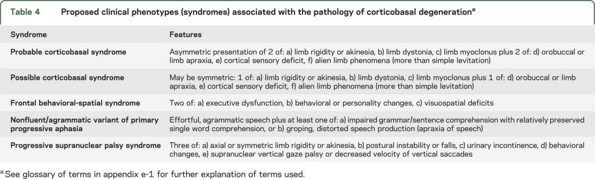
CBD/CBS: clinical phenotypes
Armstrong MJ, Litvan I, Lang AE, Bak TH, Bhatia KP, Borroni B, Boxer AL, Dickson DW, Grossman M, Hallett M, Josephs KA, Kertesz A, Lee SE, Miller BL, Reich SG, Riley DE, Tolosa E, Tröster AI, Vidailhet M, Weiner WJ. Criteria for the diagnosis of corticobasal degeneration. Neurology. 2013 Jan 29;80(5):496-503.

Slide 31
CBD/CBS: clinical pearls
Apraxia may be present in up to 70% of people corticobasal dysfunction
Some exam recommendations:
► Performing a gesture, miming the use of tools and copying meaningless gestures.
= Deficits in these movements → ideomotor apraxia.
► Performing complex, multistep tasks.
= Deficits in these processes → conceptual, or ideational apraxias
► Performing repetitive distal limb movements (tapping the thumb to each finger in turn)
= Deficits such as clumsy or inaccurate movements → limb-kinetic apraxia
(this is a somewhat controversial classification that can be difficult to distinguish from the effects of weakness or bradykinesia)

Slide 32
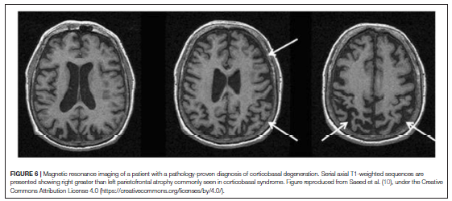
CBD/CBS: radiographic pearls
xxx

Slide 33
PSP & CBD/CBS: basic treatment tenets
1) Medications: manage specific symptoms such as Parkinsonism, dystonia, and depression.
2) Physical therapy: Physical therapy can help improve mobility, balance, and gait abnormalities.
3) Occupational therapy: Occupational therapy focuses on maintaining independence in daily activities.
4) Speech and swallowing therapy: Speech therapy can help improve speech clarity and develop alternative communication methods. Swallowing therapy aims to prevent aspiration and maintain adequate nutrition and hydration.
5) Neuropsychology: support for mood and cognitive shifts
6) Social work: They can address emotional and psychological aspects, assist with caregiving, and provide guidance on community resources.
7) Assistive devices: The use of assistive devices can enhance mobility and independence.
8) Research and clinical trials: Participating in research studies and clinical trials can provide access to experimental treatments and contribute to the advancement of knowledge and potential future therapies for PSP and CBS

Slide 34
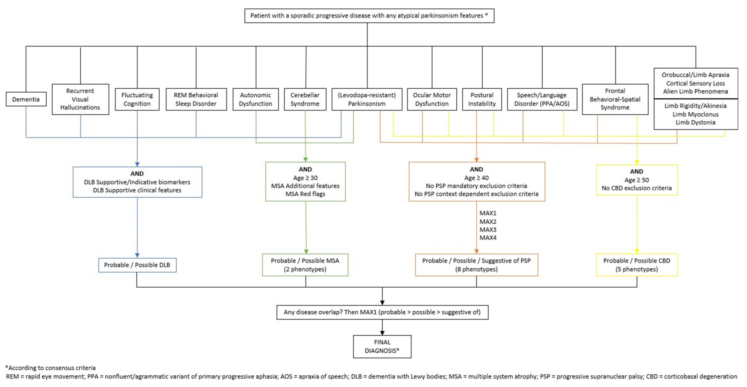
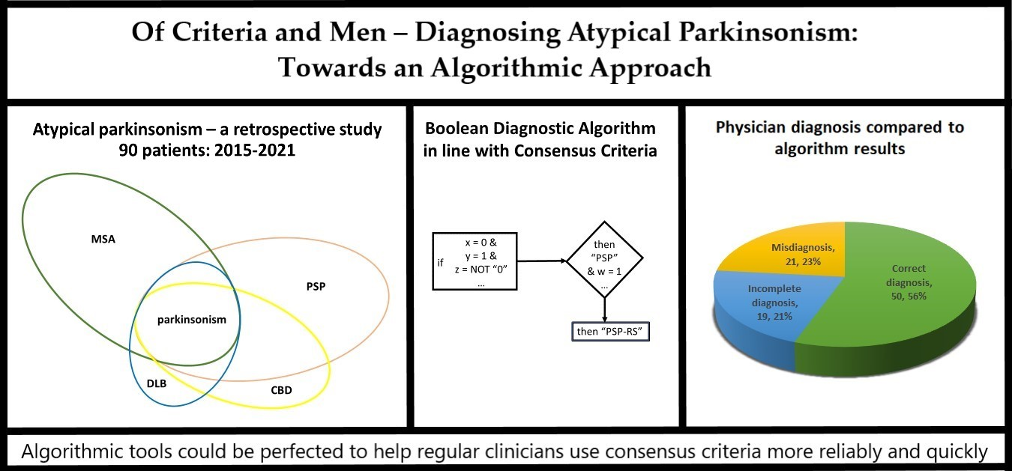
Future direction: can we get better at diagnosis?

Slide 35


Thank you!

