Slide 1


Brain Health and the Preventive Literature
Monday, January 15, 2024
David J. Houghton, MD, MPH
Ochsner Health
New Orleans, LA
January 13-16, 2024
Key Largo, Florida

Slide 2
Disclosures
Nothing to disclose

Slide 3
Objectives
Consider the growing interest in “brain health” and prevention of neurodegenerative diseases
Review the literature for preventive strategies with supportive data
Consider specific use cases for additional nutraceutical supplementation
NOT IN SCOPE TODAY
Genetics
Head trauma & other “earlier” brain insults

Slide 4
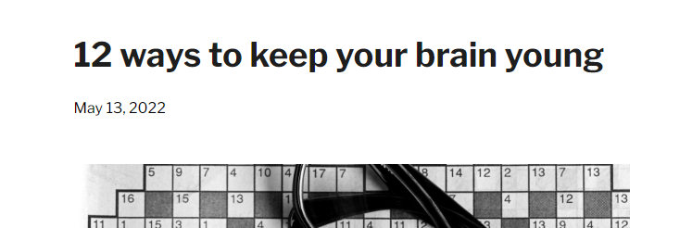
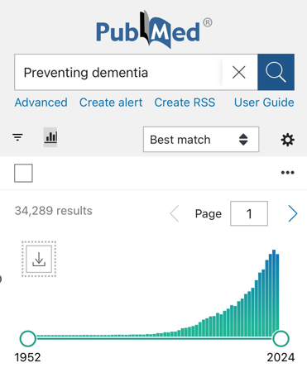











Ripped from the Headlines!

Slide 5
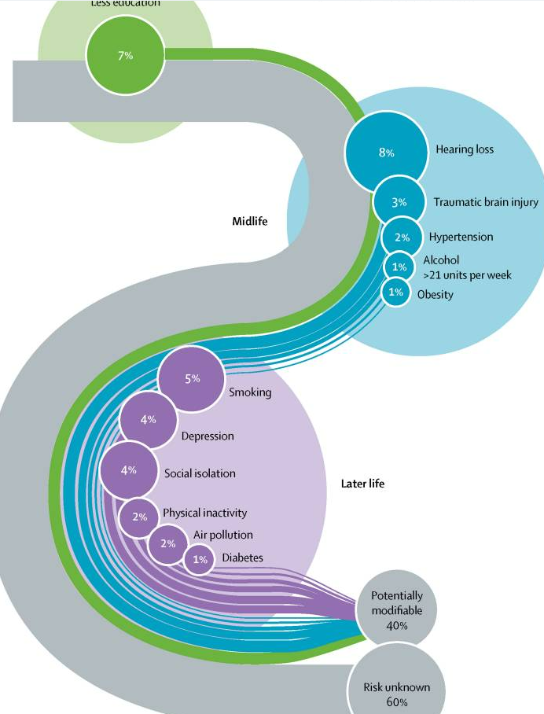
What are we really up against in brain health?
2 BILLION people are expected to be older than 65 years by 2050 1
  True dementia diagnosis estimated to be 150 MILLION by 2050
Older age is still the strongest risk factor for dementia
  or is that just a marker of accumulated other risk factors?
But dementia need NOT be an eventual consequence of aging
We KNOW modifiable risk factors
We ARE LEARNING about preventive treatments
WHO report 2015
J. Alzheimers Dis., 62 (2018), pp. 933-942

Slide 6

So what do those headlines focus on?
Reduce physical cardiometabolic risks
  Heart & brain healthy diets
  Control blood pressure
  Control blood sugar
  Control blood cholesterol
  Avoid tobacco & alcohol abuse
Get physical exercise
Protect your mental & emotional well-being
  Social networks
  Mental stimulation
Enhance sleep
Clean up your med list & consider supplementation
Lisko, JIM 2020, 289; 6: 807-830

Slide 7
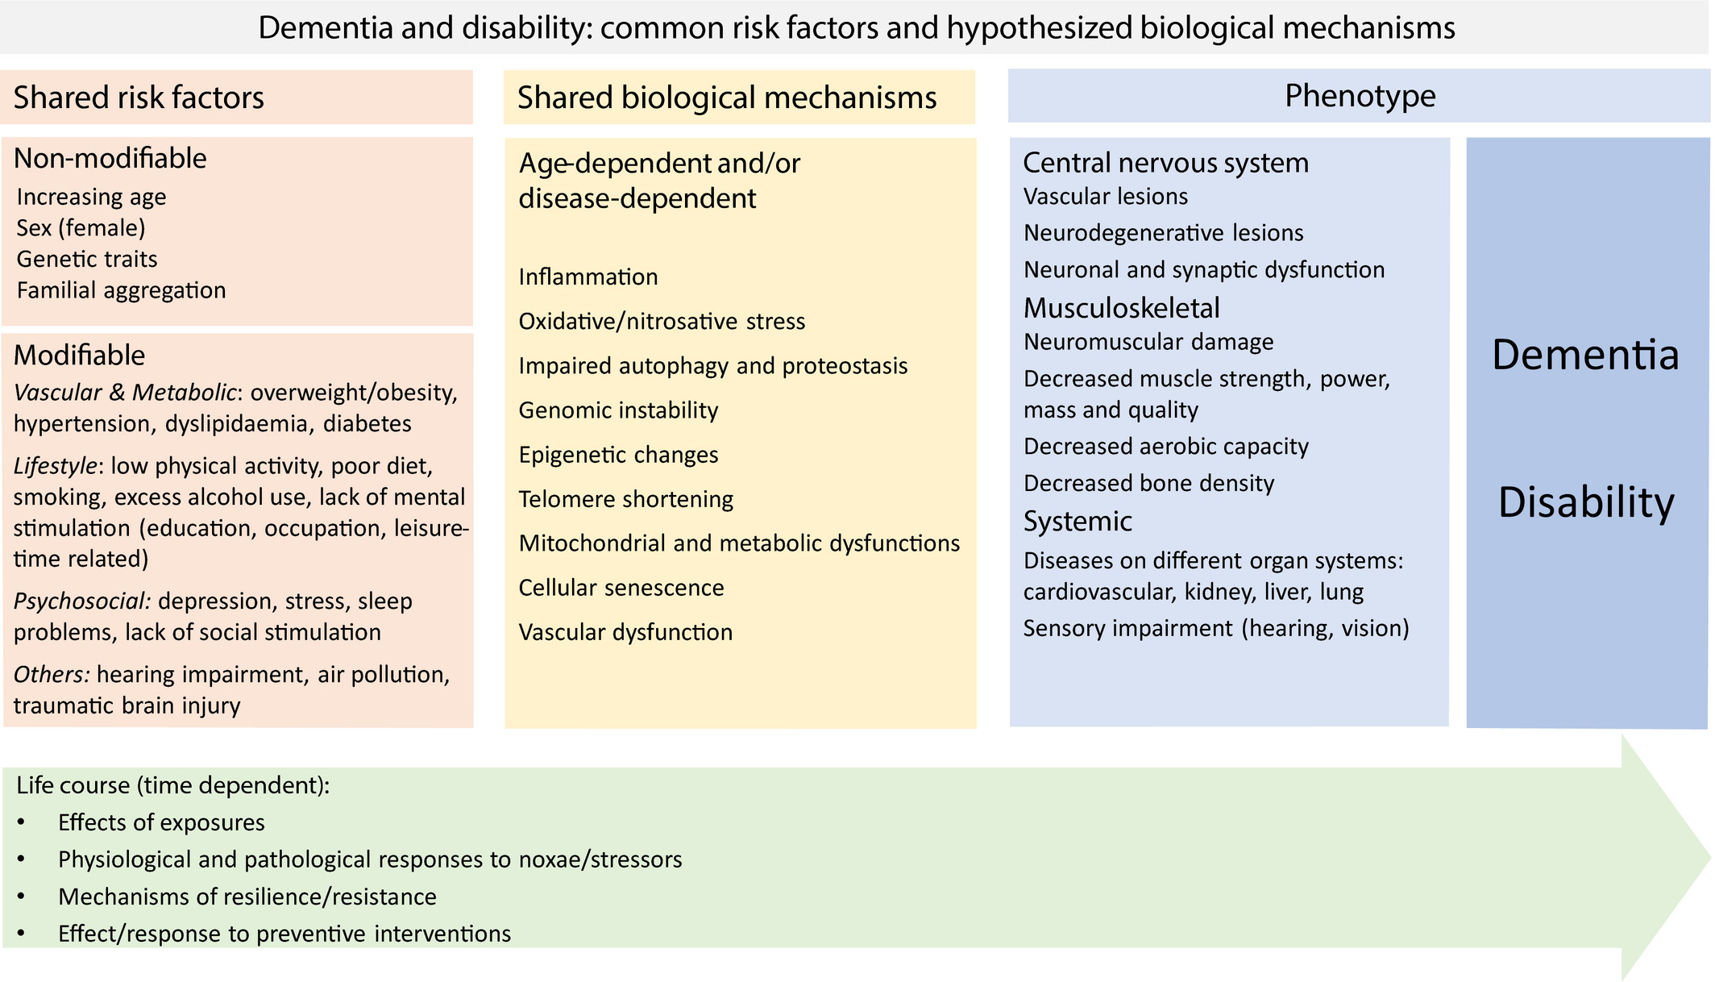
Putting it in perspective
Lisko, JIM 2020, 289; 6: 807-830

Slide 8
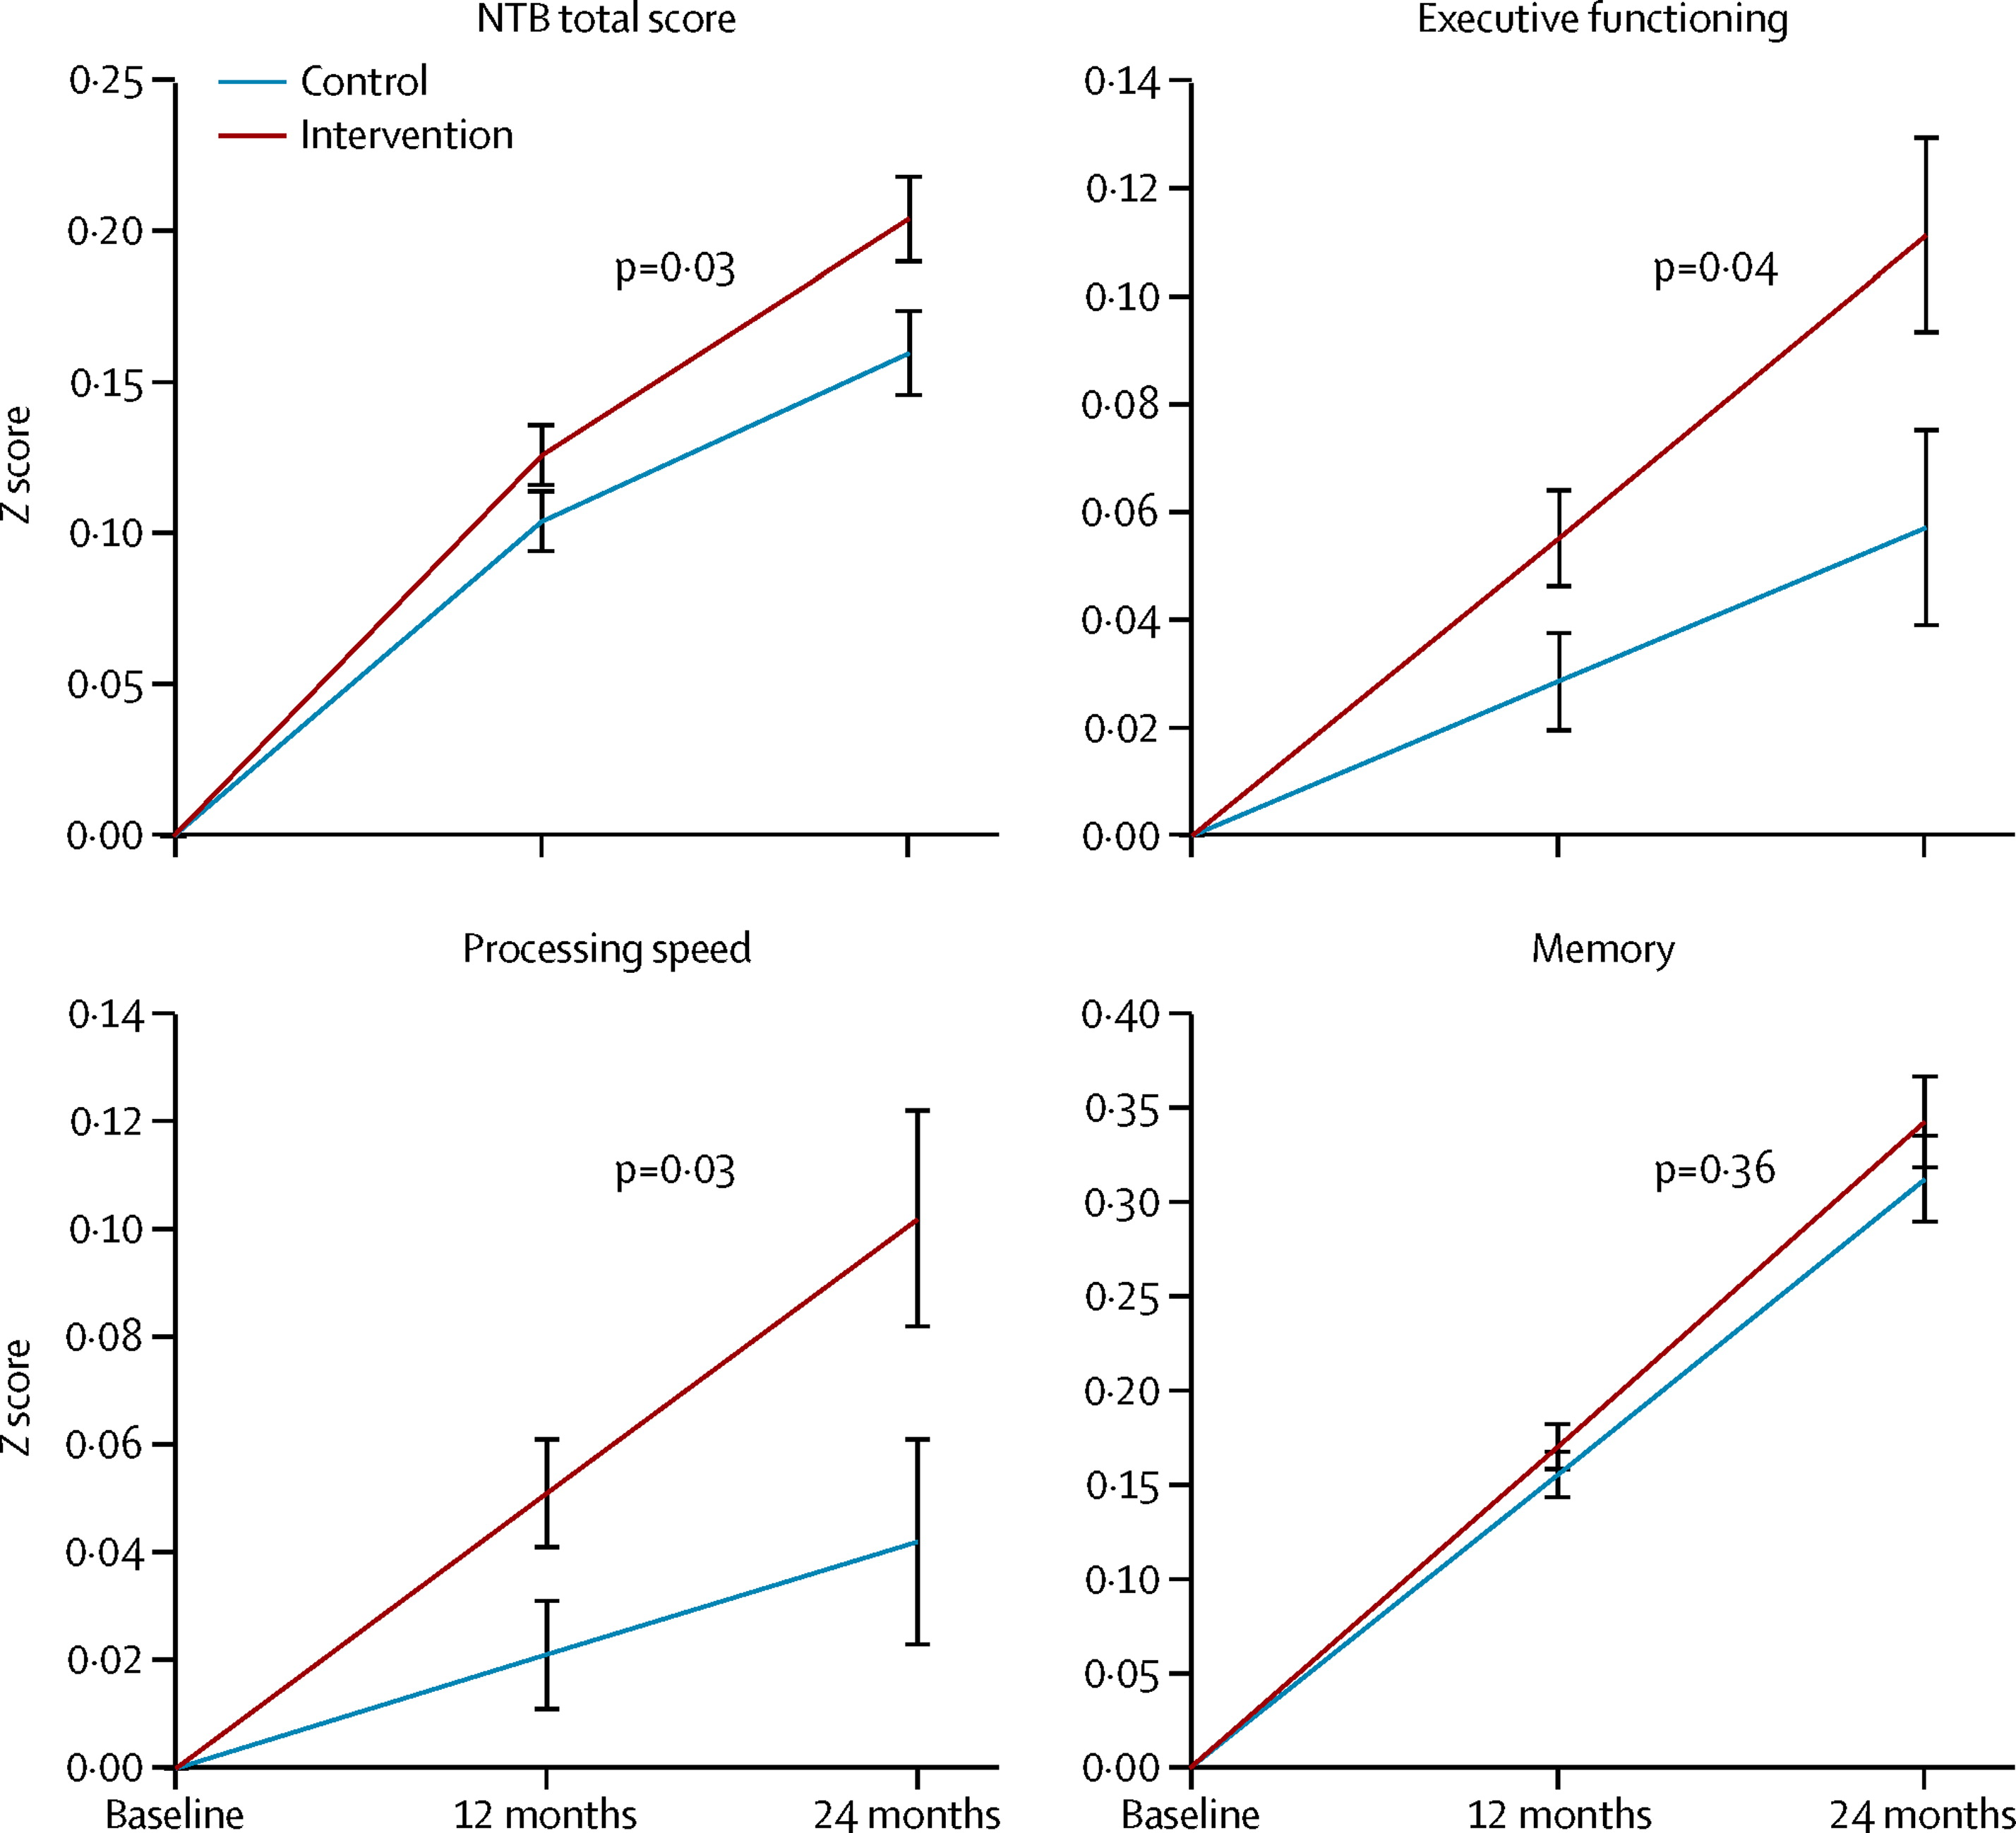
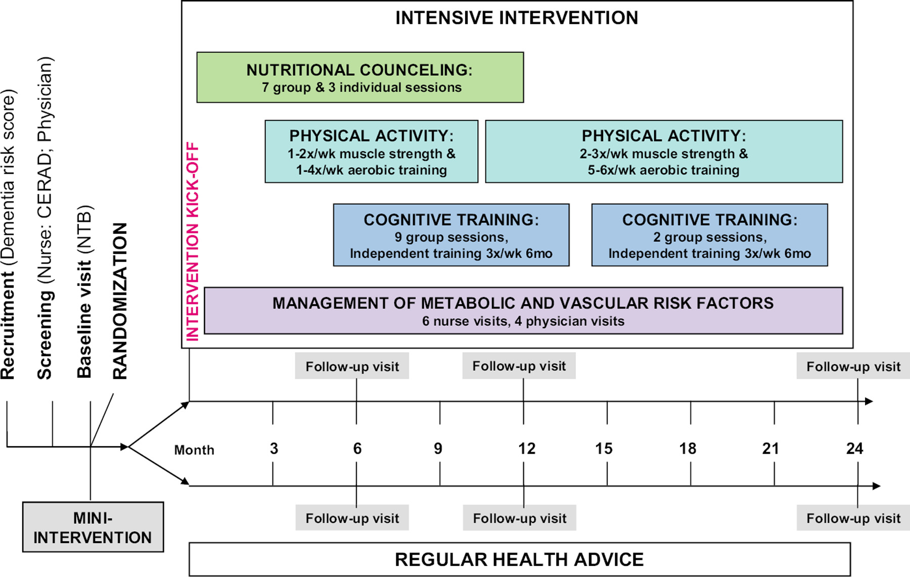
Cardiometabolic risk control – “the body protects the brain”
FINGER TRIAL (Finnish Geriatric Intervention Study to Prevent Cognitive Impairment and Disability)
1260 participants (631 treat, 629 control)
Ngandu, Lancet 2015; 385:9984-2255-2263.
Notes:
Finger trial in summary
Dietary guidance 2) Physical activity 3) Cognitive training and social activities 4) Intensive monitoring and management of metabolic and vascular risk factor
Significant beneficial intervention effect on overall cognitive performance. The beneficial effect was seen on each cognitive domain: memory; executive function, and psychomotor speed. Drop-out rate was only 11%, and participants’ experiences were very positive.
These goals are achieved by recommending high consumption of fruit and vegetables, whole grain in all cereal products; low-fat options in milk and meat products; sucrose intake less than 50 g/day; using vegetable margarine and rapeseed oil instead of butter, and consumption of fish at least two portions per week. Fish oil supplements are recommended for participants not consuming fatty fish and vitamin D supplementation (10-20 μg/day) is advised.
Muscle strength training and aerobic exercise are recorded in diaries throughout the intervention period.

Slide 9
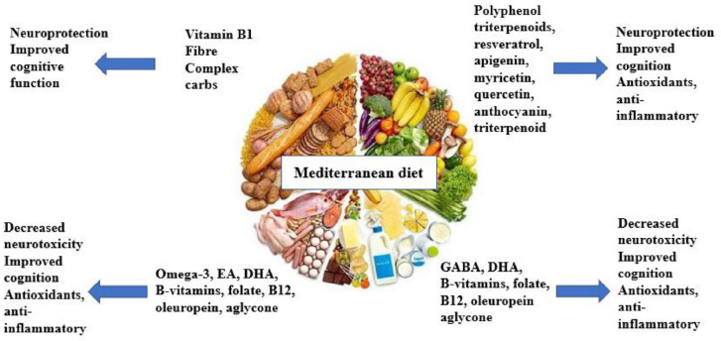
Brain diets – “from FADS to FACTS”

Slide 10
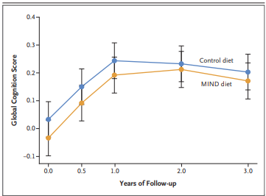
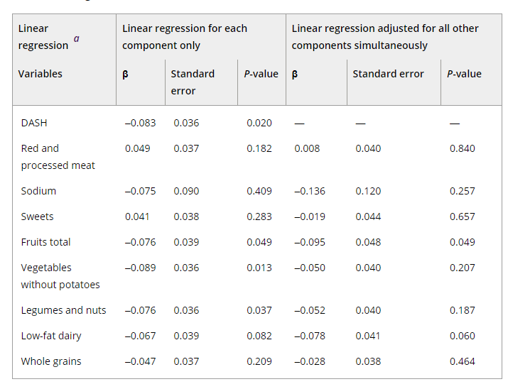
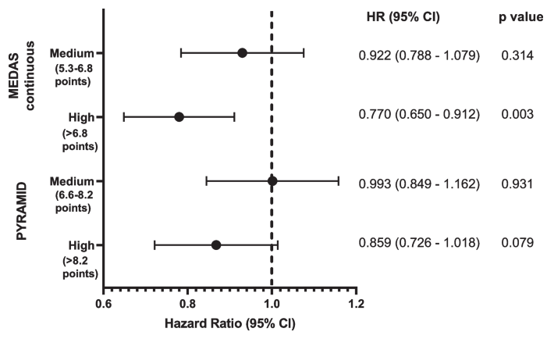
Brain diets – “from FADS to FACTS”
Mediterranean Diet ¹
DASH Diet ²
MIND Diet ³
Shannon, BMC medicine 2023; 21:81.
Song Al Dementia, 2023;
Barnes, NEJM 2023: 389:602-11.
Notes:
Shannon study of meddiet: UK Biobank is an ongoing, multi-centre prospective cohort study of over half a million participants, that provides a resource for investigating the determinants of disease in middle and older age. All-cause incident dementia cases were ascertained using data linkage to hospital inpatient records and death registries. 60,298 participants were included in this analysis mean (SD) follow up of 9.1 (1.7) years
Song study: Prior studies have indicated that the Dietary Approaches to Stop Hypertension (DASH) diet—which includes a high consumption of plant-based foods that are rich in potassium, calcium, and magnesium, and limits the intake of saturated fat, cholesterol, sodium, and sugar—prevents high blood pressure, an important risk factor for cognitive decline and AD.²
Focused in women, 5116 subjects, aged 35-65 (mid age, mean 46 → 79 years old, 32 years of follow-up) nyu womens health study from 1985-1991, questionnaires every 3-5 years, self assessment of memory by participants (6 questions), food frequency questionnaire (FFQ) We constructed the DASH score using FFQ data according to published guidelines with eight food components,³³ defined as low intakes of red meat, sodium, sweets, and high intakes of fruits (including fruit juices), vegetables (excluding potatoes), legumes and nuts, low-fat dairy, and grains
Barnes study Mediterranean–DASH Intervention for Neurodegenerative Delay,, RCT, n=604, 65+ years of age. Focus on older at-risk (overweight BMI>25 (avg 33-34), suboptimal diet, family history of dementia)3 year followup. Both groups got weight loss counseling, exercise recs and colarie restriction. Both lost about 5kg over 3 years and both had improvement in score for first year.

Slide 11
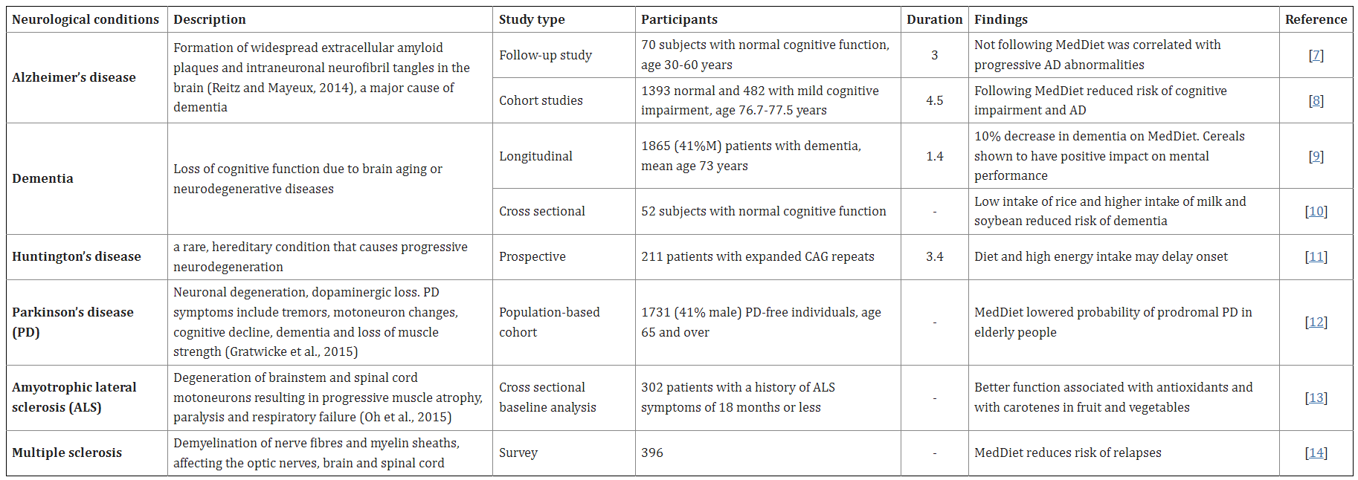
Brain diets – “from FADS to FACTS”
Mediterranean Diet 1
DASH Diet 2
MIND Diet 3
Naureen, J Prev Med Hyg. 2022 Jun; 63(2 Suppl 3): E174–E188.

Slide 12
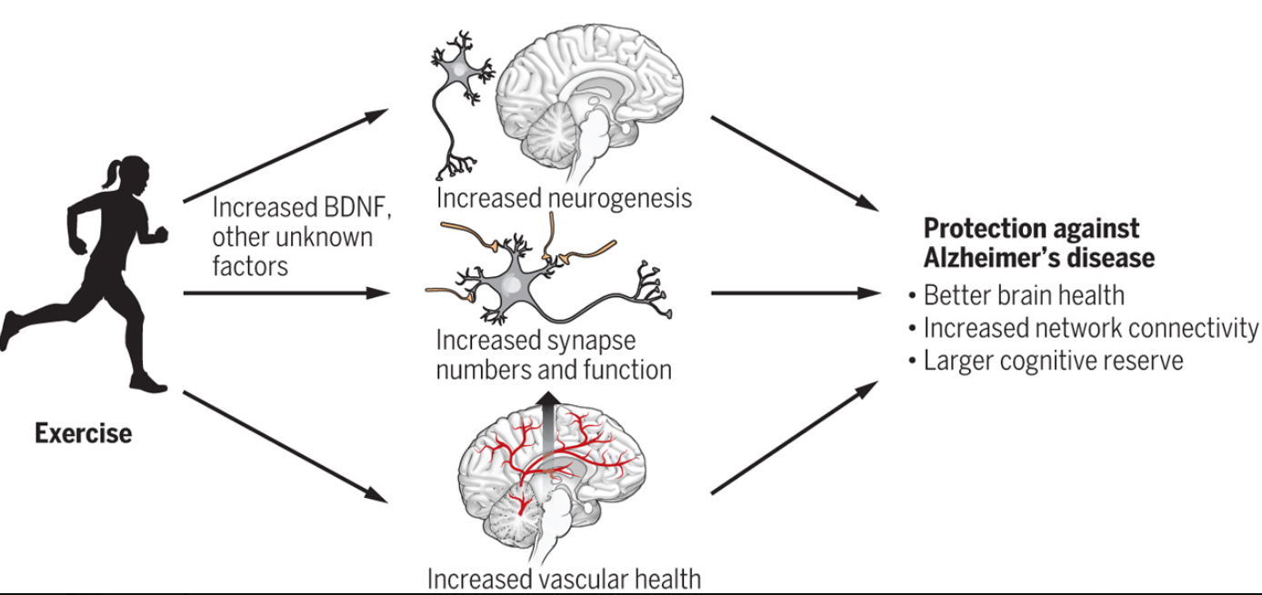
Physical exercise – “not only for the heart”
FINGER TRIAL Heart & brain healthy diets
  Control blood pressure
  Control blood sugar
  Control blood cholesterol
  Avoid tobacco & alcohol abuse
Get physical exercise
Protect your mental & emotional well-being
  Social networks
  Mental stimulation
Alty, Practical Neurology, 2019.
Livingston lancet 2020 Aug 8;396(10248):413-446.
Huzer, Medical News Today, 2021.
Sato et al, Beh Nut Phy Act. 2021: 18.
Notes:
Sato study We used cohort data from the Japan Gerontological Evaluation Study, a longitudinal cohort enrolling people aged 65 or older who were physically and cognitively independent in 2013; study participants were followed for an average of 5.7 years. Participants in the present study included 73,260 individuals living in 19 municipalities in Japan.

Slide 13
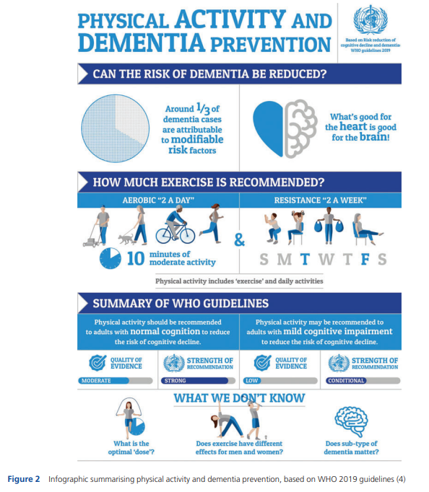
Physical exercise – “not only for the heart”
Hamer and Chida 2009
  16 prospective
  163797 non-demented participants at
  Relative Risk: highest physical activity vs. lowest
    Dementia: 0.72 [95% CI 0.60–0.86, p<0.001]
    Alzheimer’s: 0.55 (95% CI 0.36–0.84, p=0.006)
    Parkinson's 0.82 (95% CI 0.57–1.18, p=0.28).
Stephen et al, 2017
  24 studies met the inclusion criteria
  # participants ranged from 176 to 5,698; f/u 1 to 34 years.
  Physical activity was inversely associated with risk of AD in most studies (n = 18).
    Leisure-time physical activity >>work-related physical activity (compared to Sato study).
Hamer M, Chida Y. Psychol Med 2009;39:3–11.
Stephen R et al. J Gerontol A Biol Sci Med Sci . 2017 Jun 1;72(6):733-739.
WHO 2019
Notes:
Sato study We used cohort data from the Japan Gerontological Evaluation Study, a longitudinal cohort enrolling people aged 65 or older who were physically and cognitively independent in 2013; study participants were followed for an average of 5.7 years. Participants in the present study included 73,260 individuals living in 19 municipalities in Japan.

Slide 14
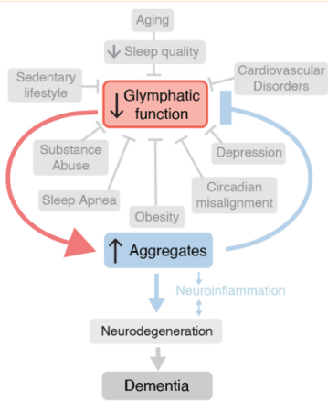
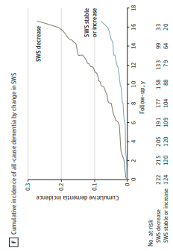
The restorative nature of sleep….
Himali 2023
  346 Framingham Heart Study Partcipants
  Mean age 69, 52% female, 17 years follow-up
  SWS loss associated with age…
  But SWS loss also associated with incidence of dementia (2.5 fold)
Bloomberg, Lancet, 2023.
Nedergaard, Science, 2020; 370: 50-56.
Himali JAMA 2023; 80:1326;1333.
Notes:
This cohort study involving 346 participants from the Framingham Heart Study found that slow-wave sleep percentage declined with aging and Alzheimer disease genetic risk, with greater reductions associated with the risk of incident dementia.
868 Framingham Heart Study participants who returned for a second PSG, this cohort included 346 participants with a mean age of 69 years (range, 60-87 years); 179 (52%) were female.
Aging was associated with SWS loss across repeated overnight sleep studies (mean [SD] change, −0.6 [1.5%] per year; P < .001). Over the next 17 years of follow-up, there were 52 cases of incident dementia. In Cox regression models adjusted for age, sex, cohort, positivity for at least 1 APOE ε4 allele, smoking status, sleeping medication use, antidepressant use, and anxiolytic use, each percentage decrease in SWS per year was associated with a 27% increase in the risk of dementia (hazard ratio, 1.27; 95% CI, 1.06-1.54; P = .01).

Slide 15
Vitamins, supplements, lotions & potions
Parts and pieces of dietary gaps
O3 fatty acids (fish oil)
Vitamin B1
Vitamin B6
Vitamin B12
Vitamin D
Vitamin E
Magnesium
Polyphenols
Alpha-lipoic acid
Supplements & plant-derived nootropics
Bacopa
Gingko Biloba
Ginseng
Lion’s Mane
Turmeric
Ashwagandha
Tart Cherries
Lorca, Crit Rev Food Sci Nutr 2023;63(22):5521-5545
Malik Plants (Basel). 2023 Mar; 12(6): 1364.
Lewis, J Clin Transl Res. 2021 Aug 26; 7(4): 575–620.
Campbell, Nutrients. 2022 Aug; 14(15): 3231.

Slide 16

So be ready for the questions from your patients!

Slide 17


Thank you!

