Slide 1


Honing the Accurate Dementia Diagnosis
James Eaton, MD
Vanderbilt University Medical Center
January 13-16, 2024
Key Largo, Florida

Slide 2
Disclosures
No relevant conflicts of interest

Slide 3
Objective
Discuss strategies for achieving accurate dementia diagnoses
Notes:
Elahi FM, Miller BL. A clinicopathological approach to the diagnosis of dementia. Nat Rev Neurol. 2017 Aug;13(8):457-476. doi: 10.1038/nrneurol.2017.96. Epub 2017 Jul 14. PMID: 28708131; PMCID: PMC5771416.

Slide 4
Notes:
Elahi FM, Miller BL. A clinicopathological approach to the diagnosis of dementia. Nat Rev Neurol. 2017 Aug;13(8):457-476. doi: 10.1038/nrneurol.2017.96. Epub 2017 Jul 14. PMID: 28708131; PMCID: PMC5771416.

Slide 5
67 year old white man with HTN and HLD who presents for evaluation of cognitive changes. Is a musician and had noticed trouble thinking of the right word and forgetfulness.
-missed a few bills and missed a few gigs
-not getting lost
-trouble communicating and has trouble following conversations sometimes
-initial MoCA was 24/30: lost points for trail (1), cube copy (1), repetition (1), abstraction (1), delayed recall (1), orientation (1)

Slide 6
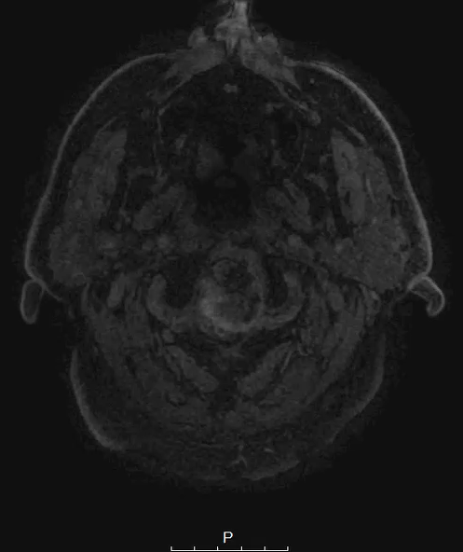
Had neuropsychological testing was notable for deficits in:
- attention and processing speed – was normal
- executive function – mild impairment with abstract reasoning, set shifting was poor
- language – primarily semantic deficits
- visuospatial – was normal
- Olfaction – mildly impaired
- learning and memory – mildly impaired verbal memory, visual memory was mildly impaired
Primary deficits were in language concerning for a semantic primary progressive aphasia.

Slide 7
Clinical Assessments
Still the most important aspect of evaluation
Despite the variability there are helpful phenotypic and pathologic correlations
Guides additional work up
I had an initial concern for a logopenic primary progressive aphasia, neuropsych testing was more suggestive of a semantic variant.

Slide 8
Primary Progressive Aphasia
Notes:
Botha H, Josephs KA. Primary Progressive Aphasias and Apraxia of Speech. Continuum (Minneap Minn). 2019;25(1):101-127. doi:10.1212/CON.0000000000000699

Slide 9
Notes:
Haneef mohamed, Atif wasim & Mcconathy, J & Natelson Love, Marissa & Middlebrooks, Erik. (2018). Neuroimaging of Primary Progressive Aphasia Variants. Neurographics. 8. 1-6. 10.3174/ng.1700052.

Slide 10
What does the clinical phenotypes matter between the aphasias?
- lvPPA would make us think amyloid
-svPPA would make us think TDP-43C

Slide 11
Alzheimer’s Phenotypes
Phenotypes which most often have Alzheimer’s Pathology:
  Amnestic
  Logopenic Primary Progressive Aphasia
  Posterior Cortical Atrophy
Atypical Phenotypes which can have Alzheimer’s pathology
  Dysexecutive
  Behavioral
  Corticobasal Syndrome

Slide 12

Posterior Cortical Atrophy
Notes:
Crutch SJ, Schott JM, Rabinovici GD, Murray M, Snowden JS, van der Flier WM, Dickerson BC, Vandenberghe R, Ahmed S, Bak TH, Boeve BF, Butler C, Cappa SF, Ceccaldi M, de Souza LC, Dubois B, Felician O, Galasko D, Graff-Radford J, Graff-Radford NR, Hof PR, Krolak-Salmon P, Lehmann M, Magnin E, Mendez MF, Nestor PJ, Onyike CU, Pelak VS, Pijnenburg Y, Primativo S, Rossor MN, Ryan NS, Scheltens P, Shakespeare TJ, Suárez González A, Tang-Wai DF, Yong KXX, Carrillo M, Fox NC; Alzheimer's Association ISTAART Atypical Alzheimer's Disease and Associated Syndromes Professional Interest Area. Consensus classification of posterior cortical atrophy. Alzheimers Dement. 2017 Aug;13(8):870-884. doi: 10.1016/j.jalz.2017.01.014. Epub 2017 Mar 2. PMID: 28259709; PMCID: PMC5788455.

Slide 13
Frontal Variants of Alzheimer’s Disease
Includes a ‘behavioral variant’ that clinically overlaps with bvFTD
Also includes a dysexecutive presentation
Additional memory and /or visuospatial deficits are frequently seen
Notes:
Ossenkoppele R, Pijnenburg YA, Perry DC, Cohn-Sheehy BI, Scheltens NM, Vogel JW, Kramer JH, van der Vlies AE, La Joie R, Rosen HJ, van der Flier WM, Grinberg LT, Rozemuller AJ, Huang EJ, van Berckel BN, Miller BL, Barkhof F, Jagust WJ, Scheltens P, Seeley WW, Rabinovici GD. The behavioural/dysexecutive variant of Alzheimer's disease: clinical, neuroimaging and pathological features. Brain. 2015 Sep;138(Pt 9):2732-49. doi: 10.1093/brain/awv191. Epub 2015 Jul 2. PMID: 26141491; PMCID: PMC4623840.

Slide 14
Frontotemporal Lobar Degeneration

Slide 15
Notes:
Grossman M, Seeley WW, Boxer AL, Hillis AE, Knopman DS, Ljubenov PA, Miller B, Piguet O, Rademakers R, Whitwell JL, Zetterberg H, van Swieten JC. Frontotemporal lobar degeneration. Nat Rev Dis Primers. 2023 Aug 10;9(1):40. doi: 10.1038/s41572-023-00447-0. PMID: 37563165.

Slide 16
Back to our patient

Slide 17
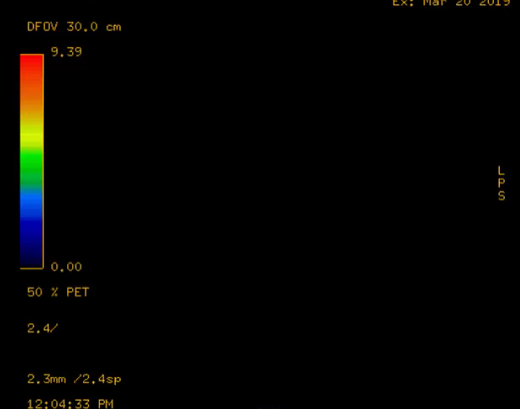
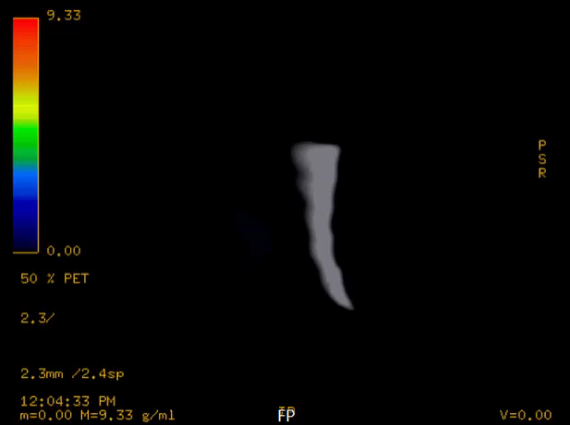

Slide 18
Notes:
Teunissen CE, Verberk IMW, Thijssen EH, Vermunt L, Hansson O, Zetterberg H, van der Flier WM, Mielke MM, Del Campo M. Blood-based biomarkers for Alzheimer's disease: towards clinical implementation. Lancet Neurol. 2022 Jan;21(1):66-77. doi: 10.1016/S1474-4422(21)00361-6. Epub 2021 Nov 24. PMID: 34838239.

Slide 19
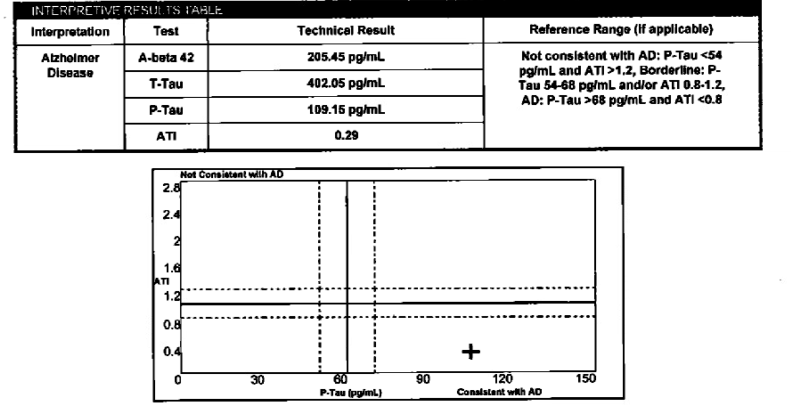

Slide 20
Neuropathology showed: diffuse Lewy Bodies in the cortex as well as the brainstem. There were rare amyloid accumulations. No significant number of neurofibrillary tangles.
Notes:
LBs in the amygdala in dementia with LB (DLB) (C, D).
Kon T, Tomiyama M, Wakabayashi K. Neuropathology of Lewy body disease: Clinicopathological crosstalk between typical and atypical cases. Neuropathology. 2020 Feb;40(1):30-39. doi: 10.1111/neup.12597. Epub 2019 Sep 9. PMID: 31498507.

Slide 21
Neuropathological Diagnosis:
Dementia with Lewy Bodies

Slide 22
Lewy Body Dementia
Notes:
Bellomo G, De Luca CMG, Paoletti FP, Gaetani L, Moda F, Parnetti L. α-Synuclein Seed Amplification Assays for Diagnosing Synucleinopathies: The Way Forward. Neurology. 2022 Aug 2;99(5):195-205. doi: 10.1212/WNL.0000000000200878. Epub 2022 Jun 3. PMID: 35914941.

Slide 23
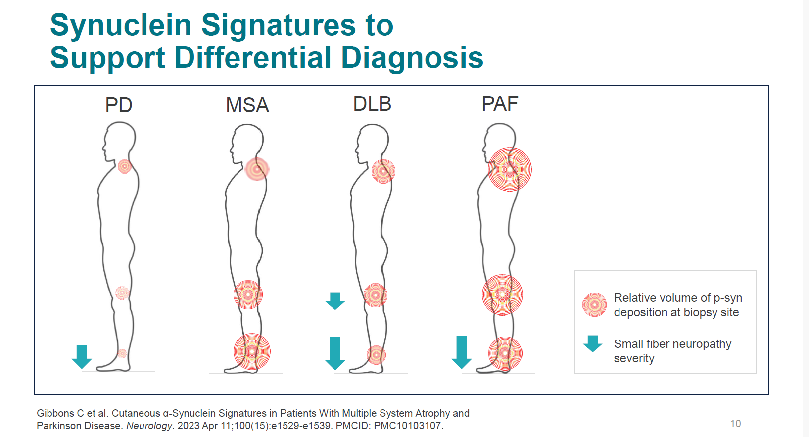

Slide 24
Amyloid PET Imaging
Notes:
Kolanko MA, Win Z, Loreto F, Patel N, Carswell C, Gontsarova A, Perry RJ, Malhotra PA. Amyloid PET imaging in clinical practice. Pract Neurol. 2020 Dec;20(6):451-462. doi: 10.1136/practneurol-2019-002468. Epub 2020 Sep 24. PMID: 32973035.

Slide 25
Notes:
Chapleau M, Iaccarino L, Soleimani-Meigooni D, Rabinovici GD. The Role of Amyloid PET in Imaging Neurodegenerative Disorders: A Review. J Nucl Med. 2022 Jun;63(Suppl 1):13S-19S. doi: 10.2967/jnumed.121.263195. PMID: 35649652; PMCID: PMC9165727.

Slide 26
In cognitively unimpaired adults amyloid PET is negative 70-90% of the time.
There is a portion of amyloid positivity in cognitively normal adults that increases with age: ~10% at 50, ~15% at 60, ~20% at 70, and ~30% at 80, and ~40% at 90

Slide 27
Centiloid scale tries to allow comparison between different tracers.
-0 centiloid is normal in young adult
-12-25 is a threshold for positivity
-100 corresponds to the mean uptake in mild AD dementia
Notes:
Pemberton HG, Collij LE, Heeman F, Bollack A, Shekari M, Salvadó G, Alves IL, Garcia DV, Battle M, Buckley C, Stephens AW, Bullich S, Garibotto V, Barkhof F, Gispert JD, Farrar G; AMYPAD consortium. Quantification of amyloid PET for future clinical use: a state-of-the-art review. Eur J Nucl Med Mol Imaging. 2022 Aug;49(10):3508-3528. doi: 10.1007/s00259-022-05784-y. Epub 2022 Apr 7. PMID: 35389071; PMCID: PMC9308604.

Slide 28
Tau PET Imaging
Notes:
Cassinelli Petersen G, Roytman M, Chiang GC, Li Y, Gordon ML, Franceschi AM. Overview of tau PET molecular imaging. Curr Opin Neurol. 2022 Apr 1;35(2):230-239. doi: 10.1097/WCO.0000000000001035. PMID: 35191407; PMCID: PMC9011369.

Slide 29
Genetic Testing

Slide 30
Works Cited
Elahi FM, Miller BL. A clinicopathological approach to the diagnosis of dementia. Nat Rev Neurol. 2017 Aug;13(8):457-476. doi: 10.1038/nrneurol.2017.96. Epub 2017 Jul 14. PMID: 28708131; PMCID: PMC5771416.
Haneef mohamed, Atif wasim & Mcconathy, J & Natelson Love, Marissa & Middlebrooks, Erik. (2018). Neuroimaging of Primary Progressive Aphasia Variants. Neurographics. 8. 1-6. 10.3174/ng.1700052.
Botha H, Josephs KA. Primary Progressive Aphasias and Apraxia of Speech. Continuum (Minneap Minn). 2019;25(1):101-127. doi:10.1212/CON.0000000000000699
Ossenkoppele R, Pijnenburg YA, Perry DC, Cohn-Sheehy BI, Scheltens NM, Vogel JW, Kramer JH, van der Vlies AE, La Joie R, Rosen HJ, van der Flier WM, Grinberg LT, Rozemuller AJ, Huang EJ, van Berckel BN, Miller BL, Barkhof F, Jagust WJ, Scheltens P, Seeley WW, Rabinovici GD. The behavioural/dysexecutive variant of Alzheimer's disease: clinical, neuroimaging and pathological features. Brain. 2015 Sep;138(Pt 9):2732-49. doi: 10.1093/brain/awv191. Epub 2015 Jul 2. PMID: 26141491; PMCID: PMC4623840.
Kolanko MA, Win Z, Loreto F, Patel N, Carswell C, Gontsarova A, Perry RJ, Malhotra PA. Amyloid PET imaging in clinical practice. Pract Neurol. 2020 Dec;20(6):451-462. doi: 10.1136/practneurol-2019-002468. Epub 2020 Sep 24. PMID: 32973035.
Chapleau M, Iaccarino L, Soleimani-Meigooni D, Rabinovici GD. The Role of Amyloid PET in Imaging Neurodegenerative Disorders: A Review. J Nucl Med. 2022 Jun;63(Suppl 1):13S-19S. doi: 10.2967/jnumed.121.263195. PMID: 35649652; PMCID: PMC9165727.
Pemberton HG, Collij LE, Heeman F, Bollack A, Shekari M, Salvadó G, Alves IL, Garcia DV, Battle M, Buckley C, Stephens AW, Bullich S, Garibotto V, Barkhof F, Gispert JD, Farrar G; AMYPAD consortium. Quantification of amyloid PET for future clinical use: a state-of-the-art review. Eur J Nucl Med Mol Imaging. 2022 Aug;49(10):3508-3528. doi: 10.1007/s00259-022-05784-y. Epub 2022 Apr 7. PMID: 35389071; PMCID: PMC9308604.
Bellomo G, De Luca CMG, Paoletti FP, Gaetani L, Moda F, Parnetti L. α-Synuclein Seed Amplification Assays for Diagnosing Synucleinopathies: The Way Forward. Neurology. 2022 Aug 2;99(5):195-205. doi: 10.1212/WNL.0000000000200878. Epub 2022 Jun 3. PMID: 35914941.
Kon T, Tomiyama M, Wakabayashi K. Neuropathology of Lewy body disease: Clinicopathological crosstalk between typical and atypical cases. Neuropathology. 2020 Feb;40(1):30-39. doi: 10.1111/neup.12597. Epub 2019 Sep 9. PMID: 31498507.
Teunissen CE, Verberk IMW, Thijssen EH, Vermunt L, Hansson O, Zetterberg H, van der Flier WM, Mielke MM, Del Campo M. Blood-based biomarkers for Alzheimer's disease: towards clinical implementation. Lancet Neurol. 2022 Jan;21(1):66-77. doi: 10.1016/S1474-4422(21)00361-6. Epub 2021 Nov 24. PMID: 34838239.
Cassinelli Petersen G, Roytman M, Chiang GC, Li Y, Gordon ML, Franceschi AM. Overview of tau PET molecular imaging. Curr Opin Neurol. 2022 Apr 1;35(2):230-239. doi: 10.1097/WCO.0000000000001035. PMID: 35191407; PMCID: PMC9011369.
Grossman M, Seeley WW, Boxer AL, Hillis AE, Knopman DS, Ljubenov PA, Miller B, Piguet O, Rademakers R, Whitwell JL, Zetterberg H, van Swieten JC. Frontotemporal lobar degeneration. Nat Rev Dis Primers. 2023 Aug 10;9(1):40. doi: 10.1038/s41572-023-00447-0. PMID: 37563165.

Slide 31


Questions

