Slide 1


What’s the Headache Disease? Differentiating Primary Headache Syndromes by Current Classification
Paige Kalika, DO
University of Miami
Department of Neurology
Division of Pediatric Neurology
January 13-16, 2024
Key Largo, Florida

Slide 2
Disclosures
Nothing to disclose

Slide 3
Objectives
At the conclusion of this presentation, participants should be able to:
Understand how to use the International Classification of Headache Disorders 3rd edition (ICHD-3)
Demonstrate differences between primary and secondary headache syndromes
Differentiate between the primary headache syndromes
Identify patterns of symptoms common to rare primary headache syndromes

Slide 4
Headache Classification Through the Ages
Arateus of Cappodocia – 1st century CE
Cephalea: chronic, frequent, severe, long-lasting headaches
Cephalalgia: infrequent, milder headaches
Thomas Willis – 1672
Within or without the skull
Universal or particular
Short, continuous, or intermittent
Wandering or uncertain
Before, behind, or on the side
Occasional or habitual
Ad hoc committee of NIH – 1962
Vascular headaches
Muscle contraction headaches
Little evidence, but used worldwide for many years

Slide 5
The International Classification of Headache Disorders
ICHD-1
Commissioned by the International Headache Society (IHS) in 1985
1988
Based mainly on expert opinion
ICHD-2
2004
Changes prompted by new evidence and revised expert opinion
ICHD-3 beta
2013
Published to promote field testing before publication of the final version
ICHD-3
Beta version released in 2013
Published in 2018 in Cephalgia
30 years after ICHD-1
Changes based on evidence and research

Slide 6
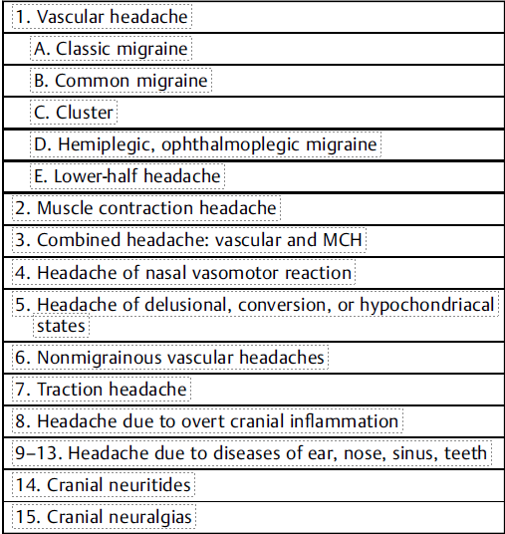
From 1962 to 2018
Ad hoc committee of the NIH
ICHD-3

Slide 7
ICHD-3
Primary headache disorders
No causative disorder
Lack radiological and physiological markers
Secondary headache disorders
Subdivided based on etiology
Secondary to trauma, vascular disease, alterations in intracranial pressure, mass lesions, substances, infections, metabolic disease, craniofacial and cervical disease, and psychiatric disorders
Appendix
Criteria for possible new entities
Alternative diagnostic criteria
Previously accepted disorders eliminated based on new information

Slide 8
Red flags and green flags
Red flags
High sensitivity for secondary headache
SNNOOP10
Green flags
Introduced in 2021
High specificity for primary headache disorders

Slide 9
Red flags and green flags
Red flags (SNOOP10)
Systemic symptoms, including fever
Green Flags
Current headache present during childhood
Patient has headache free days
Headache occurs in temporal relationship with the menstrual cycle
Close family members have the same headache phenotype
Headache occurred or stopped more than 1 week ago
Neoplasm in history
Neurological deficit or dysfunction
Onset of headache is sudden or abrupt
Older age (after 50 years)
Pattern change or recent onset of headache
Positional headache
Precipitated by sneezing, coughing ,or exercise
Papilledema
Progressive headache and atypical presentations
Pregnancy or puerperium
Painful eye with autonomic feature
Posttraumatic onset of headache
Pathology of the immune system or medical immunosuppression
Painkiller overuse or new drug at onset of headache

Slide 10
Red flags and green flags
Notes:
Epidosic syndromes
Re-kindling of previous headaches from secondary cause

Slide 11
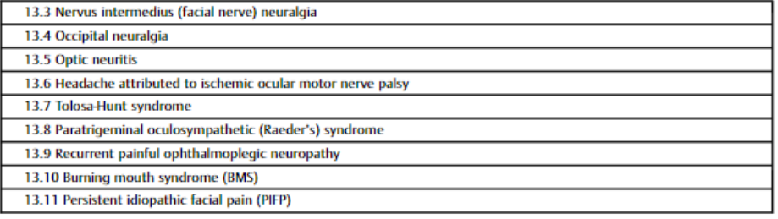
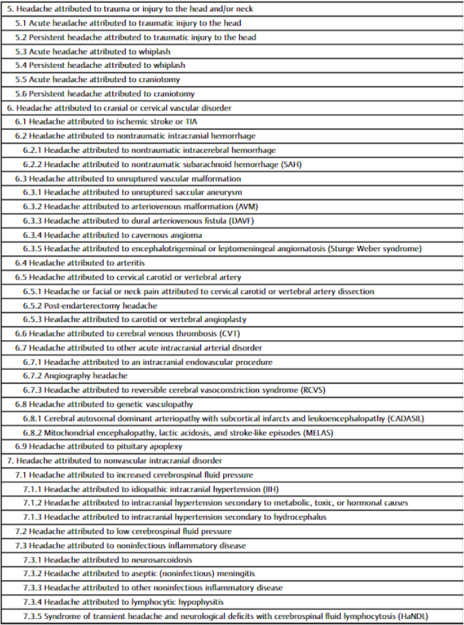
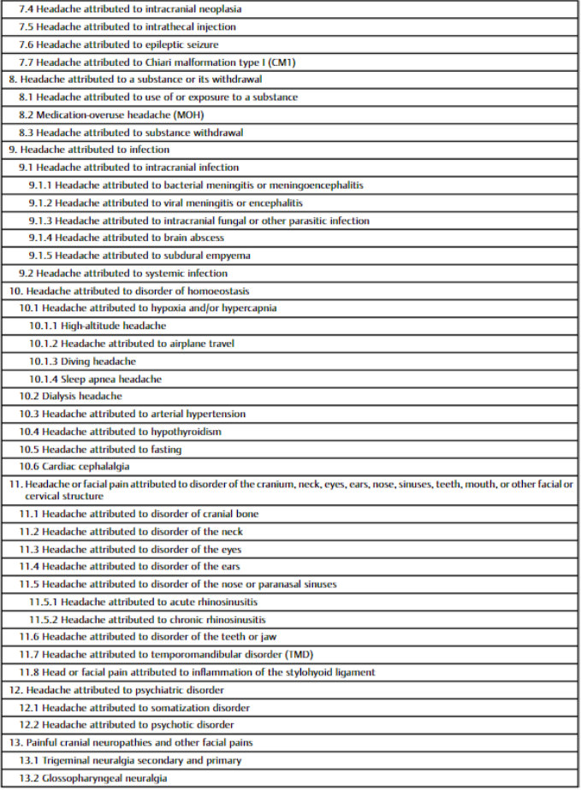
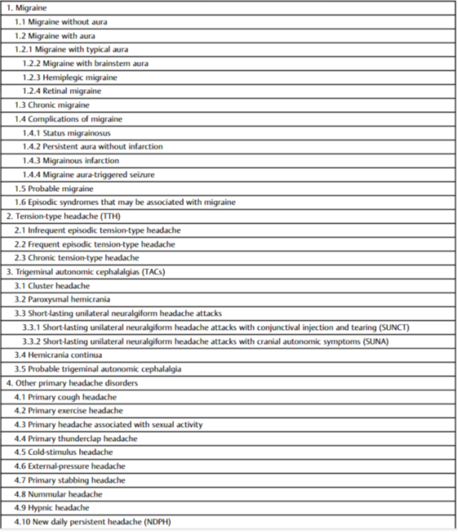
How to use the ICHD-3
Memorize it?
Notes:
Epidosic syndromes
Re-kindling of previous headaches from secondary cause

Slide 12
How to use the ICHD-3
Look for patterns
Inclusion and exclusion criteria
“Probable” if fulfill all criteria but one
Look at past history for clues
Can code separately for distinct headache types
Notes:
Epidosic syndromes
Re-kindling of previous headaches from secondary cause

Slide 13
Migraine
Most common disabling primary headache type
Prodromes and postdromes
Aura vs no aura
Atypical aura vs atypical aura
Typical: visual, sensory, and dysphasic symptoms
Atypical: “brainstem aura” (dysarthria, vertigo, hearing changes, diplopia, ataxia, decreased level of consciousness), hemiparesis, and “retinal migriane” (monocular visual changes)
Vertigo without other brainstem symptoms: vertiginous migraine (appendix)
Episodic vs chronic
Episodic syndromes that may be associated with migraine
Menstrual migraine and menstrual-related migraine (appendix)
Notes:
Positive visual phenomena: scintillations, zigzag lines, geometric shapes – migraine more than TIA
Llength of aura atypical for focal seizures
Aura described in PH, HC, and cluster headache

Slide 14
Tension-Type Headache (TTH)
Featureless headaches
Defined by what they are not
Not unilateral, not pounding, not severe, not aggravated by activity, no severe nausea or vomiting
No prodrome or postdrome
Infrequent episodic vs frequent episodic vs chronic
Can be difficult to differentiate chronic TTH from chronic migraine!

Slide 15
Trigeminal Autonomic Cephalalgias (TACs)
Severe unilateral headaches with unilateral cranial autonomic symptoms
Conjunctival inflammation, tearing, nasal congestion, rhinorrhea, eyelid edema, facial sweating, ear fullness, miosis, ptosis
All have episodic/remitting vs chronic/unremitting forms
Look for patterns
Length of attacks
Frequency of attacks
Timing of attacks
Seasonal variation?
Response to indomethacin
Restlessness!
Unilateral pain in orbital, supraorbital, or temporal regions

Slide 16
Cluster Headaches (CH)_
Nocturnal attacks lasting for 15 minutes to 3 hours
Excruciating pain
Seasonal predisposition
Male predominance
Episodic form is most common
Attacks occur once every other day to 8 times/day

Slide 17
Parosyxmal Hemicrania (PH)
Severe attacks lasting 2-30 minutes
>5x/day
Chronic PH is most common
Slight female predominance
Dramatic response to indomethacin

Slide 18
Hemicrania Continua
Baseline constant aching pain with sharp/stabbing/throbbing exacerbations
Unremitting form is most common
Exacerbations lasting 30 minutes to 3 days
Female predominance
Responds to indomethacin

Slide 19
Short-lasting unilateral neuralgiform headache attacks with/without conjunctival injection and tearing (SUNCT/SUNA)
Severe unilateral head pain lasting for seconds to up 5 minutes
Chronic form is most common
Many episodes per day (can be in the hundreds)
Male predominance
Exclude trigeminal neuralgia and painful trigeminal neuropathy

Slide 20
Other Primary Headache Disorders
Most are precipitated, paroxysmal, and short-lived
Most common preventative treatment is indomethacin

Slide 21
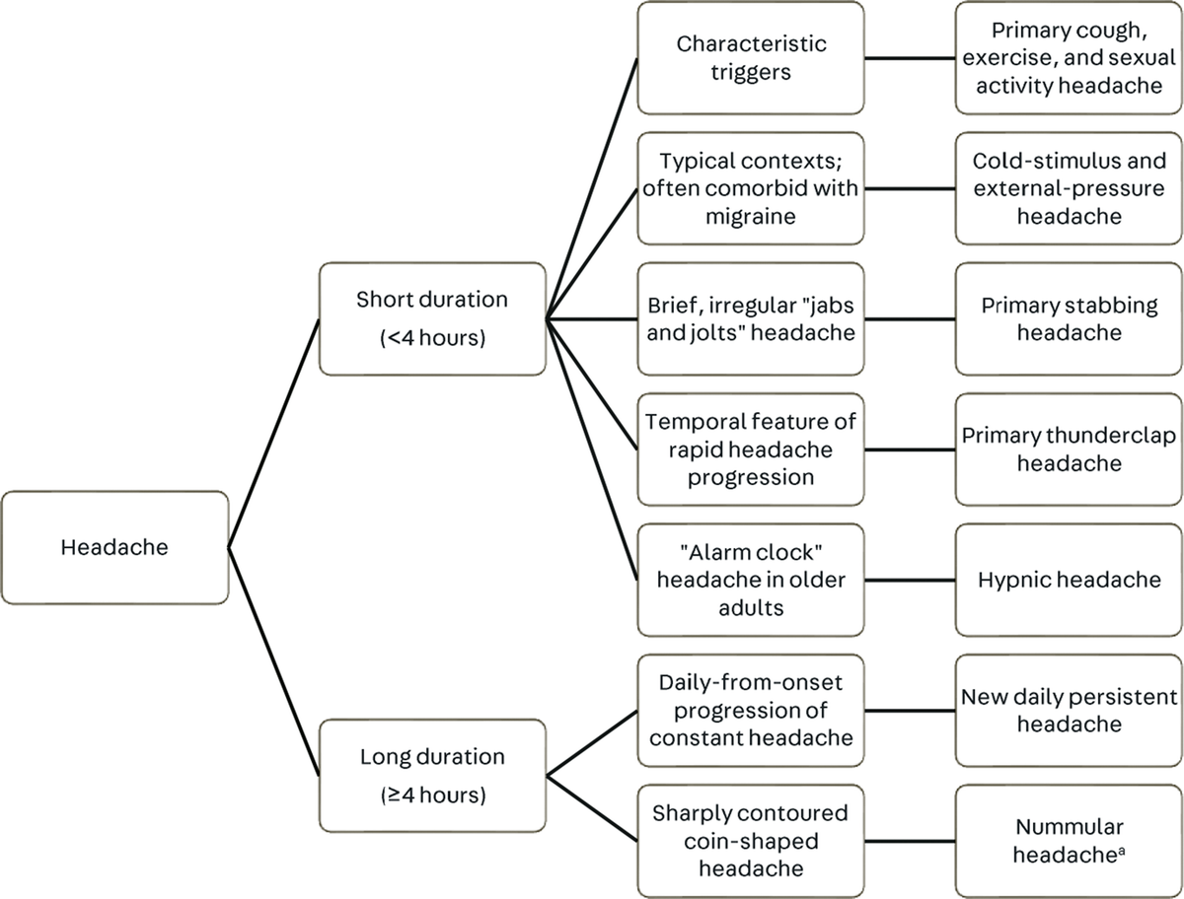
Other Primary Headache Syndromes

Slide 22
Exertion-related headaches
Primary exercise headache
Occurs gradually during exercise
1-12% of population
Female preponderance
Lasts less than 48 hours
Responds to indomethacin
Differentiate from cardiac cephalgia (rare exertional headache secondary to cardiac ischemia; improves with nitroglycerin)
Primary cough headache
Secondary in 2/3
Triggered by Valsalva (differentiate from worsening with Valsalva)
Sudden onset
Lasts 1 second to 2 hours
Pain is bilateral; few other features
Responds to indomethacin
Primary headache associated with sexual activity
Preorgasmic headache: Increasing in intensity with increasing sexual excitement; 20% of cases
Orgasmic headache: Abrupt explosive intensity just before or with orgasm; 80% of cases
Lasts 1 minute to 24 hours with severe intensity and/or up to 72 hours with mild intensity
Indomethacin and beta-blockers
Primary thunderclap headache
Pain escalates from zero to maximum in seconds
Subsequent headache is often similar to migraine
Mimics subarachnoid hemorrhage or RCVS (imaging findings may be initially normal, as vasospasm may not be seen before 2-3 weeks)
Can improve with calcium channel blockers like nimodipine
Can be spontaneous or can be triggered by exertion, bathing in hot water, hyperventilation, or sexual activity

Slide 23
Physical stimuli related
Cold-stimulus headache
Ice cream headache or “brain freeze”
Resolves within 10-30 minutes after removal of exposure or after ingestion/inhalation
Lifetime prevalence of 15% of general population
Much more common in patients with co-morbid migraine (40-93%) than TTH or healthy controls
External-pressure headache
Nontraumatic compression or traction to scalp
Can act as migraine trigger; distinct from cranial allodynia
Resolves within 1 hour of stimulus removal
Painful but benign

Slide 24
Scalp generated (epicrania)
Nummular headache
“Coin-shaped” headache
Very localized small area of pain, most often parietal
1-6 mm round or elliptical shape
Examine area for dermatological features
Pain is most often constant and mild/moderate, but can be severe or intermittent
Area can be allodynic with neuropathic symptoms
Migrainous features not typical, but comorbid migraine is common
More common in middle-aged women
Gabapentin is first-line; can respond to onabotulinumtoxinA or indomethacin
Primary stabbing headache
Lack of cranial autonomic symptoms
Lack of cutaneous triggers
Prevalence of 0.2-2% of general population
Occurs in 42% of people with migraine
Frequently comorbid with other primary headache syndromes
Risk of females in 1.5 times greater than for males
Responds to indomethacin or melatonin
Evaluate for secondary causes if fixed location, but this can be seen in 1/3 of patients

Slide 25
“Other” other primary headache syndromes
Hypnic headache
During sleep in elderly patients
Female preponderance
Tend to occur at the same time (usually between 2-4am)
Short lasting (15 minutes – 4 hours)
No triggers cranial autonomic features
Respond to caffeine; can also use indomethacin, melatonin, or lithium
New daily persistent headache
Spontaneous headache that has been continuous from a specific date for at least 3 months
Overlap in symptoms with chronic migraine and chronic TTH
Often bilateral
½ of patients have daily attacks
Most arise from non-REM sleep
10% happen during naps!

Slide 26
Secondary headaches with overlap
Post-traumatic headaches
Infectious headache
Medication overuse headache
Psychogenic headache

Slide 27


Questions

Slide 28
References
Headache Classification Committee of the International Headache Society (IHS) The International Classification of Headache Disorders, 3rd edition. Cephalalgia. 2018 Jan;38(1):1-211. doi: 10.1177/0333102417738202. PMID: 29368949.
Bahra A. Other primary headaches-thunderclap-, cough-, exertional-, and sexual headache. J Neurol. 2020 May;267(5):1554-1566. doi: 10.1007/s00415-020-09728-0. Epub 2020 Mar 4. PMID: 32130497; PMCID: PMC7184054.
Colombo B, Filippi M. Other primary headaches. Cough headache, nummular headache and primary exercise headache: a secondary point of view. Neurol Sci. 2020 Dec;41(Suppl 2):377-379. doi: 10.1007/s10072-020-04689-8. PMID: 32897489.
Do TP, la Cour Karottki NF, Ashina M. Updates in the Diagnostic Approach of Headache. Curr Pain Headache Rep. 2021 Dec 11;25(12):80. doi: 10.1007/s11916-021-00995-8. PMID: 34894320.
Eigenbrodt AK, Ashina H, Khan S, Diener HC, Mitsikostas DD, Sinclair AJ, Pozo-Rosich P, Martelletti P, Ducros A, Lantéri-Minet M, Braschinsky M, Del Rio MS, Daniel O, Özge A, Mammadbayli A, Arons M, Skorobogatykh K, Romanenko V, Terwindt GM, Paemeleire K, Sacco S, Reuter U, Lampl C, Schytz HW, Katsarava Z, Steiner TJ, Ashina M. Diagnosis and management of migraine in ten steps. Nat Rev Neurol. 2021 Aug;17(8):501-514. doi: 10.1038/s41582-021-00509-5. Epub 2021 Jun 18. PMID: 34145431; PMCID: PMC8321897.
Evans RW. Diagnostic Testing for Migraine and Other Primary Headaches. Neurol Clin. 2019 Nov;37(4):707-725. doi: 10.1016/j.ncl.2019.08.001. Epub 2019 Aug 31. PMID: 31563228.
González-Quintanilla V, Pascual J. Other Primary Headaches: An Update. Neurol Clin. 2019 Nov;37(4):871-891. doi: 10.1016/j.ncl.2019.07.010. Epub 2019 Aug 31. PMID: 31563237.
Kopel D, Gottschalk C. The Epidemiology of Primary Headache Disorders. Semin Neurol. 2022 Aug;42(4):449-458. doi: 10.1055/a-1942-6823. Epub 2022 Sep 14. PMID: 36104164.
Levin M. Classification and Diagnosis of Primary Headache Disorders. Semin Neurol. 2022 Aug;42(4):406-417. doi: 10.1055/a-1954-3937. Epub 2022 Oct 3. PMID: 36191595.
Ravishankar K. Uncommon (Group 4.0) Primary Headaches: Less Familiarity and More Missed Diagnosis. Neurol India. 2021 Mar-Apr;69(Supplement):S168-S172. doi: 10.4103/0028-3886.315979. PMID: 34003162.
Robbins MS. Diagnosis and Management of Headache: A Review. JAMA. 2021 May 11;325(18):1874-1885. doi: 10.1001/jama.2021.1640. PMID: 33974014.
Smith JH. Other Primary Headache Disorders. Continuum (Minneap Minn). 2021 Jun 1;27(3):652-664. doi: 10.1212/CON.0000000000000960. PMID: 34048397.
Zhang P. Which headache disorders can be diagnosed concurrently? An analysis of ICHD3 criteria using prime encoding system. Front Neurol. 2023 Aug 21;14:1221209. doi: 10.3389/fneur.2023.1221209. PMID: 37670775; PMCID: PMC10475541.

Slide 30
Information
Subhead
Text
• Bullet

Slide 31

Additional Material / Graphics

Slide 32
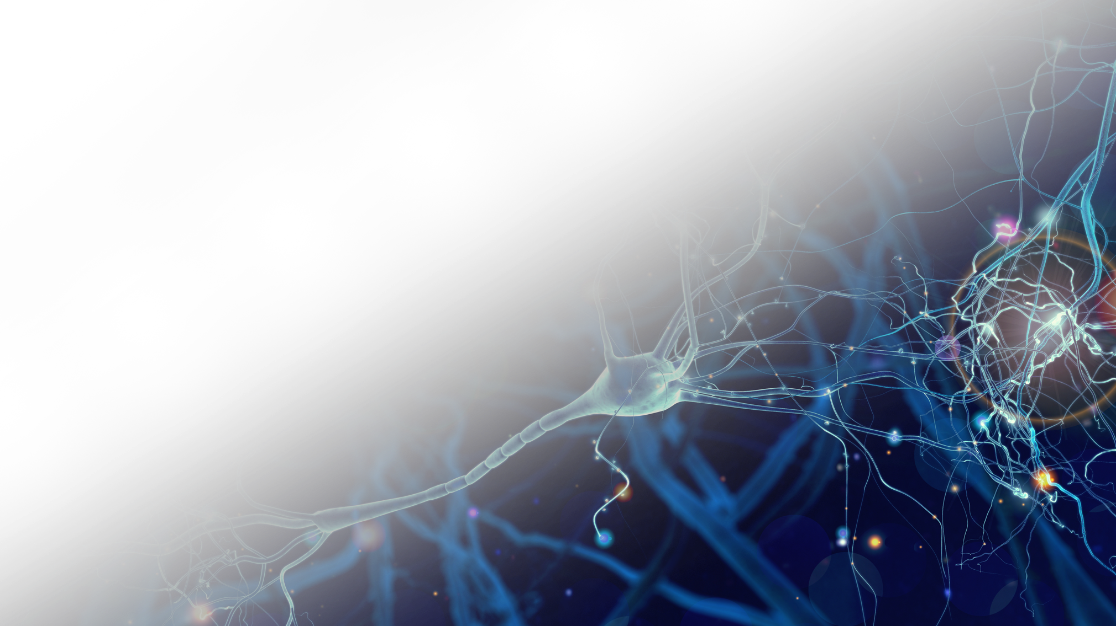
Additional Material / Graphics
Subhead
Text
• Bullet

