Slide 1

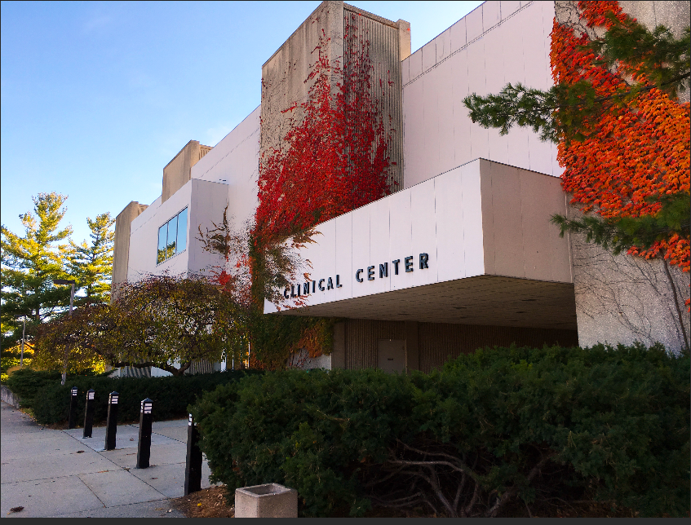
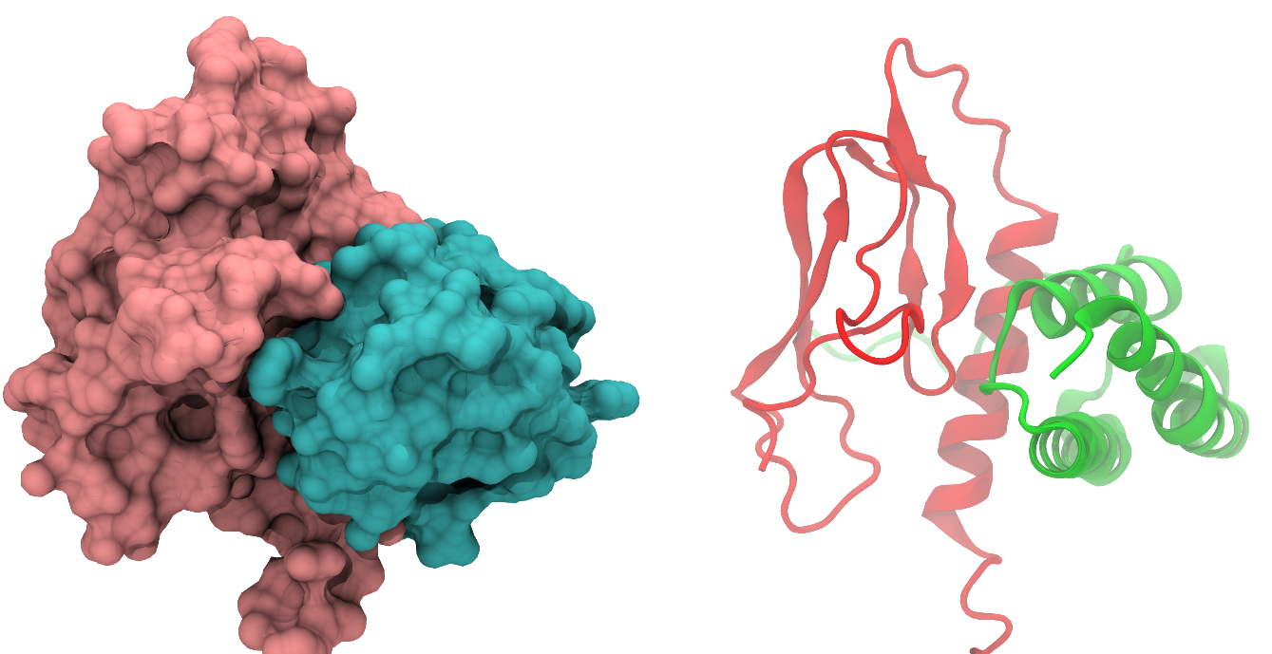
Devices, Ditan, Gepants, mAbs, Oh My (graine): Updates in Migraine Disease
50th Clinical Neurological Society of American Meeting
January 2024
L. Charleston IV, MD, MSc, FAHS
Professor of Neurology
Director, Division of Headache and Facial Pain
Department of Neurology & Ophthalmology
Michigan State University College of Human Medicine
Chief Consultant
Charleston Health Neurology & Head Pain Consultants
Twitter: @LCharlestonIVMD
LinkedIn: www.linked.com/in/LCharlestonIVMD

Slide 2
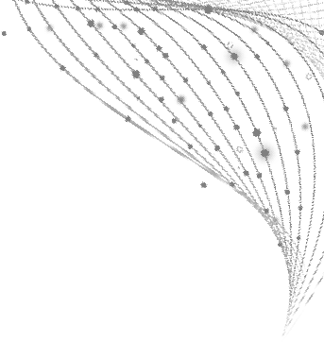
Disclosures
Consulting Fee (e.g., Advisory Board):
AbbVie/Allergan, Ameal, Amgen, Aurene, Biohaven, Haleon, LinPharma, Lundbeck/Alder, Pfizer, Satsuma, Teva
Contracted Research (Principal Investigators must provide information, even if received by the institution):
Amgen

Slide 3
Objectives
Briefly review of epidemiology, pathophysiology implicated in treatment, and diagnosis of migraine
Correctly differentiate migraine from tension type headache and “sinus” headache
Describe acute/abortive and preventive treatment goals in migraine
Identify the appropriate use of established and newer treatment options for migraine
Briefly describe neuromodulation in the treatment of migraine
Notes:
1. The learner will understand the magnitude and impact of migraine disease.
2. The learner will be able to correctly differentiate migraine from other common primary headache disorders such as tension type headache.
3. The learner will appreciate advances in migraine treatment and understand how treatments can be utilized as part of a comprehensive plan to care for people with migraine disease.

Slide 4
Migraine: a common underserved neurological problem
Migraine is a chronic neurological disease with episodic manifestations
2nd most disabling episodic condition and may affect occupational, academic, social, family, and personal domains of life.
3:1 (W:M), with an estimated 1-year period prevalence of 18% in women and 6% in men
Migraine is associated with many medical comorbidities including cardiovascular disease, psychiatric disease, and sleep disorders
Lancet Neurol 2019, 18:459-80
Burch RC et al. Neurol Clin. 2019 Nov;37(4):631-649

Slide 5
Lancet Neurol 2019,
18:459-80

Slide 6
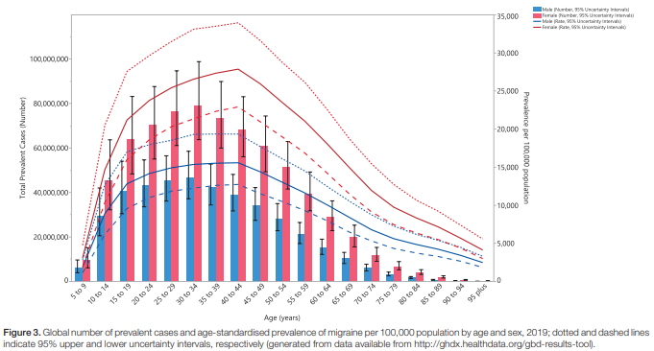
Safiri S, et al. Pain. 2021 Mar 26

Slide 7
Migraine:
A Chronic Brain Disease that can progress
Chronic migraine affects 1% to 2% of the global population; 2.5-3% of persons with episodic migraine progress to CM each year (~1.2million people in US).
Chronic migraine is associated with higher headache-related disability/impact, medical and psychiatric comorbidities, health care resource use and direct and indirect costs, and lower socioeconomic status and health-related quality of life.
Risk factors for progression may be modifiable or nonmodifiable!
Burch RC et al. Neurol Clin. 2019 Nov;37(4):631-649

Slide 8
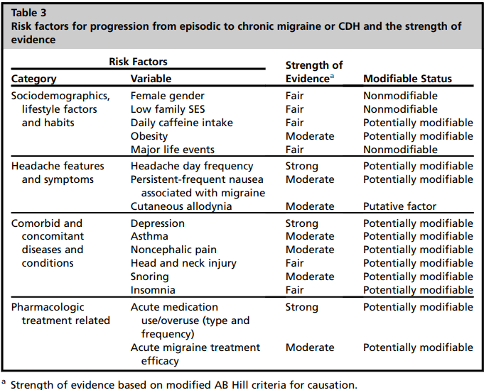
Burch RC et al. Neurol Clin.
2019 Nov;37(4):631-649

Slide 9
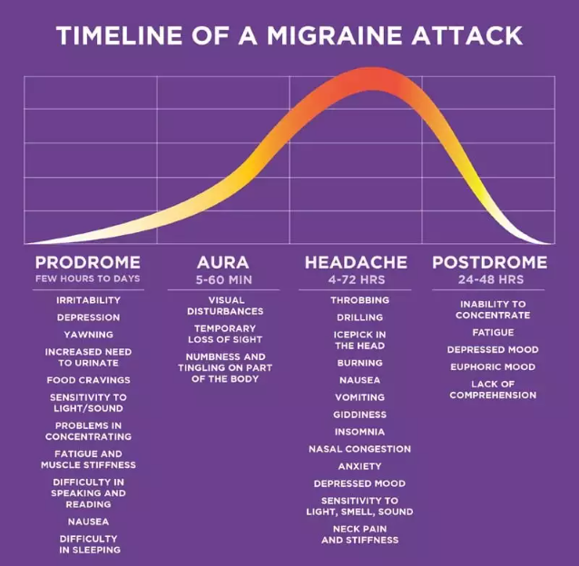
https://americanmigrainefoundation.org/resource-library/timeline-migraine-attack/ Accessed July 27, 2022

Slide 10
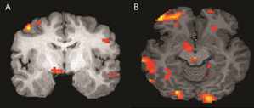

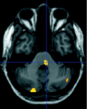

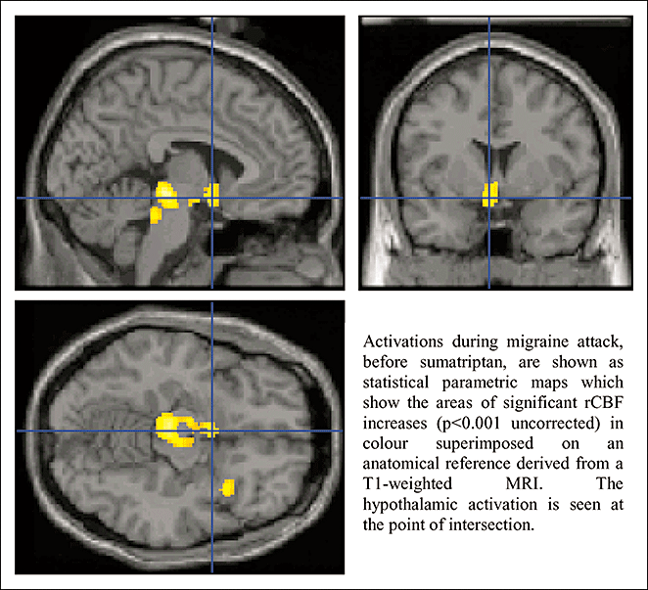

Anatomy of a Migraine Attack
Phase
Premonitory
Aura
Headache
Postdrome
Symptoms
Yawning Polyuria
Neck pain Fatigue Mood change Photophobia Phonophobia
Nausea
Visual symptoms
Sensory symptoms
Language symptoms
Cognitive symptoms
Head pain
Cutaneous allodynia
Brain Regions
?
Hypothalamus
Brainstem
Cortex
Cortex
Brainstem
Thalamus
Hypothalamus
Cortex
Thalamus
Hypothalamus

Slide 11
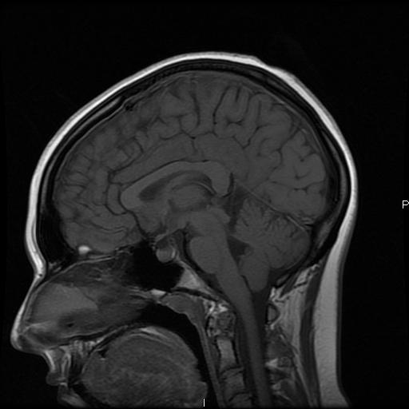






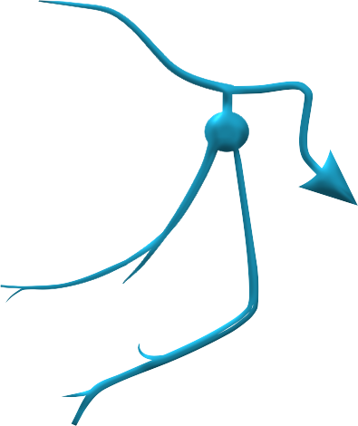

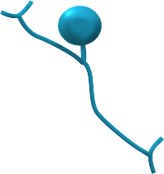
Pathophysiology of Migraine—Implications for Management
Pain perception
Cortex
Cortical spreading depolarization, altered connectivity
Migraine aura and cognitive symptoms
Target for neuromodulation
Hypothalamus
Activation in premonitory phase
Premonitory symptoms
Target for hypothalamic peptides and modulators
Thalamus
Sensitization of alteration of thalamocortical circuits
Sensory sensitivity and allodynia
Target for neuromodulation
Upper Cervical Nerves
Pain transmission or sensitization
Neck and head pain
Target for local injections and neuromodulation
Trigeminocervical Complex
Pain transmission or sensitization
Headache and neck pain
Target for medications and neuromodulation
Throbbing pain
Release of CGRP
Multiple potential sources or sites of action
Headache and other symptoms
Target for small-molecule antagonists and antibodies
Notes:
The “big-picture” message here is that migraine is not a vascular headache; it is tied intimately to the anatomy and physiology of the CNS and PNS.
This slide also helps connect the message about neck pain and the development of specific therapies, including CGRP targeting.

Slide 12

International Classification of Headache Disorders 3rd Edition

Slide 13
Migraine vs Tension-type Headache:
A Common Misdiagnosis
Migraine | Tension-type
≥2 of the following Unilateral (59% of migraine headache attacks) Pulsating (85% of migraine headache attacks) Moderate to severe intensity lasting between 4 and 72 hours (migraine headache attack) Aggravation by routine physical activity | ≥2 of the following Bilateral Not pulsating Mild to moderate intensity Not aggravated by routine physical activity
≥1 of the following Nausea/vomiting (73% of migraine headache attacks) Photophobia/phonophobia (~80% of migraine headache attacks) | No nausea/vomiting One or neither: photophobia/phonophobia
Not attributable to another disorder | Not attributable to another disorder
Notes:
Sinus Headache is Often Misdiagnosed

Slide 14
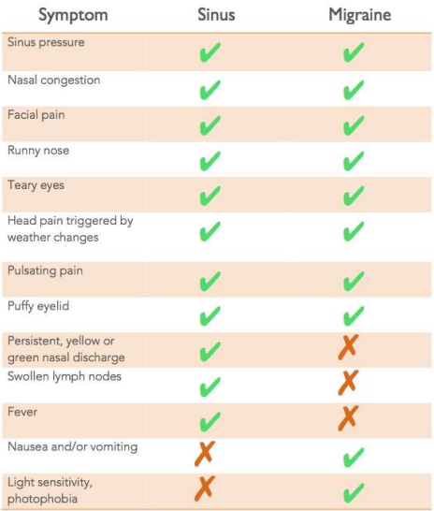
Sinus Headache – Usually means:
Sign Us Up For Migraine Workup
Sinus headache common misdiagnosis of migraine
Almost 9 in 10 who self-diagnosis with sinus headache have migraine!
Sinus headache includes infection signs:
  Persistent, yellow or green nasal discharge
  Fever
  Swollen lymph nodes
Eross E, et al. Headache. 2007 Feb;47(2):213-24, Charleston L 4th, et al. Curr Pain Headache Rep. 2014 Jun;18(6):418,
https://entad.org/wp-content/uploads/2021/12/Sinus-Migraine.pdf
https://www.health.harvard.edu/blog/sinus-headache-or-sign-us-up-for-a-migraine-consultation-2016120110758

Slide 15
A Quick Screen to “PIN” Migraine Diagnosis!
ID MigraineTM
  Photophobia
  (sensitivity to light)
  Intense
  (moderate to severe head pain intensity that decrease ability to function)
  Nausea
Its specificity and sensitivity increases with the number of reported affirmed answers.
A negative ID Migraine score reduces the probability of migraine from 59% to 23%
Meta-analysis of 8,682 participants from 22 studies pooled sensitivity, specificity, and diagnostic odds ratio were 81.0% (95% CI: 80.0%-82.0%), 68.0% (95% CI: 66.0%-69.0%) and 17.03 (95% CI: 9.94-29.18) respectively.
Notes:
ID migraine is a 3-question self-administered screening tool for diagnosing migraine.⁽¹⁵⁾ It has been validated in several countries, various clinical settings, and in the community.⁽¹⁶⁻²⁰⁾ Its specificity and sensitivity increases with the number of reported affirmed answers. If patients do not answer in the affirmative to any of the questions, although they may have headaches, it is unlikely they have a diagnosis of migraine. One systematic review and meta-analysis indicated a negative ID Migraine score reduces the probability of migraine from 59% to 23%. The sensitivity analysis reveals similar results. ⁽²¹⁾ Another meta-analysis of 8,682 participants from the 22 studies pooled sensitivity, specificity, and diagnostic odds ratio were 81.0% (95% CI: 80.0%-82.0%), 68.0% (95% CI: 66.0%-69.0%) and 17.03 (95% CI: 9.94-29.18), respectively.(18)
15. Lipton RB, Dodick D, Sadovsky R, Kolodner K, Endicott J, Hettiarachchi J, et al. A self-administered screener for migraine in primary care - The ID Migraine (TM) validation study. Neurology. 2003;61(3):375-82.
16. Ertas M, Baykan B, Tuncel D, Gokce M, Gokcay F, Sirin H, et al. A comparative ID migraine (TM) screener study in ophthalmology, ENT and neurology out-patient clinics. Cephalalgia. 2009;29(1):68-75.
17. Oztora S, Korkmaz O, Dagdeviren N, Celik Y, Caylan A, Top MS, et al. Migraine headaches among university students using id migraine test as a screening tool. Bmc Neurol. 2011;11.
18. Wang X, San YZ, Sun JM, Zhou HB, Li X, Zhang ZM, et al. Validation of the Chinese Version of ID-Migraine in Medical Students and Systematic Review with Meta-Analysis Concerning Its Diagnostic Accuracy. J Oral Facial Pain H. 2015;29(3):265-78.
19. Kim ST, Kim CY. Use of the ID migraine questionnaire for migraine in TMJ and orofacial pain clinic. Headache. 2006;46(2):253-8.
20. Siva A, Zarifoglu M, Ertas M, Saip S, Karli HN, Baykan B, et al. Validity of the ID-Migraine screener in the workplace. Neurology. 2008;70(16):1337-45.
21. Cousins G, Hijazze S, Van de Laar FA, Fahey T. Diagnostic Accuracy of the ID Migraine: A Systematic Review and Meta-Analysis. Headache. 2011;51(7):1140-8.

Slide 16
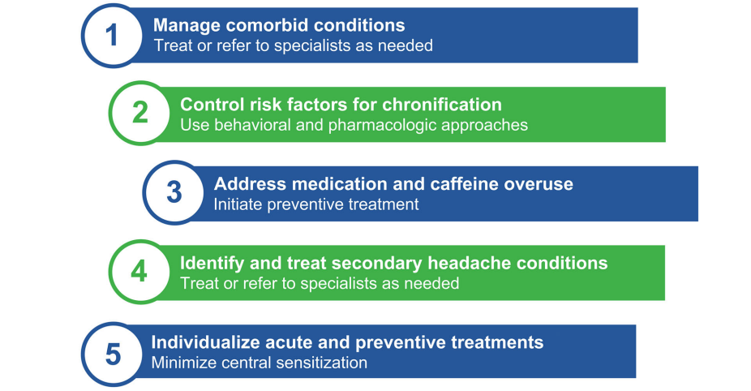
Principles of Rational Multimodal Migraine Management
Blumenfeld AM, et al. Neurol Ther. 2023 Oct;12(5):1533-1551, Epub 2023 Aug 5
Notes:
Principles of rational multimodal migraine management. These principles are not meant to be mutually exclusive due to the substantial overlap and interactions between them

Slide 17
Goals of Acute Migraine Treatment
Rapid and consistent freedom from pain and associated symptoms, especially the most bothersome symptom, without recurrence.
Restored ability to function.
Minimal need for repeat dosing or rescue medications.
Optimal self-care and reduced subsequent use of resources.
Minimal or no adverse events (AEs).
Cost considerations
Ailani J, et al Headache. 2021 Jul;61(7):1021-1039

Slide 18

Acute Treatment Principles
Establish what the patient’s goals are
Treat at least two attacks with the same medication
If medication is ineffective:
        Ensure that no other medications are interfering with response
    Ensure patient is taking the drug at the correct time
    Maximize dose
    Change formulation/route of administration
    Change drug
    Add drug
  Try combination therapy (eg, sumatriptan + naproxen)

Slide 19
Treatment of Acute Migraine: Medications
Triptans | Ergots | Nonspecific treatments | Gepants | Serotonin 5-HT_{1F} Receptor Agonist
Almotriptan Eletriptan Frovatriptan Naratriptan Rizatriptan Rizatriptan + meloxicam* Sumatriptan Sumatriptan + naproxen Zolmitriptan | Dihydroergotamine Ergotamine + caffeine | Antiemetics Aspirin +/‒ acetaminophen +/‒ caffeine Diclofenac, ketorolac, celexocib, other NSAIDs Corticosteroids (IV; rescue therapy) | Rimegepant Ubrogepant Zavegepant | Lasmiditan
A variety of routes of administration (oral, nasal spray, suppository, etc) and combinations are available
Products containing butalbital are sometimes used despite evidence that butalbital is not effective for migraine pain and can cause rebound headache
Opioids should be avoided. Reserve opiates only for limited use in very severe migraine

Slide 20
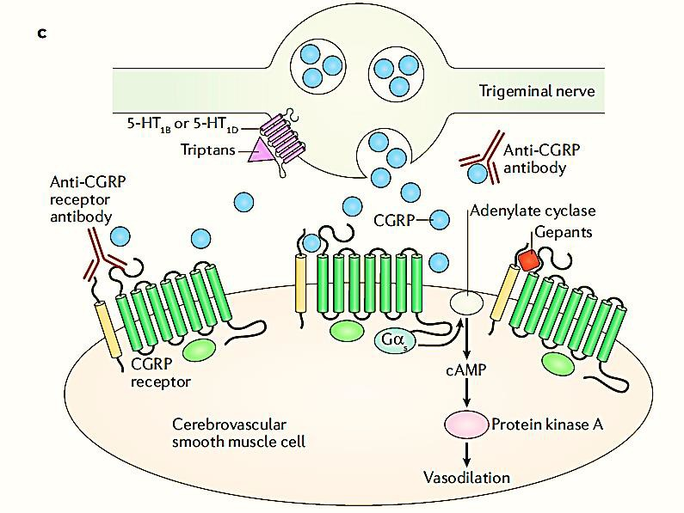
Newer Therapies Treatment Targets
Triptans and ergots prevent CGRP release, 5HT agonist
OnabotulinumtoxinA neuromodulator, prevents CGRP release
Lasmiditan 5HT receptor agonist, prevents CGRP release
Anti-CGRP ligand mAbs: eptinezumab, fremanezumab, galcanezumab
5-HT
1F,
Anti-CGRP receptor mAb: erenumab
5-HT_{1F}
CGRP receptor antagonists (gepants)
atogepant, rimegepant, ubrogepant, zavegepant
Neurogenic inflammation
Triptans and ergots constrict CGRP-dilated vessels
NSAIDs
5-HT_{1B}
mAb = monoclonal antibody; HT = hydroxytryptamine; cAMP = Cyclic adenosine monophosphate.
Adapted from Edvinsson L, et al. Nat Rev Neurol. 2018;14(6):338-350.

Slide 21
Lasmiditan, Rimegepant, Ubrogepant, Zavegepant:
New(er) Medication Options for Acute Migraine Treatment
 | Lasmiditan | Rimegepant | Zavegepant | Ubrogepant
Mechanism of Action | Serotonin 5-HT_{1F} receptor agonist | CGRP receptor antagonist | CGRP receptor antagonist | CGRP receptor antagonist
Indication | Acute treatment of migraine with or without aura in adults
Dosing | 50 mg, 100 mg, or 200 mg orally, as needed (not to exceed 1 dose in 24 hrs) | 75 mg orally or sublingual, as needed (not to exceed 1 dose in 24 hrs) | 10mg Intranasal single spray. Maximum cumulative dose that may be given in a 24-hour period is 10 mg. | 50 mg or 100 mg orally, as needed; may take 2nd dose ≥2 hours later; not to exceed 200 mg in 24 hrs
Adverse Events | Dizziness, fatigue, paresthesia, sedation, driving or machinery impairment for 8 hrs after taking | Nausea | Dysgeusia, Nasal Discomfort, Nausea | Nausea and somnolence

Slide 22
Lasmiditan PK Info
Oral absorb peak plasma concentration median 1.8hrs
Taking the drug with a high-fat meal may prolong the median time to reach maximum plasma concentration (Tmax) by about one hour and increase its exposure (maximum plasma concentration (Cmax) and surface area underthe concentration–time curve (AUC) by 22% and 19%, respectively)
  May not be clinically significant.
Binding of lasmiditan to blood proteins is 55%–60%, and biological half-life (T0.5) is 5.7 hr
Eliminated via metabolism, major pathway being ketone reduction
administration of lasmiditan with P-gp and BCRP substrate drugs should be avoided
coadministered with propranolol, could reduce heart rate by additional five beats per minute for a mean maximum of 19 beats per minute compared to propranolol alone
  patients taking also heart rate lowering drugs should be used with caution
lasmiditan and its metabolites are not clinically relevant inhibitors or inducers for any of the major CYP enzymes

Slide 23
Ubrogepant PK Info
ubrogepant is rapidly absorbed, and Cmax in plasma is achieved after about 1.5 h.
  High fat food may extend absorption process and Tmax.
Binding - blood proteins is 87%, biological half-life is 5–7 h, and the drug is mainly excreted in the feces with renal elimination being a minor route (42% and 6%)
should not be used with potent CYP3A4 inhibitors of (e.g., ketoconazole, itraconazole, clarithromycin), as these drugs may cause a significant increase in plasma concentration of ubrogepant which is mainly metabolized by this isoenzyme
recommends a starting dose of 50 mg of ubrogepant used concomitantly with moderate or weak inhibitors of CYP3A4
When used with moderate CYP3A4 inhibitors, a second dose of ubrogepant within 24 h of the starting dose should be avoided.
When ubrogepant is used with weak inhibitors of CYP3A4, the second dose of 50 mg may be administered at least 2 h after the first dose, if needed
Concomitant use of ubrogepant with strong CYP3A4 inducers (e.g., phenytoin, barbiturates, rifampin, St. John’s wort) should be avoided due to ubrogepant’s decreased efficacy
  recommends an initial ubrogepant dose of 100 mg when coadministered with moderate or weak CYP3A4 inducers.
  If needed, a second 100 mg dose of ubrogepant may be administered at least 2 h after the initial dose
  Ubrogepant dose adjustment is recommended, however, based on a conservative prediction of 50% reduction in its exposure
a P-gp-only inhibition is unlikely to result in more than 2-fold increase in ubrogepant exposure

Slide 24
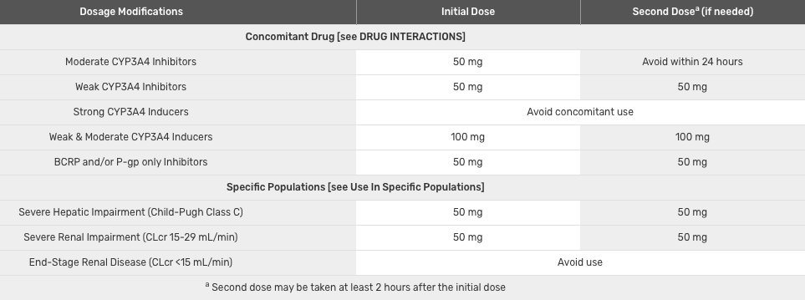
Ubrogepant – Concomitant D-I dosing
https://www.ebmconsult.com/articles/medications-inhibitors-cyp3a4-enzyme
https://www.rxlist.com/ubrelvy-drug.htm#indications

Slide 25
Rimegepant PK Info
Maximum plasma concentration of rimegepant after oral administration is achieved after 1.5 h, and its bioavailability is 64%.
When administered with a high-fat meal, Tmax of rimegepant was prolonged by 1 h, and Cmax and AUC were reduced by 42%–53% and by 32%–38%, respectively. The steady-state
volume of distribution of rimegepant is 120 L, and plasma protein binding is approximately 96% [69–75].
Metabolism of rimegepant is mainly mediated by CYP3A4 isoenzyme and to a lesser extent by CYP2C9, resulting in the formation of several minor, inactive metabolites (i.e., metabolites that represented >10% of drug-related material) detected in plasma.
Biological half-life is approximately 11 h
rimegepant can be defined as a moderate sensitive substrate for CYP3A4 (with 2 to <5-fold increase in AUC expected with a strong inhibitor of CYP3A4)
Concomitant use of rimegepant (75 mg single dose) with rifampin, a strong CYP3A4 inducer, reduced its bioavailability (AUC by 80% and Cmax by 64%), and, thus, also its efficacy
  Concomitant administration of rimegepant with strong or moderate inducers of CYP3A is avoided
rimegepant is a substrate of P-gp and BCRP efflux transporters, coadministration of this drug with inhibitors of P-gp or BCRP may significantly increase its exposure
Therefore, rimegepant should not be used with inhibitors of P-gp (e.g., quinidine) or BCRP (e.g., eltrombopaq, curcumin)

Slide 26
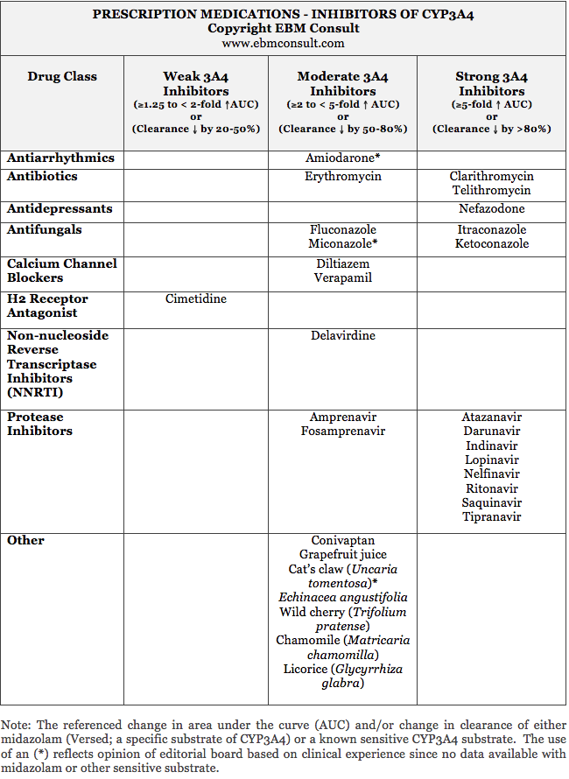
https://www.ebmconsult.com/articles/medications-inhibitors-cyp3a4-enzyme

Slide 27
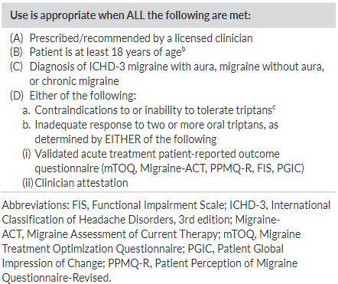
Criteria for initiating acute treatment with gepants, ditans, or neuromodulatory devices
Ailani J, et al Headache. 2021 Jul;61(7):1021-1039

Slide 28
Goals of Migraine Prevention
Reduce attack frequency, severity, duration, and disability.
Improve responsiveness to and avoid escalation in use of acute treatment.
Improve function and reduce disability
Reduce reliance on poorly tolerated, ineffective, or unwanted acute treatments.
Reduce overall cost associated with migraine treatment.
Enable patients to manage their own disease to enhance a sense of personal control.
Improve health-related quality of life (HRQoL).
Reduce headache-related distress and psychological symptoms.
Ailani J, et al Headache. 2021 Jul;61(7):1021-1039

Slide 29

Principles of Preventive Pharmacotherapy
Establish what the patient’s goals are
Give each treatment an adequate trial
Continue for at least several months
Avoid interfering, overused, and contraindicated drugs
Re-evaluate therapy
Women of childbearing potential should understand risks
Involve patients in their care to maximize adherence
Consider comorbidities and choose medications to treat coexisting disorders when possible
Choose drugs based on efficacy, patient preferences, headache profile, adverse effects

Slide 30
AAN/AHS Classification of Preventive Therapies for Episodic Migraine
Level A: Medications With Established Efficacy (≥2 class I studies) | Level B: Medications That Are Probably Effective (1 class I or 2 class II studies) | Level C: Medications That Are Possibly Effective (1 class II study)
Antiepileptic drugs Divalproex sodium Valproate sodium Topiramate | Antidepressants/SSRI/SSNRI/TCA Amitriptyline Venlafaxine | ACE inhibitors Lisinopril
 |  | Angiotensin receptor blockers Candesartan
 | β-Blockers Atenolol Nadolol | α-Agonists Clonidine Guanfacine
β-Blockers Metoprolol Propranolol Timolol |  | α-Agonists Clonidine Guanfacine
 | Triptans (MRM) Naratriptan* Zolmitriptan*
 |  | Antiepileptic drugs Carbamazepine
Triptans (MRM) Frovatriptan*
Triptans (MRM*) Frovatriptan* |  | β-Blockers Nebivolol, pindolol
 |  | Antihistamines Cyproheptadine
Considerations
Check for teratogenicity
Topiramate for patients with obesity?
β-blocker for hypertensive nonsmokers ≤60 years of age?
Triptan for MRM?
Amitriptyline for patients with insomnia, mood disorder, or depression?
Anti-CGRP monoclonal antibodies now also an option

Slide 31
Newer Therapies Treatment Targets
Triptans and ergots prevent CGRP release, 5HT agonist
OnabotulinumtoxinA neuromodulator, prevents CGRP release
Lasmiditan 5HT receptor agonist, prevents CGRP release
Anti-CGRP ligand mAbs: eptinezumab, fremanezumab, galcanezumab
5-HT
1F,
Anti-CGRP receptor mAb: erenumab
5-HT_{1F}
CGRP receptor antagonists (gepants)
atogepant, rimegepant, ubrogepant, zavegepant
Neurogenic inflammation
Triptans and ergots constrict CGRP-dilated vessels
NSAIDs
5-HT_{1B}
mAb = monoclonal antibody; HT = hydroxytryptamine; cAMP = Cyclic adenosine monophosphate.
Adapted from Edvinsson L, et al. Nat Rev Neurol. 2018;14(6):338-350.

Slide 32
Newer FDA-Approved Therapies for Headache Disorders:
Monoclonal Antibodies
Drug | Indication(s) | Dosing | Examples of Common Adverse Events
Eptinezumab | EM, CM | IV, quarterly | URI, nasopharyngitis, fatigue, diarrhea, oropharyngeal pain
Erenumab | EM, CM | SC, monthly | Injection site reactions, constipation
Fremanezumab* | EM, CM | SC, monthly or quarterly | Injection site reactions
Galcanezumab* | EM, CM | SC, monthly | Injection site reactions

Slide 33
FDA-Approved Preventive Therapies for Chronic Migraine
Anti-CGRP monoclonal antibodies*
  Eptinezumab
  Erenumab
  Fremanezumab
  Galcanezumab
Atogepant (CGRP receptor antagonist)*
OnabotulinumtoxinA

Slide 34
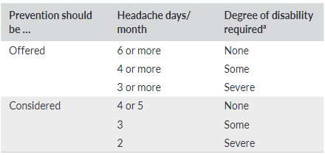
Criteria for Identifying Patients for Preventive Treatment
Ailani J, et al Headache. 2021 Jul;61(7):1021-1039

Slide 35
Indications for Initiating Treatment
With Monoclonal Antibodies to CGRP or its Receptor
Use is approved when ALL of the following are met:
Prescribed by a licensed medical provider
Patient is ≥18 years of age
ICHD-3 migraine (4-14 monthly headache days) AND:
    Poor tolerability or inadequate response to an 8-week trial of ≥2 preventive treatments OR
    ≥2 quarterly injections of onabotulinumtoxinAª
Recommended Preventive Treatments^{b}
Topiramate
Divalproex sodium/valproate sodium^{c}
Beta-blocker
Tricyclic antidepressant
Serotonin-norepinephrine reuptake inhibitor
Other treatments with A or B-level established efficacy^{b}
CGRP, calcitonin gene-related peptide;AAN-AHS, American Academy of Neurology-American Headache Society
ªChronic migraine only (15 or more headache days)
^{b}According to AAN-AHS guideline
^{c}Not for use in women of childbearing potential
AHS. Headache. 2019;59:1-18; Marmura MJ et al. Headache. 2015;55:3-20

Slide 36

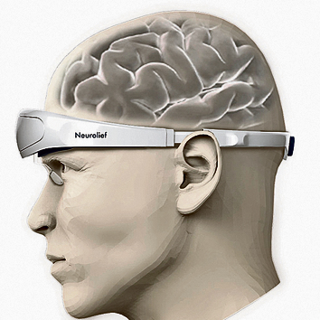
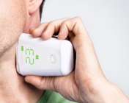

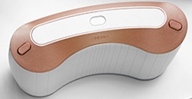
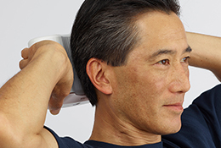
Noninvasive Neuromodulation for Migraine
FDA Cleared:
ACUTE & PREVENTIVE
FDA Cleared:
ACUTE ONLY
Being Studied for Prevention
FDA Cleared:
ACUTE & PREVENTIVE
FDA Cleared:
ACUTE & PREVENTIVE
External Trigeminal Stimulation¹ (eTNS)
Combined occipital and supraorbital transcutaneous nerve stimulation⁴ (COT-NS) ^{4,5}
Noninvasive Vagal Nerve Stimulation¹ (nVNS)
Remote Electrical Neuromodulation^{2,3} (REN)
Single Pulse Transcranial Magnetic Stimulation¹
1. Tepper SJ, Tepper DE. Practical Neurology. 2018;17:42-45; 2. Yarnitsky et al. Headache. 2019;59:1240-1252:
3. Rapoport AM and Tepper SJ. Headache. 2020;60:229-234; 4. Tepper SJ et al. Headache 2022;62: DOI: 10.1111/head.14350.
5. Sharon R and Tepper SJ. Headache 2022;62(S1):162 (abstract and ePoster presentation, AHS Annual Scientific Meeting 6/11/22.
Notes:
Most cleared for 12-17yo (Not COT-NS)

Slide 37
Criteria for initiating acute treatment with gepants, ditans, or neuromodulatory devices
Ailani J, et al Headache. 2021 Jul;61(7):1021-1039

Slide 38

Appropriate patients for neuromodulation
Young patients with episodic migraine who don’t want medications
Those planning pregnancy
Those with multiple medication failures or contraindications
Chronic migraine for whom other options are close to exhausted
Adjunctive use on top of medications
To shift the locus of control to patient with adherence or therapy commitment issues

Slide 39

Devices for Migraine Management
No Access Except the VA; Current Costs ->
eTNS: $\sim$$400 one time to own, monthly payments available, $25 for 3 electrodes, 90 day return policy, no prescription necessary
sTMS: $1,050 one time for 3 months, then $350/month to rent
nVNS: $200/month for unlimited one month use for acute and/or preventive indications
REN: $69 for first device (18 treatments), 2 refill options
  1/ $89
  3/ $199/($66 per device)
COT-nS: $200 for the first 3 months unlimited use, $75/month thereafter

Slide 40
Conclusions
Migraine is a highly impactful and burdensome neurological disease.
Newer therapy targets give insight to the pathophysiology of migraine.
Devices, -ditans, and calcitonin gene related peptide therapies has broaden our migraine treatment toolbox of effective treatments for the care of migraine disease.
Current data of neuromodulation suggest these this treatment modality is safe and may be effective in some patients with migraine disease, however, there may be challenges with access.
When we appropriately diagnosis migraine and optimize treatment, we can make a significant positive impact of the lives of many and may limit migraine disease progression.

Slide 41



Thank you for your attention!
Questions?
Picture of a few MSU HFPD Members
Twitter/Facebook: @LCharlestonIVMD
LinkedIn: www.linked.com/in/LCharlestonIVMD

Slide 42
Supplemental Slide

Slide 43
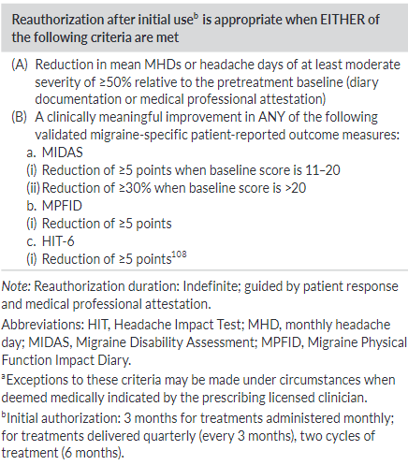
Criteria for continuation of monoclonal antibodies to calcitonin gene-related peptide or its receptor or neuromodulation therapy
Ailani J, et al Headache. 2021 Jul;61(7):1021-1039

