Slide 1

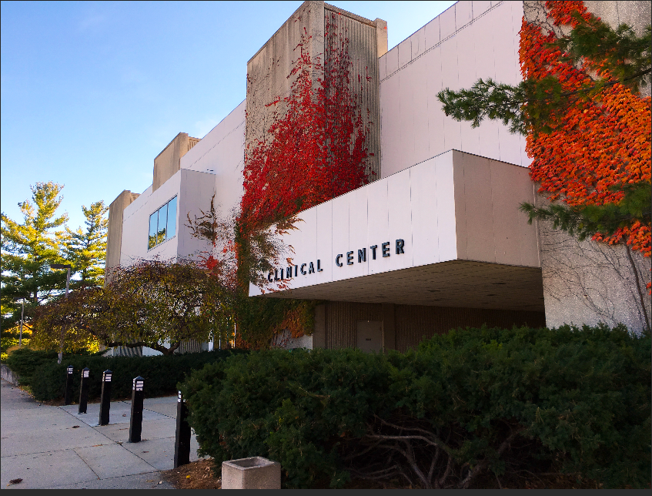
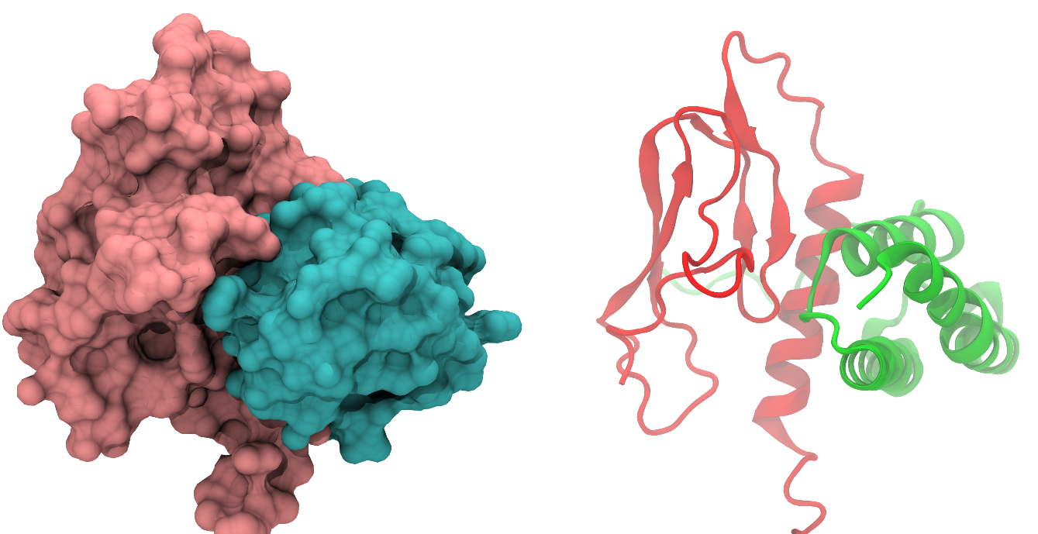
Neuromodulation in Headache Disease
50th Clinical Neurological Society of American Meeting
January 2024
L. Charleston IV, MD, MSc, FAHS
Professor of Neurology
Director, Division of Headache and Facial Pain
Department of Neurology & Ophthalmology
Michigan State University College of Human Medicine
Chief Consultant
Charleston Health Neurology & Head Pain Consultants
Twitter: @LCharlestonIVMD
LinkedIn: www.linked.com/in/LCharlestonIVMD

Slide 2
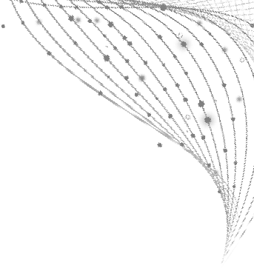
Disclosures
Consulting Fee (e.g., Advisory Board):
AbbVie/Allergan, Ameal, Amgen, Aurene, Biohaven, Haleon, LinPharma, Lundbeck/Alder, Pfizer, Satsuma, Teva
Contracted Research (Principal Investigators must provide information, even if received by the institution):
Amgen

Slide 3
Learning Objectives
At the end of the presentation, attendees should be able to:
Describe FDA-cleared non-invasive neuromodulation devices for migraine and cluster headache
Review the non-invasive neuromodulation device potential mechanisms of action
Itemize the non-invasive neuromodulation device cost and protocols for use
Remember: Neuromodulation is not neurotermination!

Slide 4

Case
57 year old man, EMT, with disabling high frequency episodic migraine
For prevention has tried amitriptyline (too sedating), topiramate (cognitive impairment), propranolol (lightheaded)
For acute treatment has tried sumatriptan (chest tightness), rizatriptan (too sedating), zolmitriptan (nausea), naratriptan (too slow and ineffective), both gepants (too slow)
Does not want to try lasmiditan because needs to drive
https://stock.adobe.com/search/images?k=distinguished%20man

Slide 5
Neuromodulation approaches for migraine
External trigeminal neurostimulation (eTNS)
FDA
cleared
Single-pulse transcranial
magnetic stimulation (sTMS)
Non‐invasive vagus nerve stimulation (nVNS)
Remote electrical
neuromodulation (REN)
Combined Occipital-Trigeminal Neurostimulation (COT-NS)
Puledda F, Goadsby PJ. Headache. 2017;57:685–691.

Slide 6

Acute Migraine Treatment
Preventive Migraine Treatment

Slide 7
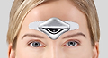
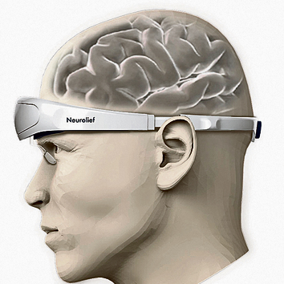
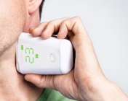

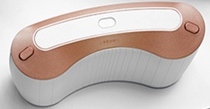
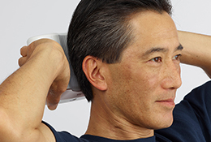
Noninvasive Neuromodulation for Migraine
FDA Cleared:
ACUTE & PREVENTIVE
FDA Cleared:
ACUTE ONLY
Being Studied for Prevention
FDA Cleared:
ACUTE & PREVENTIVE
FDA Cleared:
ACUTE & PREVENTIVE
External Trigeminal Stimulation¹ (eTNS)
Combined occipital and supraorbital transcutaneous nerve stimulation⁴ (COT-NS) ^{4,5}
Noninvasive Vagal Nerve Stimulation¹ (nVNS)
Remote Electrical Neuromodulation^{2,3} (REN)
Single Pulse Transcranial Magnetic Stimulation¹
1. Tepper SJ, Tepper DE. Practical Neurology. 2018;17:42-45; 2. Yarnitsky et al. Headache. 2019;59:1240-1252:
3. Rapoport AM and Tepper SJ. Headache. 2020;60:229-234; 4. Tepper SJ et al. Headache 2022;62: DOI: 10.1111/head.14350.
5. Sharon R and Tepper SJ. Headache 2022;62(S1):162 (abstract and ePoster presentation, AHS Annual Scientific Meeting 6/11/22.

Slide 8

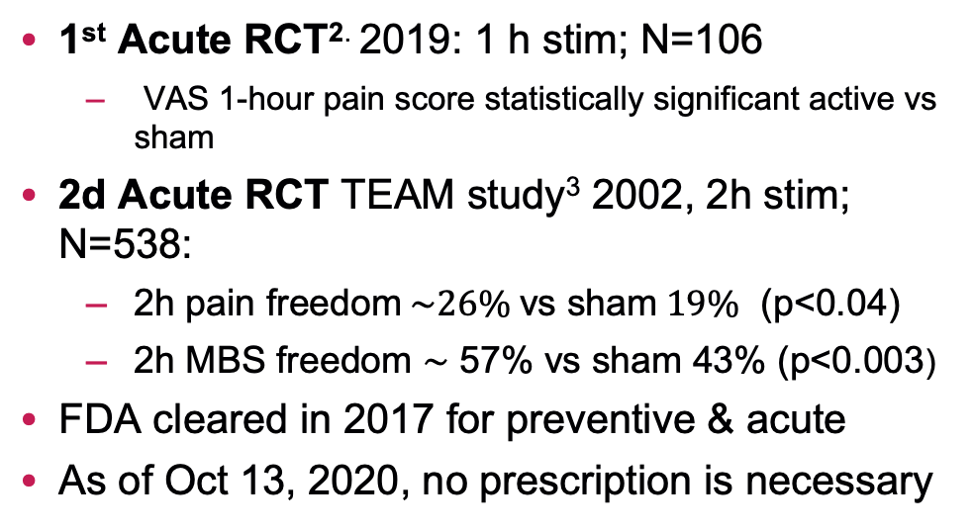
8
External Trigeminal Stimulation for Acute and Preventive Treatment of Migraine in Adults (eTNS)
Preventive RCT¹: 20 minutes/day for 3 months; N=67
2 primary endpoints:
  Migraine days/month in third month: NS
  ≥50% reduction in migraine days/month, 38.2% vs sham (P=0.023)
1st Acute RCT^{2.} 2019: 1 h stim; N=106
  VAS 1-hour pain score statistically significant active vs sham
2d Acute RCT TEAM study³ 2002, 2h stim; N=538:
  2h pain freedom$\sim 26\% \text{vs} \text{sham} 19\%$ (p<0.04)
  2h MBS freedom $\sim$ 57% vs sham 43% (p<0.003)
FDA cleared in 2017 for preventive & acute
As of Oct 13, 2020, no prescription is necessary
Change in HA days (NS)
P=0.054
50% Responder Rates
P=0.023
1. Schoenen et al. Neurology. 2013;80;697-704; 2. Chou et al. Cephalalgia. 2019;39:3-14.
3. Kuruvilla et al. Scientific Reports 2022: 12:5110.

Slide 9
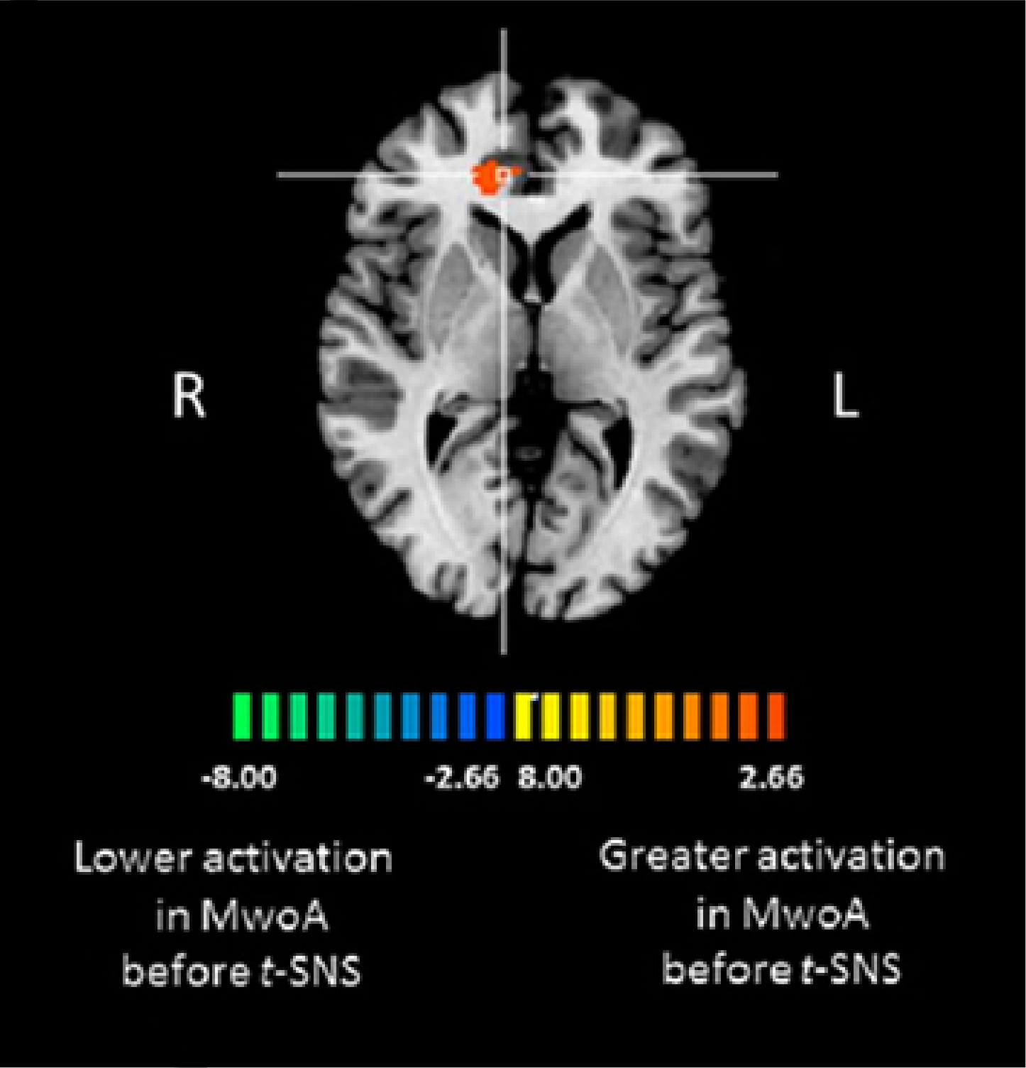
Potential mechanisms of action of eTNS: cortical or inhibitory via V1 to trigeminal nucleus caudalis (TNC)
BOLD response in rACC during stimulation at 51°C in patients with migraine without aura
0.30
0.25
0.20
0.15
0.10
BOLD % signal changes
0.05
0.00
–0.05
–0.10
–0.15
Before eTNS
After eTNS
P<0.05 cluster level corrected.
BOLD, blood oxygen level–dependent; rACC, right anterior cingulate cortex.
Russo et al. Front Neurol. 2017;8:282.
Notes:
The anti-migraine effects of external trigeminal neurostimulation (eTNS) are thought to involve functional antinociceptive modulation in the anterior cingulate cortex (ACC).
Whole-brain blood oxygen level–dependent (BOLD)-fMRI (as depicted on the left side of the slide) showed a greater BOLD response to noxious trigeminal heat stimulation in the perigenual part of the right ACC in adults with migraine without aura vs healthy controls. Treatment with eTNS resulted in a significant reduction (P=0.008) in BOLD response induced by the noxious stimulus in patients with migraine, as shown in the graph.

Slide 10
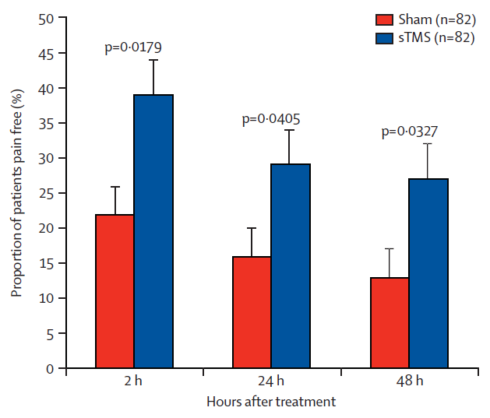

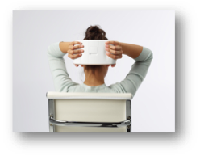
Single Pulse Transcranial Magnetic Stimulator for Acute and Preventive Migraine Treatment Ages 12 and Above (sTMS)
Acute: RCT for migraine with aura¹, now cleared for all migraine, 3 pulses, after 15 minute separations, may repeat twice more
Prevention²: 4 pulses BID
plus prn acute pulses
Max pulses/d= 17
1. Lipton et al. Lancet Neurol. 2010;9:373-80.
2. Starling et al. Cephalalgia. 2018;38:1038-1048.

Slide 11
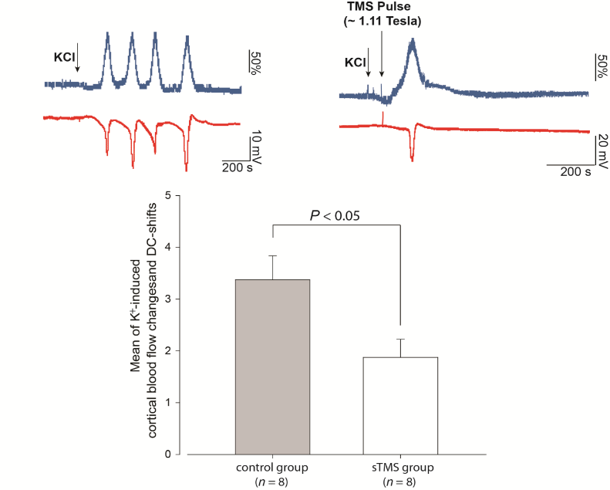
Potential mechanism of action of sTMS: Inhibits cortical spreading depolarization and inhibits thalamocortical pathways
CSD waves induced by topical KCl application in rat cortex
Untreated animal
Also inhibits thalamocortical pathways
via posterior to anterior magnetic pulses
Animal treated with sTMS
CSD, cortical spreading depression; DC, direct current; K⁺, potassium; KCl, potassium chloride.
Andreou et al. Brain. 2016;139:2002–2014.
Notes:
The left side of the slide shows representative examples of waves of cortical spreading depression (CSD) induced in rats by topical application of potassium chloride (KCl). The upper panel is from an untreated animal, and the lower panel is from an animal treated by sTMS (170 µs, 1.1 T) 30 minutes post-KCl application.
As the graph on the right shows, single-pulse transcranial magnetic stimulation (sTMS) significantly decreased the frequency of CSD waves, as indicated by the number of cerebral blood flow and intracortical steady-state potential shift changes within 60 minutes of topical KCl application.

Slide 12
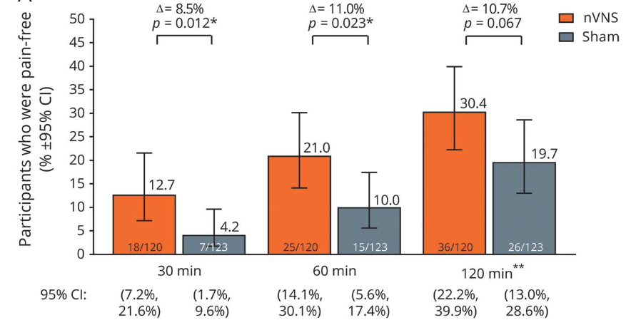
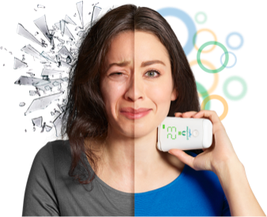
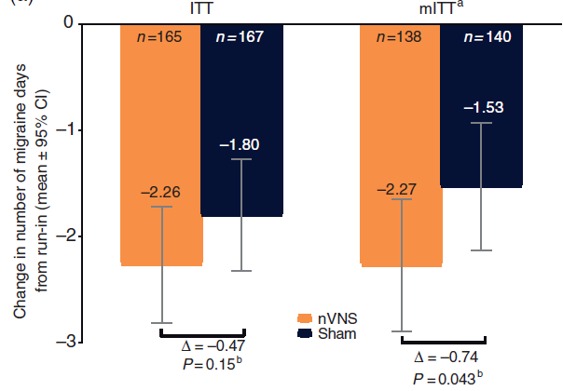
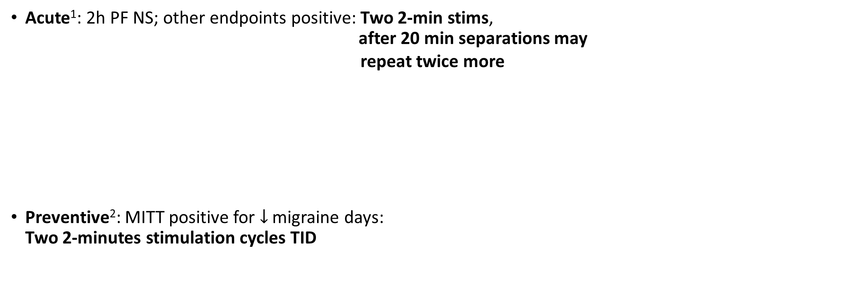
Non-invasive Vagal Nerve Stimulator for Acute and Preventive Migraine Treatment, Ages 12 and Above (nVNS)
Acute¹: 2h PF NS; other endpoints positive: Two 2-min stims, after 20 min separations may repeat twice more
Preventive²: MITT positive for $↓$ migraine days: Two 2-minutes stimulation cycles TID
Tassorelli et al. Neurology. 2018;91(4):e364-e373.
Diener et al. Cephalalgia 2019;39:1475-1487.

Slide 13
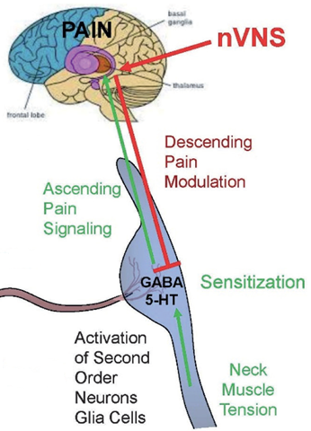
nVNS Mechanisms of Action
nVNS:
Inhibits trigeminal activation by enhanced descending pain modulation to prevent ascending nociceptive transmission
Terminates CSD
Inhibits thalamocortical pathways
Durham et al. Headache. 2019;59(Suppl 1):8.
Notes:
₁₃

Slide 14
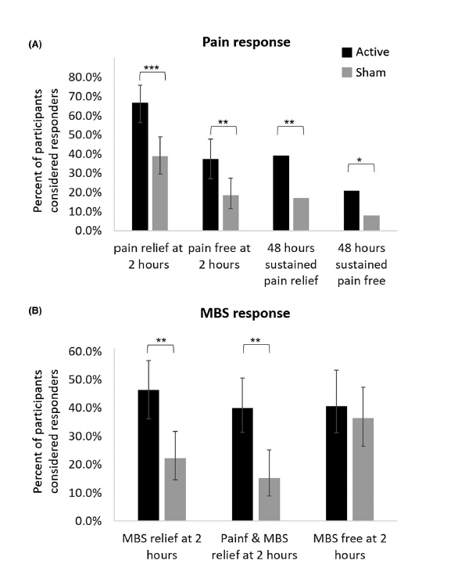
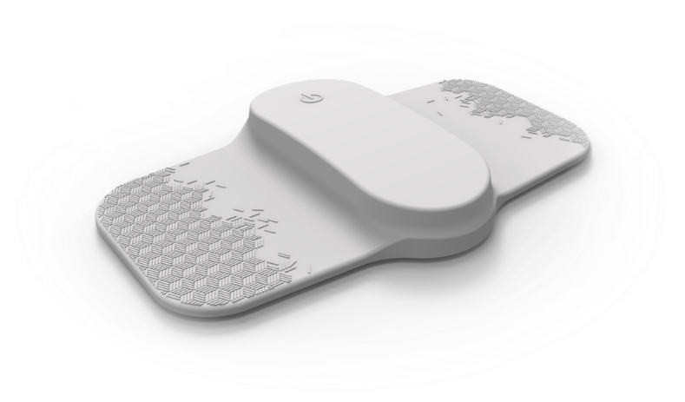

Remote Electrical Neuromodulation for Acute Treatment of Migraine Ages 12 and Above (REN)
Regulatory RCT¹, N=103, treatment 45 min
2h pain free statistically significant vs placebo
37.4% active vs 18.4% placebo
Cloud data collection²: 1,339 patients who treated without medication:
  58.9% 2h pain relief in ≥50% of attacks
  20% pain free in ≥50% of attacks
Positive studies and cleared for migraine prevention
1. Yarnitsky et al. Headache 2019;59:1240-1252.
2. Tepper SJ et al. Pain Medicine 2020;21:3522-3529.

Slide 15
Mechanism of action of REN
REN:
Activates nociceptive afferents without inducing pain, and by a conditioned pain modulation reflex, this inhibits pain at a different location
TCC, trigeminal cervical complex.
Yarnitsky et al. Headache. 2019;59:1240–1252.
Notes:
Remote electrical neuromodulation (REN) involves stimulation of upper arm peripheral nerves to induce conditioned pain modulation, an endogenous analgesic mechanism.
The REN device stimulates C and Aδ noxious sensory fibers of the upper arm above their depolarization thresholds but below the perceived pain threshold. The noxious information reaches the brainstem through the ascending pain pathway (depicted in black). This information activates the descending pain inhibitory pathway (shown in green), involving the brainstem pain regulation center (which includes the periaqueductal gray, rostral ventromedial medulla, and subnucleus reticularis dorsalis), and the release of serotonin and norepinephrine, which inhibit incoming messages of pain in the trigeminal cervical complex that occur during migraine headache (indicated in red).

Slide 16
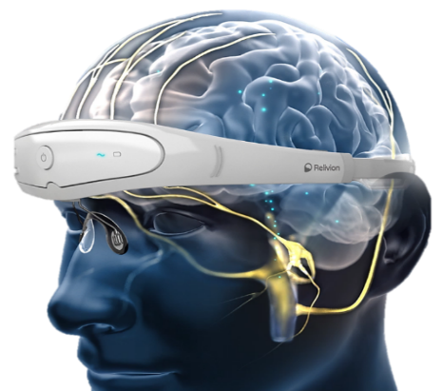
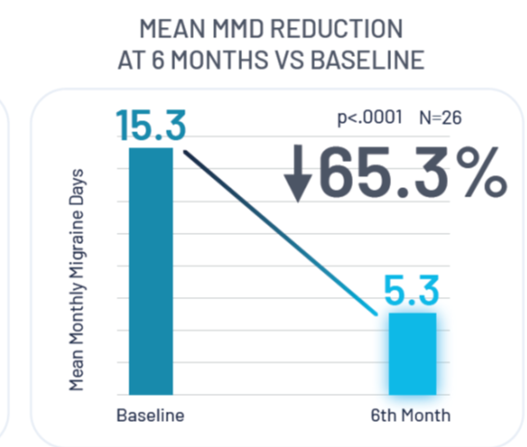
Combined Supra-orbital, Supra-trochlear (Trigeminal), and Greater Occipital Nerve Stimulation (Cervical) for Acute Migraine Treatment in Adults (COT-NS)
Acute Pivotal RCT, N=131, Treat for 60 minutes
2h Pain Relief Active: 60% ; Sham: 37% (P=0.0018)
2h Pain Free and 2h Freedom from MBS positive
Also being studied for migraine prevention
Tepper SJ et al. Headache 2022;62: DOI: 10.1111/head.14350.
Sharon R and Tepper SJ. Headache 2022;62(S1):162 (abstract and ePoster presentation, AHS Annual Scientific Meeting 6/11/22

Slide 17
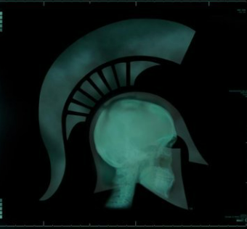
Trigeminal Autonomic Cephalalgia (TAC) Treatment via Non-invasive Neuromodulation

Slide 18
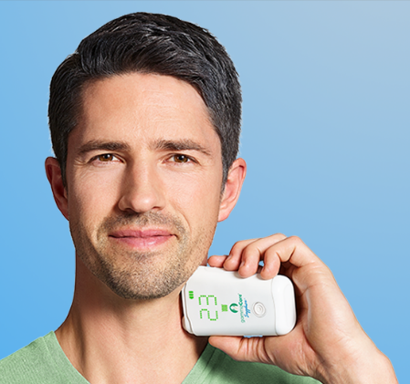
nVNS FDA Cleared for Cluster Headache, Paroxysmal Hemicrania, Hemicrania Continua
  Acute Treatment of Episodic Cluster Headache¹
    3 two-minute stimulations
    Wait 3 minutes and do 3 more 2-minute stimulations if needed
    Up to 4 attacks or 24 stimulations/day
  Adjunctive (on top of medication) Prevention of Cluster Headache²
    3 two-minute stimulations BID
  Treatment of Paroxysmal Hemicrania (PH)^{3,4} and Hemicrania Continua (HC)⁴
    Two 2-minute stimulations TID
Goadsby et al. Cephalalgia 2018;38:959-969.
Gaul et al. Cephalalgia 2016; 36:534-546.
Kamourieh et al. J Neurol Neurosurg Psychiatry. 2019;90:1072-1074.
Tso et al. JAMA Neurol. 2017;74:1266-1267.

Slide 19
Summary of Neuromodulation (proposed) Mechanism of Action

Slide 20
How Do Neuromodulation Devices Work?
Most modulate with peripheral access to central pathways
Cortex
sTMS and nVNS both interrupt CSD and inhibit thalamic pathways
Thal
nVNS via X
eTNS and COT-NS via V
REN via Conditioned Pain Modulation (CPM) brainstem reflex
COT-NS
via cervico-occipital pathways
Adapted from Mark Burish, MD

Slide 21
Quality of Data 1
Most of the devices have positive, sham controlled RCTs
The sTMS sham for acute treatment was misjudged 80%;¹ the COT-NS sham was misjudged 90^{% 2} -these shams were very effective
Most of the sham controlled RCTs were positive on primary endpoints:
  eTNS acute treatment of migraine^{3,4}
  sTMS acute treatment of migraine with aura¹
  nVNS acute treatment of episodic cluster headache⁵
  REN for acute treatment of migraine⁶
  COT-NS for acute treatment of migraine²
1. Lipton et al. Lancet Neurol. 2010;9:373-80; 2. Tepper SJ et al xxxxx; 3. Chou et al. Cephalalgia. 2019;39:3-14; 4. Kuruvilla et al. Scientific Reports 2022: 12:5110. 5. Goadsby et al. Cephalalgia 2018;38:959-969; 6. Yarnitsky et al. Headache 2019;59:1240-1252.

Slide 22
Quality of Data 2 and FDA Clearance
Some of the pivotal trials had non-significant primary endpoints:
  eTNS prevention on one of the two primary endpoints¹
  nVNS for prevention and acute treatment of migraine^{2,3}
Two of the pivotal trials were open label:
  sTMS for migraine prevention⁴
  nVNS for cluster prevention⁵
FDA clearance for indications is based on the preponderance of evidence, sometimes resulting in clearance based on studies with negative primary endpoints, sometimes resulting in clearance based on open label studies, and for two indications based on case series
1. Schoenen et al. Neurology. 2013;80;697-704; 2.Tassorelli et al. Neurology. 2018;91(4):e364-e373; 3.Diener et al. Cephalalgia 2019;39:1475-1487; 4. Starling et al. Cephalalgia. 2018;38:1038-1048; 5. Gaul et al. Cephalalgia 2016; 36:534-546.

Slide 23
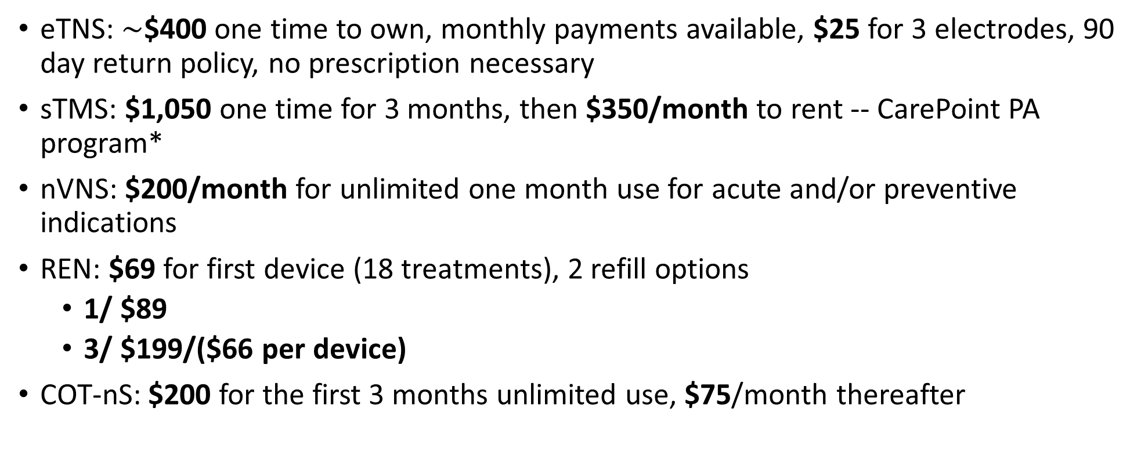
Limited Access Except the VA; Current Costs
eTNS: $\sim$$400 one time to own, monthly payments available, $25 for 3 electrodes, 90 day return policy, no prescription necessary
sTMS: $1,050 one time for 3 months, then $350/month to rent -- CarePoint PA program*
nVNS: $200/month for unlimited one month use for acute and/or preventive indications
REN: $69 for first device (18 treatments), 2 refill options
  1/ $89
  3/ $199/($66 per device)
COT-nS: $200 for the first 3 months unlimited use, $75/month thereafter

Slide 24
AHS recommends non-drug acute migraine treatment when:
Patient prefers non-drug treatments
Drug treatment ineffective
Drug treatment contraindicated
Drug treatment intolerable
Ailani et al. Headache. 2021;61:1021-1039.

Slide 25
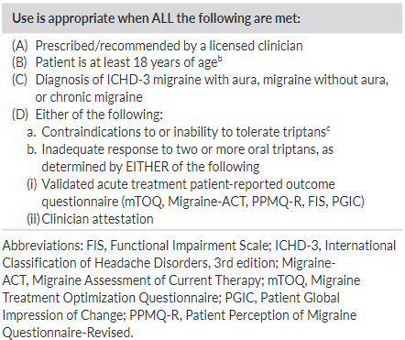
Criteria for initiating acute treatment with gepants, ditans, or neuromodulatory devices
Ailani J, et al Headache. 2021 Jul;61(7):1021-1039

Slide 26
Excuses from Commercial Payers
“Poor quality of data”
“FDA clearance is not FDA approval”
“No outcome data”
“These devices are experimental”
“Medical/Durable Medical Equipment (DME) benefit, not pharmacy benefit”
“No demand for these devices”
“Absence of confirmatory guidelines”

Slide 27
Back to the Patient
He had numerous preventive medications & acute medications fail him
He is a perfect candidate for neuromodulation, with 10-14 HA days/month, so good for both preventive and acute indications, preferably a device that does both (eTNS, sTMS, or nVNS)
https://stock.adobe.com/search/images?k=distinguished%20man

Slide 28

Appropriate patients for neuromodulation
Young patients with episodic migraine who don’t want medications
Those planning pregnancy
Those with multiple medication failures or contraindications
Chronic migraine for whom other options are close to exhausted
Adjunctive use on top of medications
To shift the locus of control to patient with adherence or therapy commitment issues

Slide 29
Conclusions
FDA-cleared non-invasive neuromodulation devices
  For migraine: eTNS, sTMS, nVNS, REN, COT-NS
  For TACs: nVNS
Migraine Acute and Prevention: eTNS, sTMS, nVNS
Migraine Acute Only: REN, COT-NS
For Adolescents and Adults: sTMS, nVNS, REN
As noted, for the patient described: eTNS, REN, or COT-NS would be reasonable
Non-invasive neuromodulation non-significant risk devices should be integrated into daily headache practice
Tolerability, safety, and efficacy are well established with RCTs
Providers and patients will need to advocate for payer access, as cost and access continue to be challenges

Slide 30



Thank you for your attention!
Questions?
Picture of a few MSU HFPD Members
Twitter/Facebook: @LCharlestonIVMD
LinkedIn: www.linked.com/in/LCharlestonIVMD

