Slide 1


Approach to Pediatric Migraine
Paige Kalika, DO
University of Miami
Department of Neurology
Division of Pediatric Neurology
January 13-16, 2024
Key Largo, Florida

Slide 2
Disclosures
Nothing to disclose

Slide 3
Objectives
At the conclusion of this presentation, participants should be able to:
  Identify children and adolescents with headache symptoms consistent with migraine
  Initiate appropriate work-up and recognize red flags requiring urgent/emergent evaluation
  Initiate acute and prophylactic treatment for migraine
  Describe established and emerging treatment modalities for pediatric migraine, both pharmacological and non-pharmacological

Slide 4
A common complaint
Pediatric headache is very common
One of the most common complaints in pediatric practice
Prevalence increases with age
By 18 years of age, 90% have had at least one headache
20% of children 4-18 report having had recurrent headaches
Higher in females after 12 years of age (28-36% vs 20%)
Most are seen by Pediatrics and never referred to Neurology
Patients who are referred are sicker
Headaches interfere with daily life
Parents are concerned for serious etiology (brain tumor!)
Most children are fine most of the time
Headache prevalence similar between pre-pubertal males and females

Slide 5
Special considerations in pediatrics
Parents will want to talk- don’t let them!
Many elementary school aged children are able to give a reasonable history if you let them
Headache drawings may be helpful!
Parents can fill in details about duration, frequency, medication, and history, including details that may suggest early episodic syndromes that may be associated with migraine
Often a two-for-one visit
Ask about parental/family history of headache
Many are unaware that they have anything other than “normal” or “sinus” headaches
You may have to exercise your detective skills
Very young children may not be able to give details or describe their symptoms
Crying at sunlight or not wanting to use the tablet → photophobia
Refusing to walk or clinging to parent’s leg → dizziness

Slide 6
Special challenges in pediatrics
Challenges are sometimes on the patient’s side
Unable to swallow pills (age, developmental status, or nausea)
Consider non-pill forms – nasal, melts, liquid, suppositories, etc
Practice pill swallowing before a headache starts, not during
May not be able to take medication at school
Challenges are sometimes on the parents’ side
Reluctance to use medication instead of “natural” remedies
Tendency to under-dose “just to take the edge off”
Tendency to over-treat
Education is key!
Review indications for supportive care vs medication
Educate about risk of medication overuse headache (MOH)

Slide 7
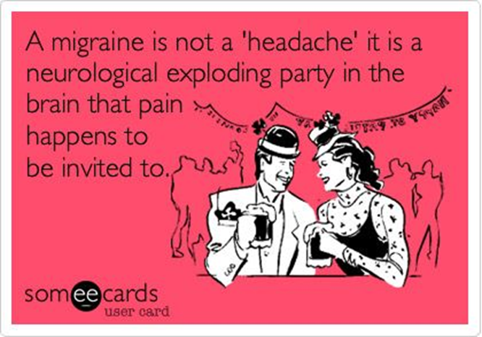
Migraine
1 in 7 Americans has migraines or severe headaches
17.6% of females
8% of males
Most common disabling primary headache disorder of children and adolescents
Major cause of disability in children
Occurs at all ages (possibly even infancy)
Ask about episodic syndromes that may be associated with migraine
Infantile colic, benign paroxysmal torticollis, benign paroxysmal vertigo, cyclic vomiting syndrome, and abdominal migraine
Prevalence increases throughout childhood and adolescence
Possible prevalence of 2.5% by age 7
Prevalence of 5% by age 10
Boys and girls affected equally before puberty
Girls more affected after puberty
Runs in families!

Slide 8
Episodic versus Chronic
Episodic migraine
Less than 15 days per month
Headaches can still be frequent and long-lasting with significant disability and diminished quality of life
Risk of medication overuse headache (MOH) still exists
Consider preventative therapy if headaches are severe and/or frequent
Menstrual migraine
Chronic migraine
At least 15 days per month for at least 3 months
<1% of children between 5-12
1-2% of adolescents between 12-17
Associated with more missed school and poor performance
Socioeconomically disadvantaged background is a risk factor

Slide 9
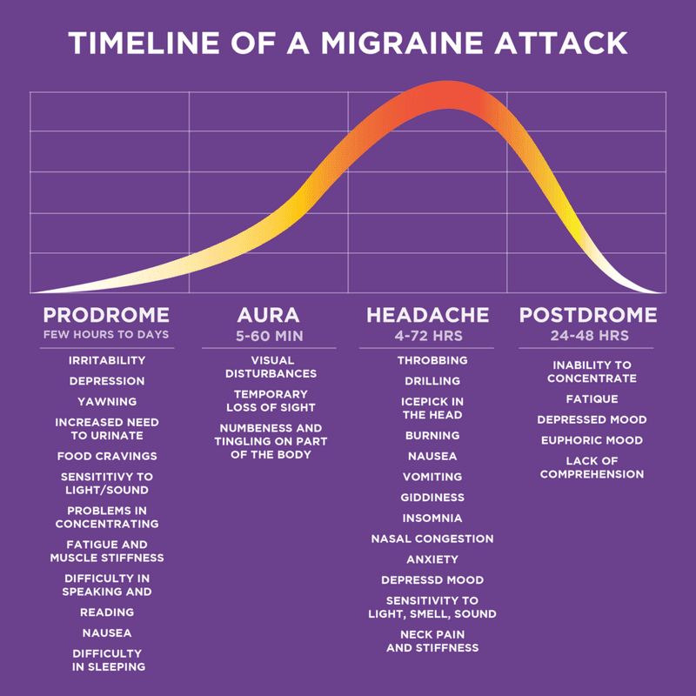
Stages of Migraine
Notes:
Premonitory phase:
Affective, vegetative, and sensitivity symptoms starting hours to days before the onset of the headache
Most commonly reported symptoms include fatigue, irritability, pallor, and shadows under the eyes
Some also report euphoria, social withdrawal, food cravings, urinary or bowel changes, neck stiffness, and increased yawning
One study noted that at least one premonitory symptom was reported by 67% of subjects
Aura:
Not always present
Does not always precede headache; can begin after headache symptoms start
Often visual: scotoma, scintillations, or fortification spectra (jagged line, often crescent shaped)
Can include sensory (focal numbness and tingling, often of the lips, lower faces, and fingers of one hand – cheiro-oral) or language (word finding difficulty to dysphasia)
Thought to be triggered by cortical spreading depression
Typical pattern involves slow spread of positive symptoms (scintillations or tingling) followed by negative symptoms (scotoma or numbness)
Typically lasts 5-60 minutes
Symptoms should spread over at least 5 minutes or should progress from one symptom to the next
Stroke risk is slightly elevated in women with migraine with aura
Risk elevated with estrogen-containing contraceptives
Can have typical aura symptoms and mild or even no headache!
Headache:
Often throbbing or pulsating
Often bifrontal, bitemporal, or generalized (more likely to be unilateral in adults)
Common symptoms include photophobia, phonophobia, nausea/vomiting, and dizziness
Very young children may be unable to report headache, but may have pallor, decreased activity, and vomiting
Headache duration tends to be shorter in younger children
Needs to be at least 2 hours untreated or unsuccessfully treated to meet criteria for migraine
Cranial autonomic symptoms are common (up to 70%): aural fullness, facial sweating/flushing, lacrimation, conjunctival injection, ptosis and/or miosis, nasal congestion and/or rhinorrhea, periorbital edema
This does not make it a sinus headache!
Observational study of 2991 patients with clinician- or self-diagnosed sinus headache showed that 88% met criteria for migraine and 8% met criteria for tension-type headache
Postdrome:
Common symptoms that persist after the headache include asthenia, cognitive difficulties, pallor, anorexia, somnolence, and nausea
Common symptoms that start after the headache include thirst, somnolence, visual disturbances, food craving, paraesthesias, and ocular pain
Many children complain of feeling drained or exhausted, but some report feeling euphoric

Slide 10
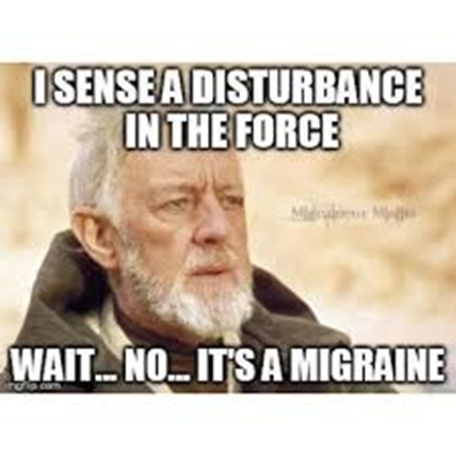
Special types of migraine with aura
Migraine with brainstem aura (basilar-type migraine)
Two or more brainstem-related aura symptoms (dysarthria, vertigo, tinnitus, hypacuis, diplopia, ataxia, decreased level of consciousness
Can also have visual aura with positive features (zigzags, flickering light) or negative features (scotoma)
Can have sensory aura with positive features (tingling) or negative features (numbness)
Can have aphasic aura
Evidence is scanty, but avoid beta blockers, triptans, and ergotamine derivatives because of theoretical concerns and anecdotal evidence that these medications may lead to cerebral ischemia (related to historical concerns over vascular theory of migraine)
Especially avoid with frequent or long-lasting auras or auras associated with prominent ataxia or a decreased level of consciousness
Hemiplegic migraine
If the aura involves motor weakness, it is classified as hemiplegic migraine
Aura includes motor weakness and at least one other symptom
Headache usual starts with or after onset of aura
Can be familial or sporadic
Retinal migraine
Sudden loss of vision or perception of bright light (photopsia) or scintillations in only one eye lasting less than 1 hour
Visual symptoms may occur without headache
Headache is typically ipsilateral and periorbital
Permanent visual loss may occur!
Possible migrainous infarction

Slide 11
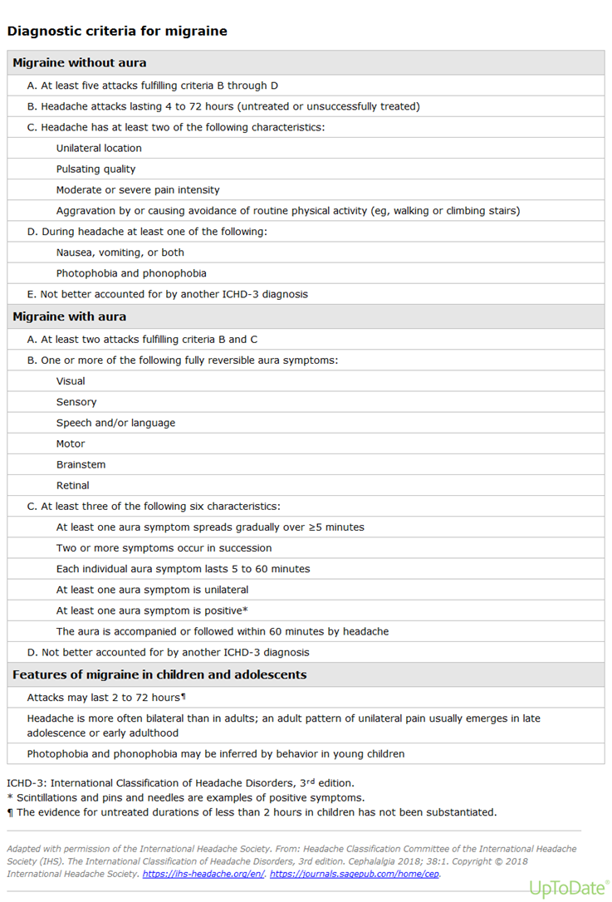

Slide 12
Pediatric and Adult: What’s the Difference?
Kids and adults are not the same!
Attacks tend to be shorter
Pain is more commonly bilateral
Children often do not complain of photophobia and phonophobia (but do want to lie down in a dark, quiet room)
Headache drawings may be helpful!
Features like pounding pain, nausea/vomiting, and photophobia had sensitivity of 93.1% and 82.7%
Positive predictive value of 87.1%

Slide 13
Diagnosis is clinical!
Diagnosis is based on history and neurological examination
Neurological examination should be normal
Neuroimaging usually not needed in the setting of established history of typical headache pattern and normal examination
No specific neuroimaging findings associated with pediatric migraine
Consider neuroimaging (MRI preferred) in the setting of abnormal neurological examination or red flags for increased intracranial pressure
Rapidly increasing headache frequency or significant change in headache frequency or characteristics
Focal neurological signs
Ataxia/worsening coordination
Headache upon awakening from sleep/worsening of headaches when supine
Personality changes, worsening school performance
Other studies are usually unnecessary
Labs and EEG usually unhelpful
Lumbar puncture only if concern for infection or IIH

Slide 14
What else could it be?
Other primary headache types
Tension-type headaches, trigeminal autonomic cephalalgias, new daily persistent headache, primary stabbing headache, etc)
Secondary headaches
Traumatic brain injury, stroke, structural lesions, infection, etc
Differential for migraine aura
Transient ischemic attack (TIA), seizure, syncope, electrolyte disturbance, and vestibular disorders
Ischemic disorders tend to have sudden onset and negative symptoms rather than gradual progressive spread and positive symptoms

Slide 15
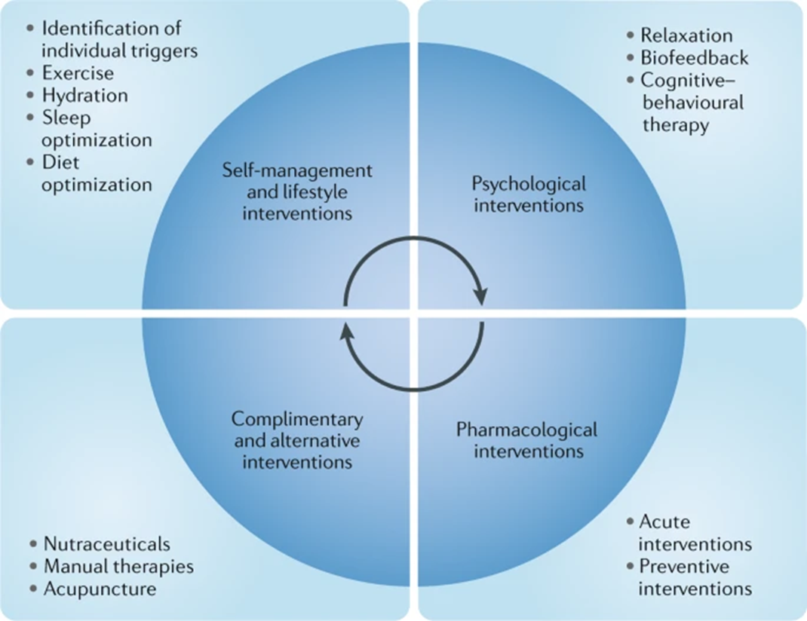
What do we do about it?
Notes:
Regular hydration
Only 17% of adolescents stay sufficiently hydrated during a given day
10% of children have experienced migraines secondary to dehydration
85% note that migraines improve with hydration
Identify and avoid food triggers
Cheese, tomatoes, nitrates, wine, aspartame
Caffeine (ingestion and withdrawal)
Chocolate – in a randomized double-blind trial, no more likely to trigger headache than the control substance!
However, food cravings, especially for sweets, are a known premonitory phase migraine symptom: migraines cause chocolate eating!
Literature review shows that various non-pharmacological treatments in young headache patients produced sizeable effects on headache frequency
Reductions ranging from 3-78%
Comparable to pharmacological treatments
Also saw other meaningful effects on common patient-reported outcomes (disability, quality of life, and symptoms of depression and anxiety)
Much better side effect profile
Enables pediatric and adolescents patients to enhance their abilities to handle pain and cope more effectively with attacks without medications
Biofeedback
Bio-behavioral approach through which patients learn to voluntarily modify their bodily reactions via feedback-mediated awareness of physiologic parameters, such as peripheral skin temperature or electromyography
Thought to act, in part, by reducing cortical excitability and affecting resonance and oscillations of essential feedback loops in the brain induced by modifications of bodily reactions through feedback-mediated awareness of physiologic parameters
Thought to normalize cortical excitability

Slide 16
But we’re really not “medicine” people…
Nutraceuticals
Riboflavin
Magnesium
Co-enzyme Q10
Melatonin
Feverfew
No major adverse effects; studies unclear or at high risk of bias due to small sample size
Butterbur
Shows efficacy, but contains hepatotoxic and potentially carcinogenic pyrrolizidine alkaloids
Supposedly removed from commercial preparations, but no long-term safety data or regulated product, so not recommended in pediatrics at this time
Physical modalities
Physical therapy
Massage
Acupuncture

Slide 17
When it hurts right now!
Supportive care
Dark, quiet room
Hydration
Sleep!
Treat early!
Acetaminophen 10-15 mg/kg/dose (1,000 mg single dose; no more than 3 doses in 24 hours)
Ibuprofen 10 mg/kg/dose (can repeat in 4-6 hours; no more than 4 doses/day; maximum daily dose 40 mg/kg/d)
Naproxen 5 mg/kg/dose (can repeat in 8-12 hours, maximum daily dose 1,000 mg)
Always review age/weight appropriate dosing because math is hard when you have a headache

Slide 18
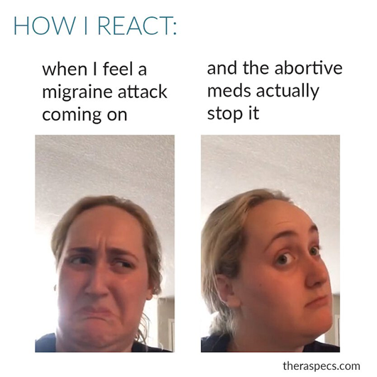
When the OTC meds don’t work
Review the doses again (trust me)
Triptans!
No more than 9 days/month to avoid MOH
Can repeat the dose if needed
No contraindication to giving to patients on SSRIs or SNRI
6 and up: rizatriptan
12 and up: sumatriptan, zolmitriptan, and almotriptan

Slide 19
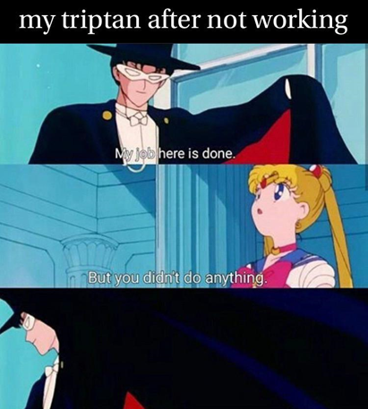
When the meds really didn’t work
At home
Triptan + naproxen
Sumatriptan-naproxen available as a combination drug
Neuroleptics (prochlorperazine, promethazine, metoclopramide, or olanzapine)
“Bridge” strategies
Naproxen
Steroids (methylprednisolone, prednisone, or dexamethasone)
Valproic acid
Gabapentin
Tizanidine (if neck pain)
Amitriptyline or hydroxyzine (if trouble sleeping)
Magnesium (prolonged aura)
In the ED
IV fluids + anti-emetic (prochlorperazine vs metoclopramide vs ondansetron) + ketorolac vs acetaminophen
Pretreat with diphenhydramine to avoid potential dystonic reaction
IV Valproate
Magnesium
Dihydroergotamine (DHE)
Precede DHE dose with antiemetic
Steroids
Occipital nerve block and transnasal SPG block
Lidocaine 4% intranasal spray

Slide 20
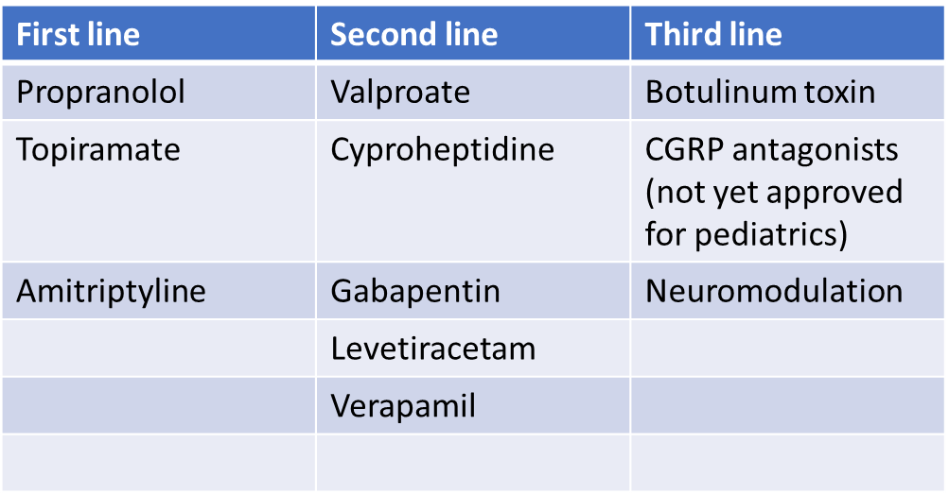
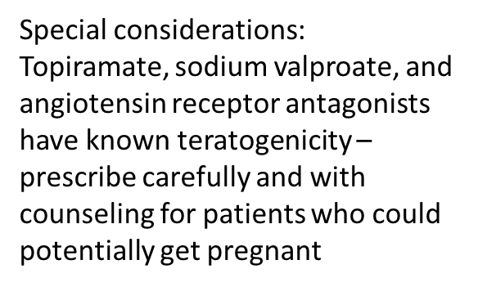
We still don’t like medicine, but we’re desperate

Slide 21
CHAMP Trial - 2017
Compared topiramate vs amitriptyline vs placebo
Stopped early for futility
Good news: kids got better!
In all three treatment arms, 60% of participants met primary end point of 50% or more reduction in headache frequency
Bad news: placebo won
Treatment efficacy was comparable, but placebo had lower rate of adverse events
Possible factors
Lifestyle migraine management reinforced at monthly study visits
Optimal acute therapy
However, these interventions alone were not enough to decrease headache frequency over 4-week baseline run-in period
Study was limited
Patients with the greatest need for effective migraine prevention (those with continuous headache, high levels of migraine-related disability, and/or MOH) were excluded
40% did not show significant improvement
Take home point
First-line pharmacological preventives should have a side effect comparable to placebo

Slide 22
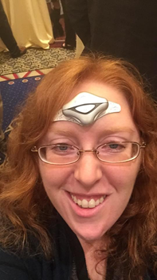
But we really, really don’t like medicine…
Remote electrical neuromodulation (REN) device
Cleared for acute and preventive treatment of migraine for >12
External trigeminal nerve stimulator neurostimulation (eTNS)
Cleared for use as monotherapy or adjunctive therapy for preventive migraine treatment for >12
Single-pulse transcranial magnetic stimulation (sTMS) device
Cleared for acute and preventive treatment of migraine for >12
External vagal nerve stimulation (nVNS) device
Cleared for acute and preventive treatment of migraine for >12
Cleared for use as monotherapy or adjunctive therapy for preventive migraine treatment
Cleared for use as monotherapy or adjunctive therapy for preventive migraine treatment

Slide 23
When nothing else works…
Tizanidine
Baclofen
Atenolol
Memantine
Zonisamide
Pregabalin
Meclizine
Olanzapine
Duloxetine
Ginger
…the list goes on

Slide 24
Future options
Good data in adults, but not yet approved for kids
CRGP monoclonal antibodies
Small molecule CRGP antagonists (gepants)
Selective serotonin 1F receptor agonist

Slide 25
What not to do?
Avoid opioids, barbiturates, and benzodiazepines
Habit forming and ineffective
Associated with development of medication overuse headache (MOH)
Avoid aspirin when possible
Concern for Reye syndrome

Slide 26
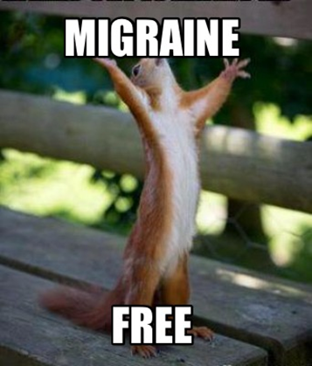
But what happens to them?
Children with migraine have a relatively good prognosis overall!
  Studies show that many children have decrease or even resolution of migraines over years
    Early age at onset may have a less favorable prognosis
  Some have relapses after a headache-free period
  Anxiety and other psychiatric comorbidities are associated with increased disability

Slide 27


Questions

Slide 28
References
Headache Classification Committee of the International Headache Society (IHS) The International Classification of Headache Disorders, 3rd edition. Cephalalgia. 2018 Jan;38(1):1-211. doi: 10.1177/0333102417738202. PMID: 29368949.
Altamura C, Corbelli I, de Tommaso M, Di Lorenzo C, Di Lorenzo G, Di Renzo A, Filippi M, Jannini TB, Messina R, Parisi P, Parisi V, Pierelli F, Rainero I, Raucci U, Rubino E, Sarchielli P, Li L, Vernieri F, Vollono C, Coppola G. Pathophysiological Bases of Comorbidity in Migraine. Front Hum Neurosci. 2021 Apr 20;15:640574. doi: 10.3389/fnhum.2021.640574. PMID: 33958992; PMCID: PMC8093831.
Andrasik F, Grazzi L, Sansone E, D'Amico D, Raggi A, Grignani E. Non-pharmacological Approaches for Headaches in Young Age: An Updated Review. Front Neurol. 2018 Nov 27;9:1009. doi: 10.3389/fneur.2018.01009. PMID: 30538669; PMCID: PMC6277635.
Cuvellier JC, Mars A, Vallée L. The prevalence of premonitory symptoms in paediatric migraine: a questionnaire study in 103 children and adolescents. Cephalalgia. 2009 Nov;29(11):1197-201. doi: 10.1111/j.1468-2982.2009.01854.x. PMID: 19811504Dooley JM, Pearlman EM. The clinical spectrum of migraine in children. Pediatr Ann. 2010 Jul;39(7):408-15. doi: 10.3928/00904481-20100623-09. PMID: 20666346.
Gazerani P. Migraine and Mood in Children. Behav Sci (Basel). 2021 Apr 14;11(4):52. doi: 10.3390/bs11040052. PMID: 33919881; PMCID: PMC8070834.
Gelfand, AA. Headache p. 1108-1136August 2018, Vol.24, No.4doi: 10.1212/CON.0000000000000638
Mathew PG, Garza I. Headache. Semin Neurol. 2011 Feb;31(1):5-17. doi: 10.1055/s-0031-1271313. Epub 2011 Feb 14. PMID: 21321829.
Nieswand V, Richter M, Gossrau G. Epidemiology of Headache in Children and Adolescents-Another Type of Pandemia. Curr Pain Headache Rep. 2020 Aug 25;24(10):62. doi: 10.1007/s11916-020-00892-6. PMID: 32840694; PMCID: PMC7447651.
Lateef TM, Merikangas KR, He J, Kalaydjian A, Khoromi S, Knight E, Nelson KB. Headache in a national sample of American children: prevalence and comorbidity. J Child Neurol. 2009 May;24(5):536-43. doi: 10.1177/0883073808327831. PMID: 19406755; PMCID: PMC2794247.
Merison K, Victorio MCC. Approach to the Diagnosis of Pediatric Headache. Semin Pediatr Neurol. 2021 Dec;40:100920. doi: 10.1016/j.spen.2021.100920. Epub 2021 Sep 3. PMID: 34749917.
Manzano S, Doyon-Trottier E, Bailey B. Myth: Ibuprofen is superior to acetaminophen for the treatment of benign headaches in children and adults. CJEM. 2010 May;12(3):220-2. doi: 10.1017/s1481803500012276. PMID: 20522287.
Minen MT, Torous J, Raynowska J, Piazza A, Grudzen C, Powers S, Lipton R, Sevick MA. Electronic behavioral interventions for headache: a systematic review. J Headache Pain. 2016;17:51. doi: 10.1186/s10194-016-0608-y. Epub 2016 May 10. PMID: 27160107; PMCID: PMC4864730.
Schreiber CP, Hutchinson S, Webster CJ, Ames M, Richardson MS, Powers C. Prevalence of migraine in patients with a history of self-reported or physician-diagnosed "sinus" headache. Arch Intern Med. 2004 Sep 13;164(16):1769-72. doi: 10.1001/archinte.164.16.1769. PMID: 15364670.
Stafstrom CE, Rostasy K, Minster A. The usefulness of children's drawings in the diagnosis of headache. Pediatrics. 2002 Mar;109(3):460-72. doi: 10.1542/peds.109.3.460. PMID: 11875142.
Stovner Lj, Hagen K, Jensen R, Katsarava Z, Lipton R, Scher A, Steiner T, Zwart JA. The global burden of headache: a documentation of headache prevalence and disability worldwide. Cephalalgia. 2007 Mar;27(3):193-210. doi: 10.1111/j.1468-2982.2007.01288.x. PMID: 17381554.
Szperka CL, Ailani J, Barmherzig R, Klein BC, Minen MT, Halker Singh RB, Shapiro RE. Migraine Care in the Era of COVID-19: Clinical Pearls and Plea to Insurers. Headache. 2020 May;60(5):833-842. doi: 10.1111/head.13810. Epub 2020 Apr 3. PMID: 32227596; PMCID: PMC7228371.

Slide 29
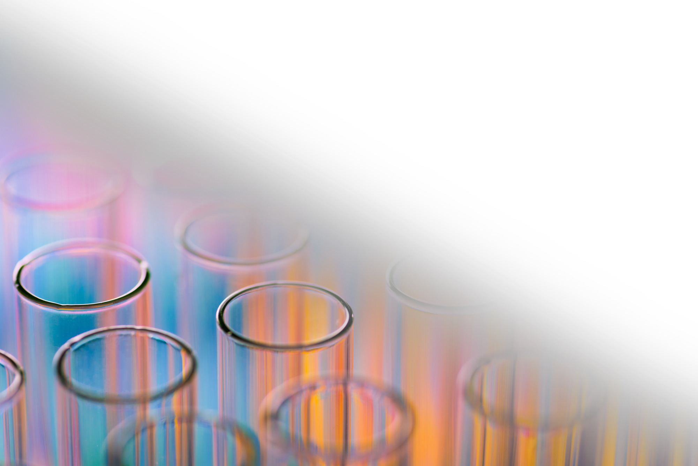
Additional Material / Graphics

Slide 30
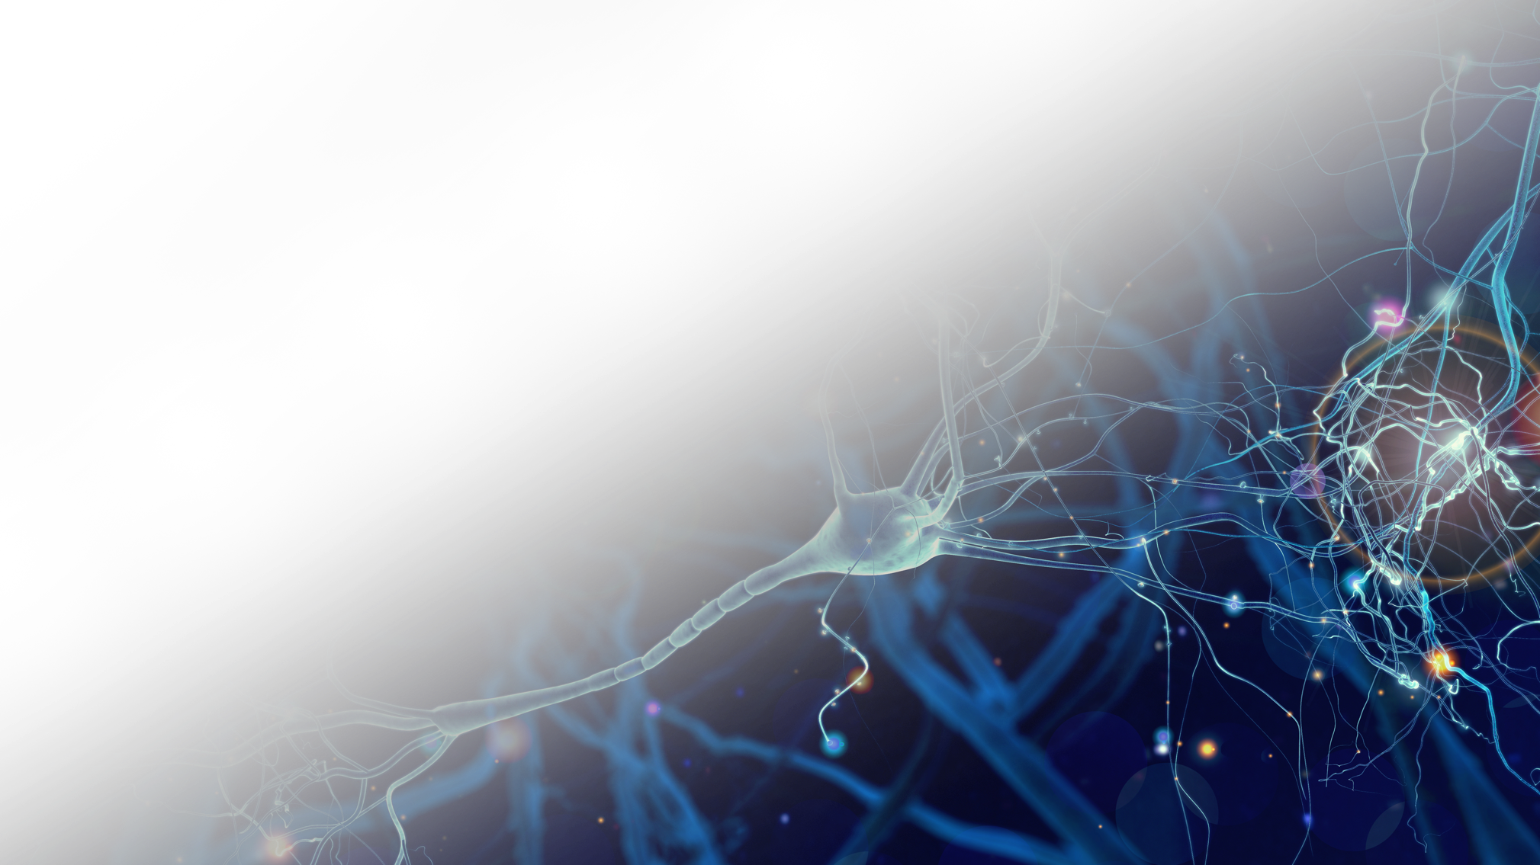
Additional Material / Graphics
Subhead
Text
• Bullet

