Slide 1


Acute Stroke Management and Time Limits…Or are there Time Limits?
Garrett Conyers, MD, MPP
Assistant Professor
Department of Neurology
University of Michigan
January 13-16, 2024
Key Largo, Florida

Slide 2
Disclosures
I have no disclosures

Slide 3
Objectives
Define evidence based “time windows” for thrombolytic and endovascular treatment of acute ischemic stroke (AIS)
Define evidence behind “extended time windows” for AIS therapies
Identify scenarios in which “time limits” may be less critical in decision making
Identify imaging modalities to utilize in decision making

Slide 4
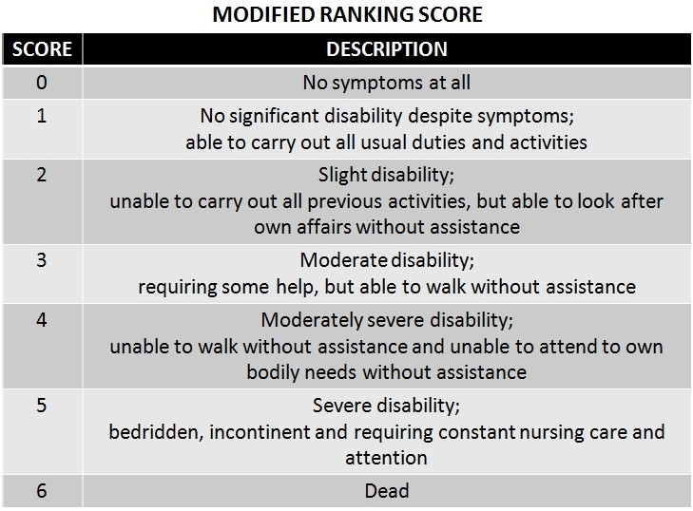
Quick Definitions
Modified Rankin Score (mRS):
measure of functional outcome
Symptomatic Intracerebral Hemorrhage
ICH after the administration of tPA/TNK
- Hemorrhagic conversion
- Used as a safety outcome

Slide 5
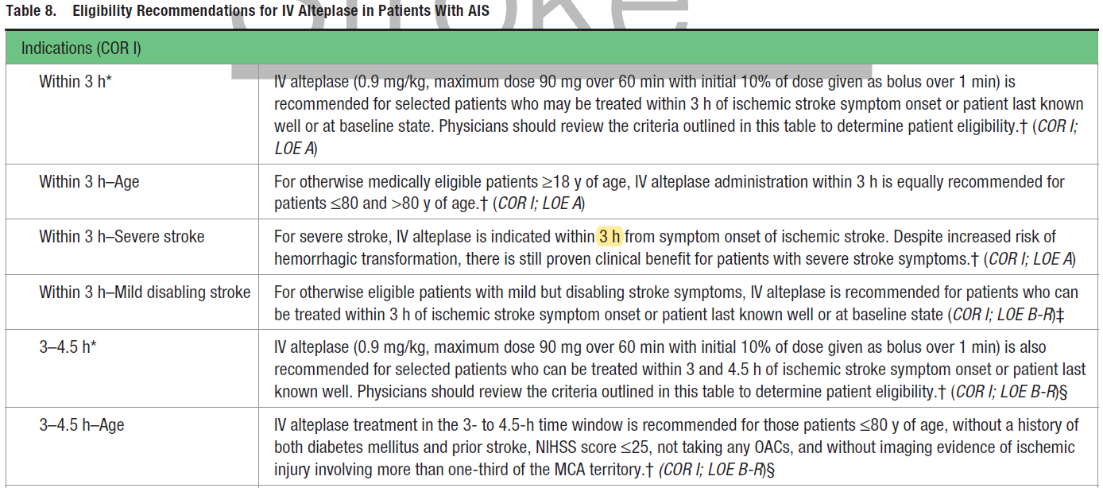
2019 Update to the 2018 AHA Guidelines for the Early Management of Acute Ischemic Stroke
Table 8. Eligibility Recommendations for IV Alteplase in Patients with Acute Ischemic Stroke

Slide 6
<3 hours from Last Known Normal (LKN)
Study | Time (H) | 90-day mRS tPA | 90-Day mRS Placebo | ARR | RRR (HR/OR) | Net sICH Rate
NINDS (N=624) | 0-3 | 27% (mRS≤1) | 17% (mRS≤1) | 10% | 40% | 5.8%
0-90min (N=312) | 0-1.5 | 25% | 19% | 6% | 24% (1.7;1.0-2.6) | -
91-180min (N=312) | 1.5-3 | 29% | 15% | 14% | 48% (2.4;1.5-3.7) | -
NINDS
Trial
ECASS II (N=800) | 0-6 | 54% (mRS≤2) | 46% (mRS≤2) | 8% | 15% (p=0.024) | 5.4%
ECASS II
Trial
Notes:
ECASS I (European Cooperative Acute Stroke Study) - dose of tPA was 1.1mg/kg and 17% of ITT population had protocol violation
ECASS II - dose lowered to 0.9mg/kg, stringent BP and CT criteria for inclusion=>positive study
ATLANTIS A/B - >70% were treated in the 4+h window
NINDS – baseline imbalances in stroke severity
Pooled analysis of all these to look at subgroups as well….

Slide 7
Within 3-4.5 hours from Last Known Normal
ECASS III Trial
Study | Time (H) | 90-day mRS tPA | 90-Day mRS Placebo | ARR | RRR (HR/OR) | Net sICH Rate
ECASS III (821) | 3-4.5 | 52% (mRS≤1) | 45% (mRS≤1) | 7% | 14% (1.34: 1.02-1.76; p=0.04) | 2.2%

Slide 8
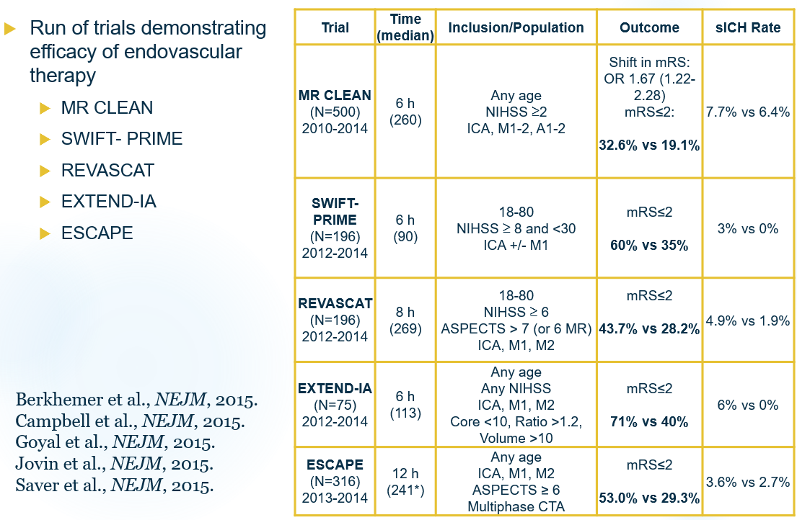
Standard Endovascular Time Window

Slide 9
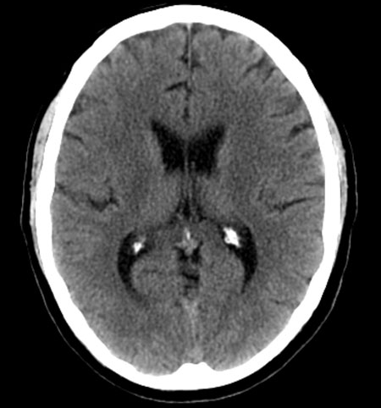
Patient Case
A 75 yo male with PMH significant for HTN, HLD, and DM presents to ED with sudden onset R-hemiparesis, dysarthria, and sensation loss.
NIHSS 7
His last known normal was 4 hours ago?
Management:
Thrombolytic

Slide 10
Patient Case
A 75 yo male with PMH significant for HTN, HLD, and DM presents to ED with sudden onset R-hemiparesis, dysarthria, and sensation loss.
NIHSS 7
His last known normal 10 h prior at bedtime.
Woke up with symptoms.
Management: ???

Slide 11
Objectives
Define evidence based “time windows” for thrombolytic and endovascular treatment of acute ischemic stroke (AIS)
Define evidence behind “extended time windows” for AIS therapies
Identify scenarios in which “time limits” may be less critical in decision making
Identify imaging modalities to utilize in decision making
Text
• Bullet
- patient cases (Last seen vs last known normal… tPA vs endo)
- AHA guidelines
- studies
classic trials…. tPA – NINDS, ECASS III (3-4.5 hours)
…. EVT… DAWN/DEFUSE/BASILAR…. 24 hour trials….)
- perfusion extended trials (wake up, extend)
- Large Core Trials
- retrospective/cohort data out of time windows…
Definitions of stuff?
What is time really? Proxy for bleeding risk/lack of benefit (large core destroyed the latter)

Slide 12
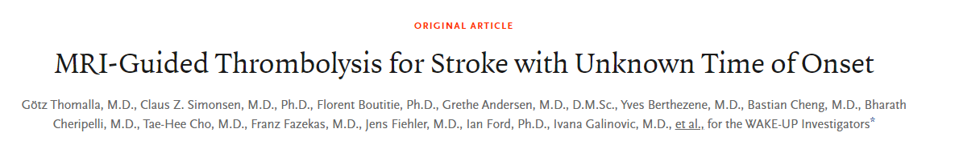
WAKE-UP Trial
Who: Patients with AIS and unclear time of onset (N= 500 patients)
- 94% of enrolled patients were “wake up” strokes
Treatment: IV tPA within 4.5 hours of symptom discover
Advanced Imaging: MRI mismatch (DWI/FLAIR)
Clinical Aspects: - Mean NIHSS 6
- Median time from LKW Symptom discovery rec ~ 7 h
- Median time to tPA from LKN ~10 h
Notes:
This study led to the recommendation as “reasonable” (Class IIa, Level B-R) to treat patients with stroke with unknown time of onset with IV alteplase when treated within 4.5 hours of discovery of symptoms if they had DWI/FLAIR mismatch with DWI lesion of less than a third of the middle cerebral artery territory. Although this trial represents a significant advancement because it increases the number of patients potentially eligible for thrombolysis, treatment decisions are still bound by time, requiring treatment within 4.5 hours from discovery of symptoms. It is also exclusively MRI-based, which limits generalizability.
The WAKE-UP RCT randomized 503 patients with AIS who awoke with stroke or had unclear time of onset and could be treated with IV alteplase within 4.5 hours of stroke symptom recognition.
Eligibility: required MRI mismatch between abnormal signal on DW-MRI and no visible signal change on FLAIR.
Exclusions: DW-MRI lesions larger than one-third of the territory of the MCA, NIHSS score >25, contraindication to treatment with alteplase, or planned thrombectomy were all exclusions.
Ninety-four percent were wake-up strokes. Median NIHSS score was 6. Median time from last known well to symptom recognition was ≈7 hours and to alteplase administration slightly over 10 hours.
The primary end point of an mRS score 0 to 1 at 90 days was achieved in 53.3% of the alteplase group and in 41.8% of the placebo group (P=0.02).
Only 20% had LVO of the intracranial internal carotid or proximal middle cerebral arteries.

Slide 13
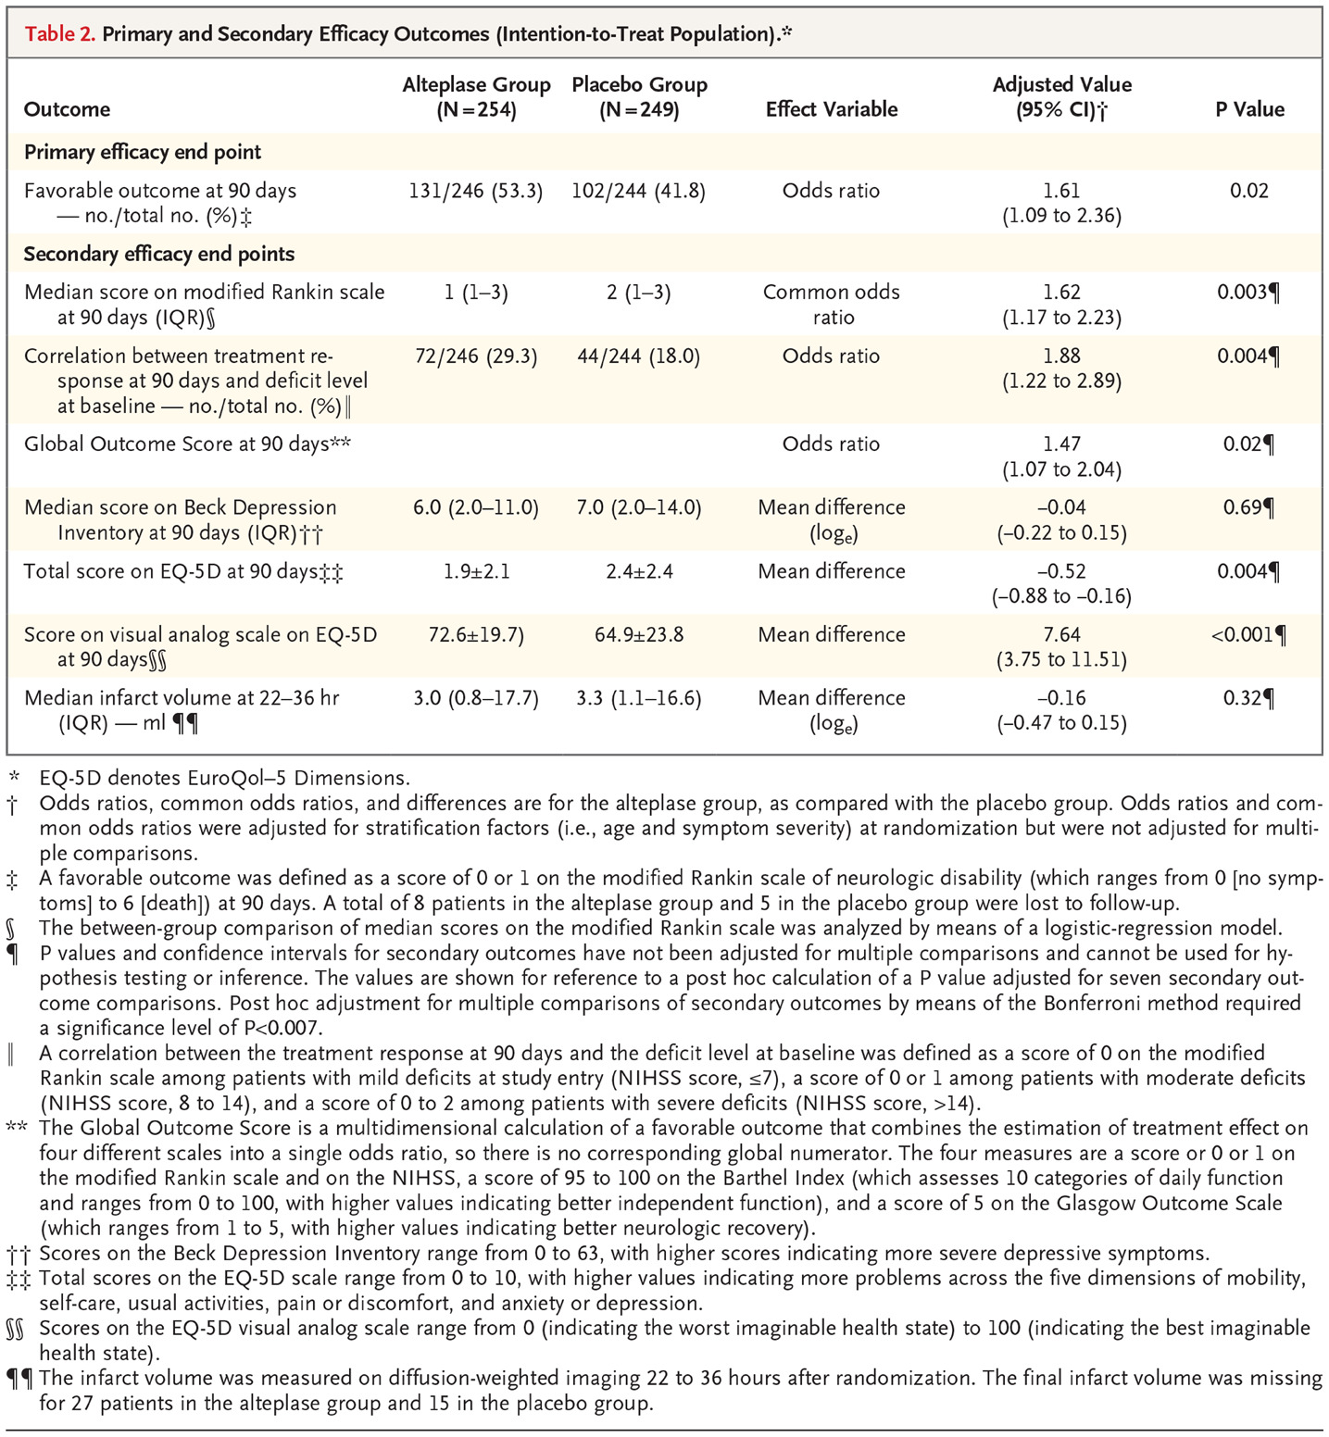
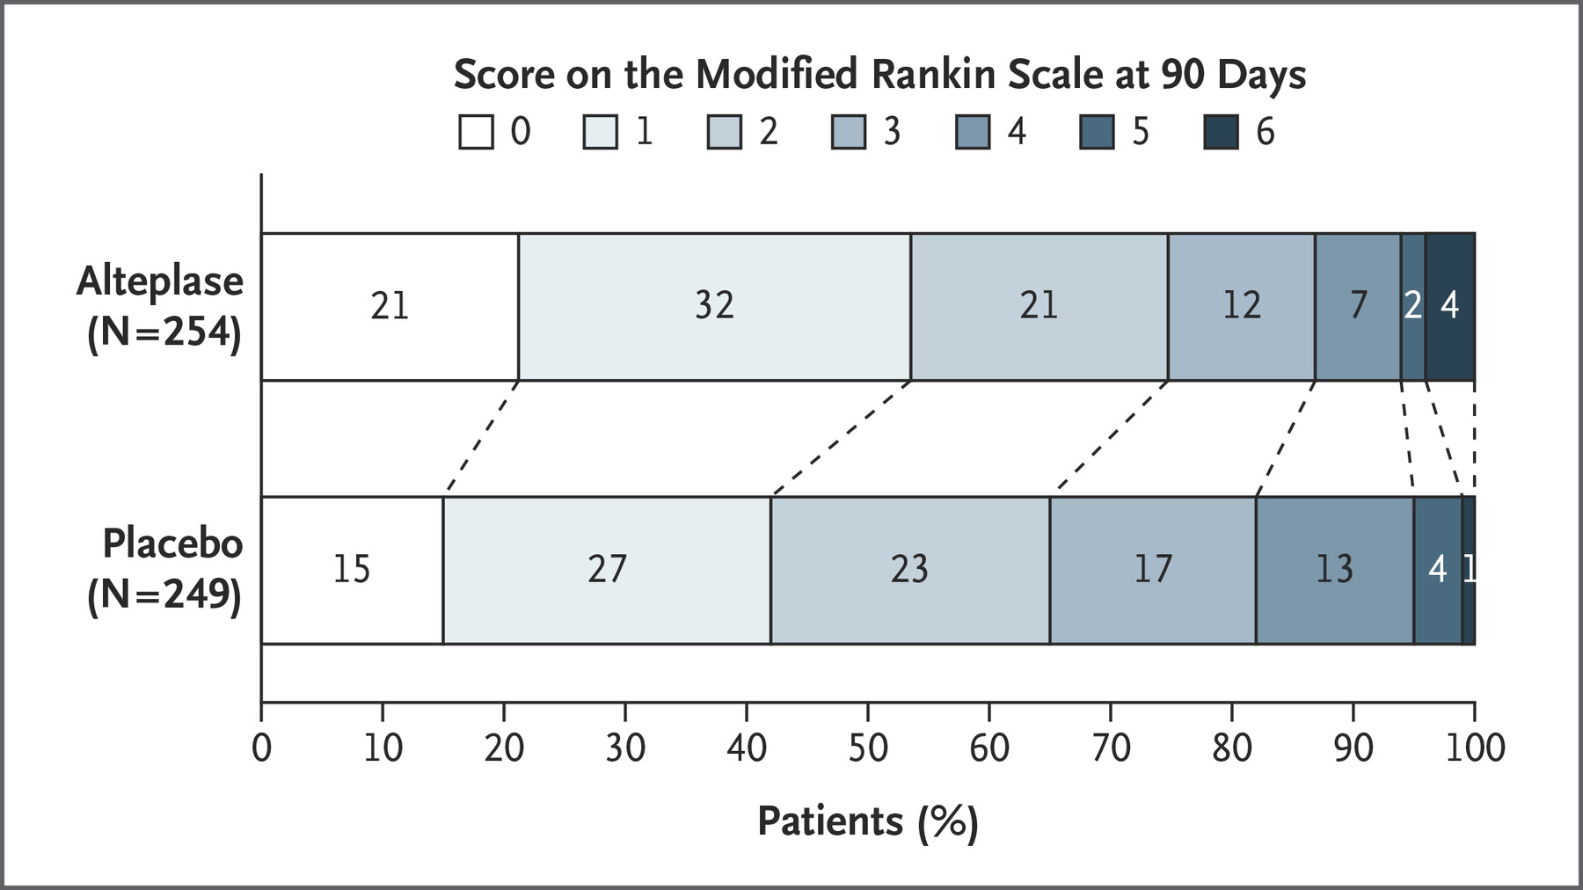
WAKE-UP Trial
Notes:
Critique
Trial was stopped prematurely due to lack of funding
Numerically higher number of deaths in alteplase group may have become statistically significant with a larger sample size
Small number of patients with NIHSS >10, limiting generalizability to that group
20% of patients enrolled in the trial could have qualified for thrombectomy in DAWN and DEFUSE (20% LVOs)

Slide 14
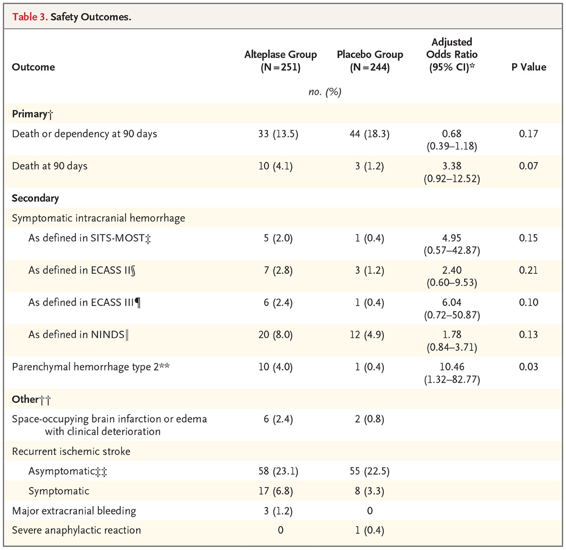
WAKE-UP Trial
Safety Outcomes
Prior thrombolytic Trials
ECASS II (N=800) | 0-6 | 5.4%
Study | Time (H) | Net sICH Rate
NINDS (N=624) | 0-3 | 5.8%
Notes:
Critique
Trial was stopped prematurely due to lack of funding
Numerically higher number of deaths in alteplase group may have become statistically significant with a larger sample size
Small number of patients with NIHSS >10, limiting generalizability to that group
20% of patients enrolled in the trial could have qualified for thrombectomy in DAWN and DEFUSE (20% LVOs)

Slide 15
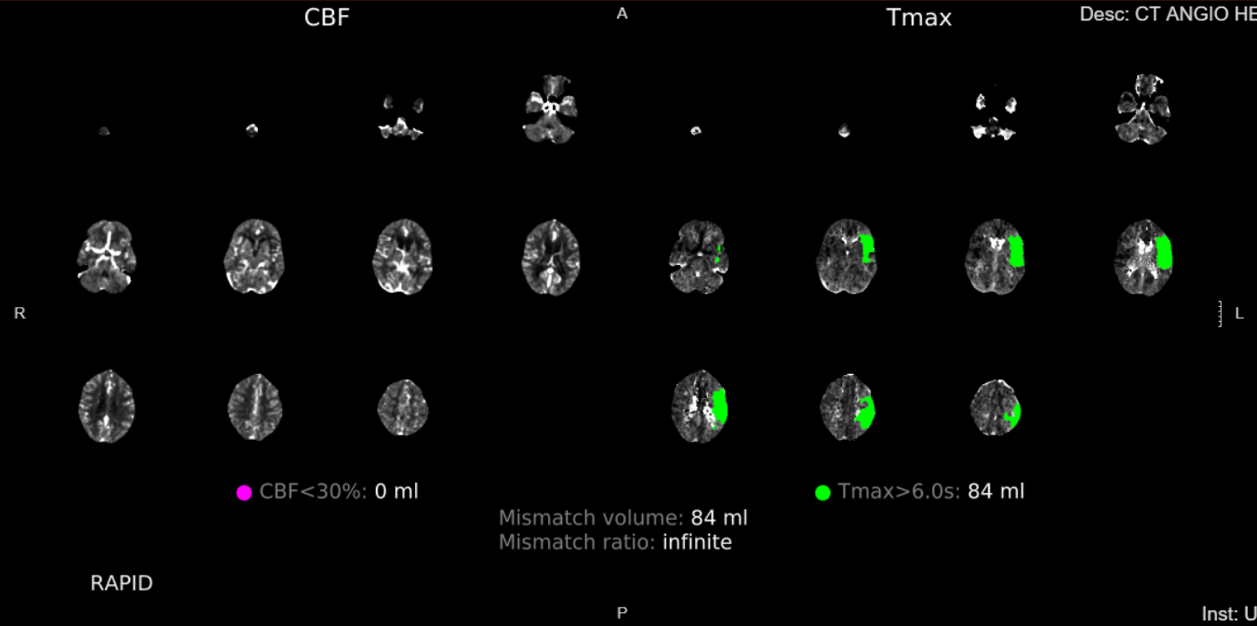
Patient Case
A 75 yo male with PMH significant for HTN, HLD, and DM presents to ED with sudden onset R-hemiparesis, dysarthria, and sensation loss.
NIHSS 7
Last known normal 10 h prior at bedtime.
Imaging on site: CT Perfusion available.
Management: ???

Slide 16
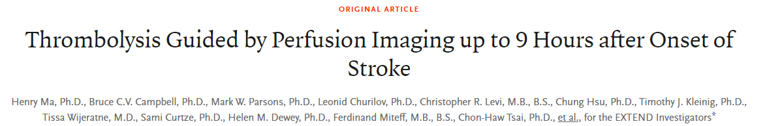
EXTEND Trial
Who: Patients with AIS (N= 225 patients)
Treatment: IV tPA within 4.5-9 h from LKN or midpoint of sleep
Advanced Imaging: CT Perfusion or MRI brain
Clinical Aspects: - Mean NIHSS (12 tPA group, 10 placebo)
- Median Core infarct size ~ 4cc
- Median time from LKW to IV tPA ~ 7h
- Median time to tPA from LKN ~10 h
Ma et al., NEJM, 2019
Notes:
~70% of cases were LVO!!!!
use of alteplase therapy in patients who had a favorable perfusion-imaging profile between 4.5 and 9 hours after stroke onset or on awakening with stroke symptoms resulted in no or minor neurologic deficits more often than the use of placebo. Because of the limited power of our conclusions as a result of premature termination of the trial and the lack of a significant between-group difference in the secondary outcome of functional improvement, further trials of thrombolysis in this time window are required

Slide 17
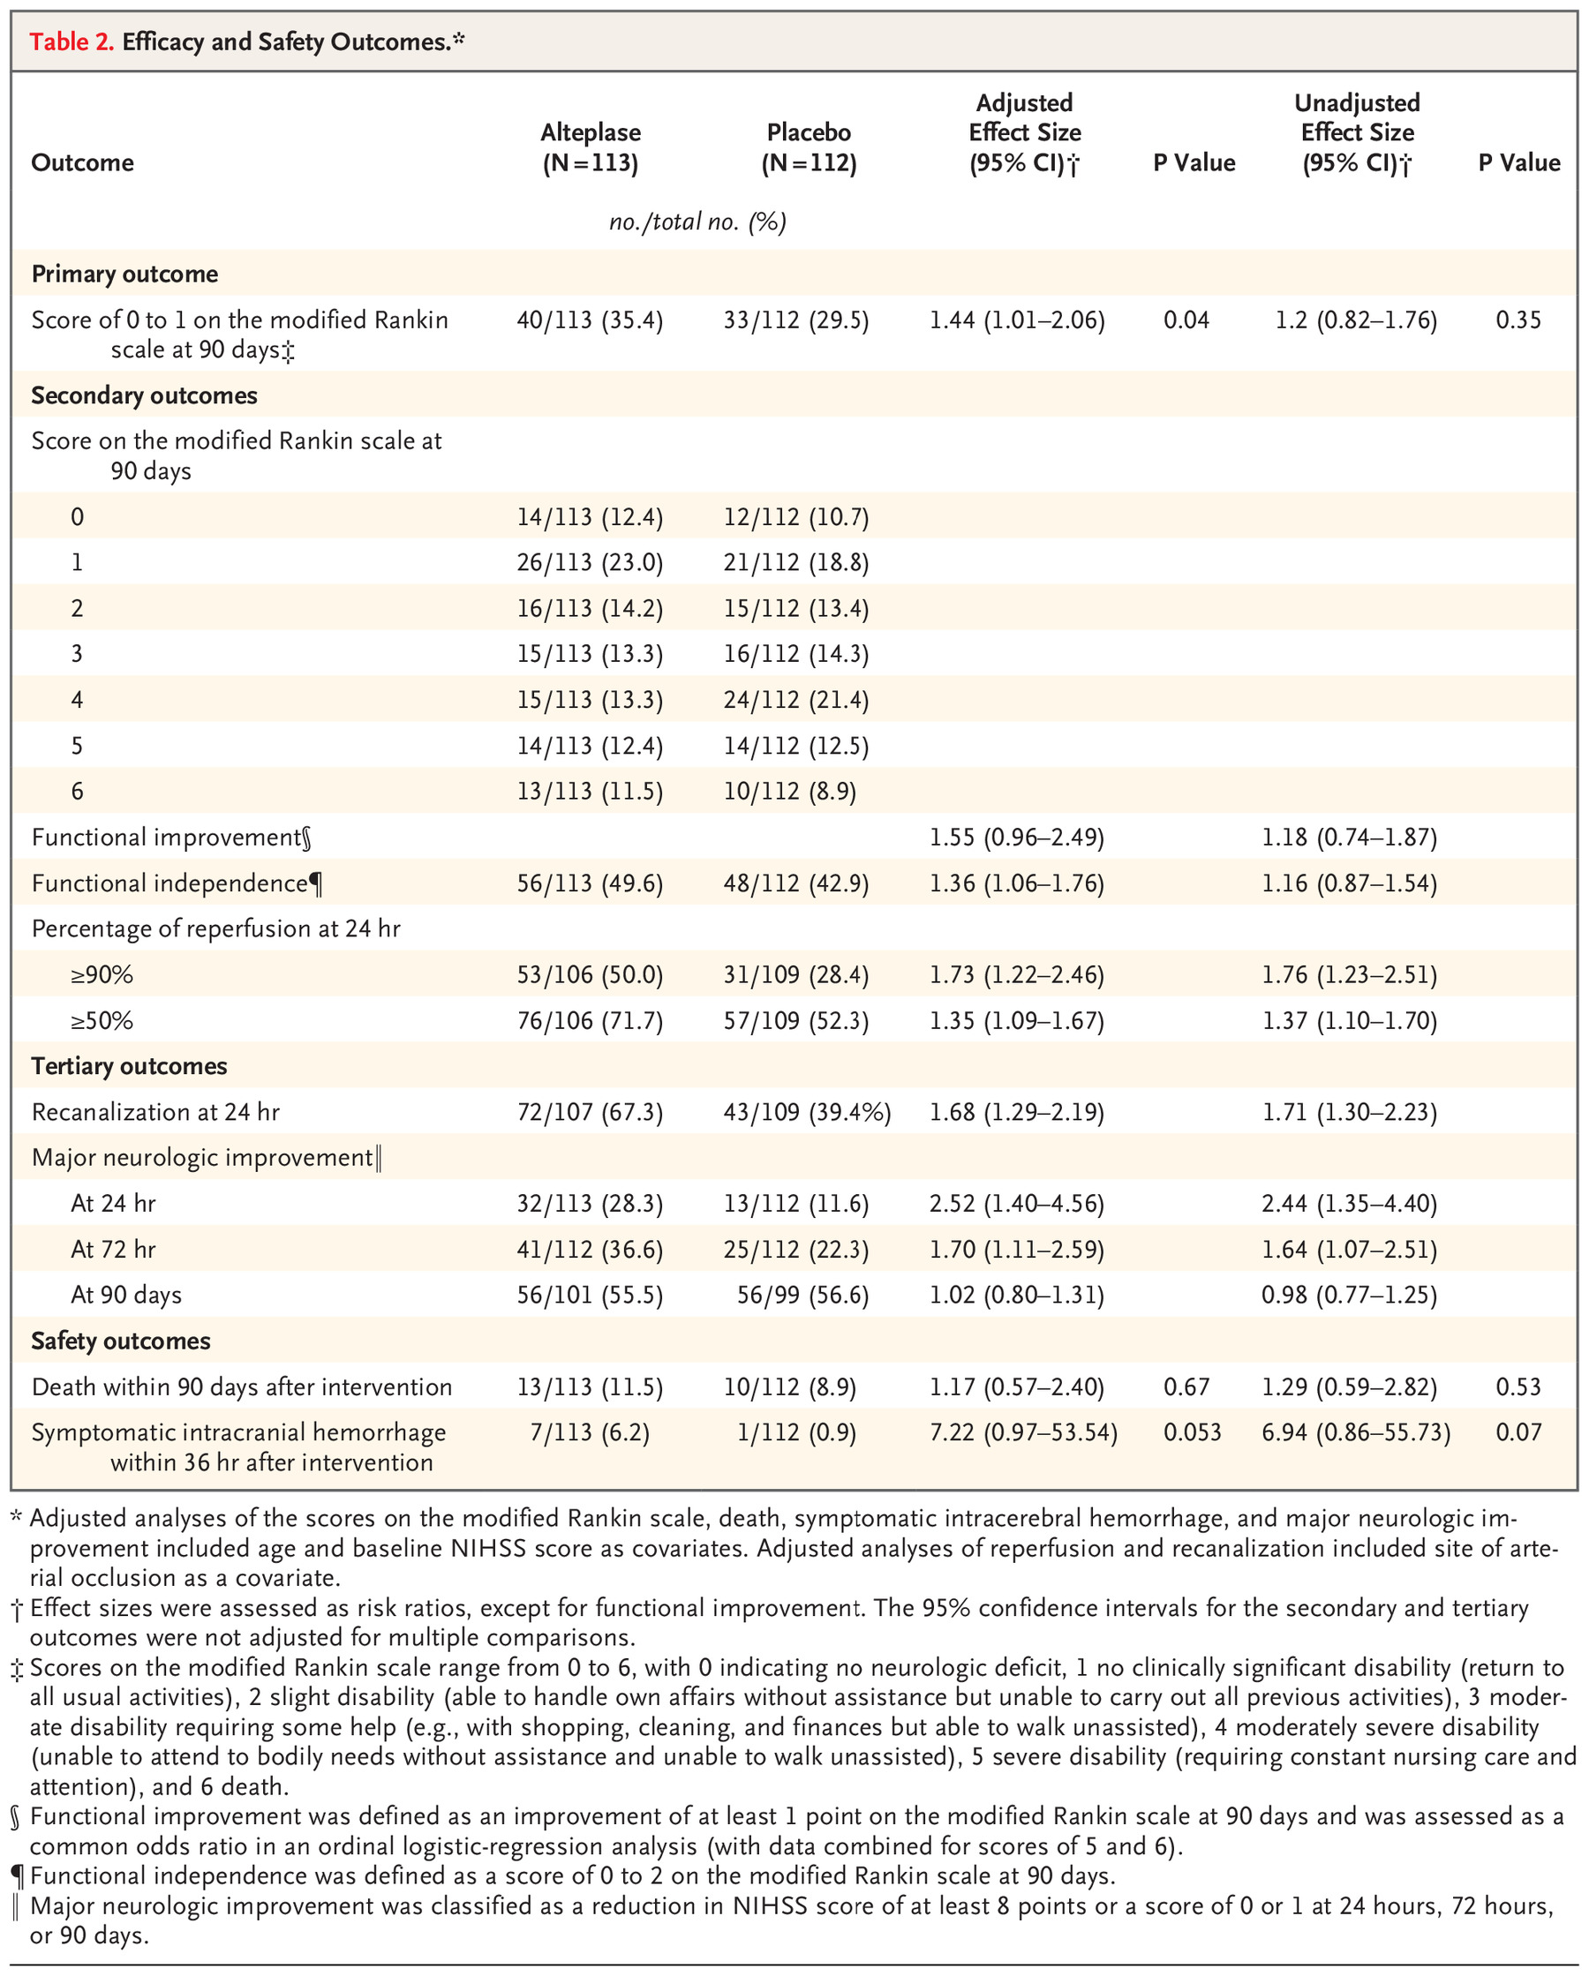
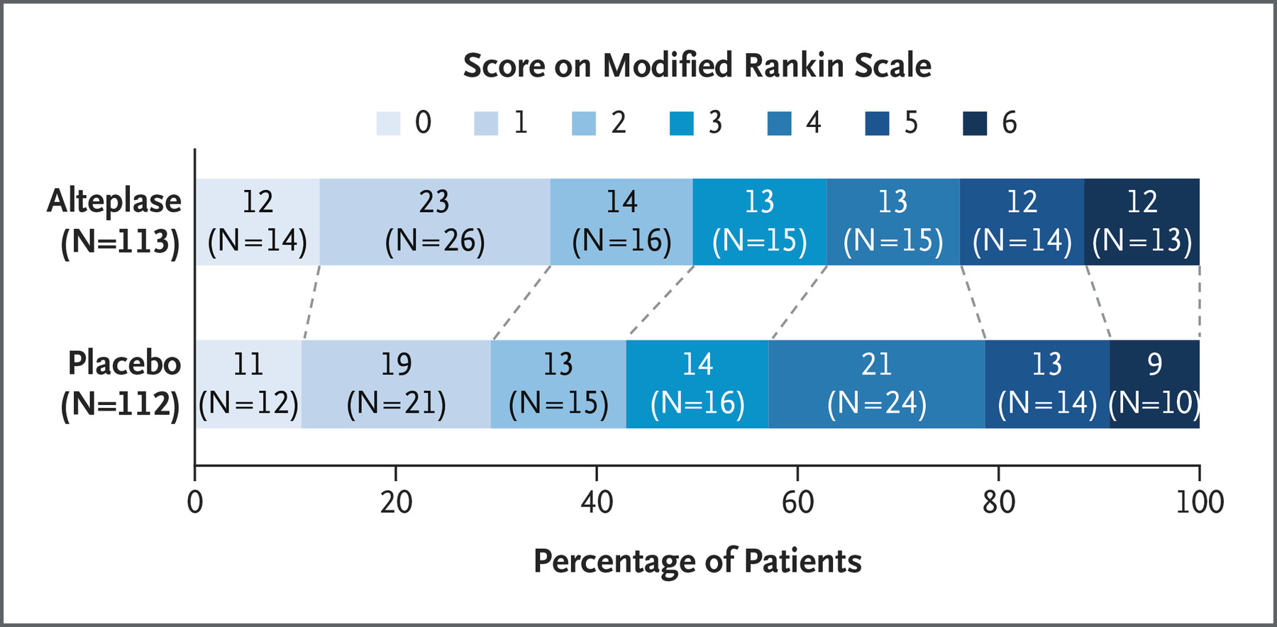
EXTEND Trial
Ma et al., NEJM, 2019
Notes:
Problems:
use of alteplase therapy in patients who had a favorable perfusion-imaging profile between 4.5 and 9 hours after stroke onset or on awakening with stroke symptoms resulted in no or minor neurologic deficits more often than the use of placebo.
Because of the some patients now who would undergo EVT (70% of these patients in trial would just go to EVT… late window)
- limited power of our conclusions as a result of premature termination of the trial
-the lack of a significant between-group difference in the secondary outcome of functional improvement, further trials of thrombolysis in this time window are required

Slide 18
EXTEND Trial
Prior thrombolytic Trials
ECASS II (N=800) | 0-6 | 5.4%
Study | Time (H) | Net sICH Rate
NINDS (N=624) | 0-3 | 5.8%
Ma et al., NEJM, 2019
Notes:
use of alteplase therapy in patients who had a favorable perfusion-imaging profile between 4.5 and 9 hours after stroke onset or on awakening with stroke symptoms resulted in no or minor neurologic deficits more often than the use of placebo. Because of the limited power of our conclusions as a result of premature termination of the trial and the lack of a significant between-group difference in the secondary outcome of functional improvement, further trials of thrombolysis in this time window are required

Slide 19
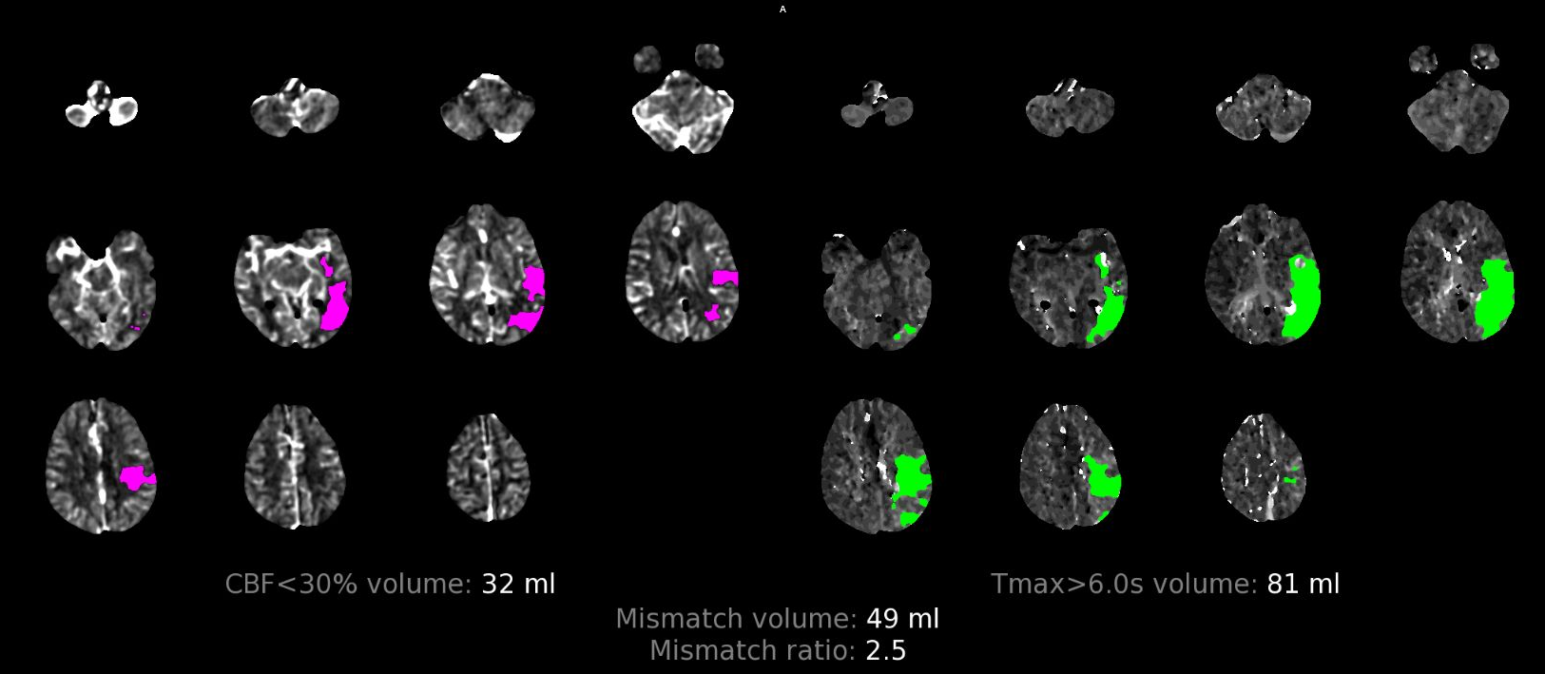
Patient Case
A 75 yo male with PMH significant for HTN, HLD, and DM presents to ED with sudden onset R-hemiparesis, dysarthria, sensation loss, and aphasia.
NIHSS 16
His last known normal 14 h prior.
Imaging on site: CT Perfusion available.
Management: ???

Slide 20
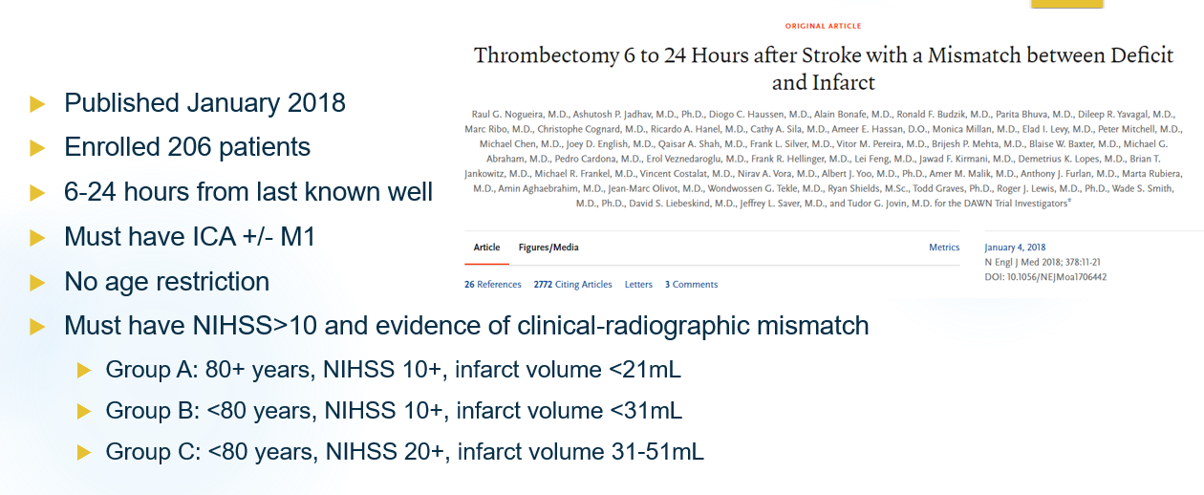
Extended Endovascular Time Window – DAWN Trial
Nogueira et al., NEJM, 2018

Slide 21
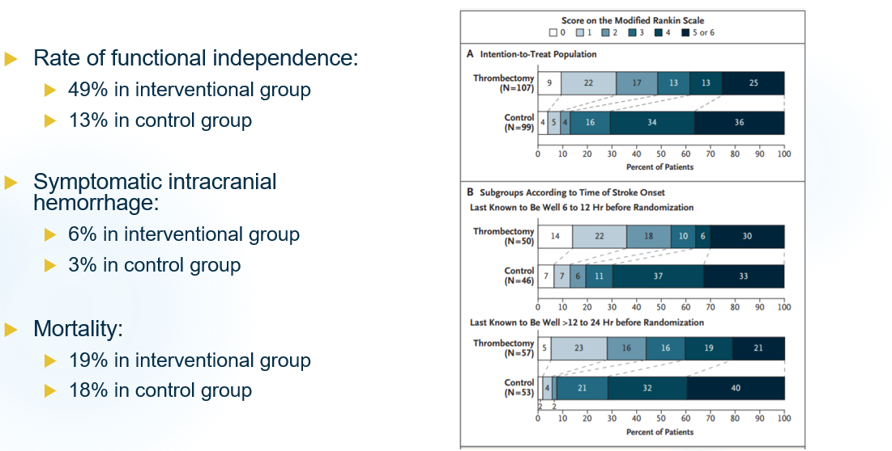
Extended Endovascular Time Window – DAWN Trial
Nogueira et al., NEJM, 2018

Slide 22
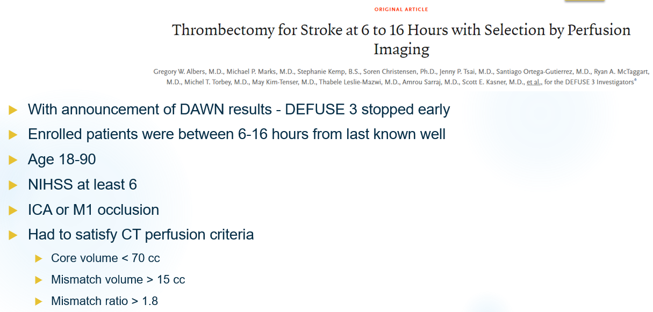
Extended Endovascular Time Window – DEFUSE 3 Trial
Albers et al., NEJM, 2018

Slide 23
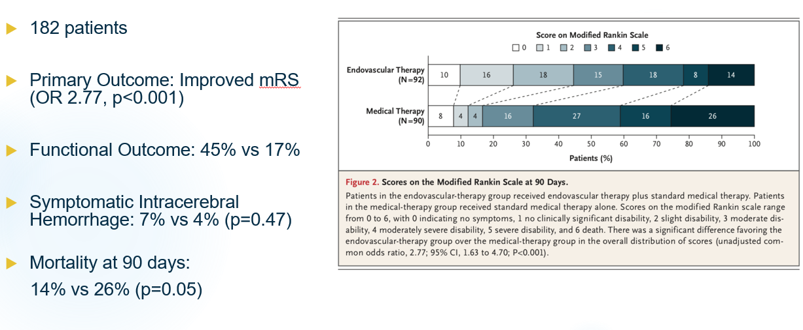
Extended Endovascular Time Window – DEFUSE 3 Trial
Albers et al., NEJM, 2018.

Slide 24
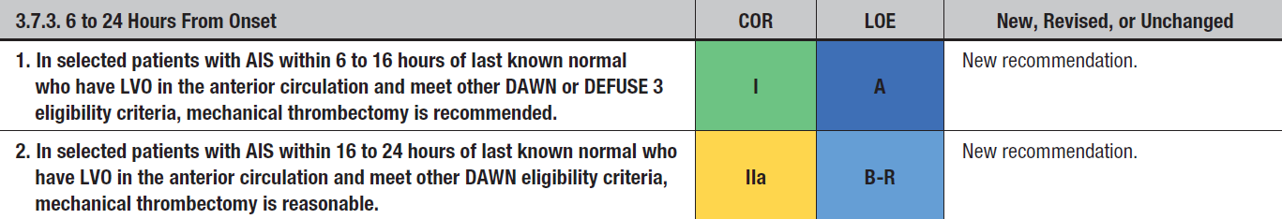
2019 Update to the 2018 Guidelines for the Early Management of Acute Ischemic Stroke
Endovascular Management of Acute Ischemic Stroke – 6-24 hours LKN
Notes:
DAWN, DEFUSE 3 trials
OF NOTE… Basilar and large core EVT trials left out as not in the guidelines

Slide 25
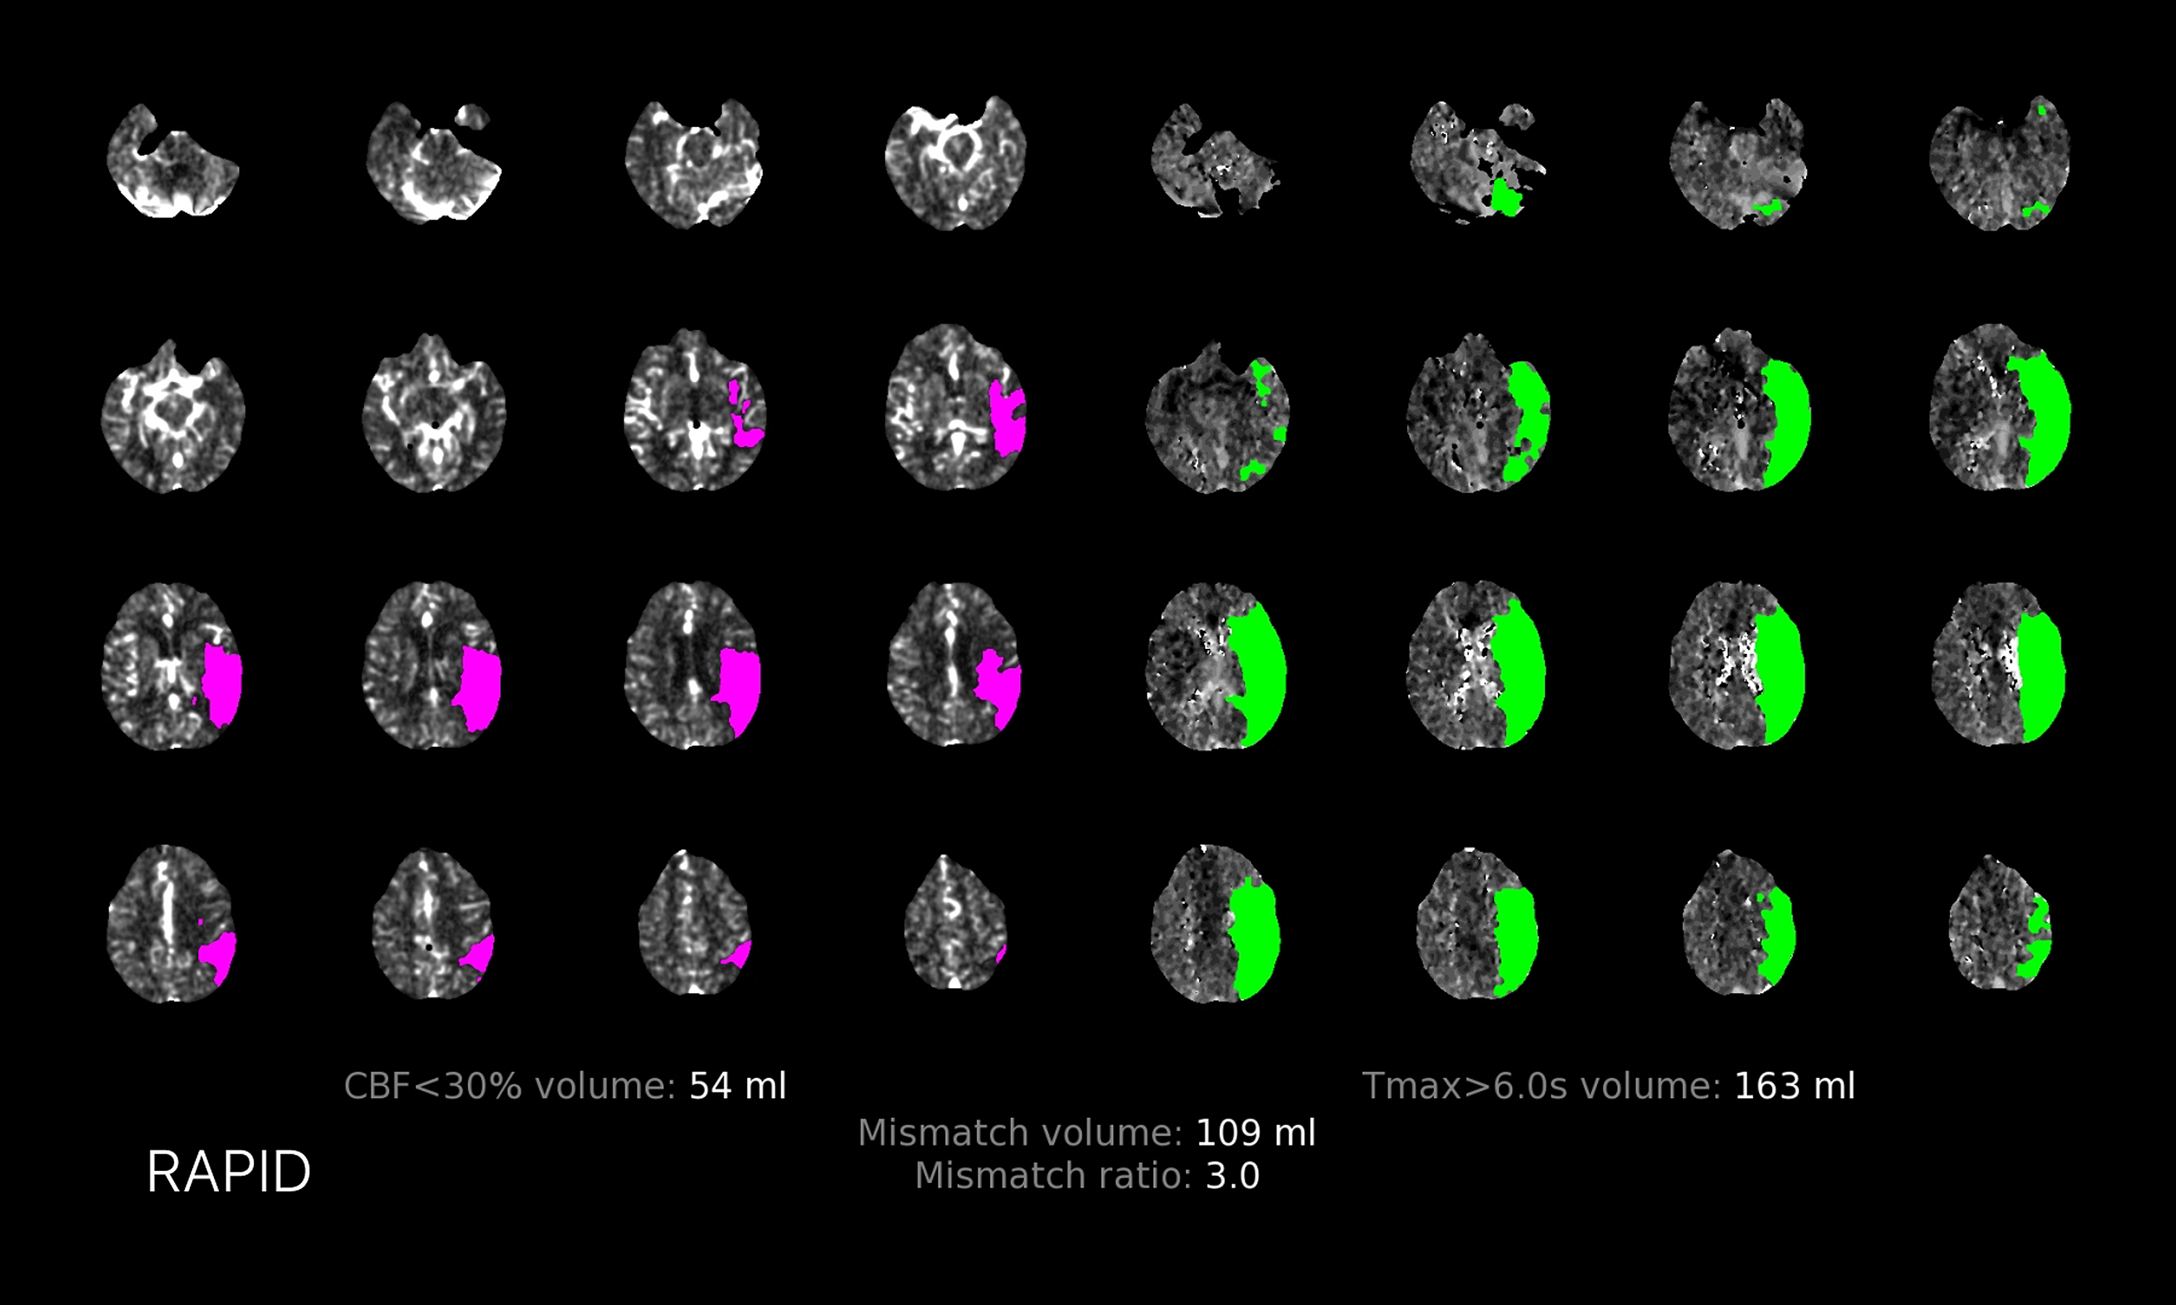
Everything solved?
A 75 yo male with PMH significant for HTN, HLD, and DM presents to ED with sudden onset R-hemiparesis, dysarthria, and sensation loss.
Which Last Known Normal Corresponds to CTP?
Last known normal: 2 hours
Last known normal: 6 hours
Last known normal: 10 hours
Last known normal: 26 hours
Notes:
Various things that influence how long you can be supported by collaterals….
Ability to augment BP (septic, drugs, other reasons), degree of collaterals (genetic or 2/2 chronic disease), etc

Slide 26
Tissue vs Time in acute ischemic stroke
Which patients are the problem?
Acute ischemic stroke patients with reassuring CT perfusion or MRI FLAIR/DWI mismatch, but…
1. Not in extended tPA window (up to 9 h from LKN)
2. Not in 24 h mechanical thrombectomy window
3. Have significant enough disability to merit consideration
Notes:
First of all rare
Various things that influence how long you can be supported by collaterals….
Ability to augment BP (septic, drugs, other reasons), degree of collaterals (genetic or 2/2 chronic disease), etc

Slide 27
Objectives
Define evidence based “time windows” for thrombolytic and endovascular treatment of acute ischemic stroke (AIS)
Define evidence behind “extended time windows” for AIS therapies
Identify scenarios in which “time limits” may be less critical in decision making
Identify imaging modalities to utilize in decision making
Text
• Bullet
- patient cases (Last seen vs last known normal… tPA vs endo)
- AHA guidelines
- studies
classic trials…. tPA – NINDS, ECASS III (3-4.5 hours)
…. EVT… DAWN/DEFUSE/BASILAR…. 24 hour trials….)
- perfusion extended trials (wake up, extend)
- Large Core Trials
- retrospective/cohort data out of time windows…
Definitions of stuff?
What is time really? Proxy for bleeding risk/lack of benefit (large core destroyed the latter)

Slide 28
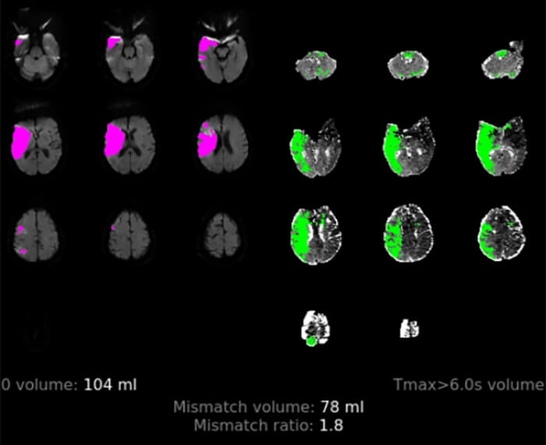
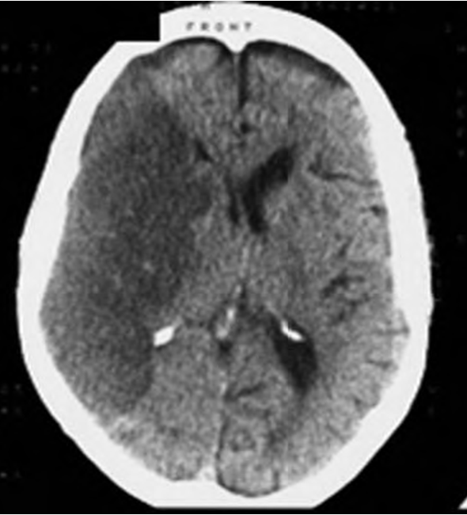
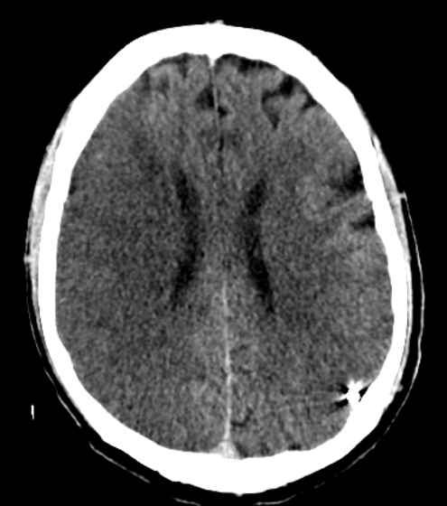
Scenarios in which “time limits” may be less critical
Endovascular Therapy (>24 h)
Common Scenarios
1. Large Core thrombectomy
2. Last seen “normal” vs last “seen”
Key Factor
Early ischemic changes vs established infarct
Notes:
Less common because most people come in by 24 hours due to the disabling nature of LVO. And 24 hours is enough time to get in.

Slide 29
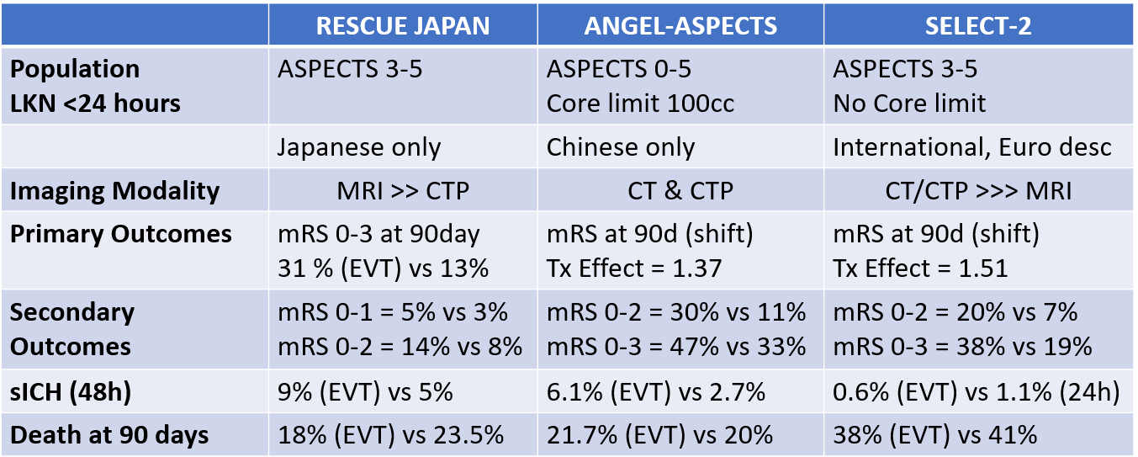
Large Core Thrombectomy Trials
x III
1 slide to show there can be benefit even in cases that look horrible…. So does it matter if 26 hours?
Or is it more how established infarct is?

Slide 30
Scenarios in which “time limits” may be less critical
Thrombolytic Therapy (>9 h)
Common Scenarios
“Slow progressors” (robust collaterals)
Wake up strokes
Motor Lacunar Stroke Syndromes (lack of MRI, perfusion isn’t for non-lvo)
Patient Specific Eloquent functions
Key Factor
Is there enough disability to justify the uncertainty?
General size of the infarcted territory?
Notes:
Less common because most people come in by 24 hours due to the disabling nature of LVO. And 24 hours is enough time to get in.

Slide 31
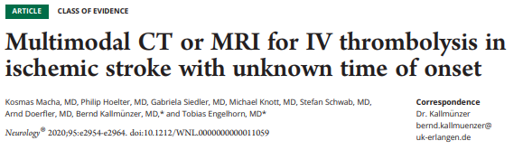
Neurology Retrospective Cohort study
Study: - Retrospective analysis
- efficacy/safety in unknown or extended time window using MRI or CT perfusion.
- All received IV tPA
Groups: 100 participants CT imaging 84 participants MR imaging
Safety Outcome: Any ICH, sICH, death at 90 days
Efficacy Outcomes: Early neurologic improvement, mRS at 90 days
Macha et al., Neurology, 2020
Notes:
Nothing randomized… just retrospective

Slide 32
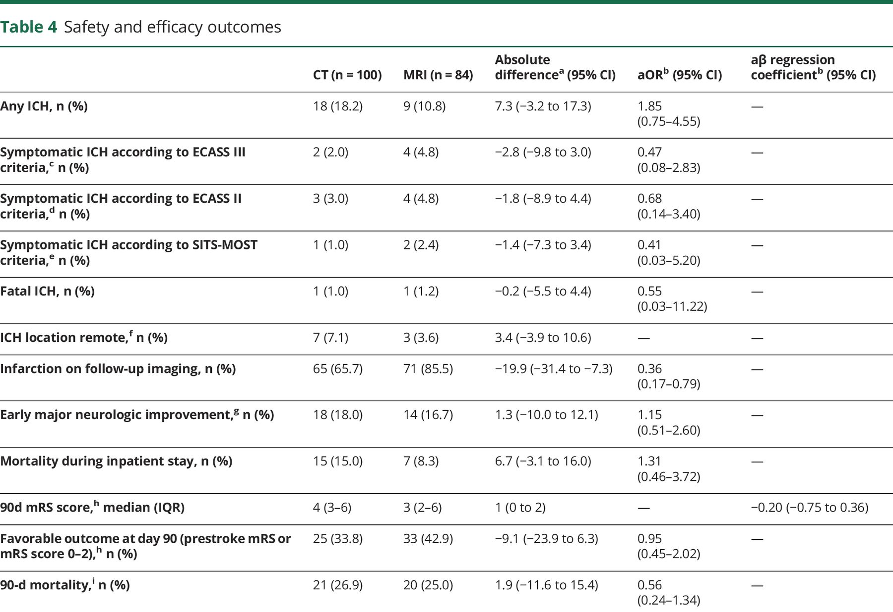
Neurology Retrospective Cohort study
Prior thrombolytic Trials
ECASS II (N=800) | 0-6 | 5.4%
Study | Time (H) | Net sICH Rate
NINDS (N=624) | 0-3 | 5.8%
Macha et al., Neurology, 2020
Notes:
Two randomized controlled trials of IV alteplase using perfusion imaging for selection of patients with stroke up to 9 hours from LKW have been completed. Both trials ended early: ECASS-4 (European Cooperative Acute Stroke Study 4) due to slow recruitment³ and the EXTEND trial (Extending the Time for Thrombolysis in Emergency Neurological Deficits) was stopped prematurely after the publication of the WAKE-UP trial
An individual patient data meta-analysis that included patients from 3 randomized studies of IV alteplase in patients treated beyond 4.5 hours of onset or wake-up stroke (EXTEND, ECASS-4, and EPITHET [Echoplanar Imaging Thrombolytic Evaluation Trial]) and having salvageable brain tissue on imaging (target mismatch defined as a core of <70 mL, mismatch volume >10 mL, and mismatch ratio >1.2.) found a significant benefit of alteplase: 76/211 (36%) patients treated with alteplase and 56/199 (29%) in the placebo group had an excellent outcome (modified Rankin Scale score 0–1) at 90 days (odds ratio 1.86, 95% confidence interval 1.15–2.99
Victor editorial -- Multimodal imaging selection for IV alteplase in unknown time of onset stroke | Neurology

Slide 33
Summary
Robust evidence for IV thrombolytics up to 4.5 hours.
Emerging data for modest benefit up to 9 hours in select patients with advanced imaging tools. Numerically more hemorrhages.
Robust evidence for mechanical thrombectomy up to 24 hours, even with large core infarcts.
No quality evidence for interventions outside of time window, but advanced imaging provides useful information that may help select patients outside window.

Slide 34


Questions

Slide 35
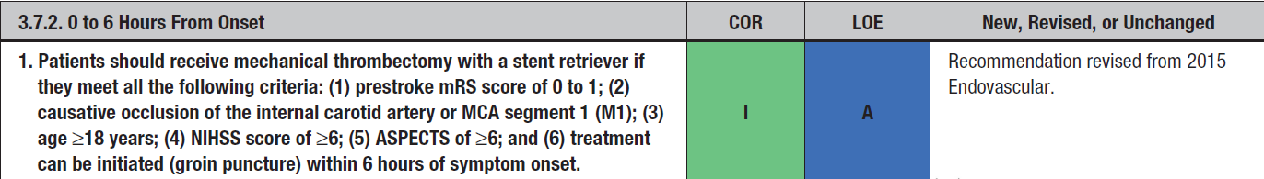
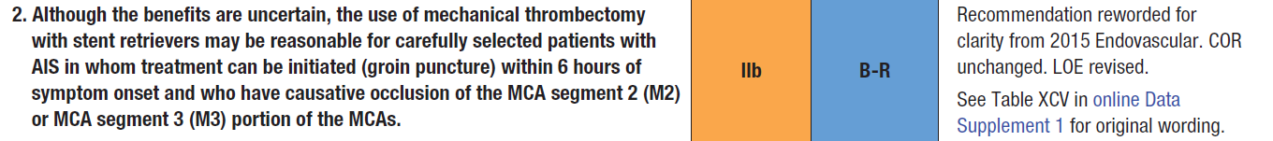
American Heart Association – Acute Ischemic Stroke, 2019
2019 Update to the 2018 Guidelines for the Early Management of Acute Ischemic Stroke
Endovascular Management of Acute Ischemic Stroke – 0-6 hours from LKN
Notes:
CLEAN, SWIFT PRIME, EXTEND-IA, ESCAPE, REVASCAT, THRACE (HERMES and SEER Collaboration studied both are Pooled patient level data)

Slide 36
American Heart Association – Acute Ischemic Stroke, 2019
2019 Update to the 2018 Guidelines for the Early Management of Acute Ischemic Stroke
Endovascular Management of Acute Ischemic Stroke – 0-6 hours from LKN
Notes:
CLEAN, SWIFT PRIME, EXTEND-IA, ESCAPE, REVASCAT, THRACE (HERMES and SEER Collaboration studied both are Pooled patient level data)

