Slide 1


Stroke Syndromes
Not To Miss
Garrett Conyers, MD, MPP
Assistant Professor
Department of Neurology
University of Michigan
January 13-16, 2024
Key Largo, Florida

Slide 2
Disclosures
I have no disclosures

Slide 3
Objectives
Identify frequently missed posterior circulation stroke syndromes
Develop structured approach to patients with posterior circulation symptoms
Recognize common pitfalls & pearls of acute stroke diagnosis in patients with dizziness

Slide 4
Patient Case
75 year old female with past medical history of hypertension, hyperlipidemia and diabetes who presents to the emergency room with dizziness and headache.
Is this a clinically relevant problem?
Notes:
Note… not talking about focal weakness, dysarthria, eye movements issues, ataxia, etc

Slide 5
The 3 C’s of Dizziness
Dizziness is common
    4% of ED CCs (+26% secondary complaint)
    4 Million visits/yr US
Dizziness is costly
    4 Billion USD/year in ED vertigo visits
Dizziness is complex
    35% of posterior fossa strokes are missed.
Saber, et al. Acad Emerg Med, 2013
Notes:
animate

Slide 6
Dizziness and Stroke
Of the 4.4 million emergency department (ED) visits/year US….
Strokes are 3-5% of such visits (130–220k per year )
Stroke visits cost ~ $10 billion per year
    Neuroimaging
    Inpatient hospital admissions
90% of the isolated posterior circulation TIAs were not recognized at first medical contact (Paul et al., Lancet Neurol, 2013)
    half of these were for isolated vertigo
Saber, et al. Acad Emerg Med, 2013
Notes:
Given their low sensitivity (7%–16%),12 computed tomography (CT) scans are of little use for identifying acute ischemic
strokes,13 particularly in the posterior fossa.
Despite this, nearly 50% of US ED patients presenting dizziness are imaged by CT, and <3% by magnetic resonance imaging (MRI)
Population-based registry showed that… 90% of isolated posterior circulation TIAS
Transition – so why so difficult??? → Brain stem anatomy
Of the˜130 000 to 220 000 patients with stroke presenting with vertigo or dizziness to the ED, it is estimated that perhaps 45 000 to 75 000 are initially missed,3 with misdiagnosis disproportionately ,3 affecting the young (age<50), women, and minorities.

Slide 7
Why is this so challenging?
Brainstem Anatomy
Notes:
Transition – so why so difficult??? → Brain stem anatomy
Of the˜130 000 to 220 000 patients with stroke presenting with vertigo or dizziness to the ED, it is estimated that perhaps 45 000 to 75 000 are initially missed,3 with misdiagnosis disproportionately ,3 affecting the young (age<50), women, and minorities.

Slide 8
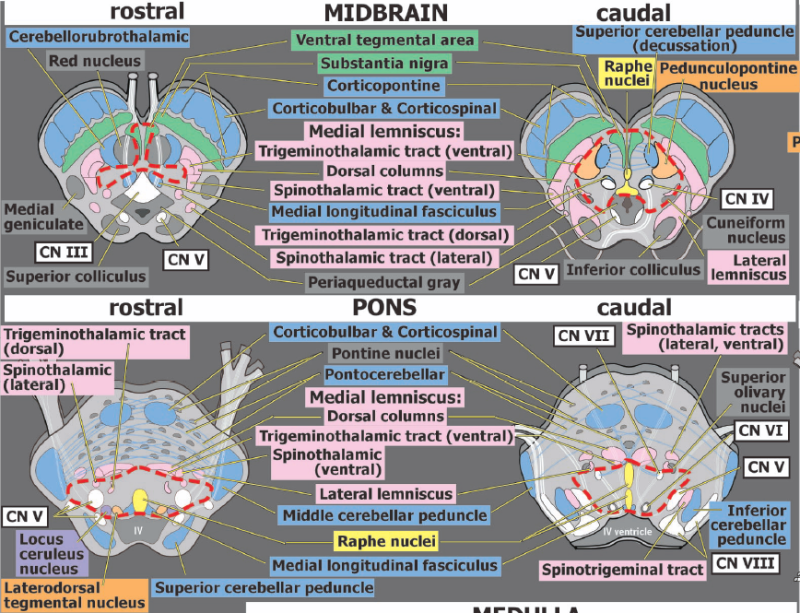
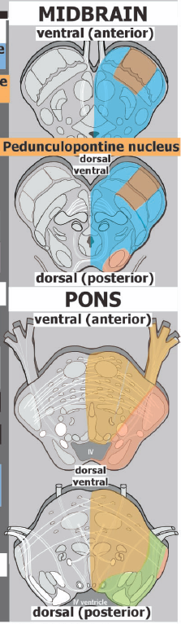
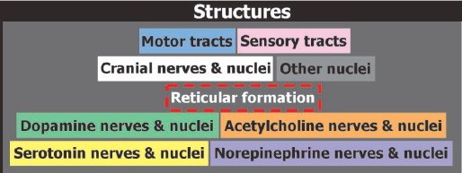
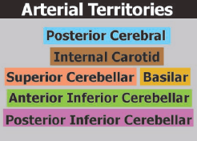
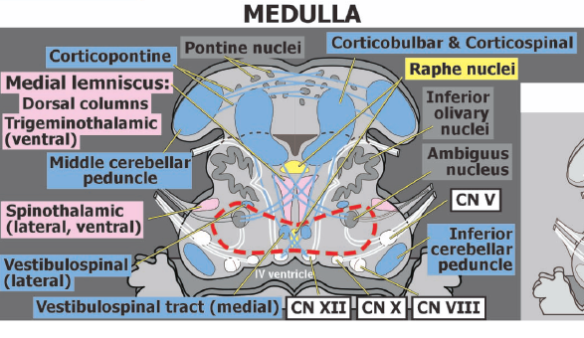
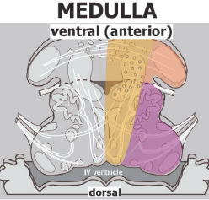
. 2010 Winte
Hurley et al., J Neuropsychiatry Clin Neurosci, 2010
Notes:
Transition – so why so difficult??? → Brain stem anatomy
Of the˜130 000 to 220 000 patients with stroke presenting with vertigo or dizziness to the ED, it is estimated that perhaps 45 000 to 75 000 are initially missed,3 with misdiagnosis disproportionately ,3 affecting the young (age<50), women, and minorities.

Slide 9
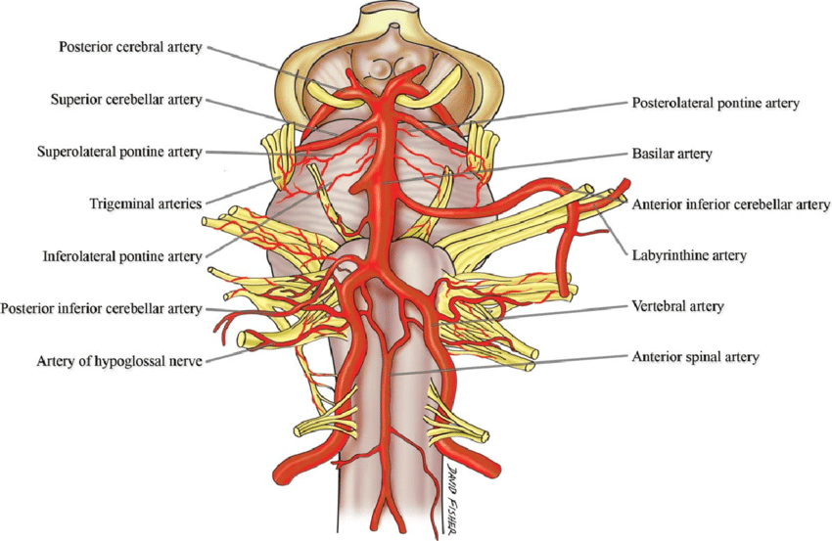
Simplified Brainstem Anatomy & Function
Midbrain
  Cranial nerve 3, 4 - Ipsilateral
  Weakness, sensory loss - Contralateral
  Ataxia - Contralateral
Pons
  Cranial nerve 5, 6, 7 - Ipsilateral
  Weakness – Contralateral
  Sensory loss- Contralateral
Medulla
  Cranial nerve 8, 9, 10, 12 - Ipsilateral
  Ataxia - Contralateral
  Sensory loss - Contralateral
  Autonomic dysfunction/vertigo lateral syndrome
Hendrix et al. Clinical Anatomy, 2014
Notes:
Key line: focus on anatomy rather than syndromes
Simplified… of course exceptions like how CN 5 nucleus spans all… etc

Slide 10
Simplified Brainstem Anatomy & Function
Midbrain
  Cranial nerve 3, 4 - Ipsilateral
  Weakness, sensory loss - Contralateral
  Ataxia - Contralateral
Pons
  Cranial nerve 5, 6, 7 - Ipsilateral
  Weakness – Contralateral
  Sensory loss- Contralateral
Medulla
  Cranial nerve 8, 9, 10, 12 - Ipsilateral
  Ataxia - Contralateral
  Sensory loss - Contralateral
  Autonomic dysfunction/vertigo lateral syndrome
Hendrix et al. Clinical Anatomy, 2014
Notes:
Simplified… of course exceptions like how CN 5 nucleus spans all… etc

Slide 11
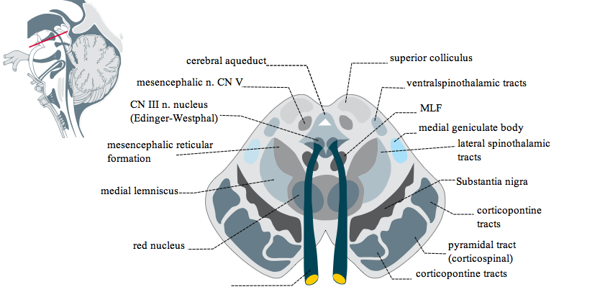
Stroke Syndromes
Tegmental Midbrain (Claude Syndrome)
3rd cranial nerve
Medial lemniscus
Cerebellothalamic tracts
Symptoms
3rd nerve Palsy - ipsilateral
Ataxia, vertigo - contralateral
+/- tremor - contralateral
Notes:
Classically: 3rd nerve palsy and contralateral ataxia
Contralateral ataxia due to interruption of cerebellar thalamic fibers
Contralateral tremor due to damage to red nucleus
Can have has contralateral sensory loss
Ipsilateral 3rd nerve palsy

Slide 12
Stroke Syndromes
Paramedian Midbrain (Benedikt Syndrome)
3rd cranial nerve
Cortical-spinal tract
Red Nucleus
Cerebellothalamic tract
Symptoms
3rd nerve Palsy - ipsilateral
Ataxia, vertigo - contralateral
Weakness - contralateral
+/- tremor or chorea – contralateral
+/- sensory loss - contralateral
Notes:
Classically: 3rd nerve palsy and contralateral ataxia
Contralateral ataxia due to interruption of cerebellar thalamic fibers
Contralateral tremor due to damage to red nucleus
Can have has contralateral sensory loss
Ipsilateral 3rd nerve palsy

Slide 13
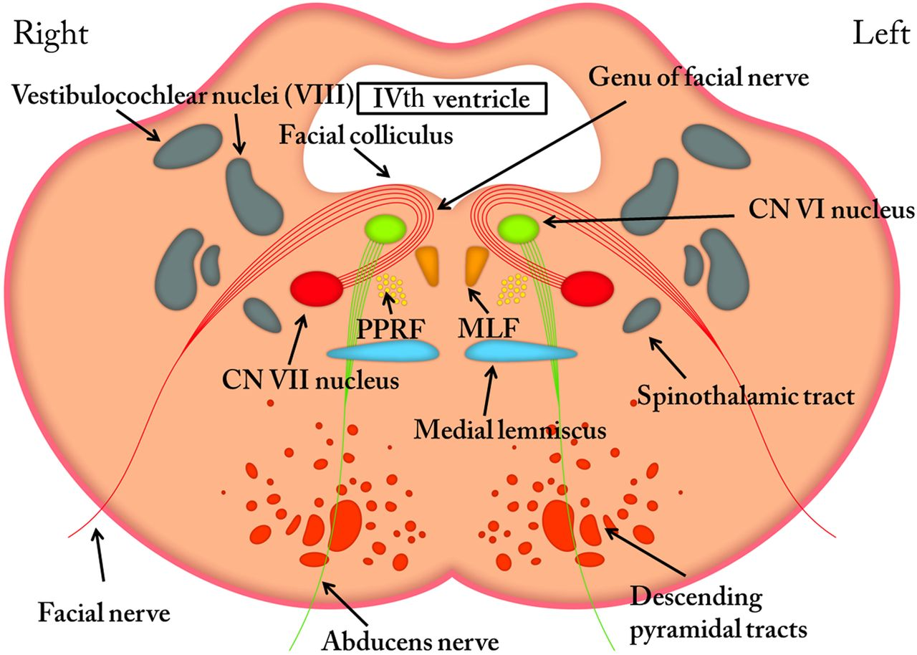
Stroke Syndromes
Lacunar Pontine Syndromes
Rostral pons
  Isolated facial sensory loss
  Fine Touch or pain loss
Mid pons
  Isolated hemiataxia
  Pure motor hemiparesis
  Ipsilateral 7th palsy
Caudal pons
  Infranuclear ophthalmoplegia, MLF
  ipsilateral 6th/7th nerve palsy syndrome
  Pure spinothalamic sensory loss
  Superior/middle/inferior cerebellar peduncles (vertigo/ataxia), Deep cerebellar nuclei
Evans et al, Prac Neuro, 2016
Notes:
Work on caudal pons… new graphic?
PUT IPSILATEERAL or CONTRALATERAL ON FINAL SLIDES
Transition – What about the rest of the syndromes??? Without weakness or obvious signs… patient case?

Slide 14
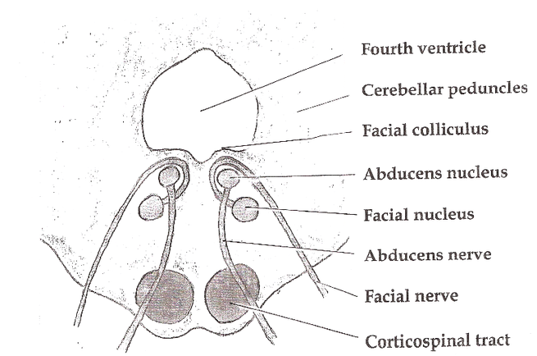
Stroke Syndromes
Lateral Pontine Syndrome (AICA)
Inferior/superior cerebellar peduncle
5th cranial nerve nucleus
7th cranial nerve fascicles
Cochlear nucleus
Vestibular nucleus
Symptoms
Ataxia, vertigo (ipsilateral), +/- nystagmus/nausea
Facial sensory loss (ipsilateral), Arm/leg sensory loss (contralateral)
Hearing loss (ipsilateral)
+/- facial weakness (ipsilateral)
Notes:
ehhh

Slide 15
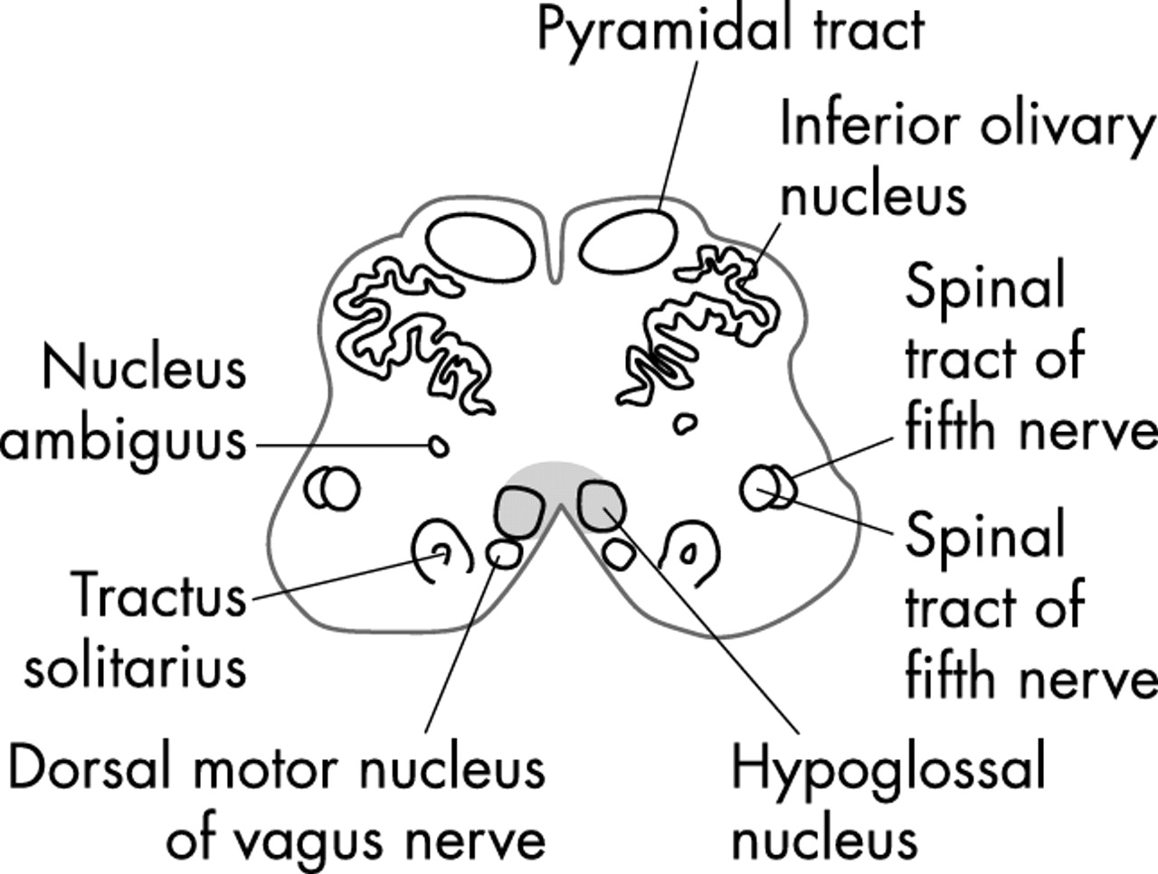
Stroke Syndromes
Lateral Medullary (Wallenberg Syndrome)
Sympathetic tract Vestibular Nuclei
Lateral spinothalamic tract Nucleus ambiguous
Spinocerebellar tract Spinal Trigeminal Nuclei
Symptoms
Sensory loss face (ipsilateral) & body (contralateral)
Ataxia (ipsilateral)
Vertigo +/- nystagmus, diplopia, nausea
Horner’s syndrome (ipsilateral)
Dysphagia
+/- hiccups
Notes:
Classically: 3rd nerve palsy and contralateral ataxia
Contralateral ataxia due to interruption of cerebellar thalamic fibers
Contralateral tremor due to damage to red nucleus
Can have has contralateral sensory loss
Ipsilateral 3rd nerve palsy

Slide 16
Stroke Syndromes
Medial Medullary (Dejerine Syndrome)
Hypoglossal nucleus
Medullary pyramid
Medial lemniscus
Symptoms
Tongue deviation - ipsilateral
Weakness – contralateral
Sensory loss - contralateral
Notes:
Classically: 3rd nerve palsy and contralateral ataxia
Contralateral ataxia due to interruption of cerebellar thalamic fibers
Contralateral tremor due to damage to red nucleus
Can have has contralateral sensory loss
Ipsilateral 3rd nerve palsy

Slide 17
Patient Case
75 year old female with past medical history of hypertension, hyperlipidemia and diabetes who presents to the emergency room with dizziness and headache.
How do you differentiate among the many causes of vertigo?
Notes:
Note… not talking about focal weakness, dysarthria, eye movements issues, ataxia, etc
But we are neurology… it must be fine… NOPE

Slide 18
Differential for vertigo
  Non-Neurologic
  Orthostatic Hypotension/presyncope
  Hypotension
  Cardiac Arrhythmia
  Hypoglycemia
  Anemia
  Pulmonary Embolism
  Aortic Dissection
  Medication Side Effect
  Toxic exposure Wernicke’s Syndrome
  Alcohol Intoxication
  Panic/anxiety attack
  Neurologic
  Stroke/TIA (Brainstem/cerebellum)
  Vertebral Artery Dissection
  Wernicke’s Syndrome
  Binocular Diplopia
  Vestibular Migraine
  Vestibular Neuritis
  Vestibulopathy
  Benign Paroxysmal Positional Vertigo
  Perceptual Postural Positional Dizziness
  Meniere’s Disease
  Superior Canal Dehiscence
Notes:
Toxic exposure (E.g CO poisoning)

Slide 19
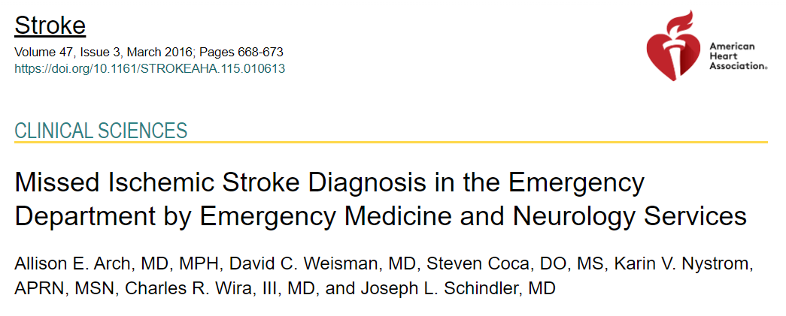
What strokes are being missed?
Study Participants:
  465 acute ischemic stroke patients (academic & community hospital)
Clinical Aspects:
  Missed strokes
  Site location, services involved, time window, anatomic location
  Presenting stroke symptoms and exam findings
Notes:
Retrospective Chart Review (Yale University ED, and and Abington Hospital (Jefferson, PA.. Community hospital)
- anterior and posterior…
- symptoms that are missed (problem with posterior).. Use their tables
- But still are some anterior issues and issues with weakness… talk about the typical brainstem syndromes…
Missed Ischemic Stroke Diagnosis in the Emergency Department by Emergency Medicine and Neurology Services | Stroke (ahajournals.org)

Slide 20
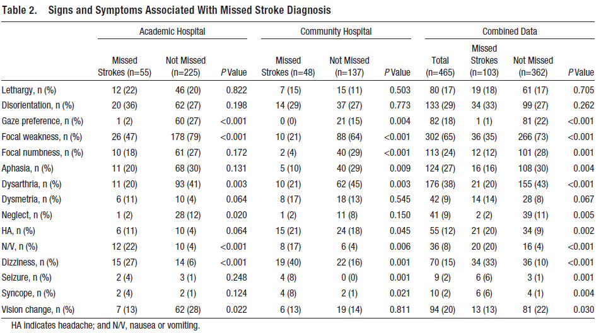
What strokes are being missed?
Arch et al. Stroke 2016
Notes:
In addition to problems with stroke, many acutely dizzy patients with peripheral vestibular causes for their symptoms are overtested, misdiagnosed, and
undertreated.21 The costs of unnecessary imaging and hospital admissions for these patients waste an estimated $1 billion each year.3

Slide 21
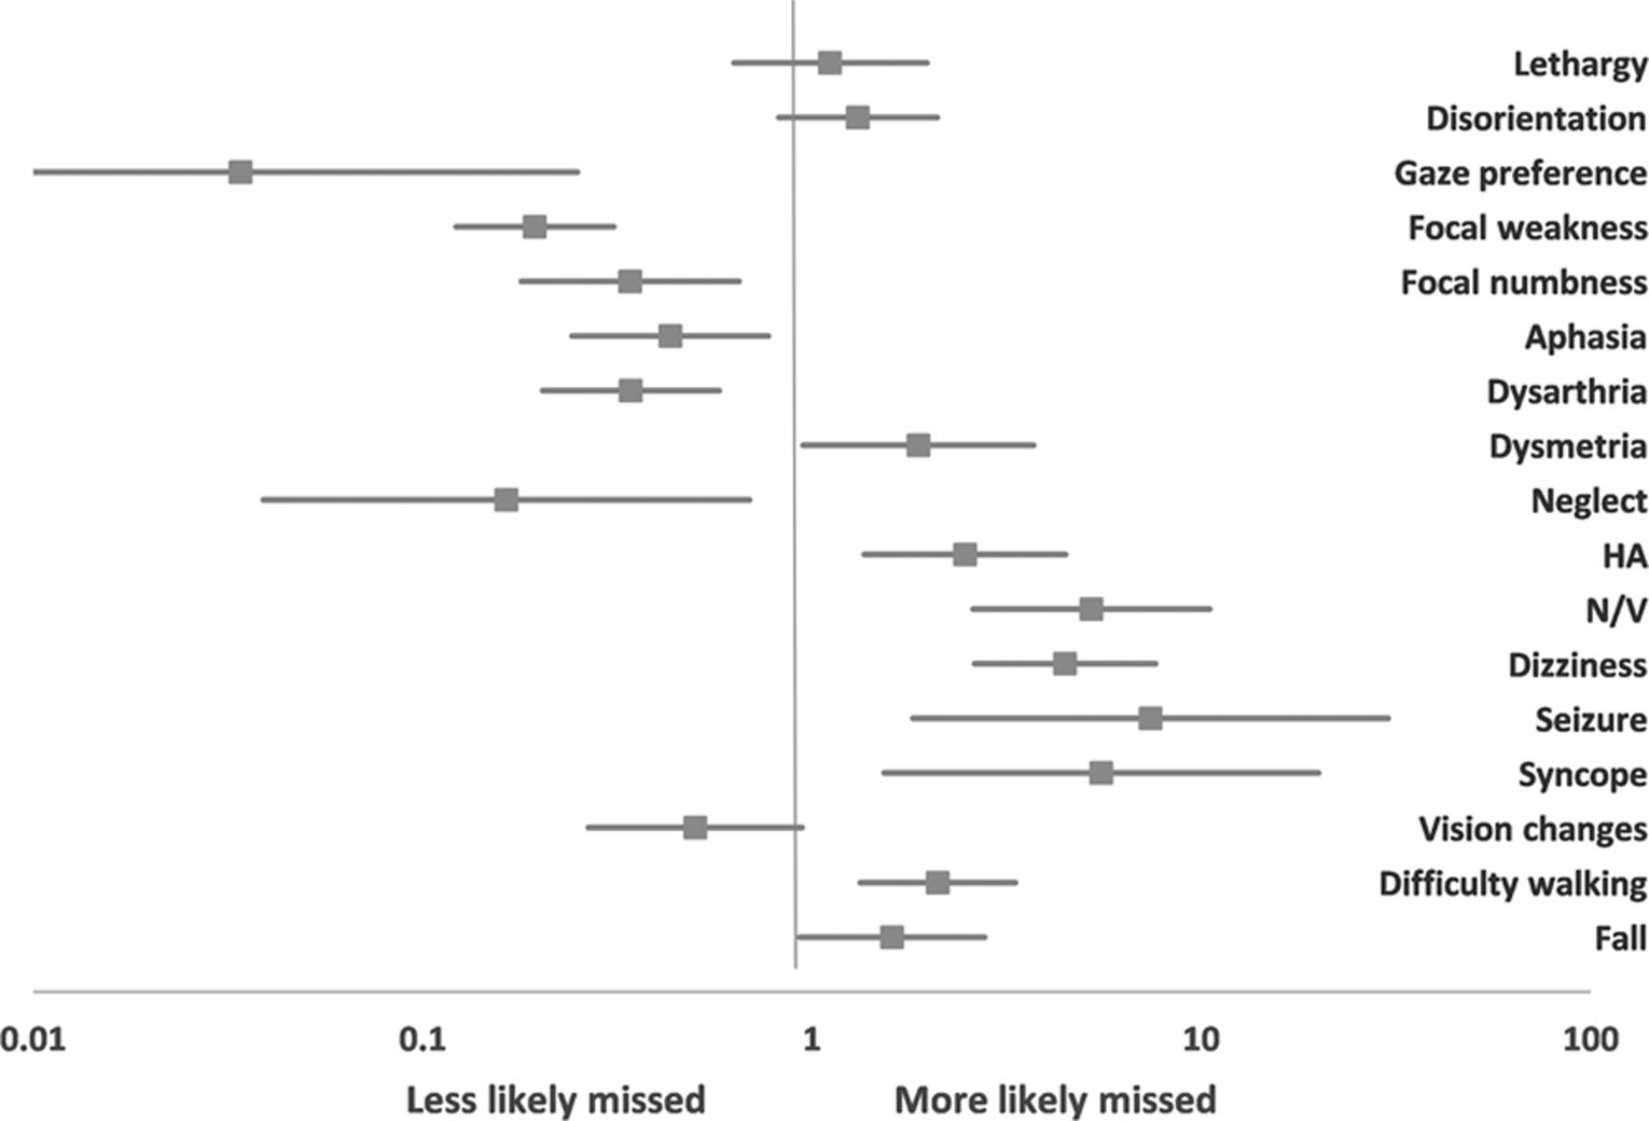
What strokes are being missed?
Figure 1. Symptoms associated with missed stroke diagnosis
Arch et al. Stroke 2016
Notes:
In addition to problems with stroke, many acutely dizzy patients with peripheral vestibular causes for their symptoms are overtested, misdiagnosed, and
undertreated.21 The costs of unnecessary imaging and hospital admissions for these patients waste an estimated $1 billion each year.3
2 slides on how strokes are missed even at academic centers
-anterior and posterior…
- symptoms that are missed (problem with posterior).. Use their tables
- But still are some anterior issues and issues with weakness… talk about the typical brainstem syndromes…

Slide 22
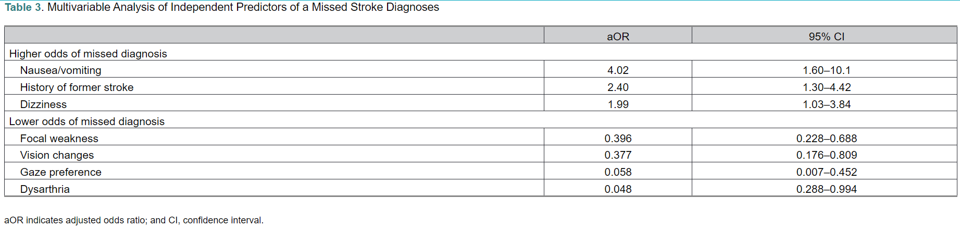
What strokes are being missed?
Arch et al. Stroke 2016
Notes:
In addition to problems with stroke, many acutely dizzy patients with peripheral vestibular causes for their symptoms are overtested, misdiagnosed, and
undertreated.21 The costs of unnecessary imaging and hospital admissions for these patients waste an estimated $1 billion each year.3

Slide 23
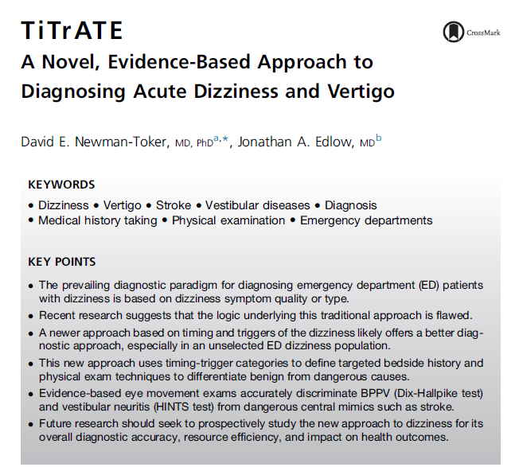
Structured Approach to Acute Vertigo
TiTrATE
(Timing, Triggers, Targeted Exam, and (diagnostic) Test)

Slide 24
TiTrATE – Structured Approach to Acute Vertigo
Timing
Triggers
Targeted
Exam
And Test
Acute, Continuous vs Episodic
Actions, movements or situations that provoke dizziness
HINTS + Migrainous Orthostatics
Dix-Hallpike Trauma
MRI Brain Canalith repositioning
Vessel imaging Toxic/metabolic
Saber, et al. Acad Emerg Med, 2013
Notes:
describe an approach to bedside diagnosis derived from current best evidence that relies first on classifying acute vertigo or dizziness by timing (episodic versus continuous)
and trigger (positional versus not), rather than type, and then uses that classification to hone in on specific, targeted bedside eye movement examinations to differentiate peripheral
versus central causes.
Tiggers: does head movement worsen or provoke symptoms… what about body movement? Is this the same? Medications? A blood pressure being low? Sitting to standing?
Use EF Vertigo slides

Slide 25
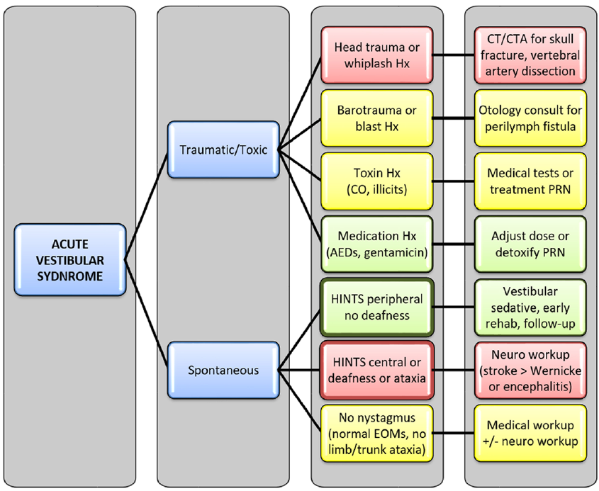
TiTrATE – Structured Approach to Acute Vertigo
Timing
Triggers
Targeted Exam
Testing
Saber, et al. Acad Emerg Med, 2013
Notes:
describe an approach to bedside diagnosis
derived from current best evidence that relies first on classifying
acute vertigo or dizziness by timing (episodic versus continuous)
and trigger (positional versus not), rather than type,
and then uses that classification to hone in on specific, targeted
bedside eye movement examinations to differentiate peripheral
versus central causes.

Slide 26
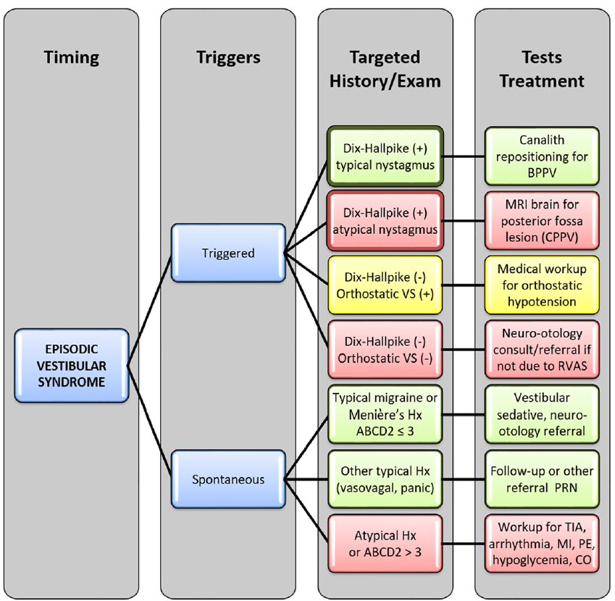
TiTrATE – Structured Approach to Acute Vertigo
Timing
Triggers
Targeted Exam
Testing
Saber, et al. Acad Emerg Med, 2013
Notes:
describe an approach to bedside diagnosis
derived from current best evidence that relies first on classifying
acute vertigo or dizziness by timing (episodic versus continuous)
and trigger (positional versus not), rather than type,
and then uses that classification to hone in on specific, targeted
bedside eye movement examinations to differentiate peripheral
versus central causes.

Slide 27
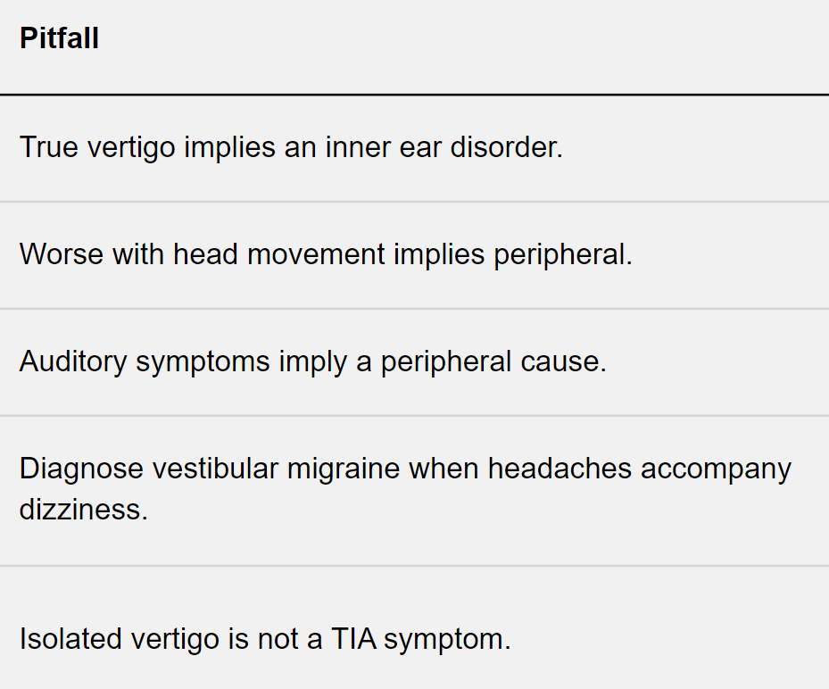
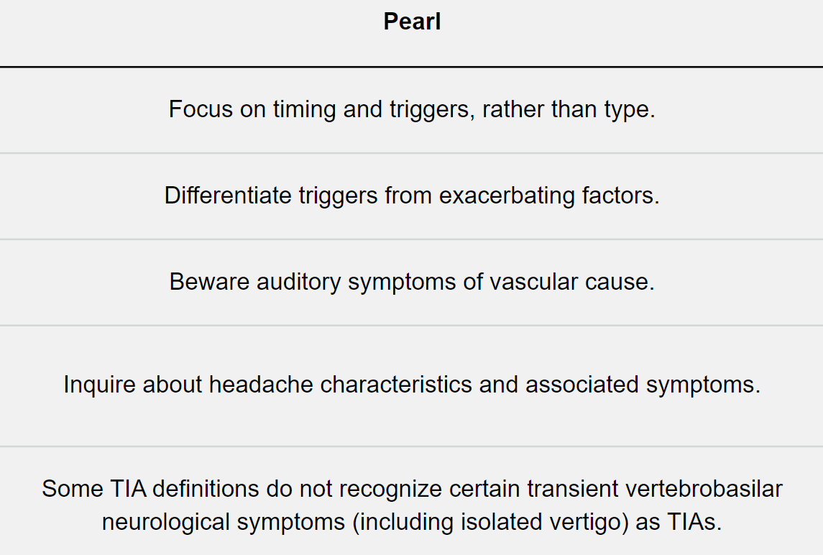
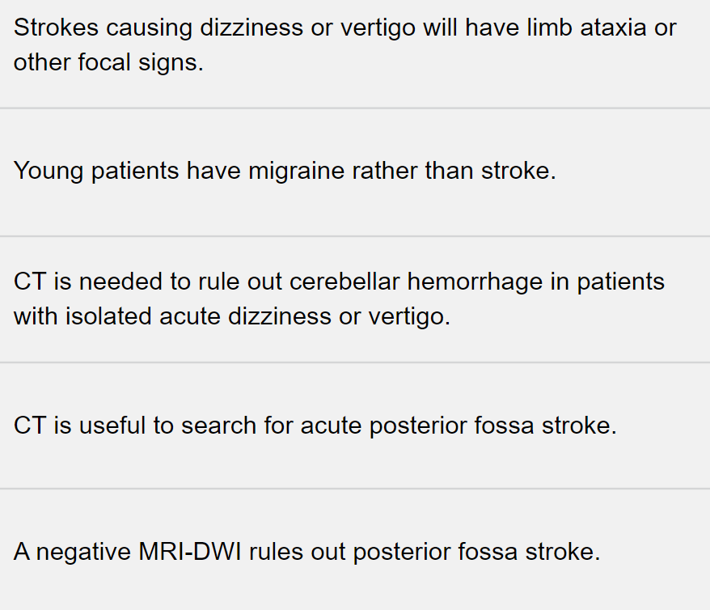
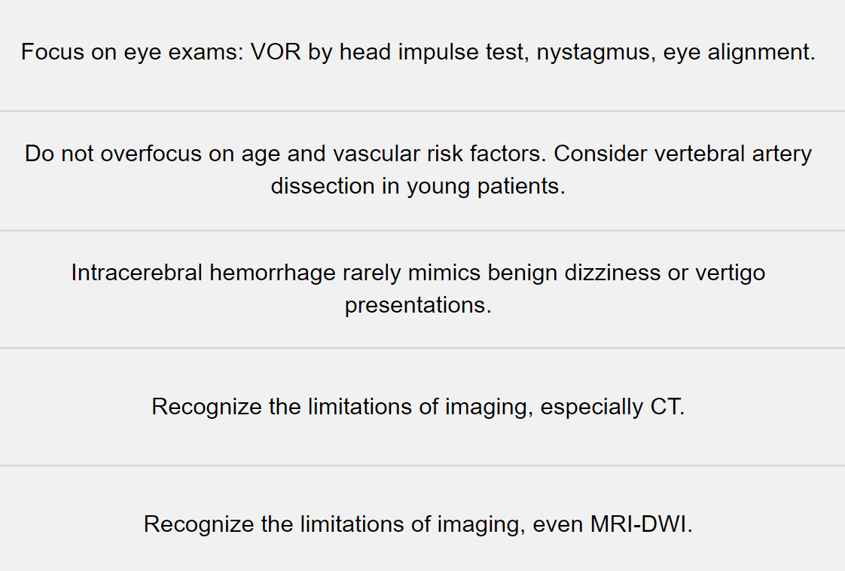
Pitfalls and Pearls
Saber, et al. Acad Emerg Med, 2013
Notes:
Isolated vertigo is not a TIA sx…… Isolated vertigo is the most common vertebrobasilar warning symptom before stroke and is rarely diagnosed correctly as a vascular symptom of first contact
Auditory symptoms… lateral pontine and inner ear strokes can cause tinnitus or hearing loss
Worse with head…. Acute vertigo (regardless of the origin peripheral vs central) is usually exacerbated by head movement
Diagnose vestibular migraine when headache… sudden, severe, pain in head/neck could be vascular pathology (dissection, aneurysm, or bascicular pathology)… any photophobia?
Strokes causing dizziness or vertigo…. Fewer than 20% of stroke patients with acute vertigo have FOCAL neurologic signs. NIHSS often 0.
CT is useful to search for acute posterior…. Retrospective suggest sensitivity up to 42%, but prospective studies suggest no higher than 16%
A negative MRI-DWI….. MRI-DWI in the first 24 hours missed 15-20% of posterior fossa infarctions (sensitivity is maximal 72-100 h after infarct)

Slide 28
Summary
Posterior circulation strokes are difficult to diagnose even when seen by neurology
Posterior circulation strokes do not always abide by classic rules
(anatomy > syndromes)
Structured approach to vertigo and other posterior circulation symptoms can help
reduce chance of missed stroke

Slide 29
Simplified Brainstem Anatomy & Function
Midbrain
  Cranial nerve 3, 4 - Ipsilateral
  Weakness, sensory loss - Contralateral
  Ataxia - Contralateral
Pons
  Cranial nerve 5, 6, 7 - Ipsilateral
  Weakness – Contralateral
  Sensory loss- Contralateral
Medulla
  Cranial nerve 8, 9, 10, 12 - Ipsilateral
  Ataxia - Contralateral
  Sensory loss - Contralateral
  Autonomic dysfunction/vertigo lateral syndrome
Hendrix et al. Clinical Anatomy, 2014
Notes:
Key line: focus on anatomy rather than syndromes
Simplified… of course exceptions like how CN 5 nucleus spans all… etc

Slide 30


Questions

