Slide 1


Management of Nonconvulsive Status Epilepticus
Robin C. Davis, MD,
Ochsner Health
January 13-16, 2024
Key Largo, Florida

Slide 2
Disclosures
Nothing to disclose.

Slide 3
Objectives
Review pathogenesis and continuum of nonconvulsive status epilepticus.
Discuss initial workup of and response to NCSE
Describe refractory NCSE and how this contributes to long term outcomes for NCSE patients.

Slide 4
“There is no one illness called epilepsy. There are many epilepsies.”
- Ernst Neidermeyer

Slide 5
Epidemiology and Prognosis of SE
Incidence: 10.3-41pts. per 100,000 (VA Richmond study, Europe, Rochester MN study)
Mortality: 1.6-40%
  Varies with etiology
Incidence and mortality greater in elderly patients
  14 % in 16-59 yo vs. 38% over 60 yo (VA Richmond Study)
Prognosis depends on the etiology, age, time to treatment, complications, etc.

Slide 6
NCSE History
NCSE recognized for over 50 years
  “Absence SE” (Lennox 1945)
  “aura continua” (Penfield and Jasper, 1954)
  “CPSE” associated with confusion, abnormal behavior, and unresponsiveness (Gastaut and Roger, 1956)

Slide 7
Natural Evolution of Seizure into SE
Up to 50% of critically ill patients with AMS experience seizure
In 80% of these seizures occur without movements (Classen et. al 2004)
Patients with severe underlying injury do poorly regardless (Bauer and Trinka, 2010)
Often begins with discrete tonic-clonic seizure
  Motor activity becomes continuous, and seizures become prolonged.
As neuronal function is impaired, jerking fades.
  May have no further motor activity or irregular myoclonus

Slide 8
Status Epilepticus Outcomes
  Multiple studies show seizure lasting longer than 5 minutes are more likely lead to SE (Lowenstein DH. Epilepsia 1999; Meldrum BS. Epilepsia 1999)
  Animal data suggest that permanent neuronal injury and pharmacoresistance may occur before the traditional definition of 30 min of continuous seizure activity have passed (Meldrum BS. Arch Neurol. 1973; Chen JWY. Lancet Neurol. 2006; Kapur J. J Neurosci. 1997; Mazarati AM. Brain Res. 1998)

Slide 9
Cerebral Damage from SE
Multifactorial
  Hypoxia
  Ischemia
  Metabolic disturbances
  Excitotoxic brain damage due to repeated depolarization
  Calcium influx resulting in cell death
  Metabolic balance is severely disrupted during sz or periodic discharges (Vespa et al. 2016, Witsch et al. 2017)

Slide 10
NCSE and Cardiac Arrest
NCSE present 1/3 comatose survivors of arrest
  Begins median 9.5 hours after arrest (based on EEG)
Favorable neurologic outcome in only 24/%
  No data on EEG prior to cooling
Motor symptoms may confer worse prognosis
  Possible reporting bias
(De Stefano et al., 2023)
Notes:
Timing of 9.5 hours limited data due to delay in starting EEG

Slide 11
Seizure to SE Continuum
Handbook of Epilepsy Treatment, Third Edition Simon Shorvon

Slide 12
Transition to Status
Seizure
  Rhythmic and/or periodic
    Evolve in field, frequency, and amplitude over 10s
Status epilepticus
  High risk after prolonged seizure (ILAE)
    >5 min GTC
    >10 min nonconvulsive seizure
    Repeated self limited events without return to baseline
  Second threshold at 30-60 min
    Correlates with risk for neuronal damage
(Trinka et al., 2015)

Slide 13
Initial Clinical Response
Speed may be more important than choice of “best” med
Must make diagnosis and identify etiology
  May alter treatment in up to 40% of cases (Alvarez et al., 2014)
Cases of NCSE are usually symptomatic, not idiopathic (Towne et al., 2000)
  “Subtle status” confers a more benign prognosis
    Manifests as confusion and cognitive impairment
    Contrasts with NCSE as later stage of convulsive CSE

Slide 14
Initial Clinical Response
Always ABC!
Benzos = First Line
  IV lorazepam (success rate 59.1-64.9%) vs rectal diazepam (46.2%) (Treiman DM, NEJM 1998; Alldredge BK, NEJM 2001; Leppik IE, JAMA 1983)
  Prehospital setting: IM Midazolam showed some efficacy.
  Initial benzo doses often too low (Alvarez et al., 2015)

Slide 15
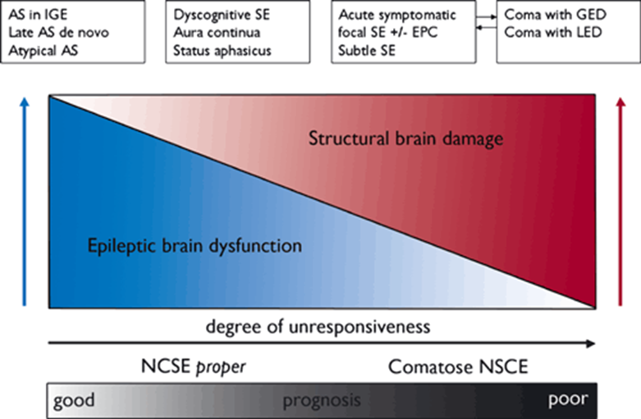
NSCE Continuum
Trinka et al., 2012

Slide 16
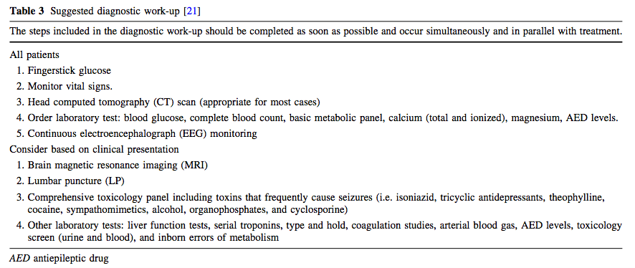
Initial Workup
Brophy GM. Neurocrit Care, 2012

Slide 17
Initial Clinical Response
If sz continues >3-5 min, IV lorazepam vs. diazepam
    Consider intranasal, IM, or PR if needed
    Repeat after 5 min while arranging 2nd line meds
    Repeat up to 3-4 doses if needed

Slide 18
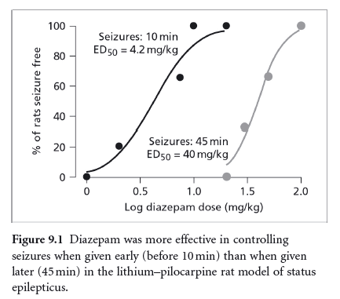
Time Dependent Response of Benzodiazepines
(Kapur and Robert L. Macdonald, Journal of Neuroscience, 1997)

Slide 19
NCSE Initial Response
Up to 1/3 of patients will not respond to benzos (Gainza-Lein et al., 2019)
Arrange cEEG
May consider non-anesthetic AEDs (e.g. LEV, LCS, VPA)
  Be mindful of airway
  Often, risk of anesthetic coma outweighs the benefit of aggressive treatment. (Trinka et al., 2015)

Slide 20
cEEG Indications
VA CSP 265 (NEJM 1998)
  In 20% of patients in whom convulsions stopped, ictal activity persisted
Needed if:
  Convulsions stop but AMS persists
  Patient is on a drip
  Neurologic state is ambiguous
Brophy GM. Neurocrit Care, 2012
Brophy GM. Neurocrit Care, 2012

Slide 21
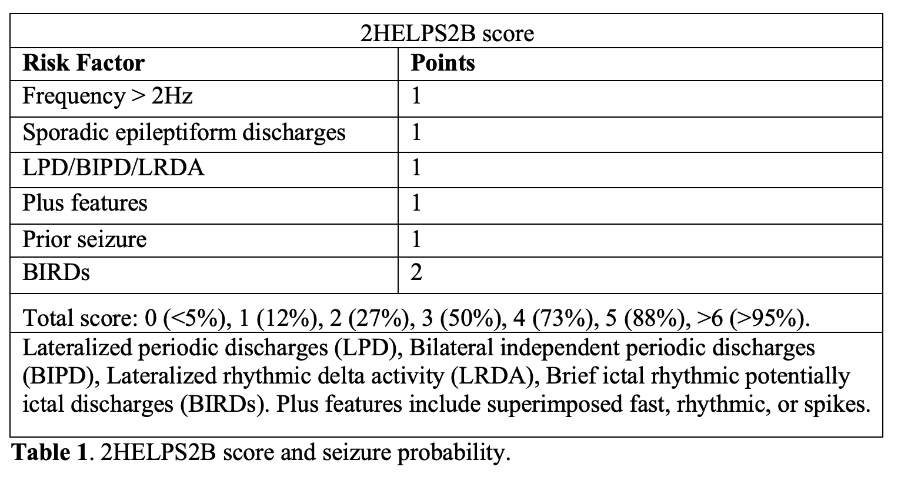
2HELPS2B Score
(Struck et al., 2020)
Notes:
Designed with machine learning
Scores >2 indication for 24 hours of EEG

Slide 22

EEG in NCSE
In critically ill patients at least 48 h of continuous EEG are needed in order to capture more than 90% of epileptic events (Claassen et al., 2004)
Traditional electrodes
Cap electrodes
Wireless EEG
Spot routines when unavailable

Slide 23
EEG in NCSE
2015 ILAE Guidelines stop short of offering distinct definition or classification of NCSE
  NCSE cannot be confirmed without EEG
Some consider rhythmic continuous encephalopathies with triphasics NCSE (Towne et al. 2000)
Must distinguish true NCSE vs. comatose NCSE
  Coma with continuous lateralized or generalized periodic discharges (Bauer and Trinka, 2024)

Slide 24
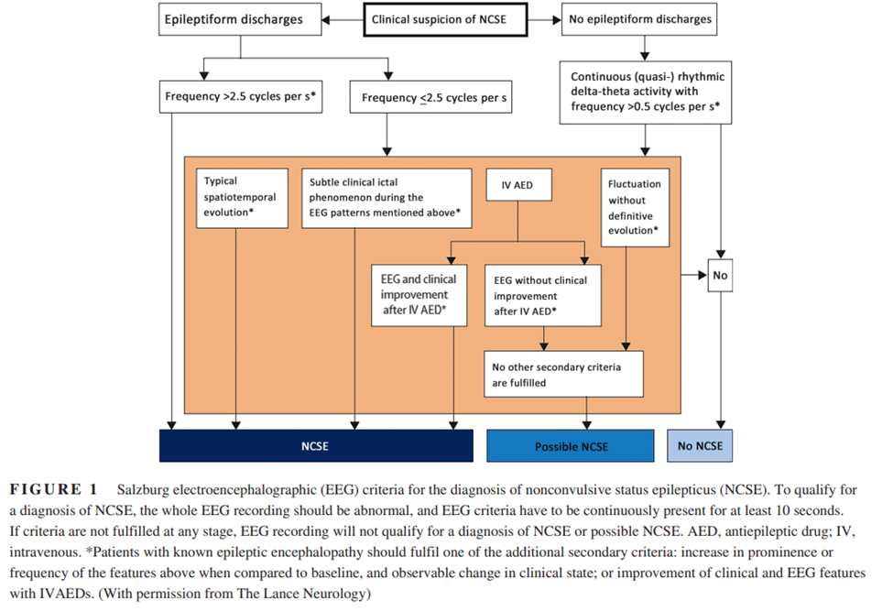
Salzburg Criteria for NCSE

Slide 25
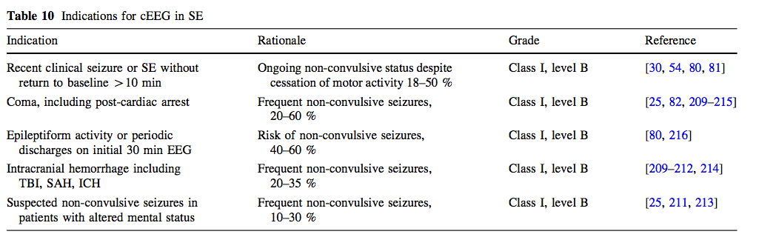
Indications for cEEG
(Brophy GM. Neurocrit Care, 2012)

Slide 26
ESETT
Established Status Epilepticus Treatment Trial (multicenter RCT)
  57 ERs across US
  Benzos given if seizure persists over 5 min with next ASM 30 min after benzo
    4mg lorazepam or 10 mg diazepam
    Followed by LEV, VPA, or fPHT
  Endpoint determined by improvement in LOC, NOT EEG
  384 patients (10% presented in PNEE)
    145 LEV
    118 fPHT
    121 VPA
Brophy GM. Neurocrit Care, 2012
Brophy GM. Neurocrit Care, 2012

Slide 27
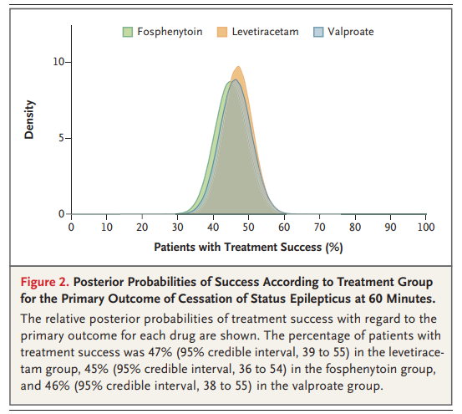
ESETT
(Trinka et al., 2015)
Brophy GM. Neurocrit Care, 2012
Brophy GM. Neurocrit Care, 2012

Slide 28
ESETT
Side effect profile of levetiracetam makes it appealing
  More hypotension and intubation with fPHT (not significant)
  More deaths in LEV group (not significant)
Ultimately all three second line agents are similar.
Brophy GM. Neurocrit Care, 2012
Brophy GM. Neurocrit Care, 2012

Slide 29
Refractory Status Epilepticus
Occurs in 31-43% of patients with SE
  Severity of impaired consciousness and de novo episodes are independent predictors
  41% require coma induction
  21% return to baseline
  39% mortality
Median duration is 48h
Survival improves when duration is <10h

Slide 30
Mortality of SE at 30 Days Post-Onset
Acute STEMI: 10%
CAP 9.7-11%
Ischemic stroke 20%
Status Epilepticus 20-30%
Pulmonary Embolism 30%

Slide 31
Status Epilepticus in the Elderly
Incidence is twice the general population in patients > 60 yo
  Acute or remote symptomatic stroke causes 60% of SE in the elderly
Mortality is 3x higher in SE + acute stroke than in acute stroke alone
  Mortality approaches 100% in patients with anoxia

Slide 32
Etiology of Status Predicts Mortality
Multiple etiologies may be concurrent
Anoxia confers highest mortality
Acute symptomatic etiologies are worse than remote symptomatic etiologies
Indeterminant prognosis in remote CVA, metabolic derangement, drug overdose, tumor, and trauma
Highest survival in subtherapeutic AED level or alcohol withdrawal

Slide 33
Reducing Mortality in Status Epilepticus
The only acutely modifiable determinant is the duration of status epilepticus
  Time to diagnosis
  Time to initiate treatment
  Effectiveness of treatment protocol

Slide 34
Second Line ASMs
PHT, fosPHT, VPA, LEV, LCS
  PHT: 42-78 % (Misra UK, Neurology 2006; Gilad R, Acta Neurol Scand 2008)
  PB: 58.2 % (Treiman DM, NEJM 1998)
  VPA: 66-72 % (Misra UK, Neurology 2006; Gilad R, Acta Neurol Scand 2008)
  LEV: 70 % in meta-analysis of 707 pts in various studies (Trinka E, Epilepsia 2011)
  LCS: 67 % in 126 pts in various studies (Trinka E, Epilepsia 2011)
May repeat another second line agent in NCSE but…
DO NOT WASTE TIME FOR CSE

Slide 35
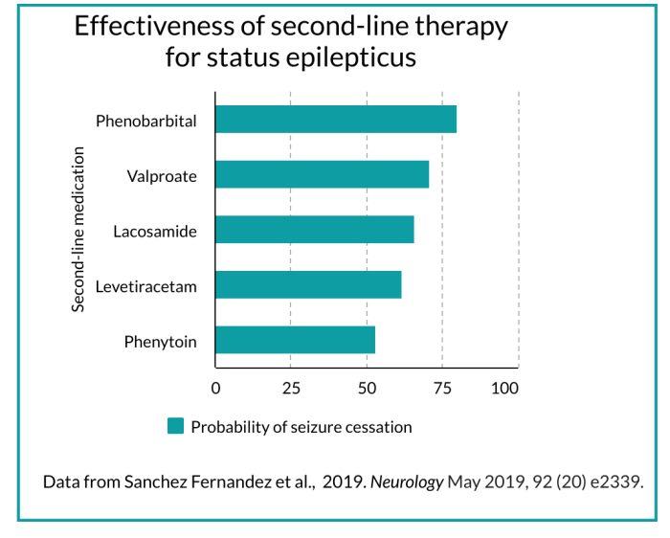
Second Line ASMs

Slide 36
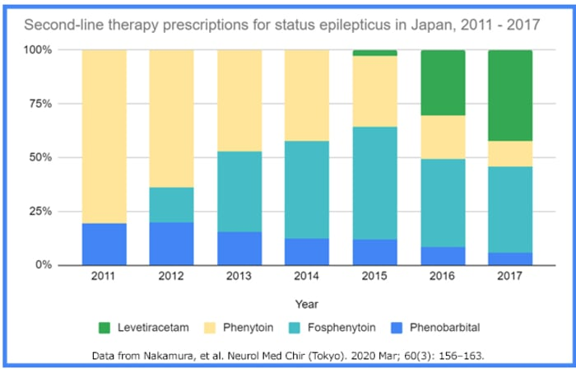
Second Line ASMs

Slide 37
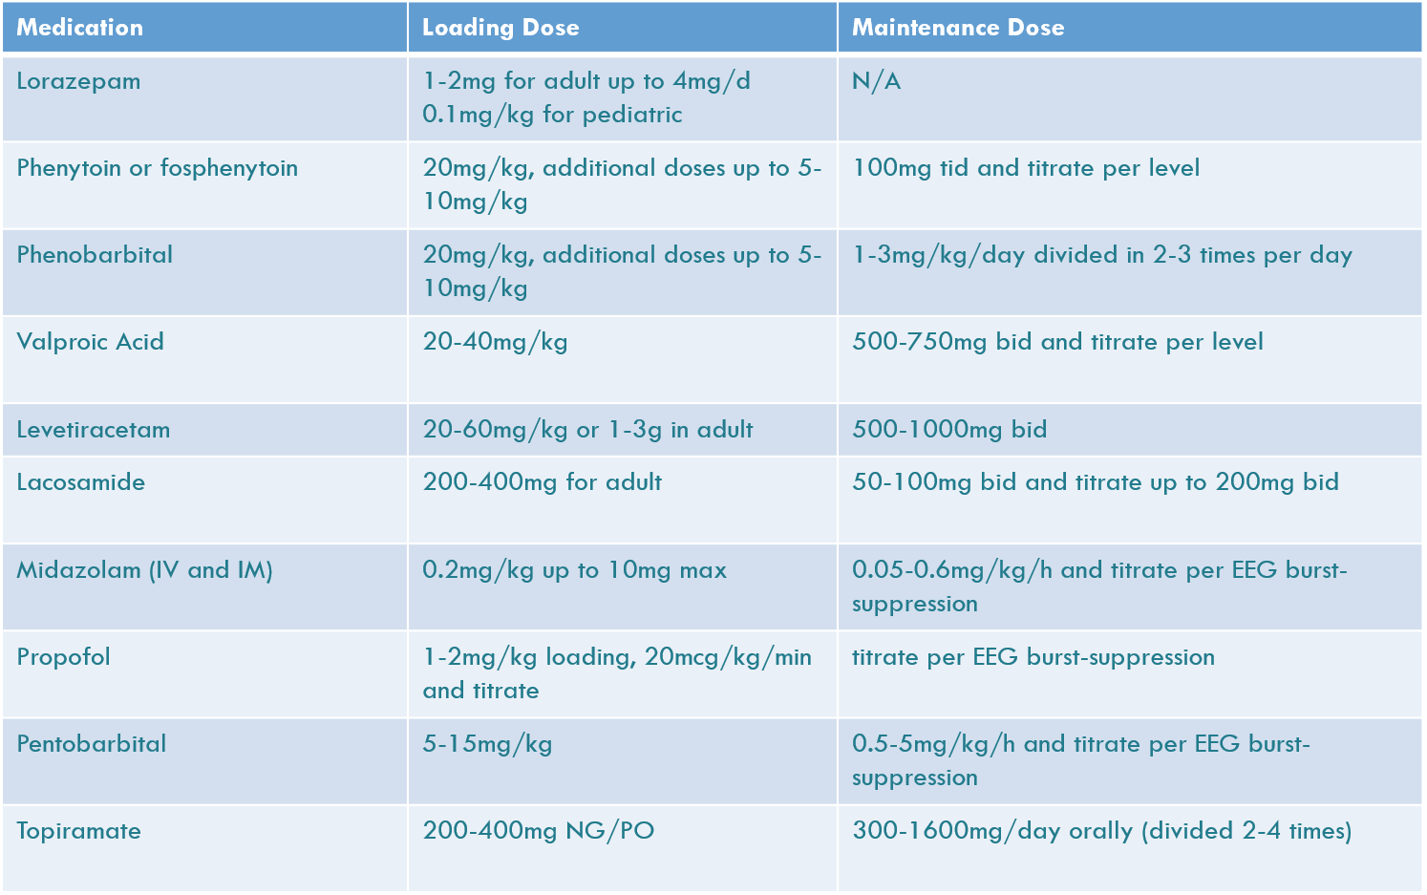
Loading Doses

Slide 38
Third Line Anesthetics
Midazolam: GABAnergic
  70-97% efficacy initially (meta-analysis 80%)
Propofol: GABAnergic
  > 64 % (meta-analysis 73%)
Pentobarb: GABAnergic
  74-100 % (meta-analysis 92%)
                (Claassen J, 2002)

Slide 39
Alternative Agents
Ketamine
Newer AEDs (e.g. clobazam,
perampanel, vigabatrin)
Topiramate
Inhaled Anesthetics
Steroids
IVIG
Plasmapheresis
Ketogenic Diet
Hypothermia
Surgery- resection, multiple subpial transection, hemispherectomy, lobectomy, callosectomy
Stimulation therapy: VNS, ECT, TMS
Even less commonly, lidocaine, magnesium, verapamil, and classical music

Slide 40
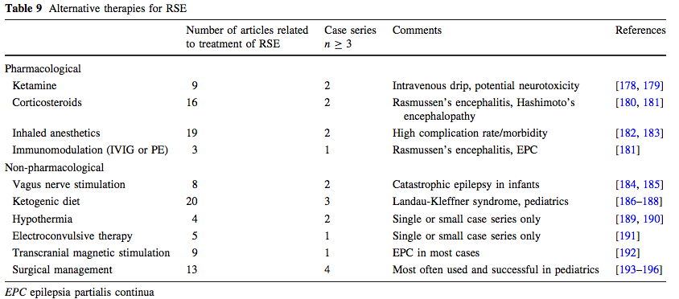
Alternative Therapies for RSE
Brophy GM. Neurocrit Care, 2012

Slide 41
Trends in Management
120 physicians queried regarding hypothetical patient in SE (Riviello et al., 2013)
  Tendency to choose lorazepam → phenytoin → levetiracetam
  Levetiracetam chosen with same frequency as midazolam, propofol, and PB
Rosetti, Hirsch, Drislane, 2019

Slide 42
Be Aggressive?
Debate at International Congress of Clinical Neurophysiology in May 2018
  NSCE associated with higher mortality and neurologic status
  Seizure burden <20% not associated with worse outcome
  Isolated seizures have no association without outcome
          (Topjian et al., 2013, Wagenman et al., 2014)
  Hirsch argues “borderline” patterns should be treated
    Periodic discharges or rhythmic delta from 1-2.5 Hz
    Epileptiform triphasics (O’Rourke et al., 2016)
(Rosetti, Hirsch, Drislane, 2019)

Slide 43
Anesthesia and Outcomes
171 patients with RSE (none post cardiac arrest)
  IV Anesthetic dose AEDs associated with increased mortality, intubation, hypotention, and poor long term neurologic outcome (Sutter et al., 2014)
  Significance reduced when accounting for severity of RSE
415 cases of SE >30 min
  Coma associated with worse outcome at d/c, longer hospitalization duration, and long term disability (RR 4.6) (Marchi et al., 2015)

Slide 44
Anesthesia and Outcomes
Study of 31 cases of super refractory SE treated with pentobarb
  1/3 pneumonia
  1/3 needed pressors
  1 propylene glycol toxicity
  1 cardiac arrest
  90% had poor outcome
    74% died
    16% severe disability
(Alvarez et al., 2016)

Slide 45
Anesthesia and Outcomes
126 RSE treated in Boston c vs. 236 in Lausanne
  Similar status epilepticus severity scores
  Therapeutic coma used in 25% in Boston but 10% in Lausanne
  No difference in mortality
  Therapeutic coma associated with increased length of hospital stay
(Alvarez et al., 2016)

Slide 46
A Compromise in Management
SE must be diagnosed and treated ASAP at adequate does
If early ASDs fail, use benzos, propofol, and pentobarb as necessary
Subtle SE warrants the same treatment as GCSE
NCSE following GCSE should be managed aggressively
SE with known associated epilepsy syndrome should rarely be treated aggressively
If no convulsive seizure or definite seizure prior to onset of NCSE,
attempt non-sedating ASDs first
If clear convulsive seizure at onset more to more aggressive
management.
Rosetti, Hirsch, Drislane, 2019

Slide 47


Slide 48


Questions

