Slide 1


Special
Populations
In Epilepsy
Robin C. Davis, MD,
Ochsner Health
January 13-16, 2024
Key Largo, Florida

Slide 2
Disclosures
Nothing to disclose.

Slide 3
Objectives
Identify the impact of hormonal changes in women on seizure frequency and management of epilepsy
Discuss care and ASM choice of the pregnant epileptic patient.
Review care of epilepsy in specific populations (e.g. geriatric, intellectually disabled, and patients with mental health concerns.

Slide 4
Women With Epilepsy
More likely to have PCOS
  Especially associated with VPA
    Inhibition of testosterone breakdown
    Weight gain
    Progesterone receptor blockade
Amenorrhea
Menstrual irregularities
Premature menopause
(Verrotti et al., 2009)
(De Stefano et al., 2023)
Notes:
Timing of 9.5 hours limited data due to delay in starting EEG

Slide 5
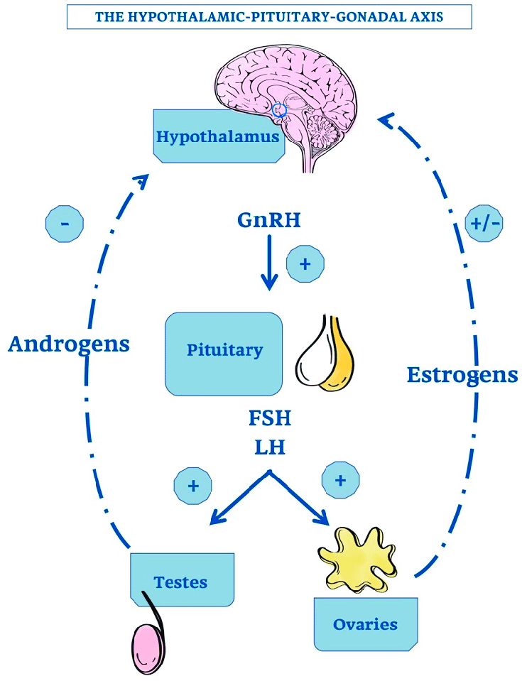
Hormones and Epilepsy
Estrogen
  Proconvulsant
  Decreases seizure threshold via glutamate receptors
  Facilitates kindling
Progesterone
  Anticonvulsant
  Modulates GABA conductance
Prolactin
  Postictal increase
Enzyme inducers] ASMs induce hepatic metabolism of sex hormones and increase hormone binding globulin
(Harden and Pennell, 2013)
Notes:
Timing of 9.5 hours limited data due to delay in starting EEG

Slide 6
Catamenial Epilepsy
Present in 1/3 of women with epilepsy
Doubling of seizures or seizure almost exclusively during specific times of menstrual cycle
Menstrual exacerbation seen in up to 70% of patients with epilepsy
On average, a cycle is 28 days.
  Day 1- First day of menses
  Day 14 (approx.)- Ovulation
  (Herzog et al., 1997)
Notes:
Timing of 9.5 hours limited data due to delay in starting EEG

Slide 7

Catamenial Epilepsy
Stage 1- Follicular (follicle develops)
Stage 2- Luteal (ovulation) (Type C2)
Stage 3- Menstruation (Type C1)
Estrogen to progesterone ratio highest in stages 2-3
Women with anovulatory cycles may have more seizures in ovulatory, luteal, and menstrual phases (Type C3)
(Herzog et al., 1997)
Notes:
Timing of 9.5 hours limited data due to delay in starting EEG

Slide 8
Notes:
Timing of 9.5 hours limited data due to delay in starting EEG

Slide 9
Progesterone Supplementation
Progesterone Treatment Trial (n=294) used natural progesterone supplements
  No significant reduction in seizures
  BUT post-hoc analysis showed 63 women with C1 type (3x seizures during menses) had reduction in seizures
  Synthetic supplements reduce seizures by fully suppressing cycle
(Herzog et al., 2012)
Notes:
Timing of 9.5 hours limited data due to delay in starting EEG

Slide 10
Other Methods
Clobazam (n=18) dosed at 20-30 mg/day for 10 days during peak cycle times led to 14 of18 women with reduced seizure frequency
Acetazolamide associated with a 40% seizure frequency reduction with doses from 125-750 mg daily
(Feely et al., 1982, Lim et al., 2001)
Notes:
Timing of 9.5 hours limited data due to delay in starting EEG

Slide 11
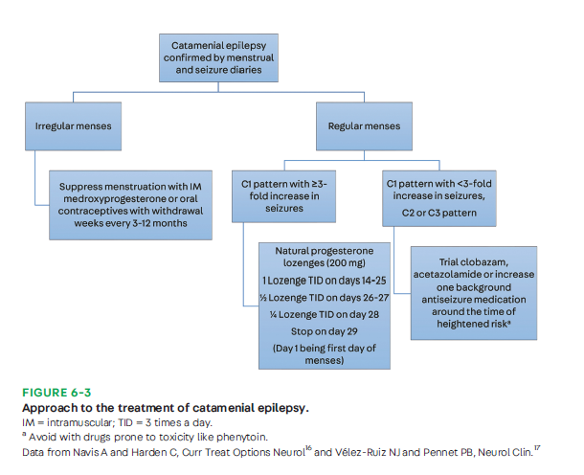
Notes:
Timing of 9.5 hours limited data due to delay in starting EEG

Slide 12

Trans Patients and Epilepsy
Estimated up to 450,000 transgender people have epilepsy
Some gender affirming meds may interact with ASMs
  17 Beta Estradiol may lower lamotrigine levels
  Enzyme inducing ASMs may reduce levels of gender affirming drugs
    GNRH analogue, medroxyprogesterone, 17beta-estradiol, spironolactone, transdermal estrogen
Be wary of valproate for AFAB patients
  Hirsutism, alopecia, weight gain
  (Johnson and Kaplan, 2017)
Notes:
Timing of 9.5 hours limited data due to delay in starting EEG

Slide 13
Sexual Dysfunction in Women With Epilepsy
Reduced libido
Mood disorders
Disabling seizures
Topiramate, valproate, pregabalin, and gabapentin are associated with sexual dysfunction
  Lamotrigine, levetiracetam, oxcarbazepine are better tolerated
  (Yang and Wang, 2016)
Notes:
Timing of 9.5 hours limited data due to delay in starting EEG

Slide 14
Fertility and Epilepsy
1 in 3 women cite epilepsy as reason for avoiding pregnancy
Infertility rates of 9.2% compared to 6% in the general population
  Highest in women with childhood onset epilepsy, structural/metabolic causes, polytherapy, drug resistant epilepsy, or associated disability
2018 prospective cohort study noted average age of conception at 31.9 years for women with epilepsy (31.1 for control group)
  Miscarriage rates were similar
  (Mostacci et al., 2018)
Notes:
Timing of 9.5 hours limited data due to delay in starting EEG

Slide 15

Fertility and Epilepsy
Risk of hormones that increase estrogen progesterone ratio
ASMs may interact with meds
  Reduce lamotrigine
Gonadotropin and exogenous estrogen may lower seizure threshold
Rates of conception are similar
(Larson et al. 2020)
Notes:
Timing of 9.5 hours limited data due to delay in starting EEG

Slide 16

Contraception
Many ASMs are teratogenic
Approximately 50% of pregnancies in seizure patients are unplanned
On average, pregnancy discovered at approx. 6.5 weeks
  Neural tube closes at 4 weeks
Epilepsy Birth Control Registry Study
  Web based, self report
  Women on hormonal contraceptives report 6.75x more seizures than barrier method
  (Herzog et al., 2017, Johnson et al., 2018)
Notes:
Timing of 9.5 hours limited data due to delay in starting EEG

Slide 17

Contraception Choices
Lamotrigine, valproate, and oxcarbazepine metabolized by ethinlestradiol in OCPs
OCP enzyme induction of CYP3A4 pathway may result in contraceptive failure
  Watch out for spotting/breakthrough bleeding!
IUD use higher in women with epilepsy
  Local rather than systemic effects
  (Reimers et al., 2015)
Notes:
Timing of 9.5 hours limited data due to delay in starting EEG

Slide 18
Pregnancy Considerations
  Hepatic metabolism increases
  Renal blood flow increases
  Serum albumin changes
  Increased blood volume
  Reduces ASM levels
    Worst for LTG and LEV
    May be made worse by vomiting
(Stephen et al., 2019)
Notes:
Timing of 9.5 hours limited data due to delay in starting EEG

Slide 19
Pregnancy Considerations
Most women have improved or stable seizure frequency during pregnancy
EURAP study followed 3806 pregnancies in 3451 women with epilepsy
  66% seizure free in epilepsy
  Higher frequency in genetic epilepsies compared to focal onset
  GTCs in 15.2%
  LTG monotherapy with lower rates of seizure freedom
(Battino et al., 2013)
Notes:
Timing of 9.5 hours limited data due to delay in starting EEG

Slide 20
Pregnancy Considerations
Seizure frequency 9-12 months before conception predicts pregnancy seizure frequency
  Higher risk with low ASM levels, focal seizures, and polytherapy
  Seizure frequency may improve in women with catamenial epilepsy
Maternal Outcomes and Neurodevelopmental Effects of Antiepileptic Drug study (MONEAD) showed similar seizure rates in pregnant (19%) vs. nonpregnant (17%) persons
(Pennell et al., 2020)
Notes:
Timing of 9.5 hours limited data due to delay in starting EEG

Slide 21
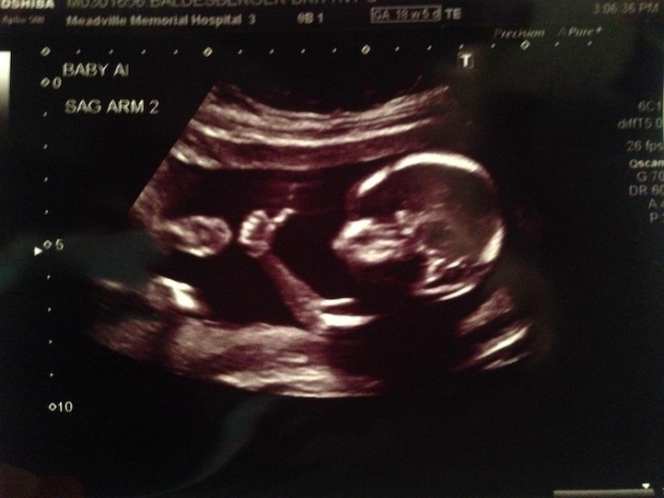
Seizure and Fetal Development
GTCs associated with fetal hypoxia and lactic acidosis
Fetal decels may be seen in focal seizures
Taiwanese study (n= 1016 WwE vs. 8128 control) noted
  1.37x risk of small gestational age,
  1.63x risk of preterm birth
  1.36 risk of low birth weight
  (Chen et al., 2009)
Notes:
Timing of 9.5 hours limited data due to delay in starting EEG
Study limited due to lack of specified subtypes/clarification of seizure severity

Slide 22
ASMs and Fetal Risk
North American, Australian, European, and UK-Ireland pregnancy registries track outcomes
Risk of cardiac, neural tube, urogenital, and craniofacial malformations
  Valproate is highest risk
    Avoid in women of childbearing age (Last resort!)
    Phenobarbital (6.4%), carbamazepine (5.5%), and topiramate (3.9 %) are intermediate risk
  Levetiracetam (2.8%), lamotrigine (2.9%), or oxcarbazepine (3.0%) lowest risk
        (Tomson et al., 2019)
Notes:
Timing of 9.5 hours limited data due to delay in starting EEG
Study limited due to lack of specified subtypes/clarification of seizure severity

Slide 23
ASMs and Fetal Risk
Notes:
Timing of 9.5 hours limited data due to delay in starting EEG
Study limited due to lack of specified subtypes/clarification of seizure severity

Slide 24
ASMs and Fetal Risk
Teratogenicity appears to be dose related
  Lowest rates of malformation with <325 mg of LTG daily
  VPA doses <650 mg are comparable to higher dose CBZ
Target ultrasounds to common malformations
  PB, CBZ, LTG- cardiac
  TPM- cleft palate and lip
  VPA- neural tube, cardiac, urogenital
Highest risk with polypharmacy with VPA or TPM
  Up to 15%
  (Tomson et al., 2019)
Notes:
Timing of 9.5 hours limited data due to delay in starting EEG
Study limited due to lack of specified subtypes/clarification of seizure severity

Slide 25
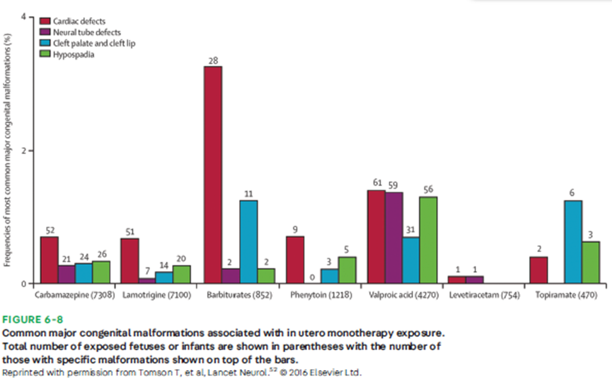
ASMs and Fetal Risk
Notes:
Timing of 9.5 hours limited data due to delay in starting EEG
Study limited due to lack of specified subtypes/clarification of seizure severity

Slide 26

VPA and Fetal Risk
Associated with cognitive and behavioral impairment, psychomotor and language delay, ADHD, ASD
May still be used in patients with GTCs, myoclonic epilepsies, JME
Risk of GTC 33% due to withdrawal compared to 29% with switch to alternative (Tomson et al., 2016)
Notes:
Timing of 9.5 hours limited data due to delay in starting EEG
Study limited due to lack of specified subtypes/clarification of seizure severity

Slide 27
Newer ASMs
Shallow breathing at birth- perampanel
Study of eslicarbazepine
  91 pregnancies studied, 30 delivered with no issues, 5 with major anomalies
    Unbalanced chromosome 18, conjoined twins, congenital knee dislocation, talipes
      All likely unrelated
Lacosamide and brivaracetam
  Limited studies with no major fetal malformations
    Minor malformations such as hemangioma
  (Vasquez et al., 2021, Costa et al., 2018)
Notes:
Timing of 9.5 hours limited data due to delay in starting EEG
Study limited due to lack of specified subtypes/clarification of seizure severity

Slide 28
Relative Risk of ASMs in Pregnancy
Notes:
Timing of 9.5 hours limited data due to delay in starting EEG
Study limited due to lack of specified subtypes/clarification of seizure severity

Slide 29
Folic Acid Supplementation
Maintain at least 0.4 mg preconception
Up to 4 mg for women at high risk (prior history of MCM)
Optimal dose unclear,
  >5 mg may be associated with lower psychomotor scores
  Limited by bias and did not account for maternal IQ
Norwegian Trial of n=260 on folic acid and n=68 control
  5-8x lower risk of autistic traits from ages 18-36
NEAD study showed mean higher 7 IQ points with folic acid exposure
      (Bjork et al., 2018, Meador et al., 2013)
Notes:
Timing of 9.5 hours limited data due to delay in starting EEG
Study limited due to lack of specified subtypes/clarification of seizure severity

Slide 30
Special Considerations
VNS in pregnancy not well studied
  44 pregnancies with 2 ending in miscarriage
    Lower than average 10% risk
Ketogenic diet not recommended due to malformations in mice models
(Ding et al., 2021, Sussman et al. 2013)
Notes:
Timing of 9.5 hours limited data due to delay in starting EEG
Study limited due to lack of specified subtypes/clarification of seizure severity

Slide 31
Managing Epilepsy During Pregnancy
USE THE LOWEST DOSE OF THE MOST EFFECTIVE BEST TOLERATED MED
Obtain preconception level in all women of childbearing age
Critical for LEV, LTG, TPM, ZNS, and OXC
  LEV and LTG levels change the most in the first trimester
  OXC and TPM change the most in second trimester
Dose adjust, especially if level drops >35%
  If no level available, increase meds 30-50% after first trimester if on highly metabolized med
  (Voinescu et al., 2018)
Notes:
Timing of 9.5 hours limited data due to delay in starting EEG
Study limited due to lack of specified subtypes/clarification of seizure severity

Slide 32

Morbidity and Mortality
11.46x increased risk of death during delivery
5.57x overall risk of mortality in pregnancy and up to 42 days postpartum
  Causes include SUDEP
Possibly higher rates of C section, induction of labor, placental abruption, PROM, and preterm delivery
(MacDonald et al., 2015, Christensen et al., 2018)
Notes:
Timing of 9.5 hours limited data due to delay in starting EEG
Study limited due to lack of specified subtypes/clarification of seizure severity

Slide 33

Morbidity and Mortality
ASM levels re-increase postpartum
Drugs cleared by glucuronidation (lamotrigine) may increase rapidly
  Taper as early as day 3 with return to pre-pregnancy dosing by day 10-21
Renally cleared meds (levetiracetam) normalize at 2-3 weeks postpartum
CYP450 metabolized meds are slower (4-8 weeks to normalize)
Breastfeeding data is limited- LACTMED is a useful resource
(Pennell and Hoving, 2008 Polepally et al, 2014)
Notes:
Timing of 9.5 hours limited data due to delay in starting EEG
Study limited due to lack of specified subtypes/clarification of seizure severity

Slide 34
Safety for Epileptic Parents of Young Children
  Support regular sleep
  Never bathe baby alone
  Bathroom door unlocked
  Reduce bath temps
  Change diapers on low surfaces
  Feed baby on low surfaces
  NO CO-SLEEPING. EVER.
  Using “containers” when epileptic parent is alone
  Teach children to call for help
    - Seizure drills
  Monitor for postpartum depression
  - Higher rates of PPD
  (Galanti et al., 2009)
Notes:
Timing of 9.5 hours limited data due to delay in starting EEG
Study limited due to lack of specified subtypes/clarification of seizure severity

Slide 35
Epilepsy And Aging Women
Osteoporosis is already 4x more common in women
  May be seen with phenobarbital, primidone, oxcarbazepine, and carbamazepine
  Gabapentin, topiramate, and valproate associated with increased fracture risk
  Possibly reduction of osteoblast proliferation
Follow vitamin D, calcium, and phosphate
Maintain a baseline DXA
Counsel on exercise, vitamin D and calcium supplementation
(Pack and Walczak, 2008)
Notes:
Timing of 9.5 hours limited data due to delay in starting EEG
Study limited due to lack of specified subtypes/clarification of seizure severity

Slide 36
Epilepsy And Aging Women
Menopause may occur earlier
  Average age 47.8 compared to 51.4
Perimenopause lasts median 4 years
  Does not appear to impact frequency
HRT may worsen seizures
(Harden et al., 2006, Erel and Guralp, 2011)
Notes:
Timing of 9.5 hours limited data due to delay in starting EEG
Study limited due to lack of specified subtypes/clarification of seizure severity

Slide 37
Psychiatric Diagnoses and Epilepsy
1 in 3 people with epilepsy carries a psychiatric history
1 in 4 has an active psychiatric diagnosis
Developmental and psychiatric diagnoses may be seen in 43% of children with epilepsy
(Mula et al., 2021)
Notes:
Timing of 9.5 hours limited data due to delay in starting EEG
Study limited due to lack of specified subtypes/clarification of seizure severity

Slide 38
Mental Health Comorbidities
Depression
  Observational study of 10M UK patients
    Associated with 2X risk of developing epilepsy
Schizophrenia
  Retrospective large cohort study indicates
  2-3x risk of developing epilepsy
    Theories include low serotonin, hyperactivation of hypothalamic-pituitary-adrenal axis, or GABA downregulation
Comorbidities
  Anxiety
  ADHD
  ASD
  Psychosis
  PNEE
(Josephson et al., 2017 , Chang et al., 2021)
Notes:
Timing of 9.5 hours limited data due to delay in starting EEG
Study limited due to lack of specified subtypes/clarification of seizure severity

Slide 39
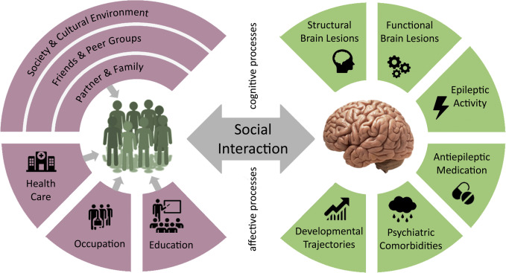
Psychiatric Diagnoses and Stigma
Social withdrawal
Isolation
Marginalization
Distress
Lack of access to care
(Steiger and Jokeit, 2017)
Notes:
Timing of 9.5 hours limited data due to delay in starting EEG
Study limited due to lack of specified subtypes/clarification of seizure severity

Slide 40

Mental Health and Epilepsy Morbidity
Higher likelihood of side effects
High likelihood of drug resistance
Increased risk of substance use
Increased risk of suicide
Female patients with psychiatric comorbidities have a 5x risk of SUDEP
1 in 6 will develop mental health complaints as a med side effect
(Hesdorffer et al., 2015 Svenison et al. 2017)
Notes:
Timing of 9.5 hours limited data due to delay in starting EEG
Study limited due to lack of specified subtypes/clarification of seizure severity

Slide 41
Psychiatric Diagnoses and Epilepsy
Temporal lobe seizures
  Can last for weeks
  Associated with violence and suicide
Postictal depression may occur in up to 43%, anxiety in up to 45%
Retrospective study of 2600 patients, 1 in 7 cases of psychosis due to ASMs
(Kanner 2004)
Notes:
Timing of 9.5 hours limited data due to delay in starting EEG
Study limited due to lack of specified subtypes/clarification of seizure severity

Slide 42
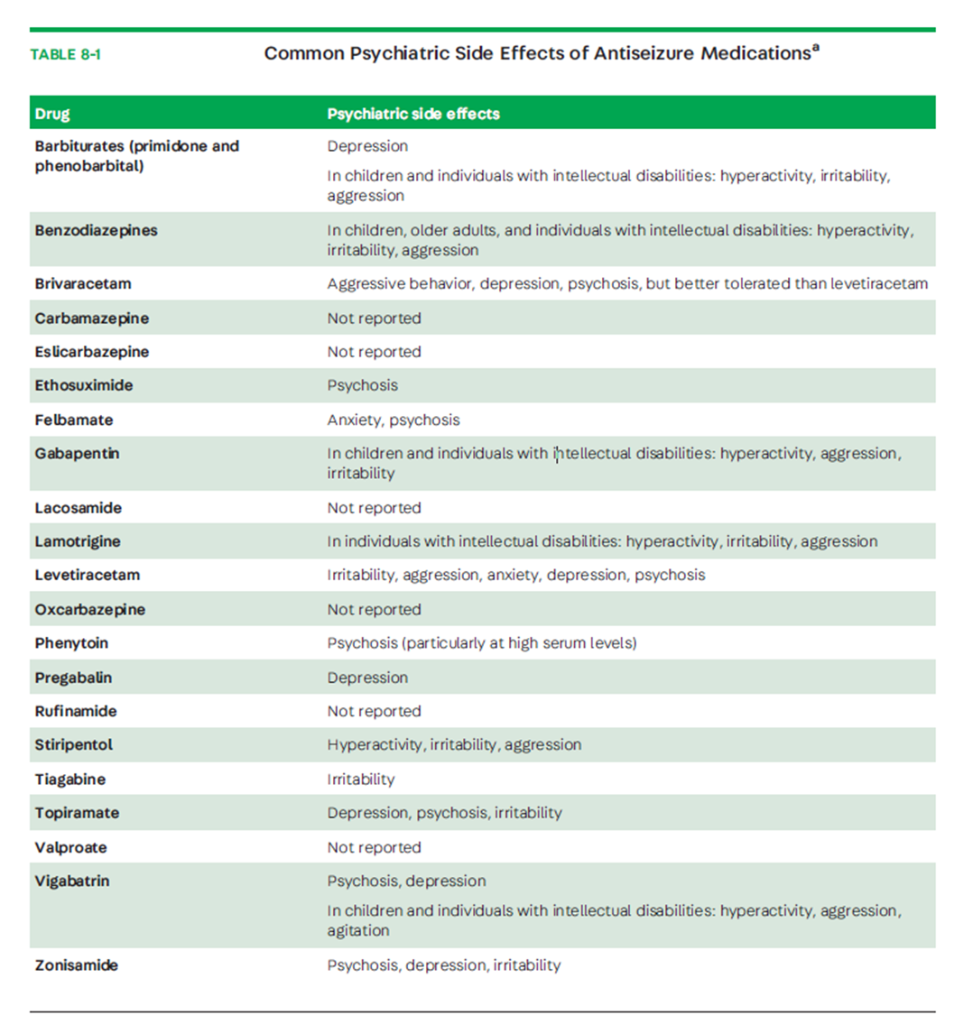
(Mula et al., 2021)
Notes:
Timing of 9.5 hours limited data due to delay in starting EEG
Study limited due to lack of specified subtypes/clarification of seizure severity

Slide 43
Management of Psychiatric Comorbidities
Evidence most SSRIs have no different than placebo risk for seizure
Avoid bupropion!
Reduce/switch problematic ASMs
  Fluoxetine, fluvoxamine, and sertraline may increase PHT and VPA levels
  Inducers (PHT, CBZ, barbs) reduce blood levels of antipsychotics (VPA acts as an inhibitor)
  Clozapine has a 9.5 risk of seizure compared to placebo
Swedish study of over 21,000 children showed no increase in seizures with ADHD meds (ILAE confirmed)
(Alper et al, 2006, Brickell, 2019, Auvin et al., 2018)
Notes:
Timing of 9.5 hours limited data due to delay in starting EEG
Study limited due to lack of specified subtypes/clarification of seizure severity

Slide 44
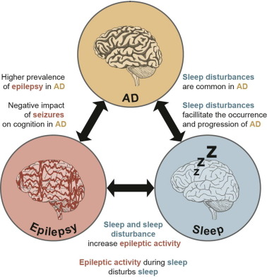
Seizures in Geriatric Patients
May mimic TIA, syncope, sleep disorders, sundowning, dementia behaviors
Initially associated with AD
  Recent literature indicates consistent risk across dementia subtypes
  AD more frequently encountered in clinic
  (Hanke et al., 2022, Arnald et al., 2020)
Notes:
Timing of 9.5 hours limited data due to delay in starting EEG
Study limited due to lack of specified subtypes/clarification of seizure severity

Slide 45
Epilepsy in Patients With Intellectual Disability
1 in 5 patients with ID (IQ <65-75) has epilepsy
Prevalence of epilepsy increases with severity of ID
May be syndromic
  e.g. Lennox Gastaut, Landau Kleffner, Dravet, Doose
Involve neuropsychiatry early
May complicate consent for treatment (e.g. surgery)
(Robertson et al. 2015)
Notes:
Timing of 9.5 hours limited data due to delay in starting EEG
Study limited due to lack of specified subtypes/clarification of seizure severity

Slide 46


Questions?

Slide 47



