Slide 1


How to Break Down Vertigo and Dizziness
Fawad A. Khan, MD
Ochsner Neurosciences Institute
January 13-16, 2024
Key Largo, Florida

Slide 2
Disclosures
Consulting Fee (e.g., Advisory Board):
Eisai, Zimmer Biomet, LivaNova, Neurelis, Inc, Lundbeck, Pfizer
Contracted Research (Principal Investigators must provide information, even if received by the institution):
Amgen, Teva Pharmaceutical, Biohaven Pharmaceutical, Marinus, UCB, Lundbeck, Abbvie
Honoraria:
Natus, Stratus
Speakers' Bureau:
Amgen, UCB, SK Life Science, Lundbeck, Allergan, Lilly USA, Impel Pharmaceuticals, AbbVie

Slide 3
Learning Objectives
Define sense of balance during motion
Describe the anatomy physiology of the Vestibular system and the Vestibular syndromes
Demonstrate a physical examination to test the Vestibular system

Slide 4

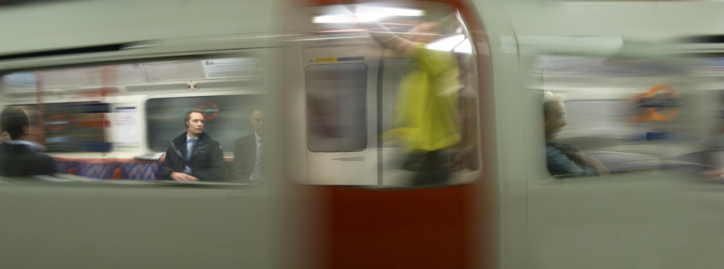

Sense of Balance During Motion
Sensory input from 3 systems is integrated and processed by the brainstem
  Vestibular
  Visual
  Proprioception
Pathological situations

Slide 5
Vestibular System
Reflex pathways that are responsible for making compensatory movements and adjustments in body position.
Pathways that project to the cortex to provide perceptions of gravity and movement.
Components: 3 semicircular ducts (horizontal, anterior and posterior), 2 otolith organs (saccule and utricle), vestibular nuclei, central connections, cortical regions

Slide 6
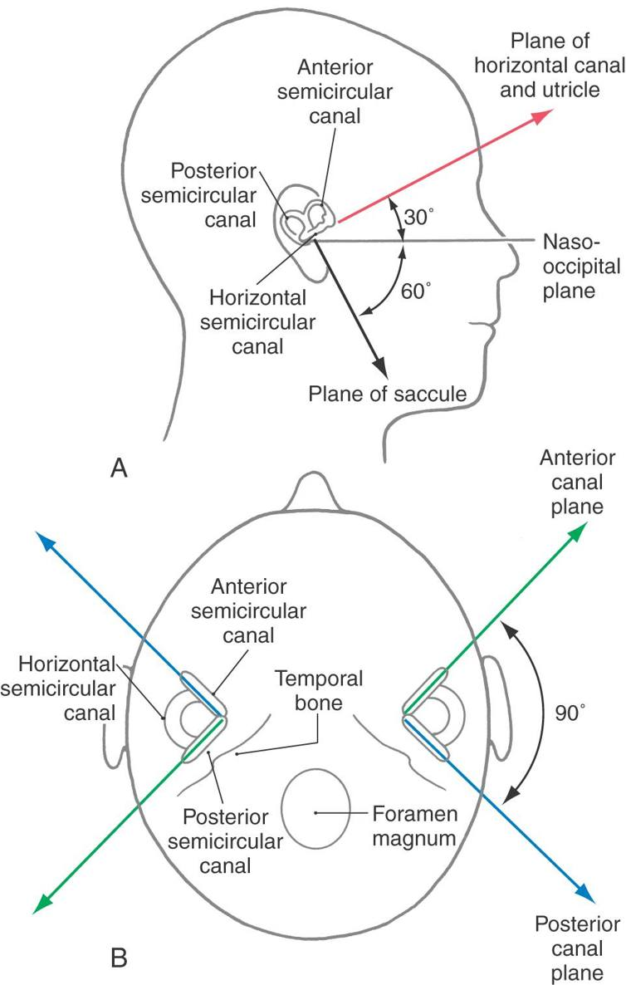
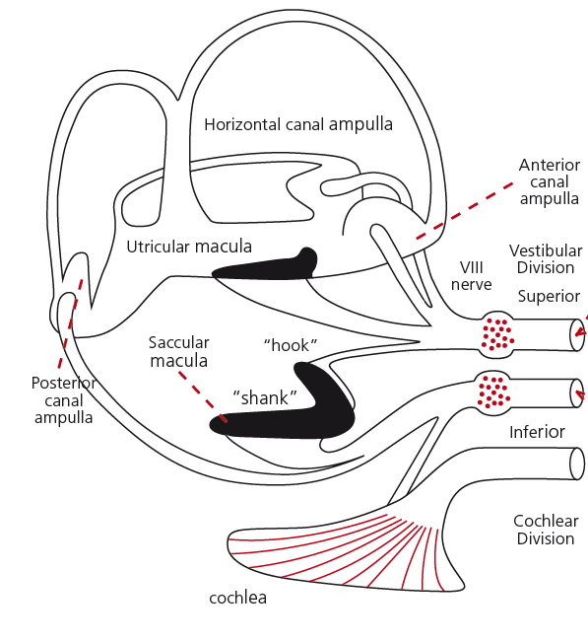
Acceleration
Semicircular ducts - angular acceleration
Utricle: horizontal plane – linear acceleration
Saccule: vertical plane – linear acceleration
The Vestibular System | Neupsy Key

Slide 7
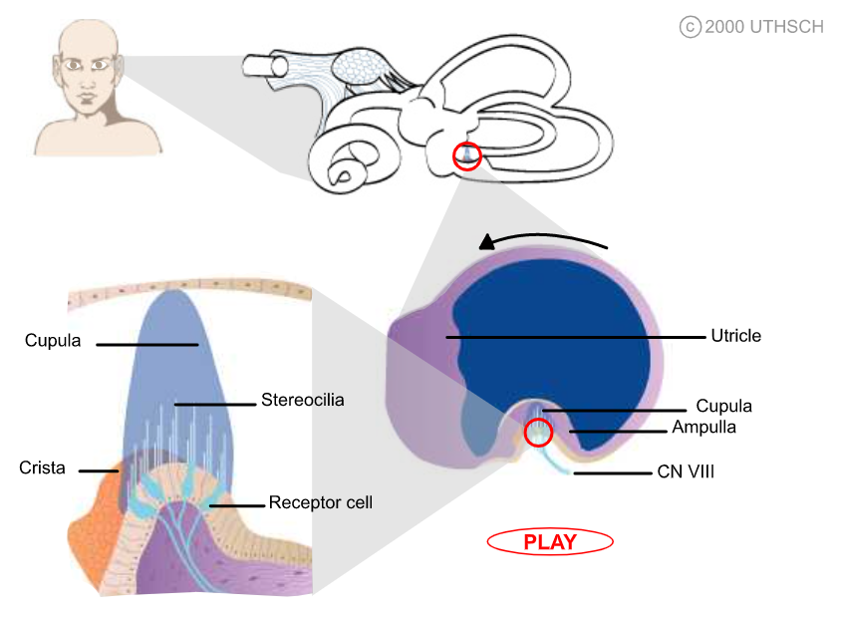
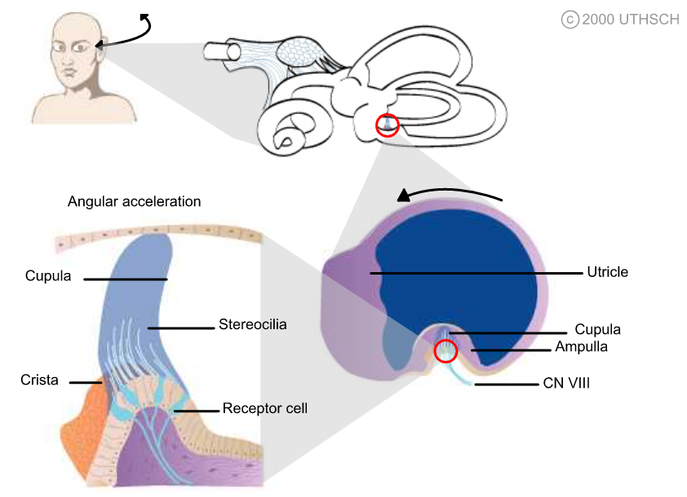
Semicircular ducts
Neuroscience Online - https://nba.uth.tmc.edu/neuroscience/m/s2/chapter10.html

Slide 8
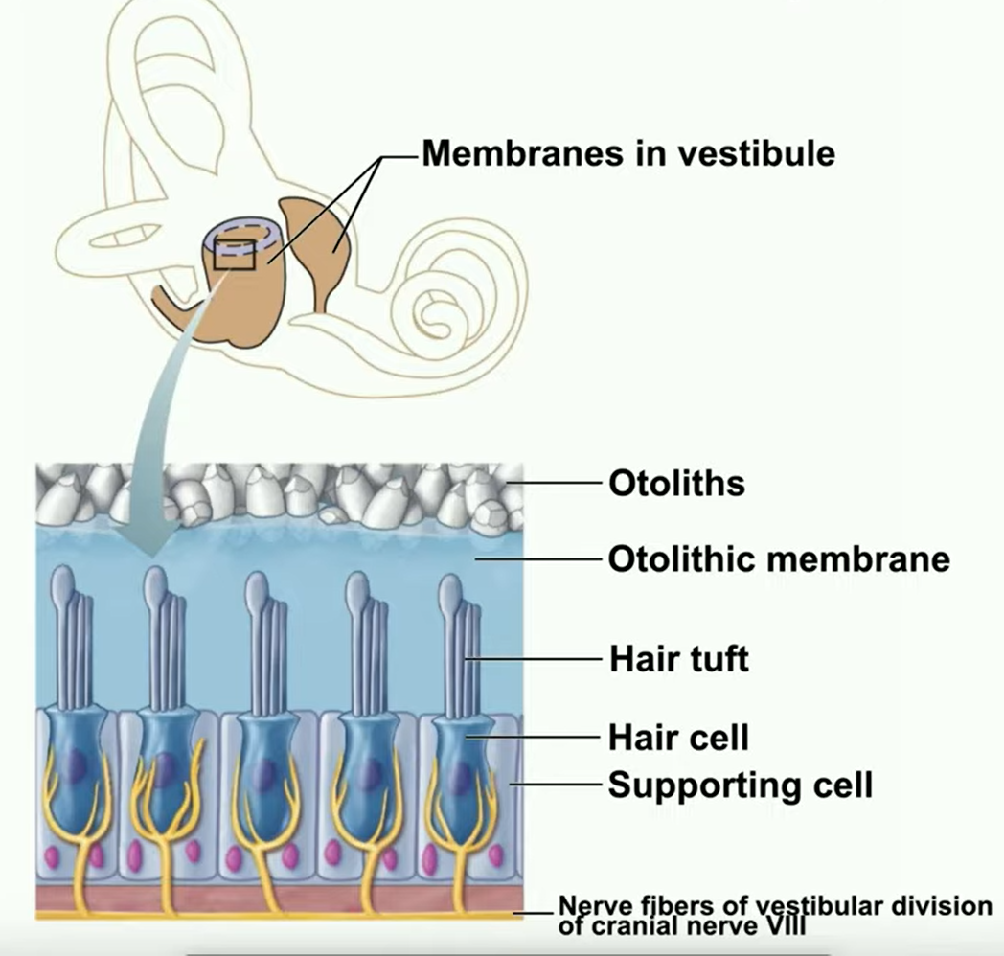
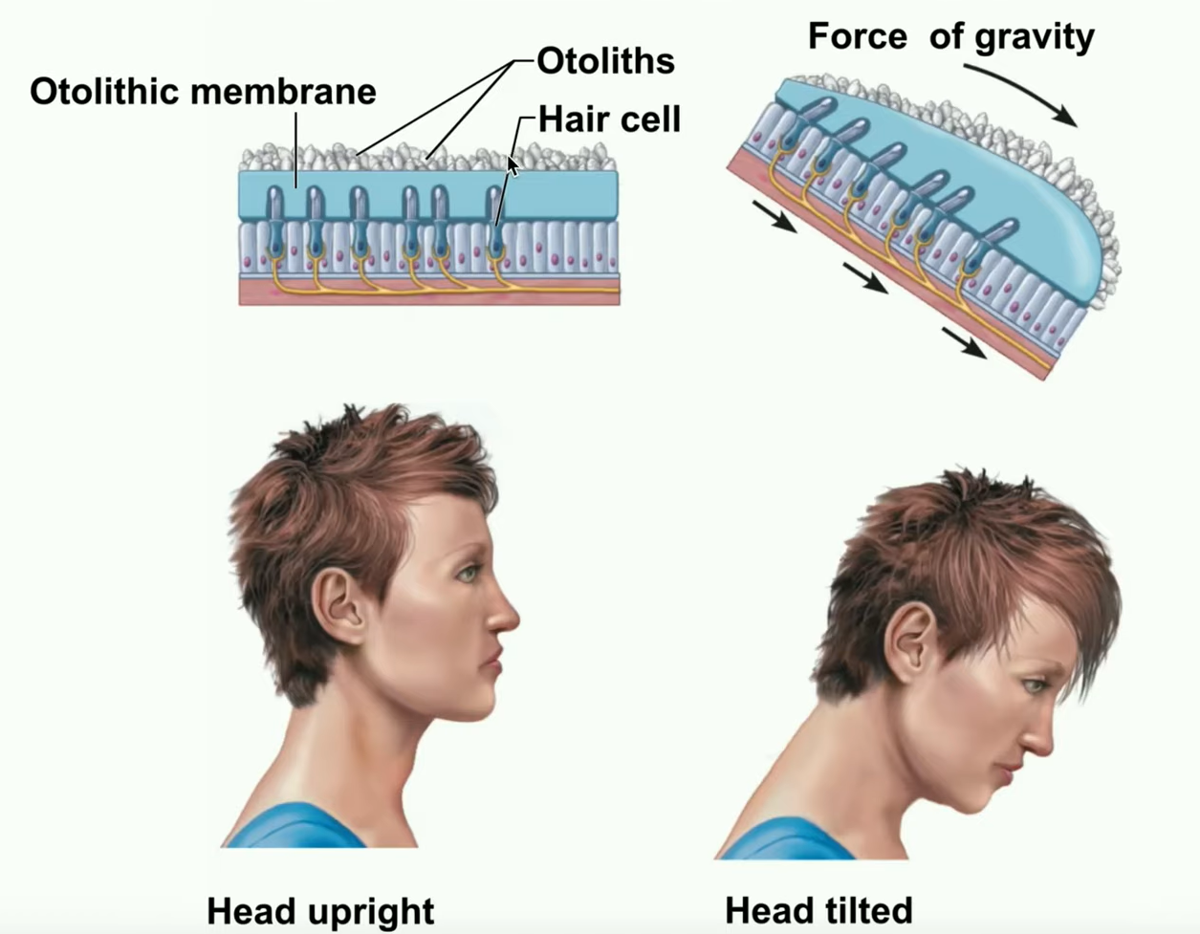
Otolith organs (saccule and utricle)
https://www.youtube.com/watch?v=5iZAnn5HlVw

Slide 9
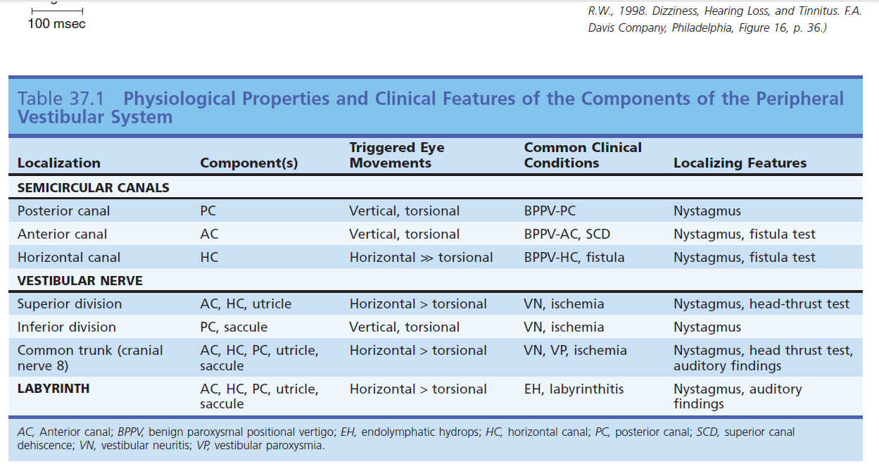
Reflex pathways

Slide 10
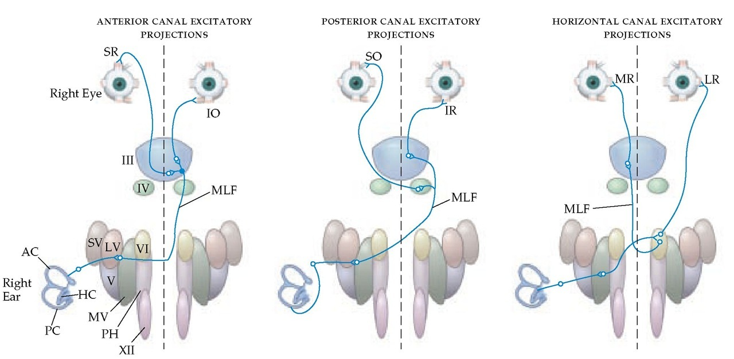
Central reflex pathways
https://www.physio-pedia.com/Vestibular_Anatomy_and_Neurophysiology

Slide 11
Clinical classification
Syndrome
Triggered episodic vestibular syndrome | Repetitive episodes of dizziness that are triggered Completely asymptomatic at rest Develop dizziness (usually lasting < 1 min) that is reliably triggered by a specific head movement or postural shift (i.e., standing or sitting up)
Spontaneous episodic vestibular syndrome | Multiple episodes of dizziness (usually lasting minutes-hours) that comes on without any clear identifiable trigger Some relationship to sleep deprivation, stress, or hormonal changes Completely asymptomatic at rest
Acute vestibular syndrome | Acute dizziness that begins abruptly or very rapidly and persists continuously for days/weeks Dizzy at rest Exacerbated by movement but it is not triggered by movement

Slide 12
Clinical classification
Syndrome | Common Benign Cause | Dangerous Cause(s)
Triggered episodic vestibular syndrome | Benign paroxysmal positional vertigo Anxiety or panic disorder Cervicogenic vertigo Medication side effects Postural hypotension Ménière’s disease | Posterior fossa tumor Demyelinating diseases
Spontaneous episodic vestibular syndrome | Vestibular migraine | Transient ischemic attack Ictal vertigo Cardiac dysrhythmia
Acute vestibular syndrome | Vestibular neuritis | Stroke Multiple sclerosis

Slide 13
Clinical Approach – History
Dizzy ED patients changed their ‘type’ of dizziness 50% of the time when asked repeated questions in a different sequence within 10 min
  Newman-Toker DE, Cannon LM, Stofferahn ME, Rothman RE, Hsieh YH, Zee DS. Imprecision in patient reports of dizziness symptom quality: a cross-sectional study conducted in an acute care setting. Mayo Clin Proc 2007;82:1329–40.
Onset of symptoms - spontaneous, head or visual motion provoked
Pattern - Intermittent or continuous
Provocative factors – heads positions, sneezing
Duration of episodes - seconds, minutes, hours, days, weeks
Type of dizziness*
Neurological symptoms - double vision, oscillopsia, dysarthria, sensory or gait disturbances
Constitutional symptoms- nausea, vomiting, headaches, motion sickness, intolerance of light, palpitations, anxiety, drop attacks
Specific hearing: aural fullness, tinnitus (pulsating, quality), progressive/fluctuating hearing loss, sensitive to noise/ intolerance of sound
Past medical history –head trauma, meningitis back surgery, diabetes, ototoxic drugs (ex: gentamicin, marijuana use)

Slide 14
What is “Dizziness”
Dizziness
Vertigo
Presyncope
Syncope
Unsteadiness
Directional pulsion
Mal de embarquement

Slide 15
The physical exam
Why Physical exam?:
PE identified all stroke patients, as compared to DWI-MRI performed within 48 h of symptom onset
  Kattah JC, Talkad AV, Wang DZ, Hsieh YH, Newman-Toker DE. HINTS to diagnose stroke in the acute vestibular syndrome: three-step bedside oculomotor examination more sensitive than early MRI diffusion-weighted imaging. Stroke 2009; 40:3504–10.
Cranial nerve, cerebellar, and gait testing - up to 60% sensitivity for stroke
  EdlowJA, Newman-Toker DE, Savitz SI. Diagnosis and initial management of cerebellar infarction. Lancet Neurol 2008;7:951–64.
Vast majority of patients with cerebellar stroke also have nystagmus
  Lee H, Sohn SI, ChoYW, et al. Cerebellar infarction presenting isolated vertigo: frequency and vascular topographical patterns. Neurology 2006;67:1178–83
Facial motor
Face sensory exam for symmetry (pain and temperature)
Eye movements
Dysarthria, dysphagia
Finger-to-nose (or finger-to-chin)
Heel-to-shin
Gait testing and assess for truncal ataxia
Other cerebellar exams:
  Finger tapping, heel tapping
  Arm pulling test (overshoot)

Slide 16
Eye motility exams
Smooth pursuit – jerky, saccadic, slow initiation, ocular dysmetria
Saccadic eye movements – overshooting with correction
Skew deviation – cover uncover test reveals refixation – horizontal, vertical misalignment

Slide 17
Nystagmus
Rhythmic oscillation - Slow deviation followed by corrective fast nystagmus otherwise eyes would have been pinned
Allows eyes to be ready to focus on new arriving targets in the field of rotation and/or fixation can be maintained
Examples: – vestibular stimulation, optokinetic, lateral gaze
Jerk nystagmus - the eyes slowly drift off target (the pathologic phase) and then snap back to the target (by convention, this ‘‘fast phase’’ is the direction that is named)
Pathological nystagmus:
Spontaneous nystagmus
Positional nystagmus
Nystagmus during special testing
Gaze evoked nystagmus

Slide 18
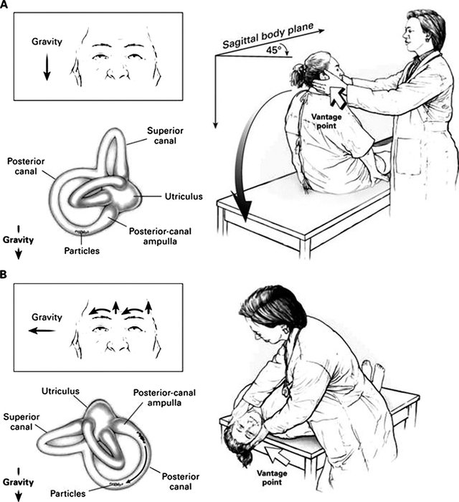
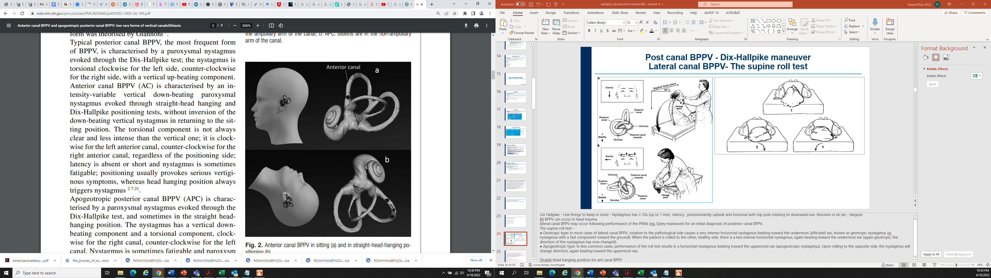
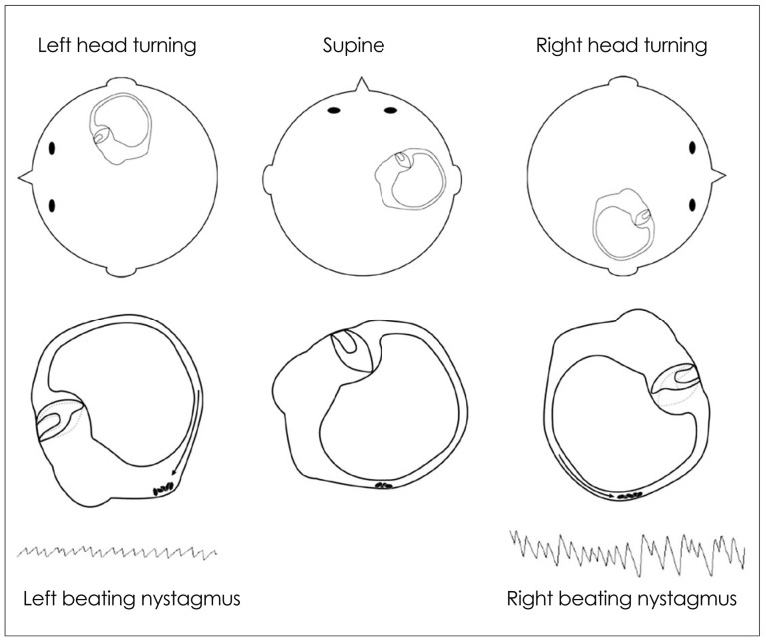
Nystagmus
Bhattacharyya, Neil, et al. "Clinical practice guideline: benign paroxysmal positional vertigo (update)." Otolaryngology–Head and Neck Surgery 156.3_suppl (2017): S1-S47.
Califano, L., et al. "Anterior canal BPPV and apogeotropic posterior canal BPPV: two rare forms of vertical canalolithiasis." ACTA otorhinolaryngologica italica 34.3 (2014): 189.
Huh, Young-Eun, and Ji-Soo Kim. "Bedside evaluation of dizzy patients." Journal of clinical neurology 9.4 (2013): 203-213.

Slide 19
Head impulse test - vestibulo-ocular reflex (VOR)
Can test that assesses all 6 semicircular canals independently
Indication:
Essential in determining - superior vs inferior branch of the nerve, unilateral vs bilateral, affecting the anterior, posterior or lateral canals.
  Newman-Toker, David E., et al. "Normal head impulse test differentiates acute cerebellar strokes from vestibular neuritis." Neurology 70.24 Part 2 (2008): 2378-2385.
  Edlow, Jonathan A., and David Newman-Toker. "Using the physical examination to diagnose patients with acute dizziness and vertigo." The Journal of emergency medicine 50.4 (2016): 617-628

Slide 20
Other tests
Caloric vestibular testing
Cervical Vestibular Evoked Myogenic Potential (cVEMP)
Ocular Vestibular Evoked Myogenic Potential (oVEMP)

Slide 21


Questions

