Slide 1


Artificial Intelligence in Neurology
Fawad A. Khan, MD
Ochsner Neurosciences Institute
January 13-16, 2024
Key Largo, Florida

Slide 2
Disclosures
Consulting Fee (e.g., Advisory Board):
Eisai, Zimmer Biomet, LivaNova, Neurelis, Inc, Lundbeck, Pfizer
Contracted Research (Principal Investigators must provide information, even if received by the institution):
Amgen, Teva Pharmaceutical, Biohaven Pharmaceutical, Marinus, UCB, Lundbeck, Abbvie
Honoraria:
Natus, Stratus
Speakers' Bureau:
Amgen, UCB, SK Life Science, Lundbeck, Allergan, Lilly USA, Impel Pharmaceuticals, AbbVie

Slide 3
Learning Objectives
Describe the role of AI in Healthcare & Neurology
Describe the societal and ethical issues of AI in Healthcare
List the Federal Regulations

Slide 4
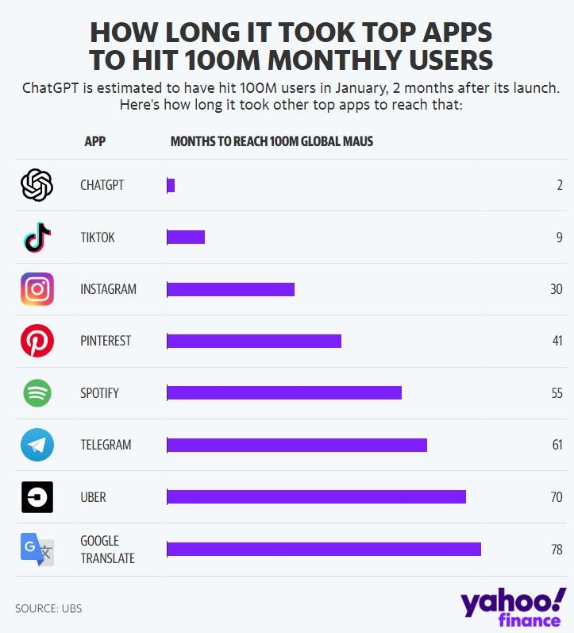
Why is this important
https://finance.yahoo.com/news/chatgpt-on-track-to-surpass-100-million-users-faster-than-tiktok-or-instagram-ubs-214423357.html

Slide 5
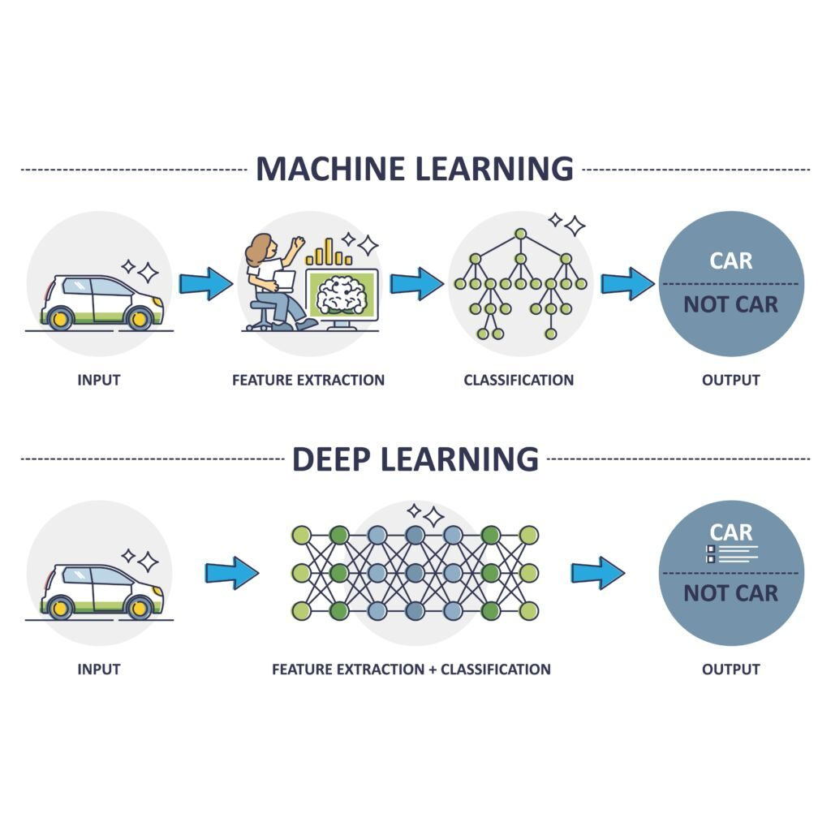
Definitions
Artificial Intelligence (AI) is a scientific field concerned with the development of algorithms that allow computers to learn without being explicitly programmed
Machine Learning (ML) is a branch of AI, which focuses on methods that learn from data and make predictions on unseen data (task oriented)
Types of ML
Supervised: learning with labeled data
  Example: email classification, image classification
Unsupervised: discover patterns in unlabeled data
  Example: cluster similar data points
Reinforcement learning: learn to act based on feedback/reward
  Example: learn to play Go
https://datascienceathome.com/deep-learning-vs-tabular-models-ep-217/

Slide 6
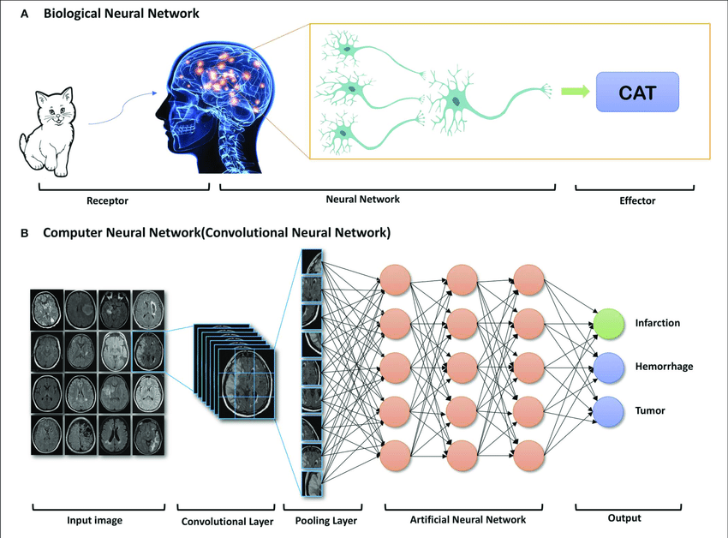
Definitions
Deep learning (DL) is a machine learning subfield that uses multiple layers for learning data representations
DL is exceptionally effective at learning patterns
DL methods automatically learn various layers of representations from training data, using neural network models to build complex, layered representations.
Zhu G, Jiang B, Tong L, Xie Y, Zaharchuk G, Wintermark M. Applications of Deep Learning to Neuro-Imaging Techniques. Front Neurol. 2019 Aug 14;10:869. doi: 10.3389/fneur.2019.00869.

Slide 7
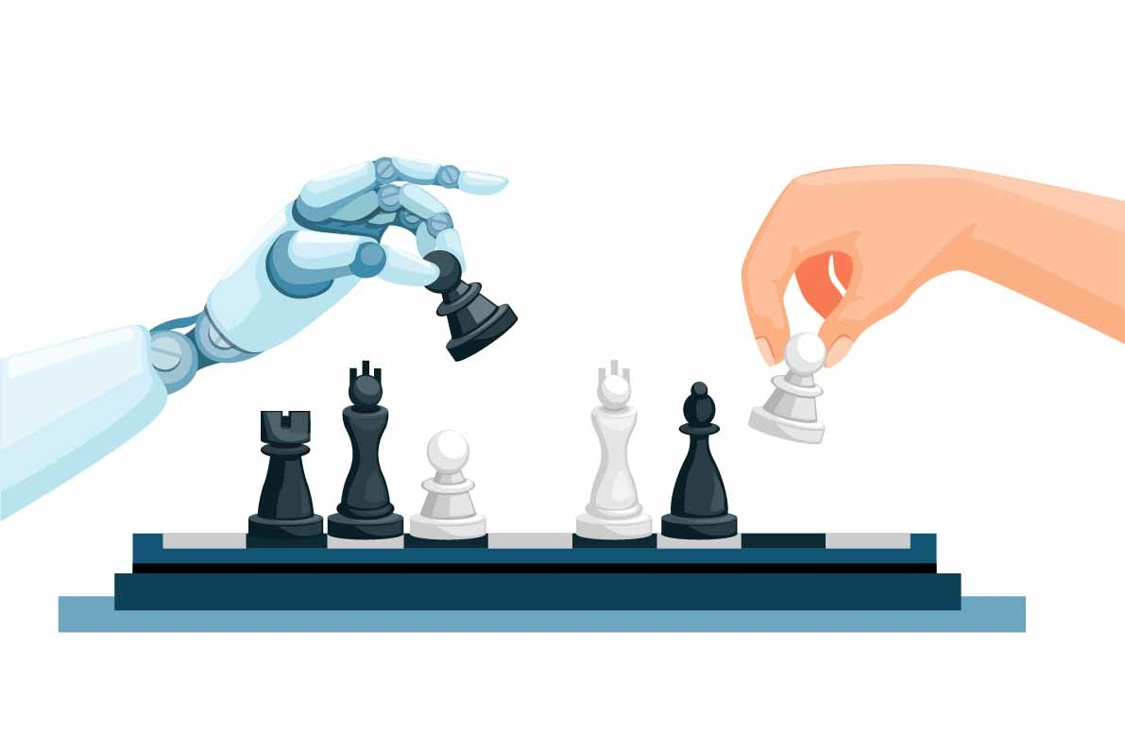
ML in Medical Imaging
Skin cancer detection
  Tschandl P﻿, Rinner C﻿, Apalla Z﻿, et al. Human-computer collaboration for skin cancer recognition. ﻿ Nat Med. 2020;26(8):1229-1234.
Diabetic retinopathy in retinal fundus photographs
  Gulshan V﻿, Peng L﻿, Coram M﻿, et al. Development and validation of a deep learning algorithm for detection of diabetic retinopathy in retinal fundus photographs. ﻿ JAMA. 2016;316(22):2402-2410.
Histopathology
  van der Laak J﻿, Litjens G﻿, Ciompi F﻿. Deep learning in histopathology: the path to the clinic. ﻿ Nat Med. 2021;27(5):775-784

Slide 8
ML in Healthcare
ML tools could support complex clinical decision-making and could automate many of the mundane tasks that may waste clinician time and lead to work dissatisfaction.
Challenges
Topol EJ. High-performance medicine: the convergence of human and artificial intelligence. Nat Med 2019;25:44–56.
Cohen JP, Cho T, Viviano JD, et al.. Problems in the deployment of machine-learned models in health care. CMAJ 2021. Aug. 30

Slide 9
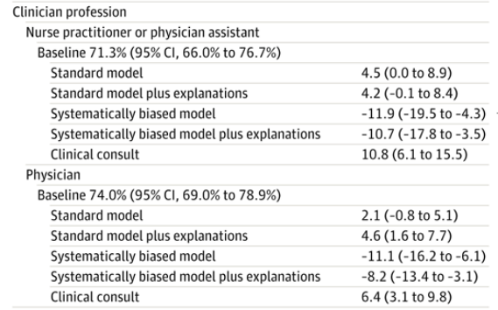
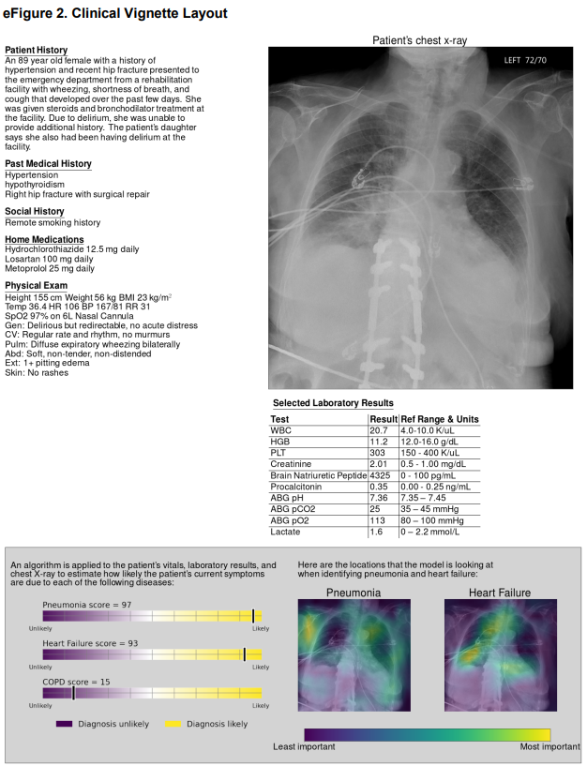
Diagnostic support
Jabbour S, Fouhey D, Shepard S, et al. Measuring the Impact of AI in the Diagnosis of Hospitalized Patients: A Randomized Clinical Vignette Survey Study. JAMA. 2023;330(23):2275–2284.

Slide 10
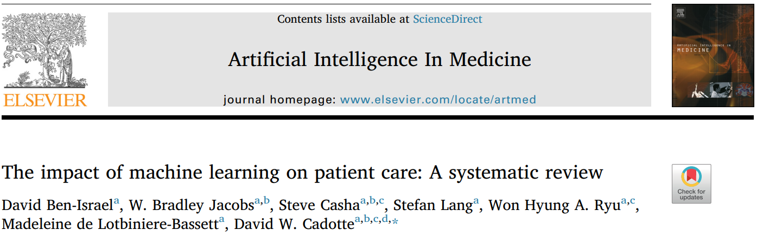
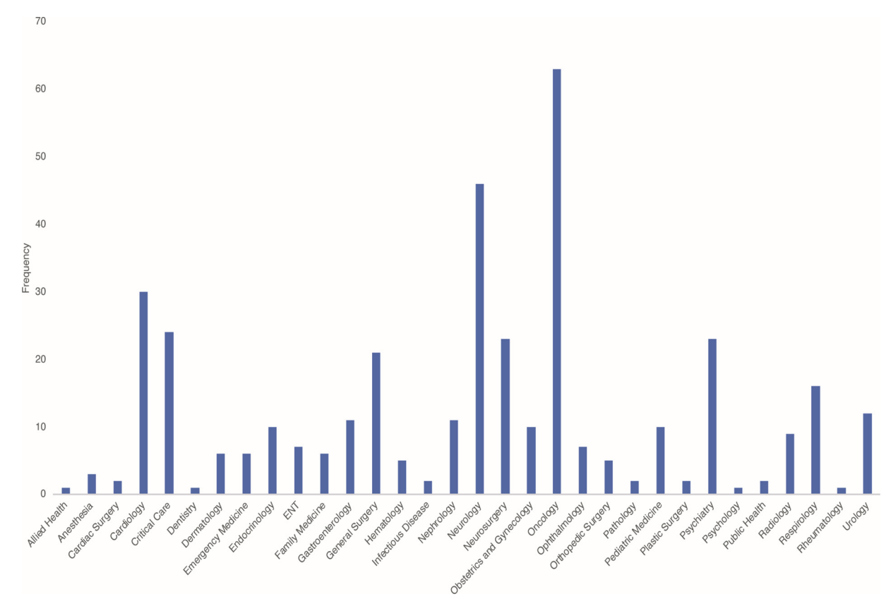
AI in neurology
A systematic review was performed in accordance with the PRISMA guidelines using Medline, EBM Reviews, Embase, Psych Info, and Cochrane Databases, focusing on human studies that used ML to directly address a clinical problem
Included studies were published from January 1, 2000 to May 1, 2018
Ben-Israel D, Jacobs WB, Casha S, Lang S, Ryu WHA, de Lotbiniere-Bassett M, Cadotte DW. The impact of machine learning on patient care: A systematic review. Artif Intell Med. 2020 Mar;103:101785. doi: 10.1016/j.artmed.2019.101785.
Notes:
Calgary team

Slide 11
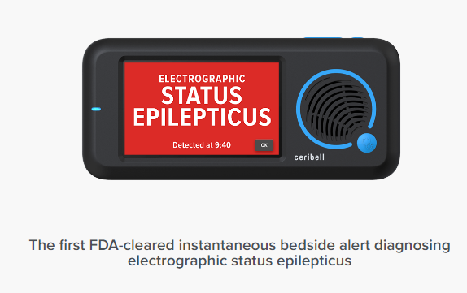
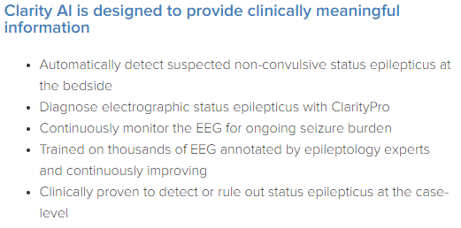
Diagnostic Neurology – EEG
.
Epilog EEG data from patients at clinical partner epilepsy centers were used to determine which specific features, machine learning model types, and machine learning model hyperparameters.
  Frankel MA, Lehmkuhle MJ, Spitz MC, Newman BJ, Richards SV, Arain AM. Wearable Reduced-Channel EEG System for Remote Seizure Monitoring. Front Neurol. 2021 Oct 18;12:728484. doi: 10.3389/fneur.2021.728484
https://ceribell.com/clarity-study/
Notes:
As would be with intern, limitations, weak areas, immature bias

Slide 12
Diagnostic Neurology – EEG
Data were collected from 169 patients who wore a wearable single-channel EEG sensors alongside standard-of-care 19+ wired-channel video-EEG monitoring. 58 of these patients had epileptologist-noted seizure activity in their wired EEG records. The raw, single-channel EEG data was processed through a pipeline that included denoising, detrending, and artifact rejection, standardized using a sliding window across the many-day record, and then reshaped into 2-s, non-overlapping segments. A total of 61 features were extracted for each data
Conclusions: This work explored a machine learning framework that has the ability to detect seizures across a varied patient population from just a single-channel EEG wearable sensor. Our initial results of the segmented-data detection show promise that a non-patient-specific seizure detection algorithm can support those with seizure disorders in their everyday lives.
.
https://www.aesnet.org/abstractslisting/non-patient-specific-seizure-detection-from-single-channel-eeg-using-data-standardization-and-feature-normalization

Slide 13
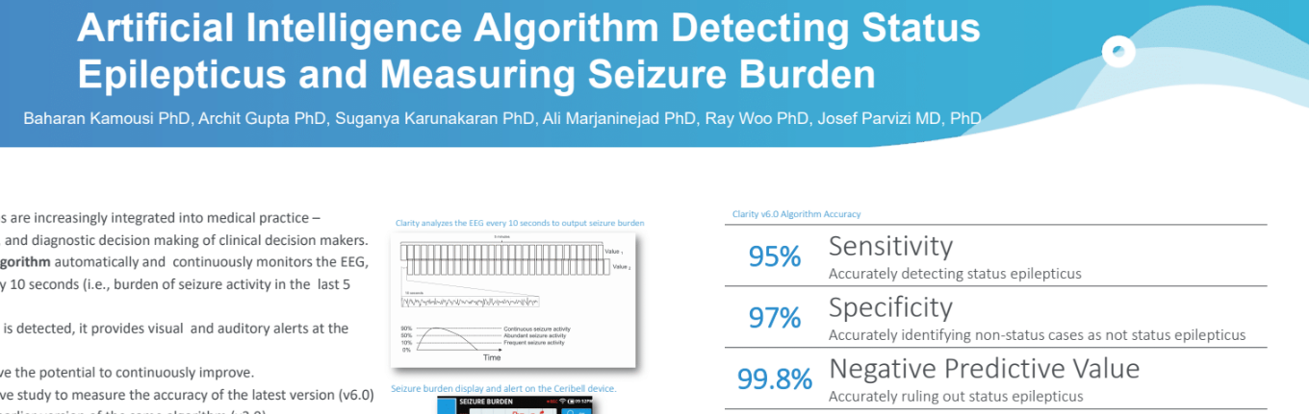
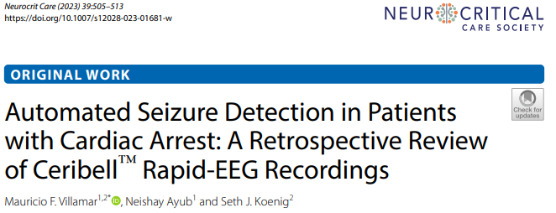
Diagnostic Neurology – EEG
https://ceribell.com/clarity-study/
.
4 of 21 patients with cardiac arrest (19.0%) who underwent Rapid-EEG monitoring had multiple electrographic seizures, and 2 of those patients (9.5%) had electrographic status epilepticus within the first 24 h of the study. None of these ictal abnormalities were detected by the seizure detection system. The system showed 0% seizure burden throughout the entirety of all four Rapid-EEG recordings, including the EEG pages that showed definite seizures or status epilepticus.

Slide 14
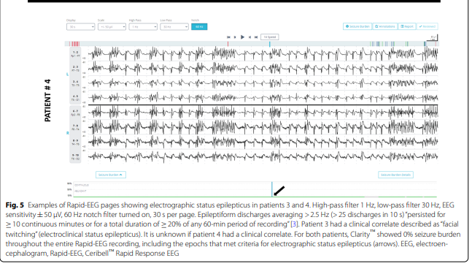
Example

Slide 15
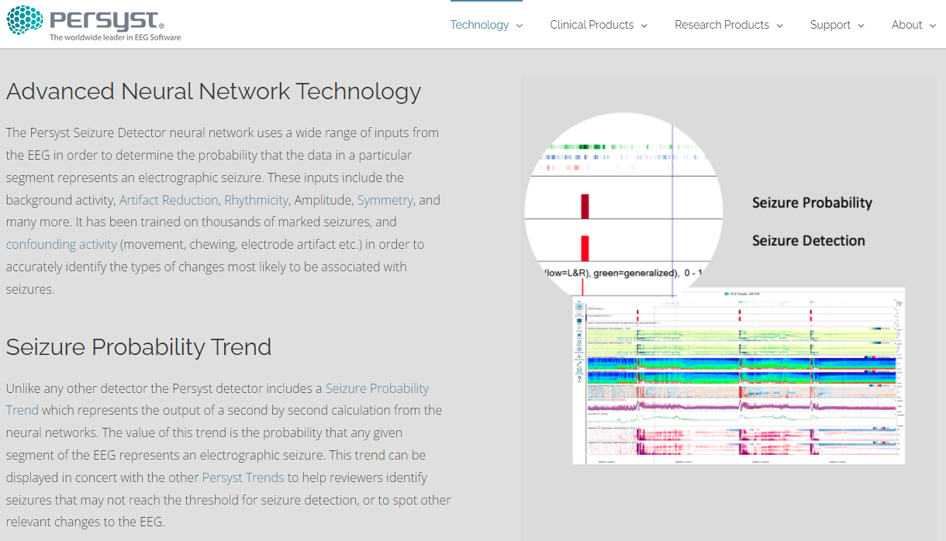
Diagnostic Neurology – EEG
Persyst seizure detection tool (P14) in EMU recordings showed noninferior seizure detection performance compared to human experts
  Scheuer ML, Wilson SB, Antony A, Ghearing G, Urban A, Bagić AI. Seizure detection: interreader agreement and detection algorithm assessments using a large dataset. J Clin Neurophysiol. 2021;38(5):439-447

Slide 16
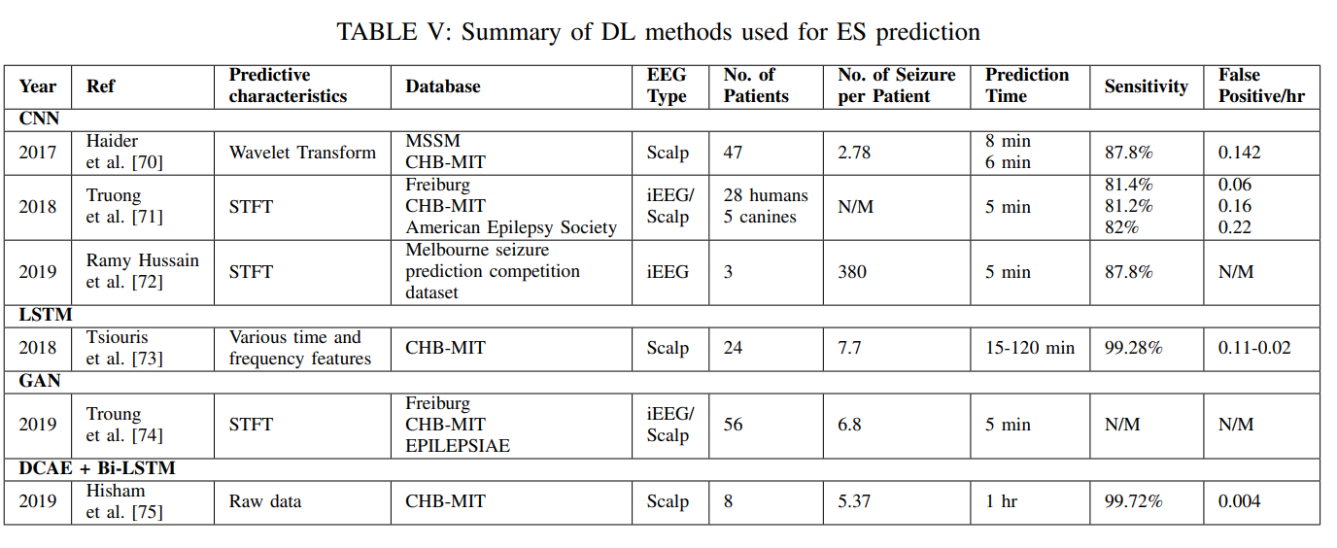
Diagnostic Neurology – seizure prediction (pre-ictal)
EEG ML-based prediction. These algorithms can be trained to learn patterns from a big database by processing it throughout a multi-layer hierarchical architecture, allowing seizure detection and might provide warnings to patients, allowing for acute treatment at the time of seizure onset
Rasheed K, Qayyum A, Qadir J, Sivathamboo S, Kwan P, Kuhlmann L, O'Brien T, Razi A. Machine Learning for Predicting Epileptic Seizures Using EEG Signals: A Review. IEEE Rev Biomed Eng. 2021;14:139-155.

Slide 17
Diagnostic Neurology – seizure prediction (pre-ictal)
In 188 pre-recorded epileptic seizures in 49 patient cohort, patient-specific algorithm results show high quality results with high accuracy and sensitivity of 95%, and a reduced false positive trend of 0.023 false alarms per hour. 10-13 min in advance
  Torres-Gaona G, Aledo-Serrano Á, García-Morales I, Toledano R, Valls J, Cosculluela B, Munsó L, Raurich X, Trejo A, Blanquez D, Gil-Nagel A. Artificial intelligence system, based on mjn-SERAS algorithm, for the early detection of seizures in patients with refractory focal epilepsy: A cross-sectional pilot study. Epilepsy Behav Rep. 2023 Apr 5;22:100600.

Slide 18
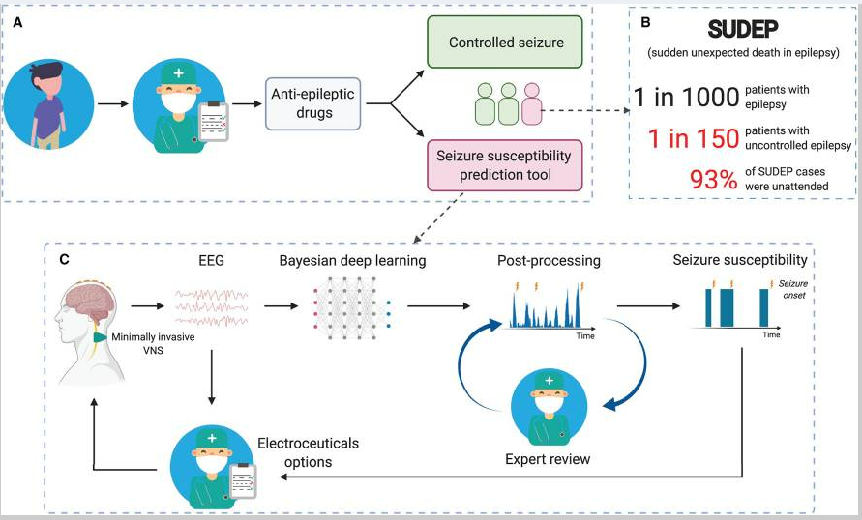
Diagnostic Neurology – seizure prediction (interctal)
Truong ND, Yang Y, Maher C, Kuhlmann L, McEwan A, Nikpour A, Kavehei O. Seizure Susceptibility Prediction in Uncontrolled Epilepsy. Front Neurol. 2021 Sep 13;12:721491
Notes:
Auastralian group
Conceptual model

Slide 19
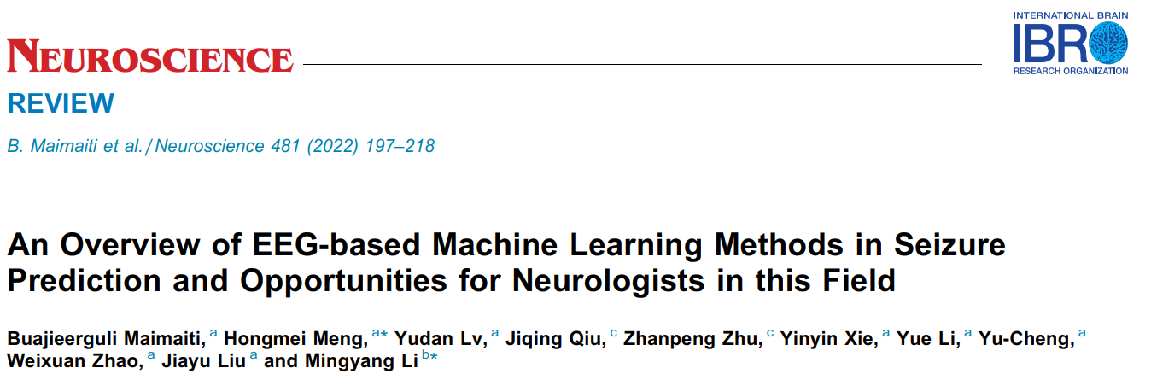
Diagnostic Neurology – seizure prediction (interctal/forecasting)
Notes:
https://pubmed.ncbi.nlm.nih.gov/34793938/

Slide 20
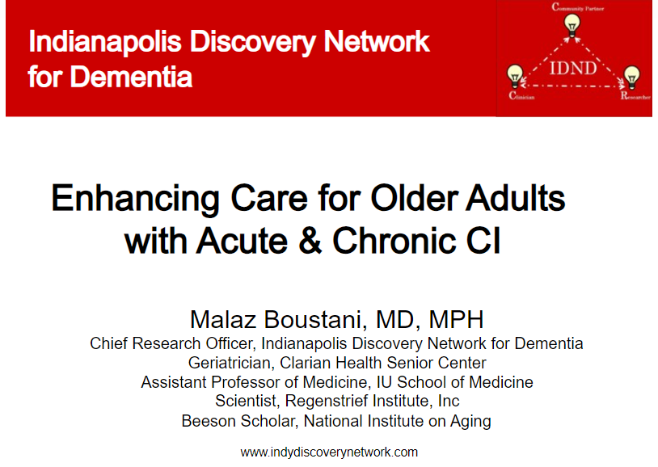

Diagnostic Neurology –prediction of Alzheimer's disease
Currently, tests to screen for dementia risk are invasive, time-consuming and expensive.
Prediction may provide the opportunity for early screening and for delaying the onset of the disease through adequate health plan-based interventions.
  Malaz Boustani, Anthony J. Perkins, Rezaul Karim Khandker, Stephen Duong, Paul R. Dexter, Richard Lipton, Christopher M. Black, Vasu Chandrasekaran, Craig A. Solid, Patrick Monahan. Passive Digital Signature for Early Identification of Alzheimer's Disease and Related Dementia. Journal of the American Geriatrics Society, 2019
  Zina Ben Miled, Kyle Haas, Christopher M. Black, Rezaul Karim Khandker, Vasu Chandrasekaran, Richard Lipton, Malaz A. Boustani. Predicting dementia with routine care EMR data. Artificial Intelligence in Medicine, 2020; 102: 101771
Notes:
https://pubmed.ncbi.nlm.nih.gov/34793938/

Slide 21
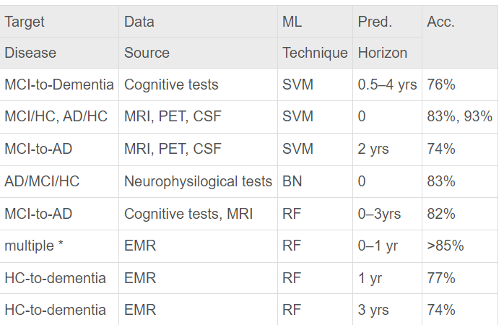
Diagnostic Neurology –prediction of Alzheimer's disease
The researchers developed and tested ML using data from EMRs to identify patients who may be at risk for developing the dementia 1-3 yrs prior to the onset of the disease without any additional monitoring or screening.
The model was analyzed and was found not to be affected by biases related to institution affiliation, race or gender.
The clinical features are extracted from prescriptions, diagnosis and medical notes. The diagnosis features suggested by domain experts were confirmed by the exploratory models developed from the prescriptions data set.
The study also shows that medical notes are the best source of predictive features.
Williams J.A., Weakley A., Cook D.J., Schmitter-Edgecombe M.: Machine learning techniques for diagnostic differentiation of mild cognitive impairment and dementia. Workshops at the twenty-seventh AAAI conference on artificial intelligence 2013; pp. 71-76.
Notes:
Generalizable, cost effective
Using routine care EMR data to develop the proposed models makes them accessible to a wide range of patients at a reduced cost. Despite this fact, the proposed models have a performance comparable to dementia models that are based on specialized medical tests such as MRI and cognitive tests
support vector machine
Random fiorrests
Naive Bayesian network

Slide 22
ChatGPT
OpenAI was founded in December 2015 by Sam Altman, Greg Brockman, Elon Musk, Ilya Sutskever, Wojciech Zaremba, and John Schulman.
ChatGPT is an artificial intelligence (AI) chatbot built on top of OpenAI's foundational large language models (LLMs) like GPT-4 and its predecessors.
AI that understands context, nuance, and even humor.
OpenAI released ChatGPT on November 30, 2022
Use are broad (non-clinical and clinical)
Applications in healthcare
Notes:
As would be with intern, limitations, weak areas, immature bias

Slide 23
LLM in healthcare for public
The healthcare industry’s first safety-focused LLM is designed with an initial emphasis on patient-facing, non-diagnostic applications.
This model has outperformed GPT-4 on over 100 healthcare certifications, expresses compassion
Reinforcement learning with human feedback (RLHF) via healthcare professionals, training on healthcare-specific vocabulary, and creating the model from scratch.
Most language models pre-train on the common crawl of the Internet, which may include incorrect and misleading information. Unlike these LLMs, we invest heavily in legally acquiring evidence-based healthcare content.
At the heart of every single work we undertake we pay critical attention to address bias and fairness over time. This directly includes working with policy makers, researchers and affected communities to gain insights on our systems.
The Physician Advisory Council (health systems and digital health companies and medical information pioneers) reflects the commitment to building the safest and most medically accurate LLM possible.
We aim to minimize the effect of bias in LLMs by seeking a diverse and representative dataset for training.
Our models follow the Hippocratic Oath philosophy and only surfaces evidence-based recommendations aligned to the highest standards of care.
https://www.hippocraticai.com/safety
Notes:
, Oct. 10, 2023
Do not involve people in the development phase thar understand - patient experience, medical care paths and more; and serve as a resource on specific medical topics, including clinical workflows, patient engagement protocols, safety and quality policies, and clinical education.

Slide 24
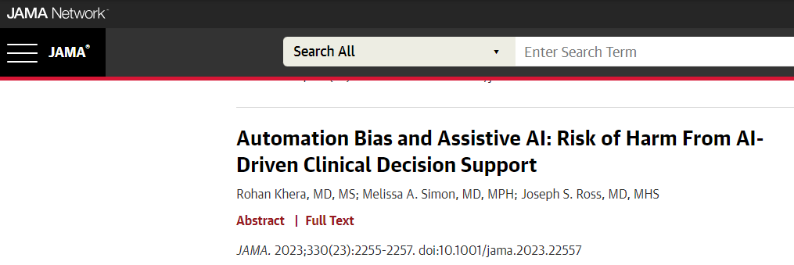
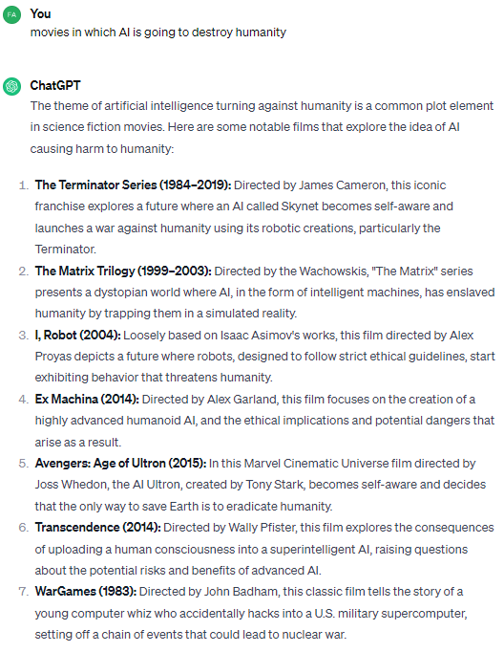

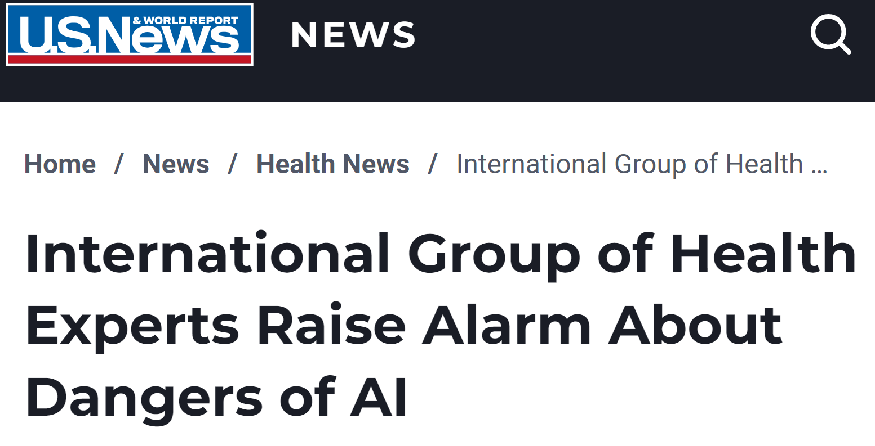
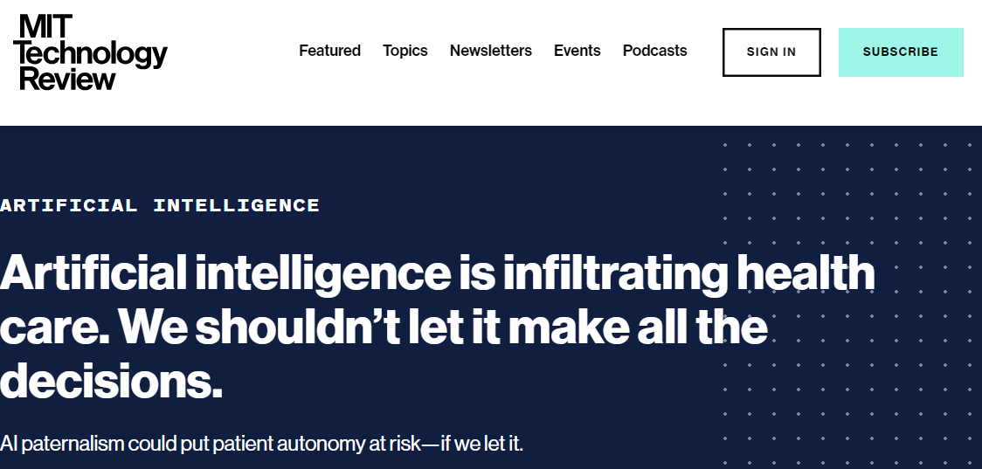
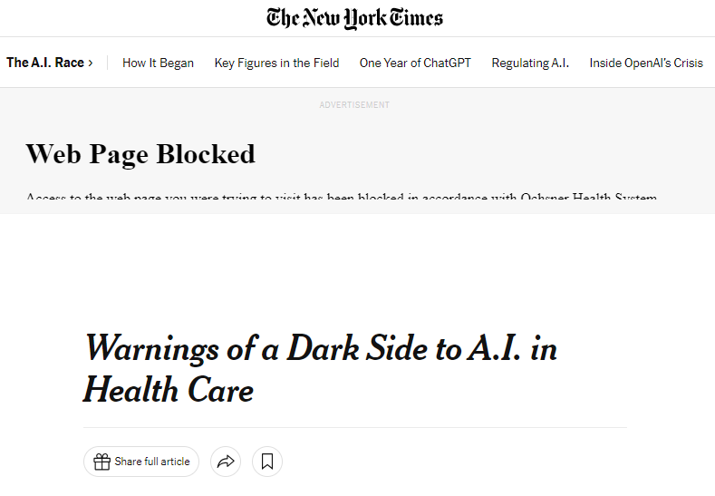
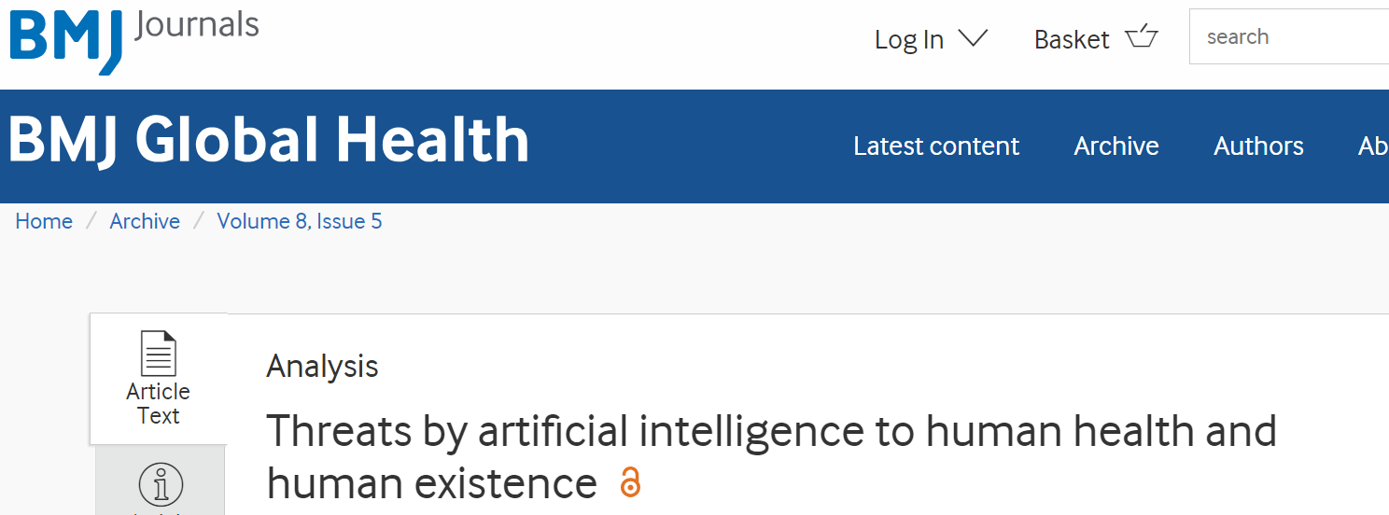
The Risks & Fears

Slide 25
The Big Issue
Technological limitations
Underperformance
Biased predictions based on clinically irrelevant findings
  Jabbour S﻿, Fouhey D﻿, Kazerooni E﻿, Sjoding MW﻿, Wiens J﻿. Deep learning applied to chest x-rays: exploiting and preventing shortcuts. ﻿ Proc Mach Learn Res. 2020;126:750-782.
Systematically biased AI models can lead to errors and potential harm
Exacerbate biases - widespread in health care disparities
Lack of awareness - 66.7% of participants were unaware that AI models could be systematically biased
  Jabbour S, Fouhey D, Shepard S, et al. Measuring the Impact of AI in the Diagnosis of Hospitalized Patients: A Randomized Clinical Vignette Survey Study. JAMA. 2023;330(23):2275–2284.
  Examples:
  AI model trained on data in which female patients are consistently underdiagnosed for heart disease may learn this bias and underdiagnose females if deployed
  Beery TA﻿. Gender bias in the diagnosis and treatment of coronary artery disease. ﻿ Heart Lung. 1995;24(6):427-435.
  AI model misdiagnosing certain race
  Gichoya JW﻿, Banerjee I﻿, Bhimireddy AR﻿, et al. AI recognition of patient race in medical imaging: a modelling study. ﻿ Lancet Digit Health. 2022;4(6):e406-e414.
  Obermeyer Z﻿, Powers B﻿, Vogeli C﻿, Mullainathan S﻿. Dissecting racial bias in an algorithm used to manage the health of populations. ﻿ Science. 2019;366(6464):447-453.
Need appropriate governance
Issues with overreliance
  Vasconcelos H﻿, Jörke M﻿, Grunde-McLaughlin M﻿, Gerstenberg T﻿, Bernstein MS﻿, Krishna R﻿. Explanations can reduce overreliance on AI systems during decision-making. ArXiv.

Slide 26

US Govt - Regulation
US FDA highlights the importance of providing clinicians with the ability to independently review the basis for software recommendations, including the information and logic used in a model’s decisions
https://www.whitehouse.gov/briefing-room/presidential-actions/2023/10/30/executive-order-on-the-safe-secure-and-trustworthy-development-and-use-of-artificial-intelligence/

Slide 27
Within 90 days of the date of this order, the Secretary of HHS shall, in consultation with the Secretary of Defense and the Secretary of Veterans Affairs, establish an HHS AI Task Force that shall, within 365 days of its creation, develop a strategic plan that includes policies and frameworks — possibly including regulatory action, as appropriate — on responsible deployment and use of AI and AI-enabled technologies in the health and human services sector (including research and discovery, drug and device safety, healthcare delivery and financing, and public health), and identify appropriate guidance and
resources to promote that deployment, including in the following areas:
(A) development, maintenance, and use of predictive and generative AI-enabled technologies in healthcare delivery and financing — including quality measurement, performance improvement, program integrity, benefits administration, and patient experience — taking into account considerations such as appropriate human oversight of the application of AI-generated output;
(B) long-term safety and real-world performance monitoring of AI-enabled technologies in the health and human services sector, including clinically relevant or significant modifications and performance across population groups, with a means to communicate product updates to regulators, developers, and users;
(C) incorporation of equity principles in AI-enabled technologies used in the health and human services sector, using disaggregated data on affected populations and representative population data sets when developing new models, monitoring algorithmic performance against discrimination and bias in existing models, and helping to identify and mitigate discrimination and bias in current systems;
(D) incorporation of safety, privacy, and security standards into the software-development lifecycle for protection of personally identifiable information, including measures to address AI-enhanced cybersecurity threats in the health and human services sector;
(E) development, maintenance, and availability of documentation to help users determine appropriate and safe uses of AI in local settings in the health and human services sector;
(F) work to be done with State, local, Tribal, and territorial health and human services agencies to advance positive use cases and best practices for use of AI in local settings; and
(G) identification of uses of AI to promote workplace efficiency and satisfaction in the health and human services sector, including reducing administrative burdens.

Slide 28
Within 180 days of the date of this order, the Secretary of HHS shall direct HHS components, as the Secretary of HHS deems appropriate, to develop a strategy, in consultation with relevant agencies, to determine whether AI-enabled technologies in the health and human services sector maintain appropriate levels of quality, including, as appropriate, in the areas described in subsection (b)(i) of this section. This work shall include the development of AI assurance policy — to evaluate important aspects of the performance of AI-enabled healthcare tools — and infrastructure needs for enabling pre-market assessment and post-market oversight of AI-enabled healthcare-technology algorithmic system performance against real-world data.
Establishes a common framework for approaches to identifying and capturing clinical errors resulting from AI deployed in healthcare settings as well as specifications for a central tracking repository for associated incidents that cause harm, including through bias or discrimination, to patients, caregivers, or other parties;

Slide 29

The Even Bigger Issue
Who is using my information…and for what?
Mitigation – testing, risk assessment, auditing
https://www.whitehouse.gov/ostp/ai-bill-of-rights/

Slide 30

The Even Bigger Issue
Paradigm shift - big tech organizations would have trust and safety teams trying to ensure that their products were not damaging the public and content moderation.
Key measures of AI tool scalability: safe, proven effective, and to have transparency

Slide 31
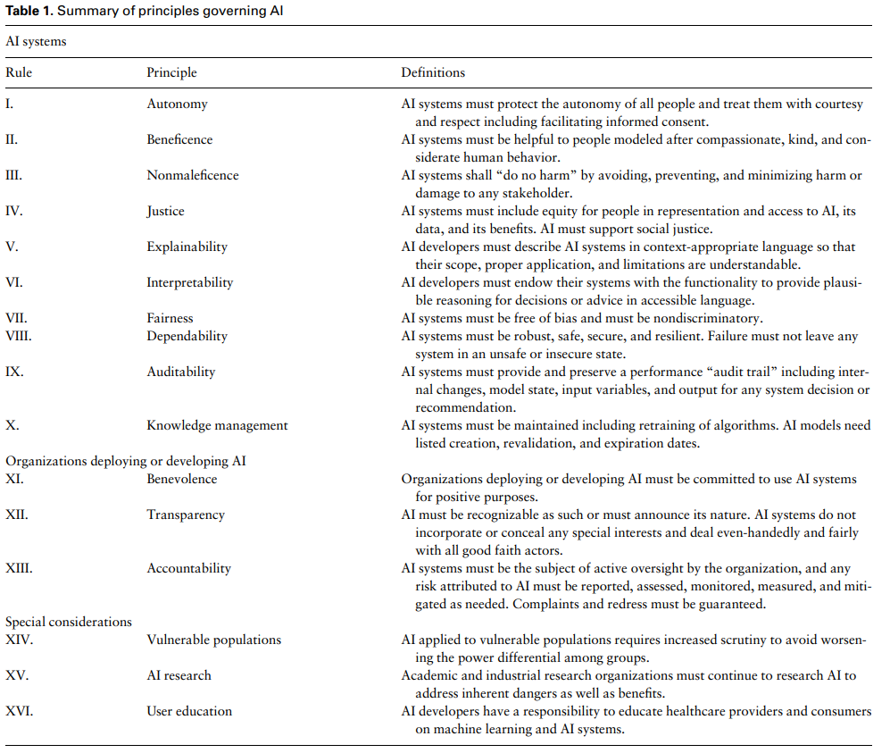

Ethical Issues
Solomonides AE, Koski E, Atabaki SM, Weinberg S, McGreevey JD, Kannry JL, Petersen C, Lehmann CU. Defining AMIA's artificial intelligence principles. J Am Med Inform Assoc. 2022 Mar 15;29(4):585-591.

Slide 32
Ethical Issues and Resolutions
Technology is not bad or unethical
Ethics of the User

Slide 33
Why do we NEED it?
Burn out
Shortage of personnel, talent, sites
Dire need to make work more meaningful , less administrative, interesting, help more people, greater reward
Human error factor
Gain Proficiency
Unmet modern care needs
Care extenders need help
81.1% diagnostic accuracy with AI vs innate 73%
  Jabbour S, Fouhey D, Shepard S, et al. Measuring the Impact of AI in the Diagnosis of Hospitalized Patients: A Randomized Clinical Vignette Survey Study. JAMA. 2023;330(23):2275–2284.

Slide 34
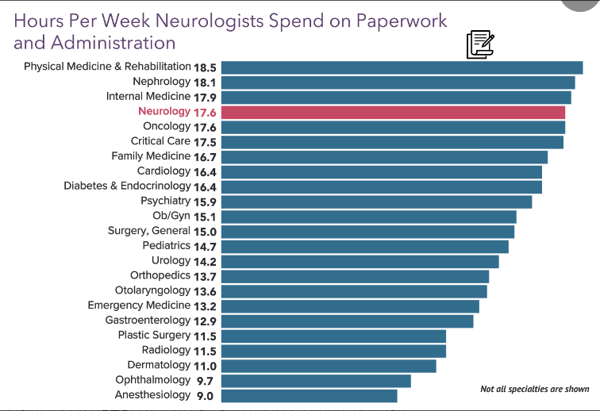


Slide 35
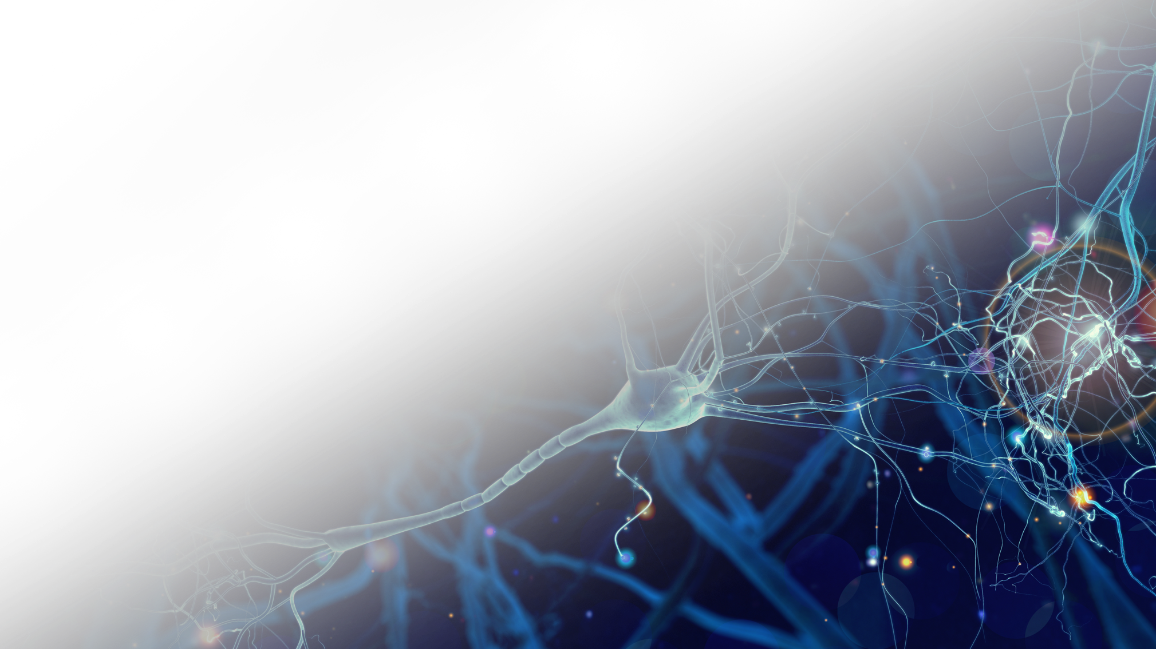
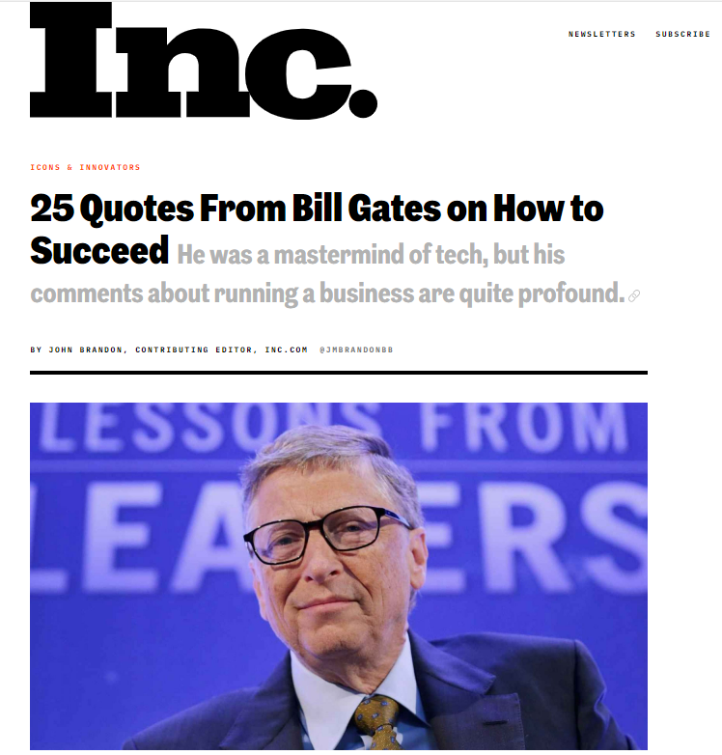
Food for thought
Subhead
Text
• Bullet
"The first rule of any technology used in a business is that automation applied to an efficient operation will magnify the efficiency. The second is that automation applied to an inefficient operation will magnify the inefficiency."

Slide 36


Questions

