Slide 1
Multiple Sclerosis Case Discussion: RRMS to SPMS
William Kilgo, MD
Francesca Bagnato, MD PhD

Slide 2
Disclosures
William Kilgo:
Contracted Research (Principal Investigators must provide information, even if received by the institution): Genentech, EMD Serono, Alexion, Bristol Meyers Squibb Honoraria: Octave Biosciences, TG Therapeutics Speakers' Bureau: Genentech, Biogen, TG Therapeutics
Francesca Bagnato:
Nothing to Disclose

Slide 3
Learning Objectives
Describe advances in diagnosis and treatment of neuroimmunological diseases, including multiple sclerosis subtypes and autoimmune encephalitis

Slide 4
Question 1
Thoughts on Early High Efficacy Treatment versus an Escalating Approach?

Slide 5
Case
38 year old African American female, presenting as new patient
Blurry vision in left eye, associated with painful eye movement (20/100 at worst), improved with steroids
One month later develops numbness on left side from chest to foot
Twin sister with MS
Declines CSF testing
NMO/MOG antibodies were negative
JCV, HepB/HCV/Quantiferon Gold all negative
Initial therapy?

Slide 6
Escalation versus High Efficacy
Factors to consider:
Current clinical equipoise
Poor prognostic features
Non-Caucasian, male gender, early motor disability, highly active presentations
Patient preference
Patient safety/risk mitigation
Potential for mild disease course in a substantial percentage of patients
Trials underway:
TREAT-MS

Slide 7
64 yo female requests consultation
Diagnosed with MS in her early 40s
Presenting symptoms numbness and tingling from chest down, which resolved over 2 weeks without treatment
MRI and lumbar puncture led to MS dx, started on interferon beta (IM once weekly)
Over the years has experienced discrete relapses including diplopia, vertigo with left upper extremity tremor, right sided weakness/numbness, and has chronic symptoms of balance disturbance, fatigue, and cognitive dysfunction
Self discontinued interferon beta after 5 years, pegylated interferon after 1 year, dimethyl fumarate after 18 months, and fingolimod after 6 months due to perceived lack of benefit

Slide 8
64yo female, cont.
Last episode of a new neurologic symptom was right sided weakness 6 years ago, which was treated with IV steroids and subjectively improved to 90% of baseline
Last MRI was 1 year ago, no new or enhancing lesions
Last enhancing lesion per MRI reports was 9 years ago
Neurologic exam notable for flat affect with mild dysarthria and scanning speech, right INO, mild right hemianesthesia, marked left upper extremity dysmetria, wide based unsteady gait

Slide 9
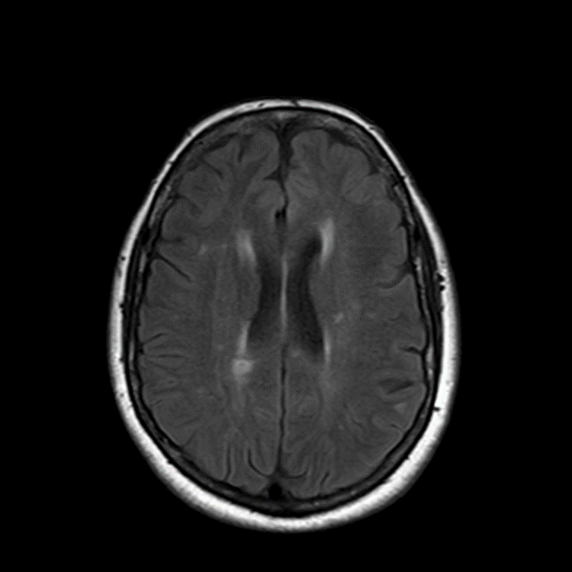
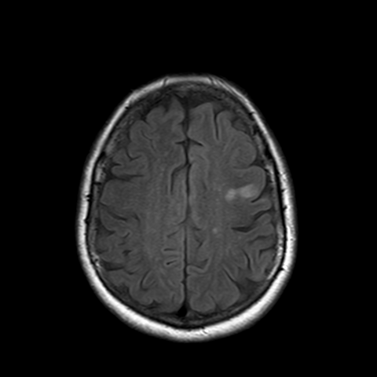
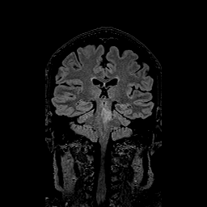

Slide 10
Plan?
Patient states that she is here to initiate a new treatment, which she has seen advertised on MS Society website and on TV
Patient states that if she is not prescribed this treatment, she can no longer tolerate her symptoms and voices intent to take her own life

Slide 11
Expectations of Treatment
Currently available treatments proven to modify progression of disease
NOT proven to reverse established disease
Relapses still may occur and are usually managed with IV steroids, but recovery is not always complete
Based on frequency of relapses, severity, or side effects, treatment may be altered over time

Slide 12
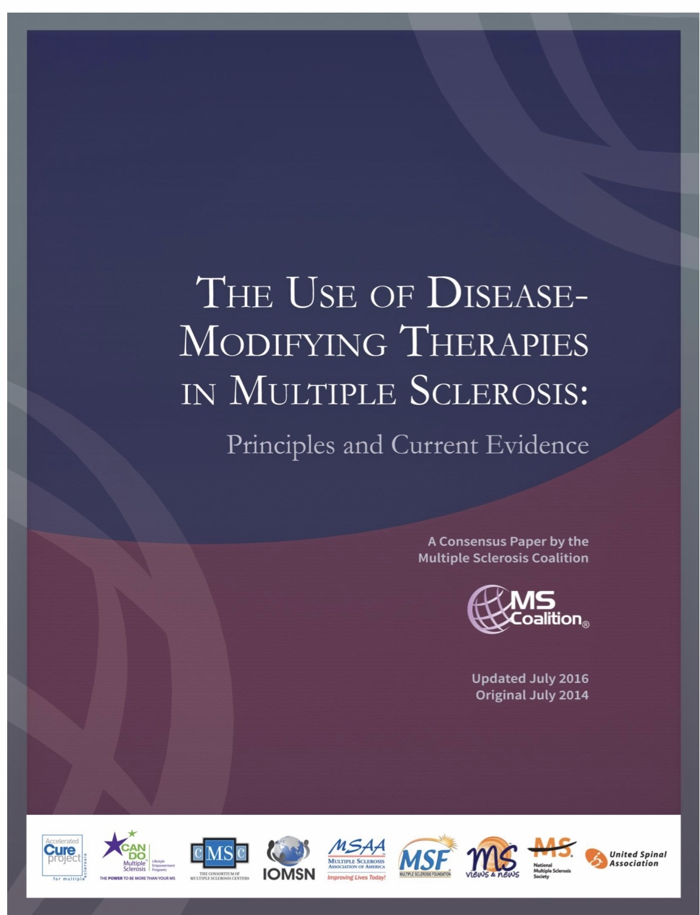

Slide 13
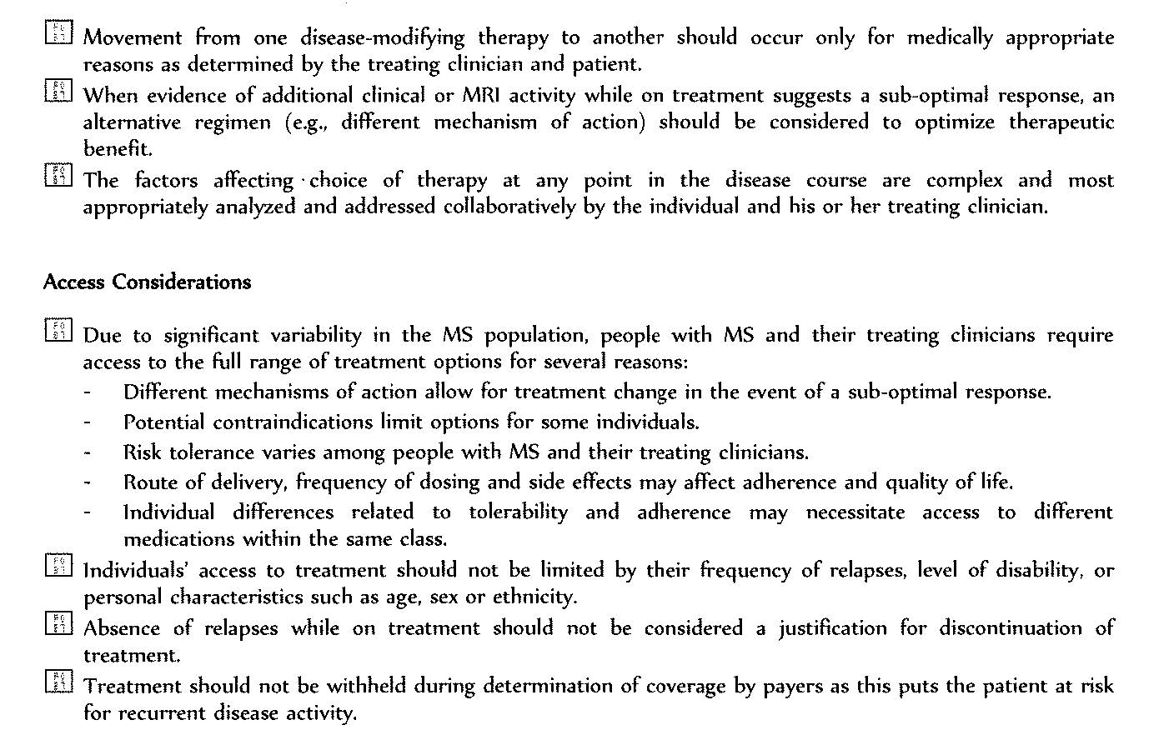
Consensus Statement from the MS Coalition

Slide 14
Question 2
What impact has the COVID-19 pandemic had on your general approach to treating patients with MS?
Risk mitigation strategies
Vaccination status
Choices of DMT?

Slide 15
Case
44 year old female
COVID-19 infection in 12/2020
5 days later after diagnosis develops gait imbalance, weakness, dropping objects in both hands with paresthesias. Improved with steroids.
The lab threw away misplaced her CSF, not repeated due to bad experience
Repeat MRI 6 months later showed multiple new lesions, several active
Treated with ocrelizumab, doing well
No lesions were gd (+)

Slide 16
Question 3
What is your general approach to MS patients who desire pregnancy?

Slide 17
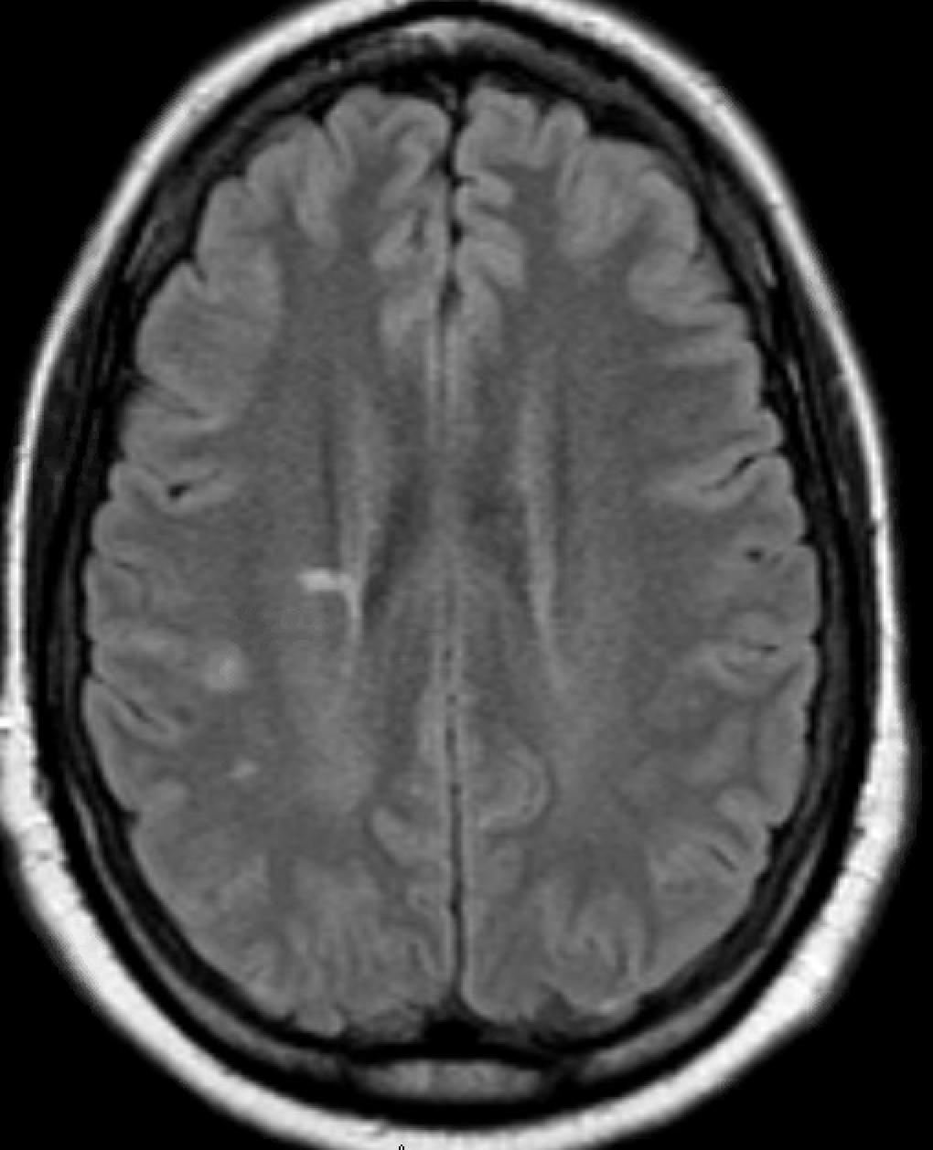
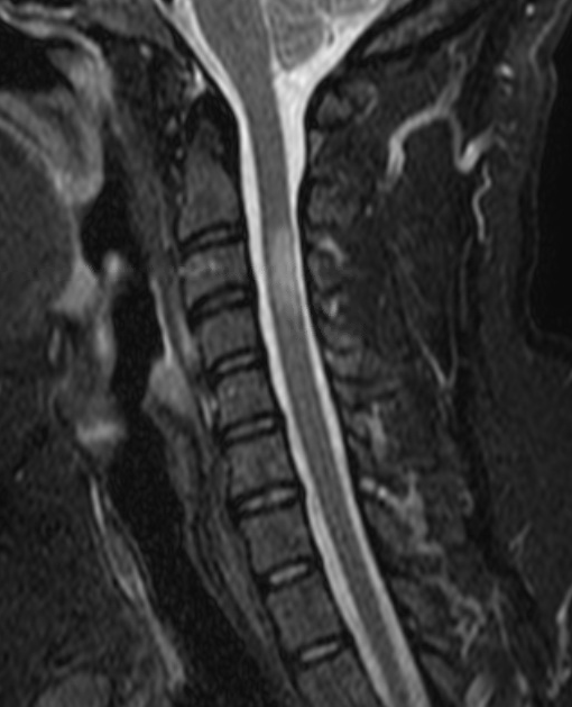
Case
31 year old female with RRMS, clinically stable on natalizumab
Onset 3 years ago with optic neuritis/transverse myelitis (T-spine)
Presents 10 months following last visit
Currently 20 weeks pregnant, had not notified MS clinic and kept getting infusions
Advised to stay on DMT by her obstetrician (at outside facility with no records sent). Pregnancy is going well.
Would you stop natalizumab or continue it?

Slide 18
MS and Pregnancy
Pregnancy is generally considered to be a protective state against MS related disease activity
The post-partum period is when patients are at the most risk of relapse
Most DMTs are not recommended to be continued during pregnancy, but some are perhaps more favorable when conception is desired soon

Slide 19
MS and Pregnancy
Cladribine: 18 month treatment window
Alemtuzumab: 18-24 month treatment window
Ocrelizumab: Intermittent dosing, long-lasting effect
Natalizumab: emerging evidence of use in first trimester, up until conception, though risk of rebound disease is very real
Glatiramer acetate: Likely safe while attempting conception and during pregnancy
Need to consider risk/benefit for individual patient
History of highly active disease?
Plans to breastfeed?
Biologics may be preferred

Slide 20
Question 4
Do you consider the disease modifying drugs with a common mechanism of action to be (relatively) interchangeable?
When do you switch within the same class and why?
Anti-CD20
S1PR

Slide 21
Question 5
What is your approach (if you have one) to DMT discontinuation?
Age dependent?
Disease duration dependent?

Slide 22
53yo female presents for routine follow up
Diagnosed with MS 12 years prior
Presented with clinical syndrome of transverse myelitis
Imaging and CSF consistent with MS, started on IFN
New enhancing R periventricular lesion 6 years later (asymptomatic), DMT changed to fingolimod, no new symptoms or MRI changes since
Recurrent episodes of oral and genital HSV past 3 years, despite daily anti-viral
3 months ago severe dysphagia and cough, diagnosed with esophageal candidiasis
Self discontinued fingolimod and does not want to resume treatment at this time

Slide 23
72yo female presents for routine follow up
Diagnosed with MS in 1984
Initial syndrome optic neuritis, later that year left leg weakness
Initial DMT interferon beta 1a; 2 relapses over 14 years, complained of flulike side effects
Changed to fingolimod in 2012 – elevated LFTs
Changed to PEG-IFN, intolerable side effects
Changed to dimethyl fumarate in 2014 – intractable nausea and diarrhea despite mitigation strategies
Changed to teriflunomide – full body rash and itching
Changed to daclizumab – pulled from market
Opted to stop DMT due to lack of disease activity (clinical and radiologic)

Slide 24
Stopping DMT
Numerous case reports/series document disease activation upon stopping/switching DMT
Most patients in these series are less than 50 years of age, with variable but relatively short duration of disease and treatment
A few prospective and observational series suggest that DMT withdrawal may be reasonable in patients >50-55 without clinical or radiological disease activity for 2-5 years
Requires careful consideration of risk/benefit as well as informed consent discussion with patient
Ongoing clinical and MRI surveillance recommended
DISCO-MS trial was inconclusive

Slide 25
Question 6
When does radiologically isolated syndrome warrant treatment?

Slide 26
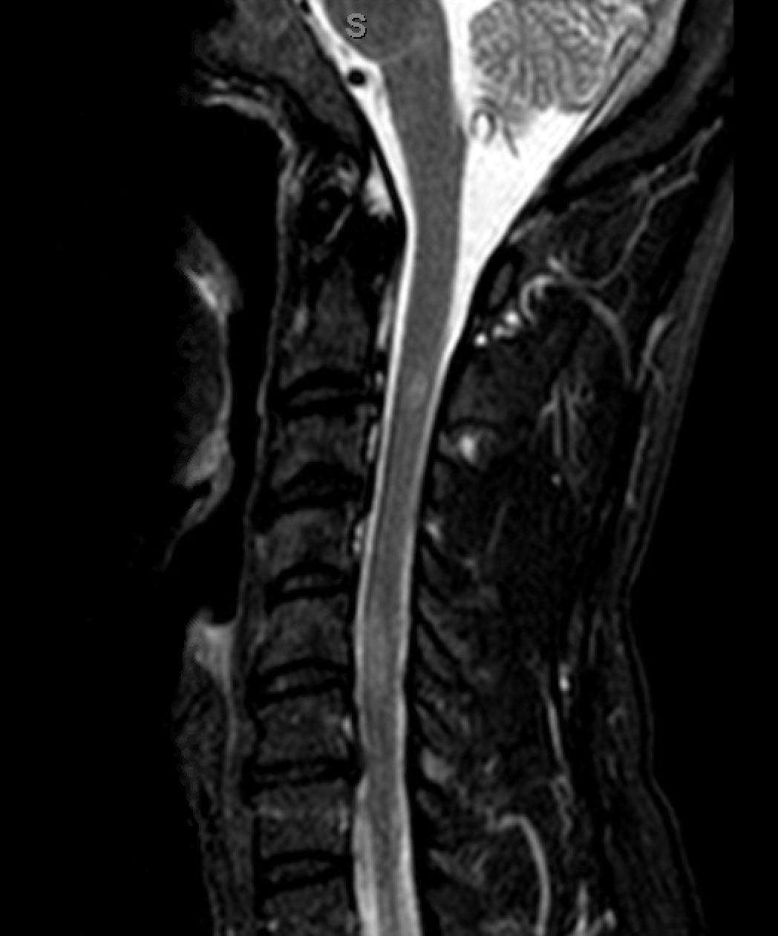
Case
43 year old male. Imaged in 2015 after having headaches associated with intermittent upper extremity paresthesias.
CSF was normal in 2015, but showed (+) oligoclonal banding when repeated in 2017.
Imaging stable over that interval. Started on fingolimod after abnormal CSF result. Referred to our clinic in 2019 for second opinion.
Detailed history uncovered no typical demyelinating event other than suspicion re: paresthesias that were intermittent, almost always associated with a headache and lasting minutes at a time. Exam normal. Patient reports some fatigue but no cognitive symptoms.

Slide 27
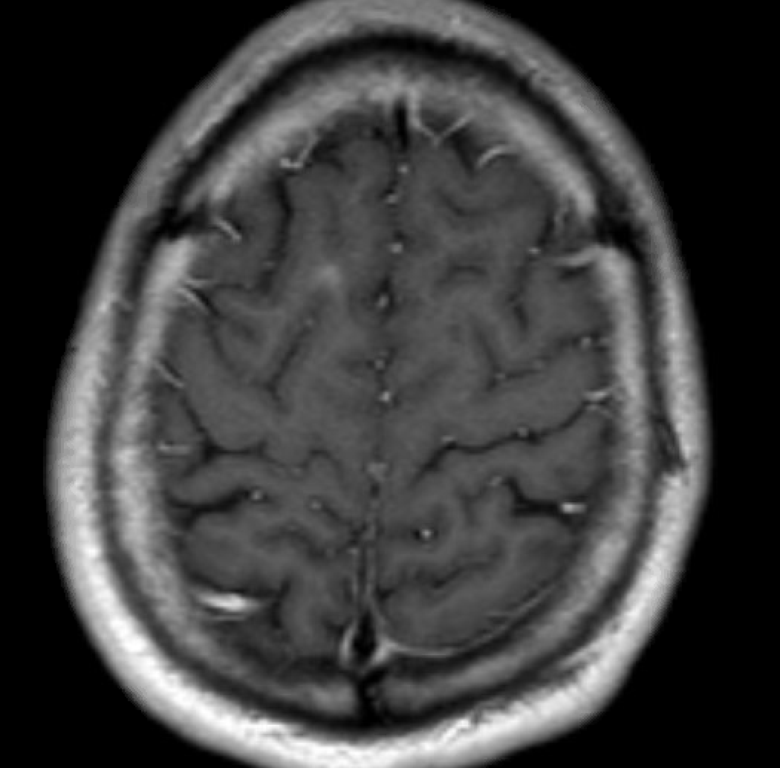
Case, continued
Had run out of fingolimod just prior to visit, and passed over threshold for needing to repeat FDO, so he elected to stay off therapy after risk/benefit discussion
6 months after trial of discontinuation, active lesion noted in subcortical white matter. No new symptoms
Restarted on DMT with dimethyl fumarate after new lesion noted
Stable to present day but no prototypical demyelinating event yet
Works full time, owns a restaurant

Slide 28
Question/Topic 7
Risk Mitigation
For the stable, long-term natalizumab patient that seroconverts to (+)JCV status
For the patient with prior malignancy
For patients with (+) Hepatitis B/C serology
For patients with (+) TB Test?

Slide 29
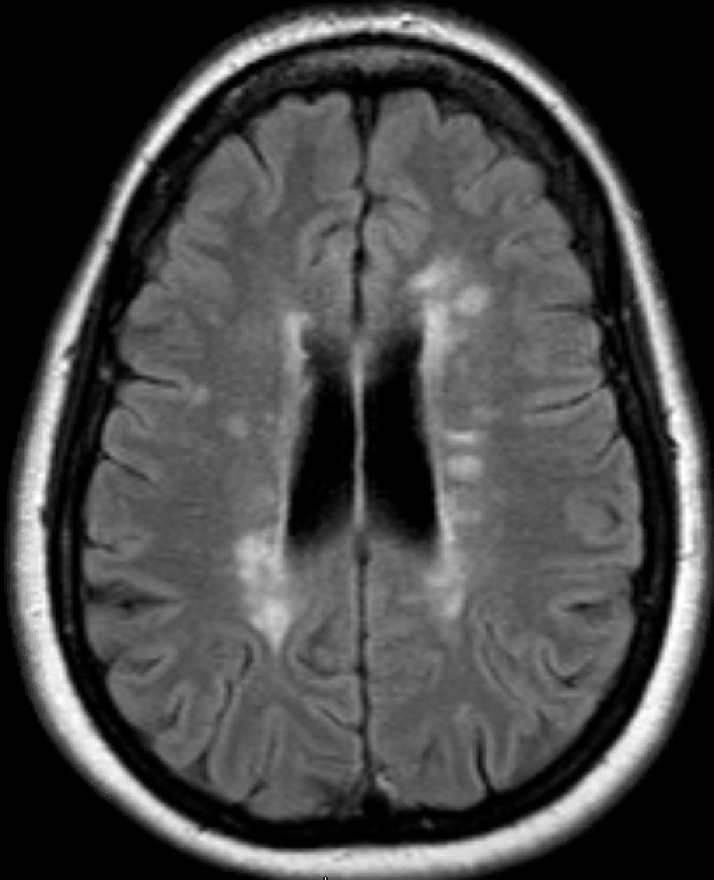
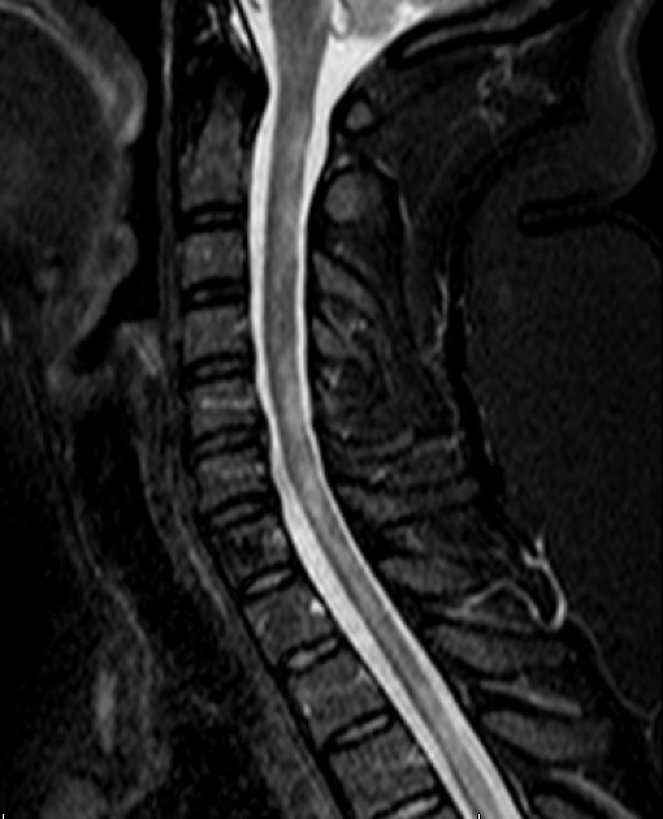
Case
A 44 year old female with established MS diagnosis is referred to clinic due to 6-12 months of worsening disability status and a new cervical cord lesion. Works as a teacher, no known comorbidities. EDSS 6 with unilateral walking aid.
DMT history
5 years on IFN, breakthrough disease
7 years on dimethyl fumarate, breakthrough disease as above
Labs:
(+) JCV 3.5
(+) HepB core antibody indicative of prior infection
(+) Quantiferon Gold

Slide 30
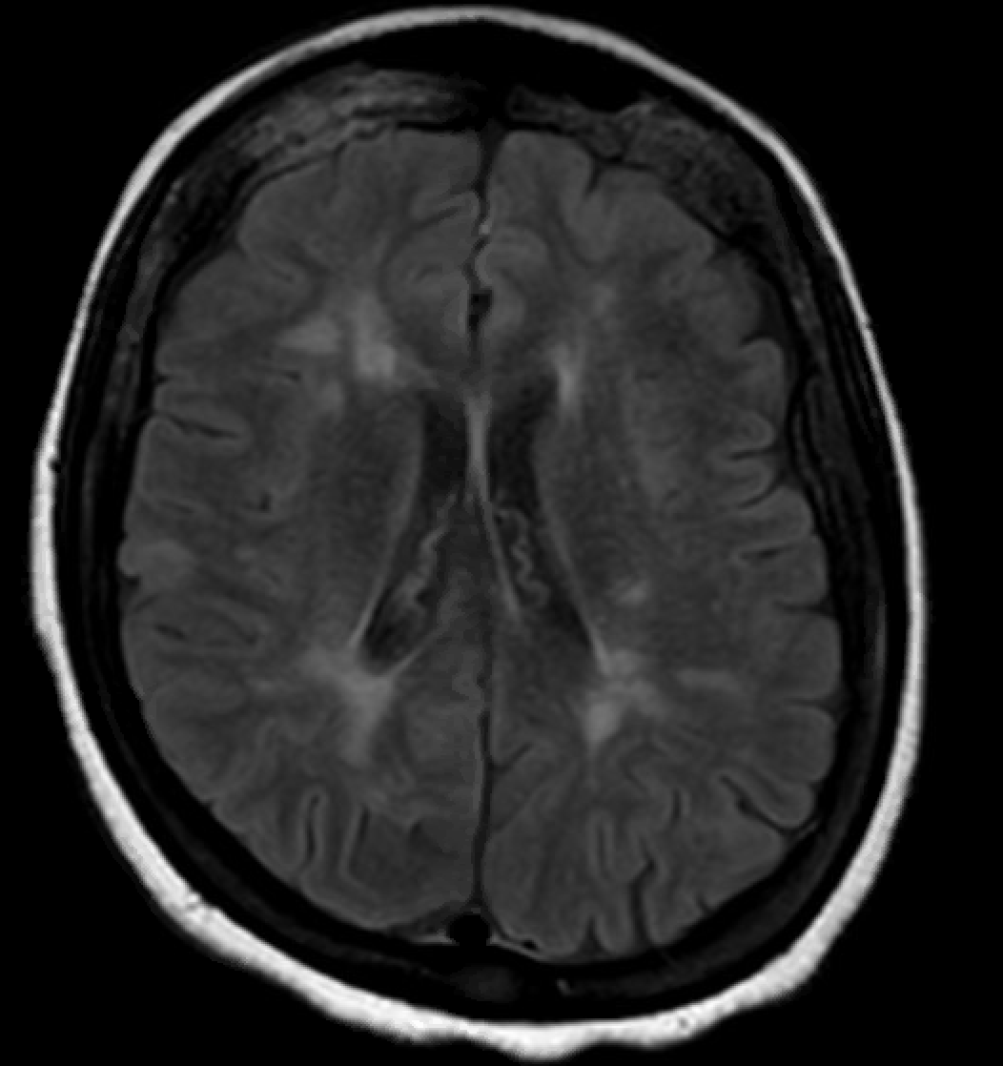
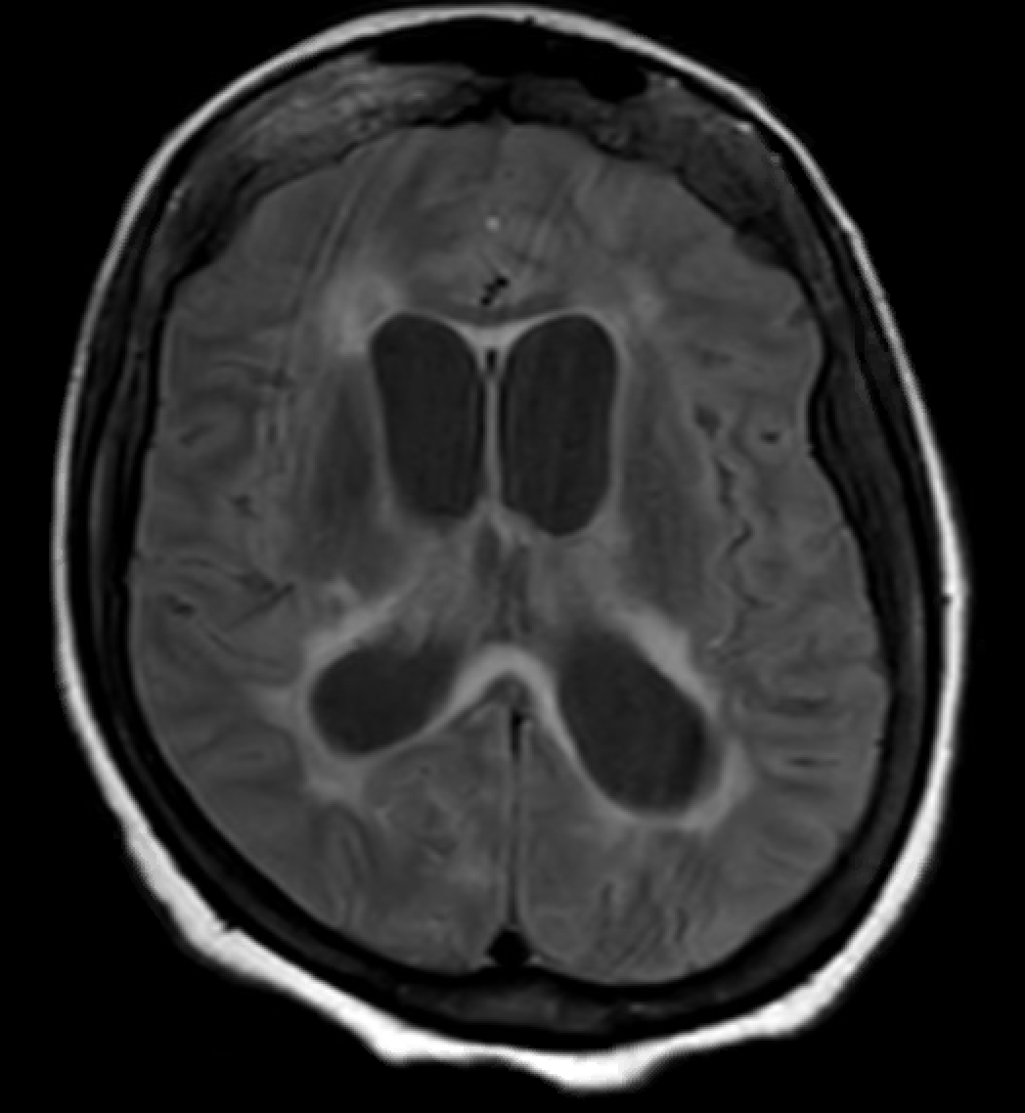
Case
57 year old female with SPMS, at baseline nonambulatory presents with 3-4 months of cognitive decline, initially presenting as short term memory difficulties.
At office visit her spouse noted new-onset hallucinations, weight loss and overall rapid decline in functional status.
DMT: fingolimod x 6 years
Diagnosed 2007 after transverse myelitis and abnormal CSF testing
2018
2021

Slide 31
Case, continued
CSF:
738 protein
32 glucose
53 WBCs
(+) cryptococcal antigen
Prolonged admissions, poor response to treatment. Functional status remains poor

Slide 32
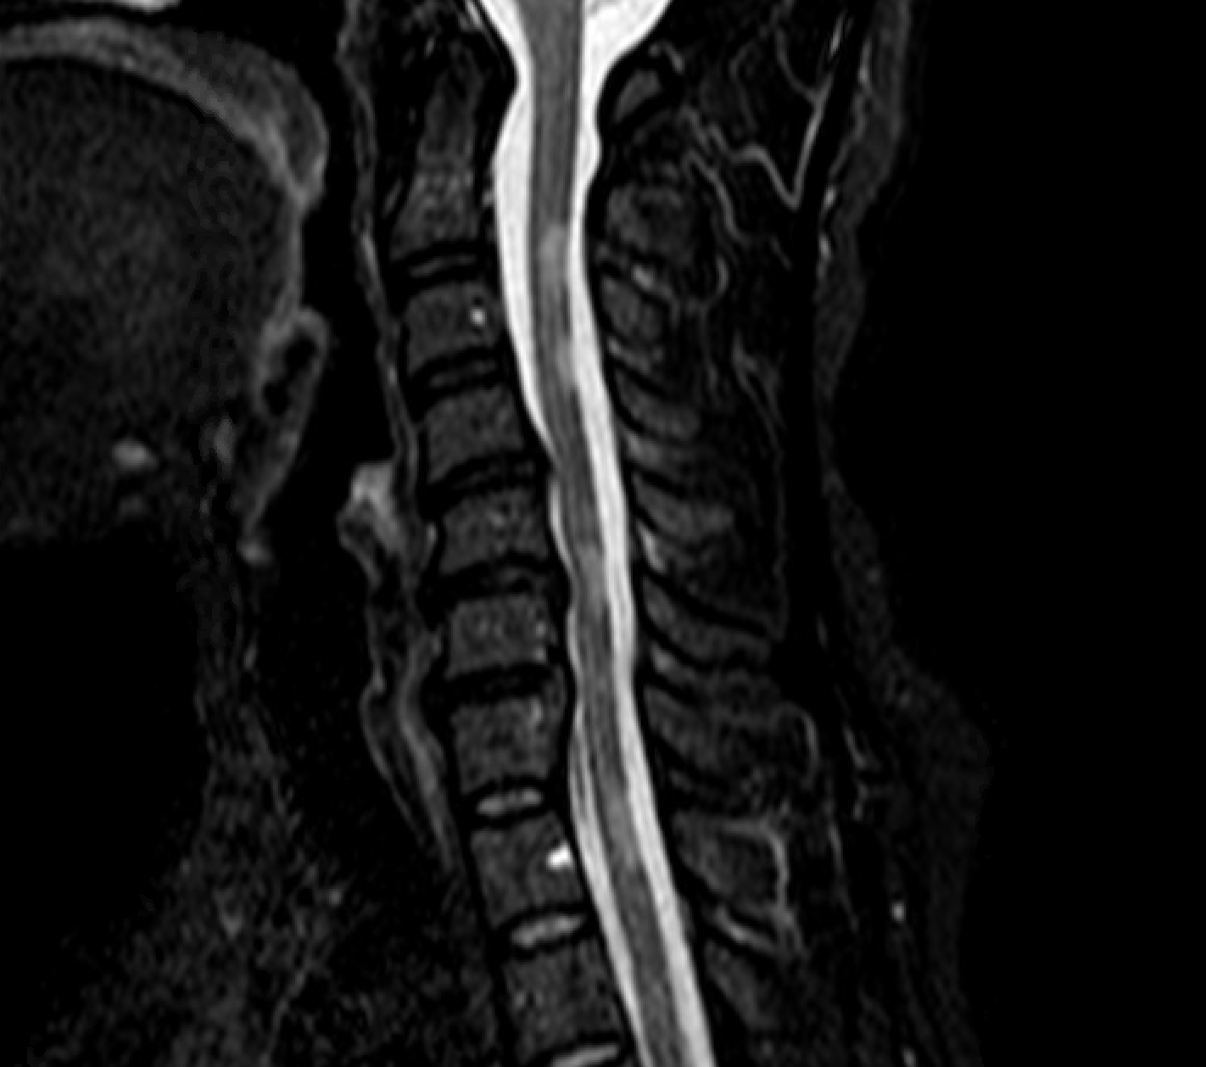
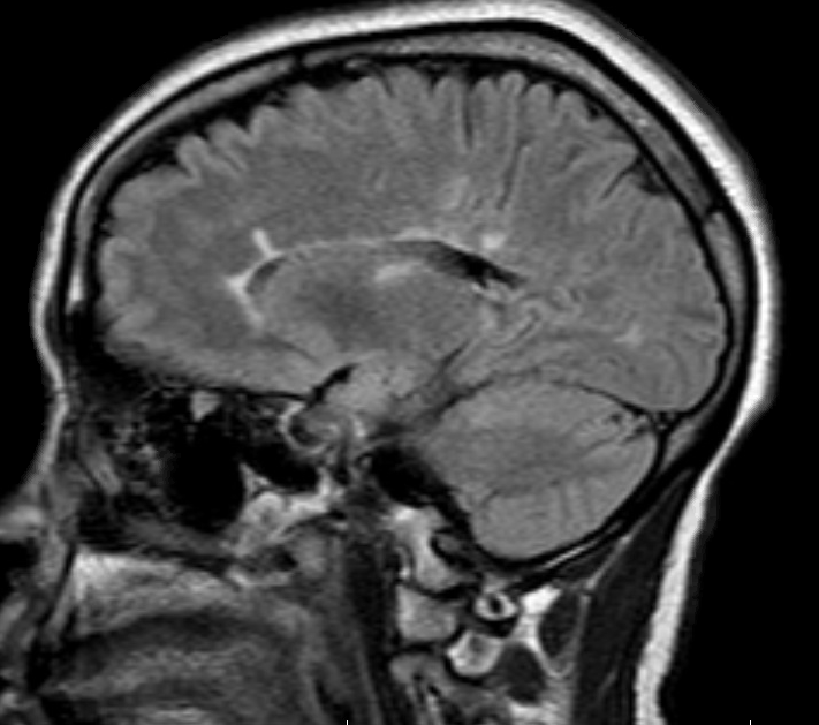
Case
43 year old female with RRMS, diagnosed in 1999 after optic neuritis. On IFN until 2018, switched to fingolimod after new C-spine lesion, tolerability issues with IFN.
Stable on fingolimod with no new disease activity. Goes to the dermatologist to have a skin abscess excised after most recent visit
CBC: ALC of 170
Pathology: cutaneous cryptococcosis

Slide 33
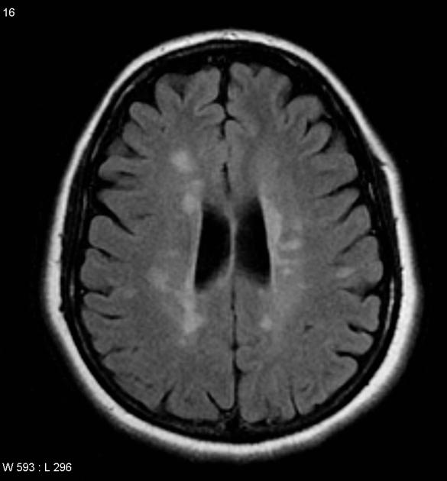
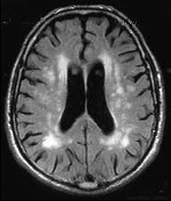
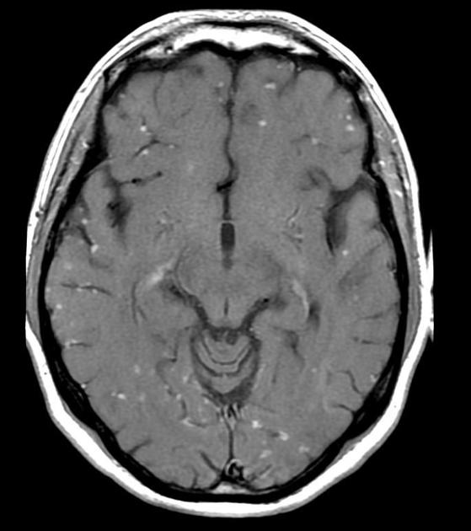
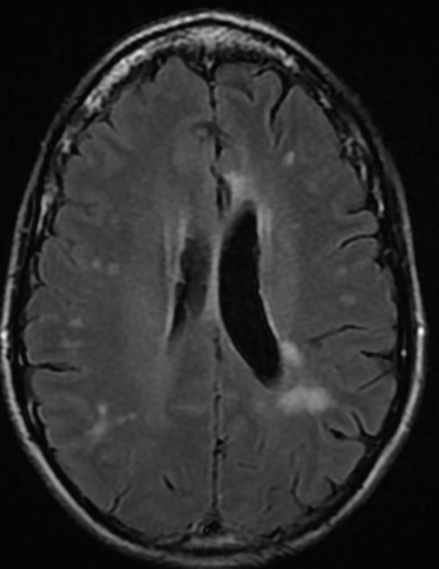
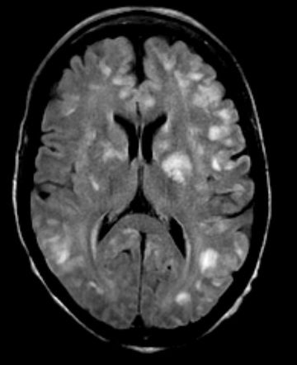
Question 8
How frequently do you “undiagnose” MS in your clinical practice?
Most common reasons?
Overreliance on abnormal imaging
Misapplication of McDonald Criteria to symptoms not attributable to demyelination
Multiple Sclerosis
Microvascular Disease
Sarcoidosis
Migraine
Lupus

Slide 34
MS Misdiagnosis
Solomon, 2016:
Survey of MS specialists, 110 reported cases
Half “definitely” misdiagnosed
Half “probably” misdiagnosed
Some had participated in clinical trials
Kaisey, Sicotte; 2019:
17% and 19% of referrals to UCLA and Cedars-Sinai (n=241) were determined to have been misdiagnosed
110 patient years total of unnecessary disease modifying therapy

Slide 35
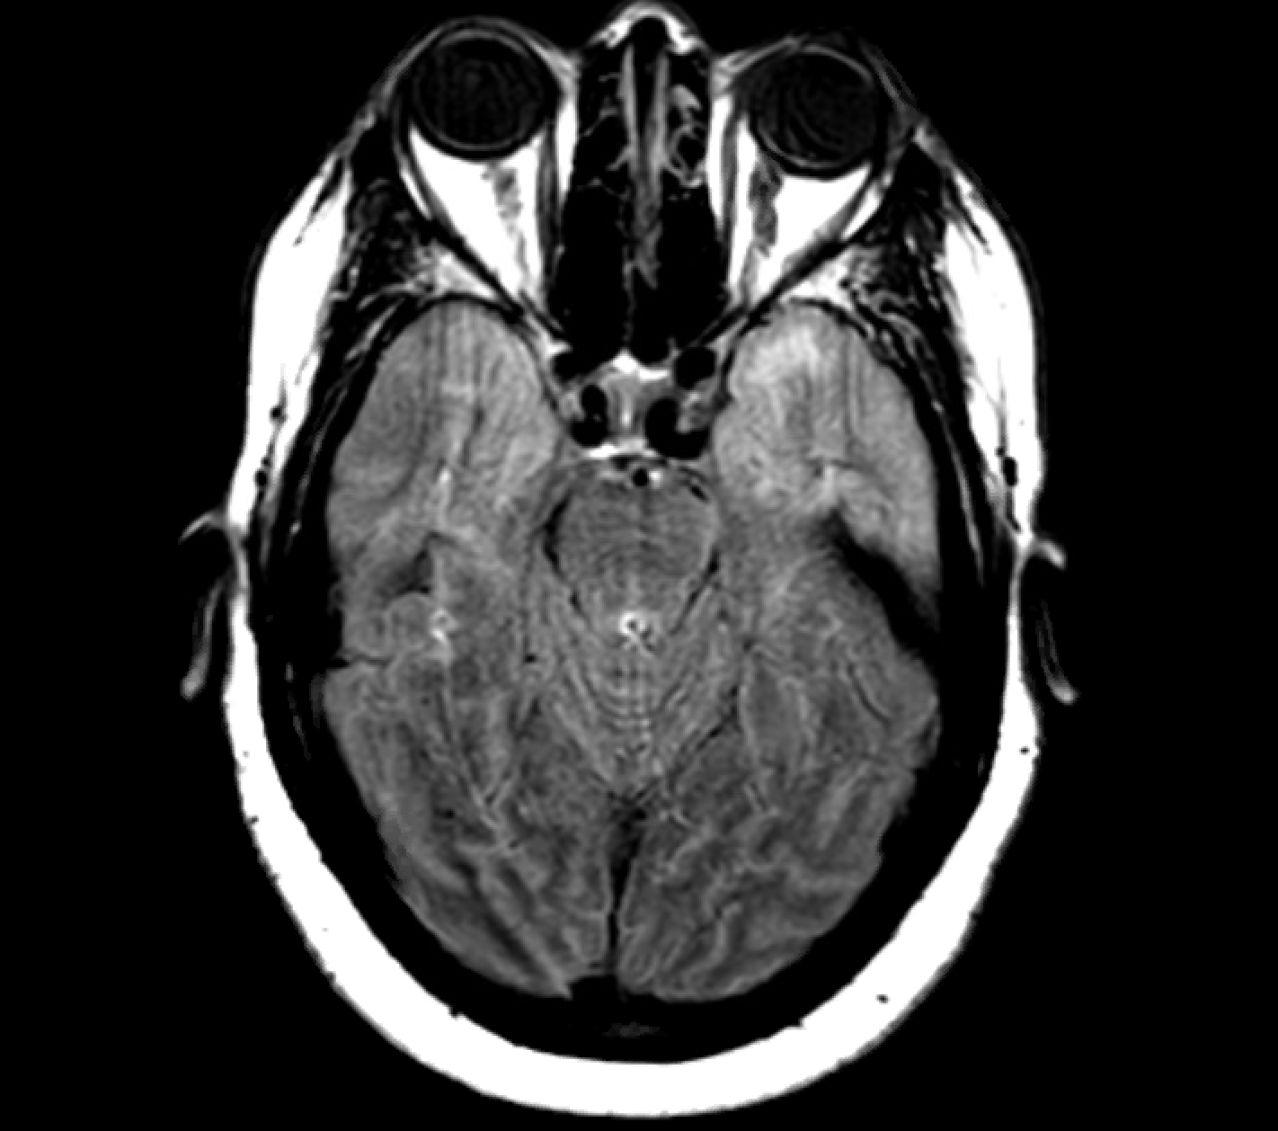
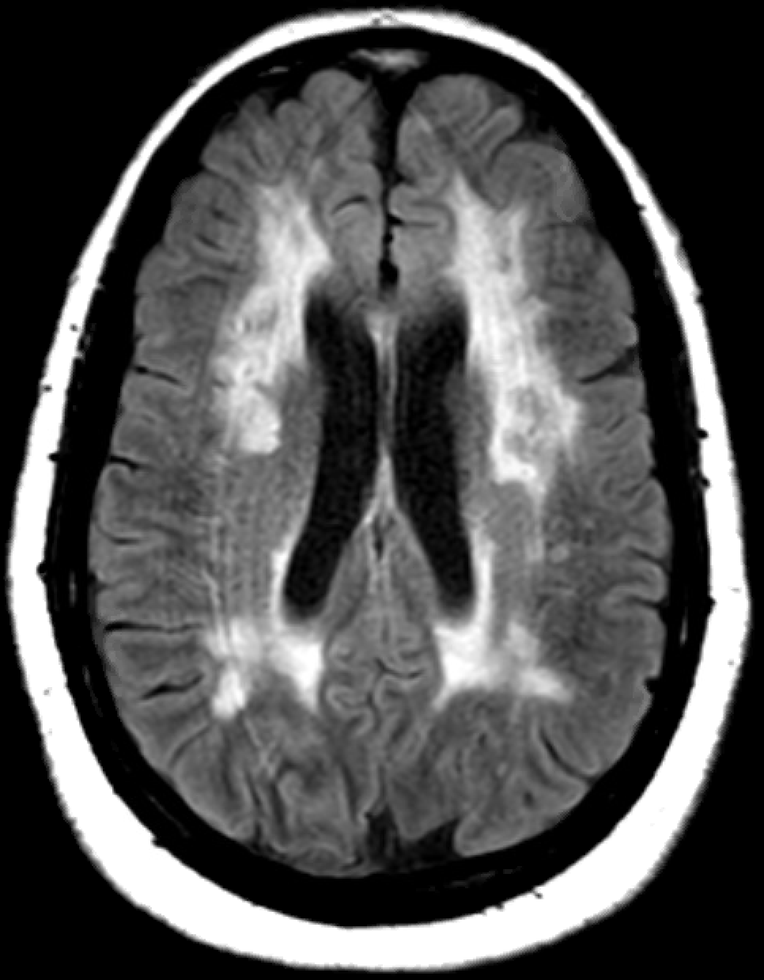
Case
31 year old female (in 2008)
2008: presents with sudden onset hemi-weakness
MRI: differential includes demyelination so CSF performed—(+) for OCB
d/c summary labeled as “likely MS”
Lost to follow-up
2018: now 41, returns with progressive cognitive decline. Noted to have migraine with aura and multiple first degree relatives with similar history
Genetic testing (+) for Notch3 gene, diagnosed with CADASIL
2008
2018

Slide 36
Questions!

