Slide 1
Toward Precision Phenotyping of
Multiple Sclerosis
Francesca Bagnato M.D.Ph.D francesca.r.bagnato@vumc.org
Associate Professor of Neurology Associate Vice Chair of Research Department of Neurology Vanderbilt University Medical Center
Associate Director of Research MSCoE-East Veteran Health Care System
January 16, 2024

Slide 2
Disclosure
Nothing to Disclose

Slide 3
Today’s Overview
Objective 1: To learn about the role of conventional imaging in diagnosing and monitoring disease changes in multiple sclerosis (MS).
Objective 2: To learn about the role of non-conventional imaging in uncovering pathological changes leading to disease progression in MS.
Objective 3: To understand the role of precision medicine in MS.

Slide 4
Multiple Sclerosis (MS)
. Autoimmune disease of the central nervous system;
. Affects women > men (2.3/1)
. Peak incidence between 20 and 40 years of age

Slide 5
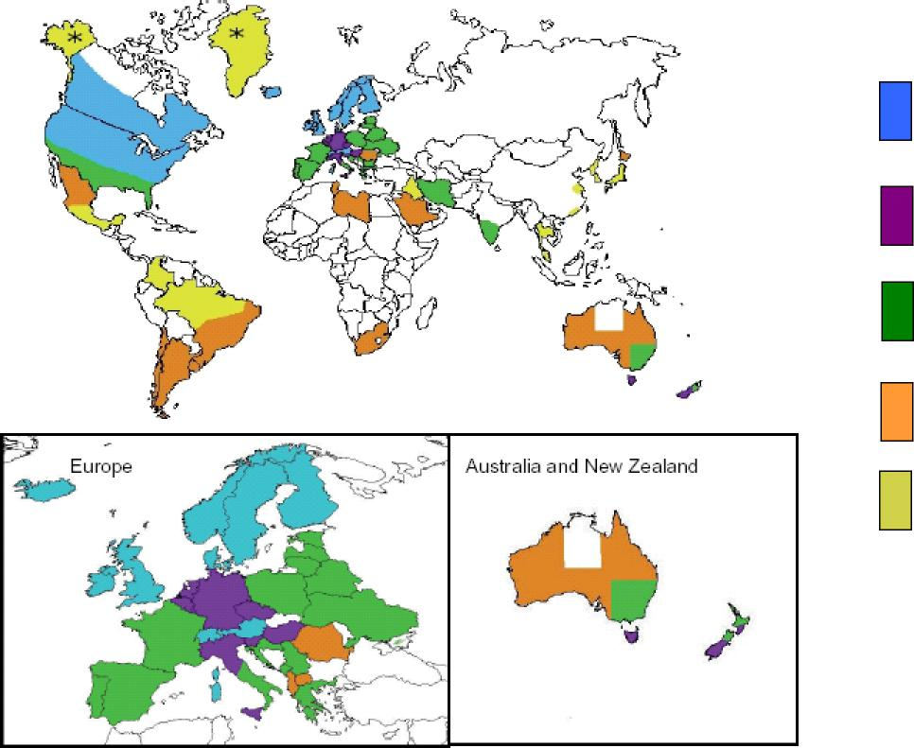
MS Prevalence around the World
 | >90/10,0 >90/100,0 60-89/10,60-89/100,00 30-59/10,30-59/100 00 5-29/100,0 5-29/100,0 <5/100,00<5/100
Courtesy of Alberto Ascherio and Kassandra Munger.

Slide 6
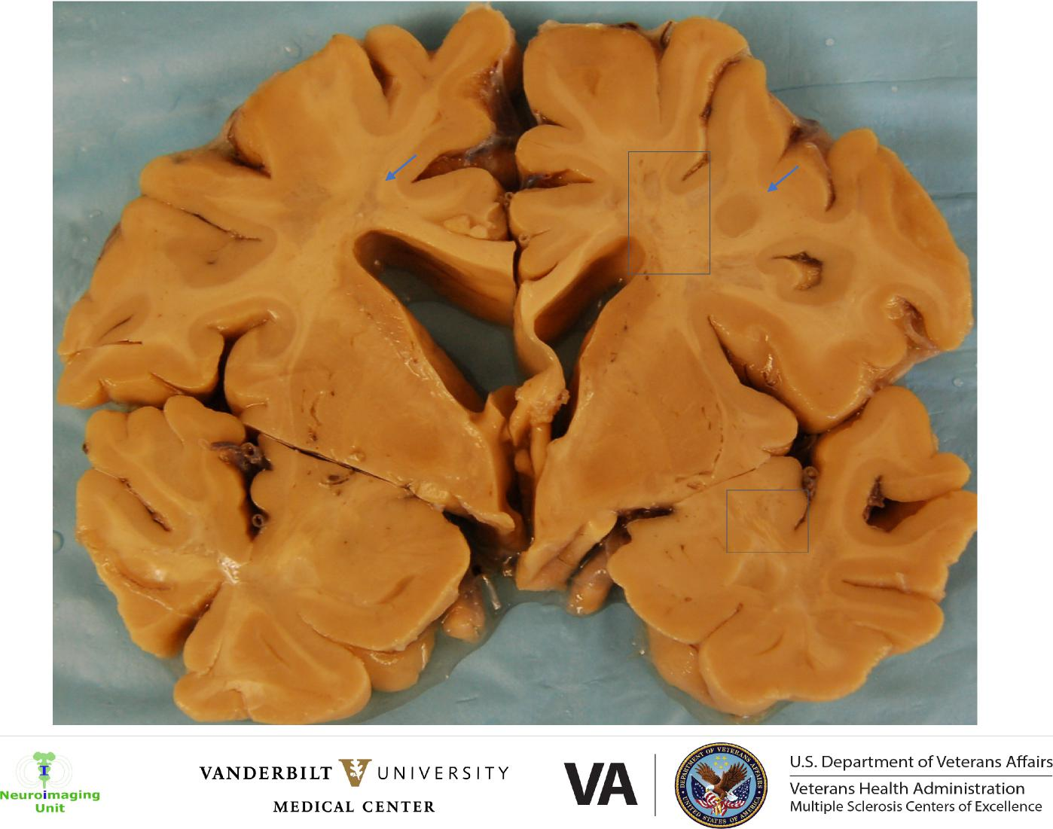
VANDERBILT V U N IVE RS I TY
VA
U.S. Department of Veterans Affairs
Neuroimaging Unit
Veterans Health Administration
Multiple Sclerosis Centers of Excellence
MEDICAL CENTER

Slide 7
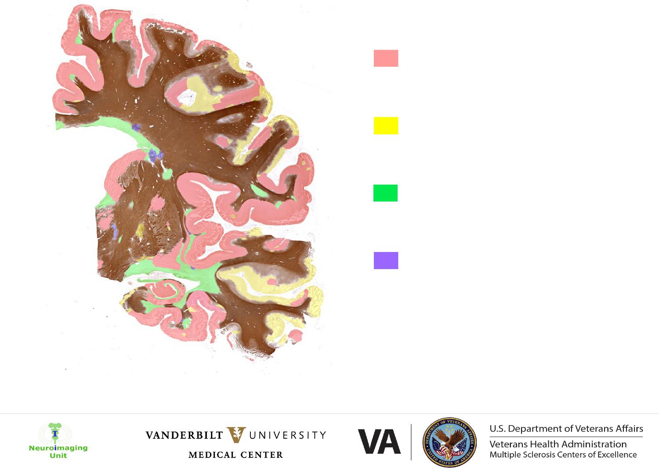
Cortical demyelination
Cortical re-myelination
White Matter demyelination
White Matter re-myelination
Bagnato F, Hametner S, Pennell D, Dortch R, Dula AN, Pawate S, Smith SA, Lassmann H, Gore JC, Welch EB. 7T MRI-Histologic Correlation Study of Low Specific Absorption Rate T2-Weighted GRASE Sequences in the Detection of White Matter Involvement in Multiple Sclerosis. J Neuroimaging. 2015

Slide 8
MS Clinical Course
Pre-clinical phase Relapsing-Remitting MS (RRMS) Secondary-Progressive MS (SPMS)
EXPANDED DISABILITY
STATUS SCALE (EDSS)
 |  |  |  | Brain volume decreases & chronic lesions increases
MRI
TIME

Slide 9
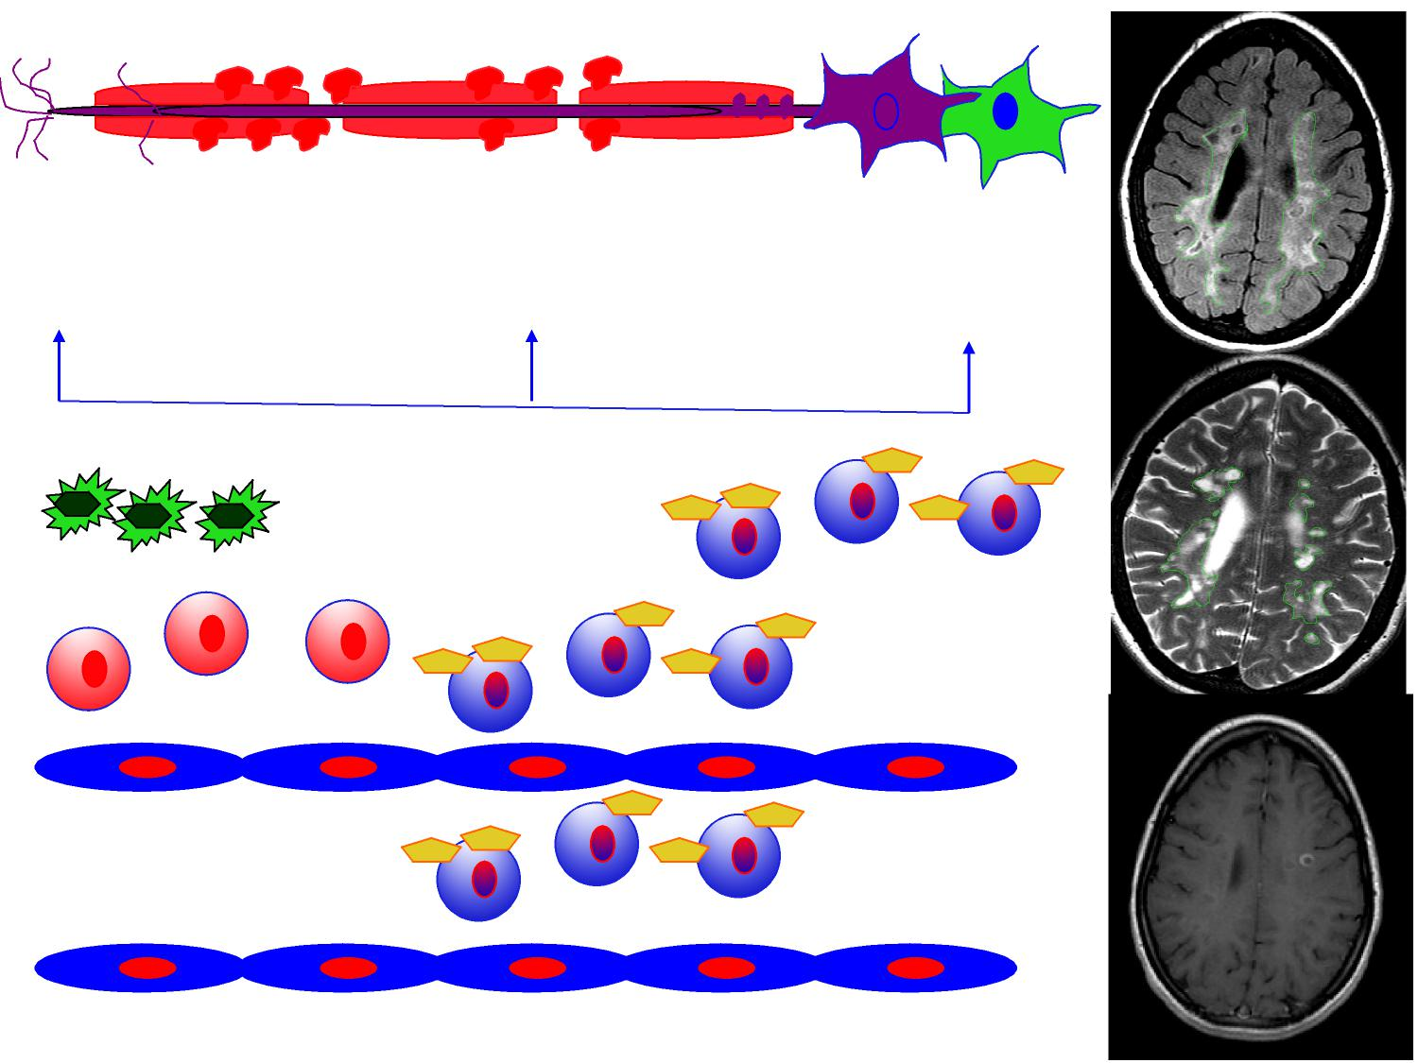
Complement factors Antibodies Toxic products
IFN-gamma
TNF-alpha
Macrophages
T-cells
B-cells
T-cells
BBB
Peripheral compartment
T-cells

Slide 10
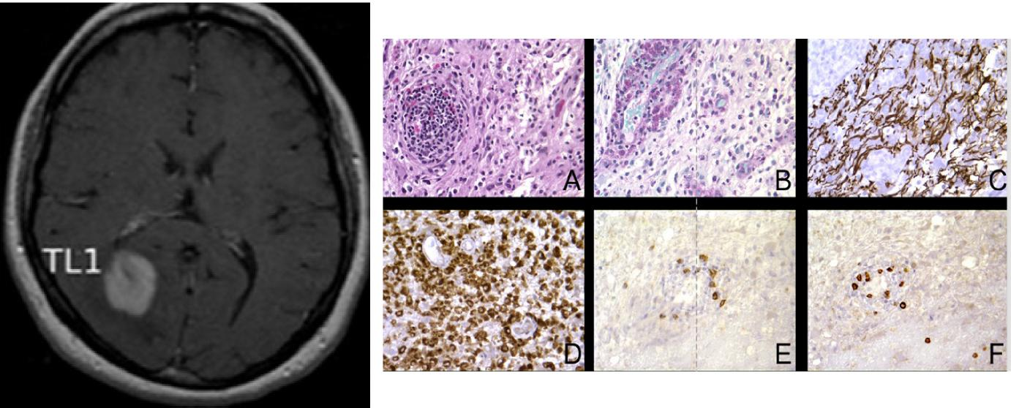
Acute Gadolinium Enhancing Lesions
Ikonomidou VN, Richert ND, Vortmeyer A, Tovar-Moll F, Bielekova B, Cook NE, Duyn JH, Bagnato F. Evolution of tumefactive lesions in multiple sclerosis: a 12-year study with serial imaging in a single patient. Mult Scler. 2013

Slide 11
Chronic Black Holes on T1-weighted MRI
T1-W pre and post contrast MRIs at time 0
T1-W pre contrast MRIs at months 1, 2, 3 and 10
On average, 1 every 5 contras-enhancing lesion will turn into a T1 hypo-intense chronic black
hole (BH)

Slide 12
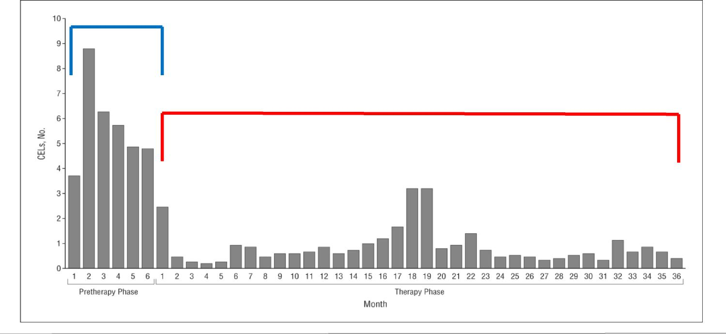
From: Heterogeneity in Response to Interferon Beta in Patients With Multiple Sclerosis: A 3-Year Monthly
Imaging Study
Chiu AW, Richert N, Ehrmantraut M; Ohayon J, Shiva Gupta S, Bomboi G, Gaindh D, Cantor FK, Frank JA, McFarland H, Bagnato
F. Arch Neurol. 2009;66(1):39-43. doi:10.1001/archneur.66.1.noc80047
Pre-therapy Phase
Therapy Phase
Copyright © 2016 American Medical
Date of download: 10/4/2016 Association. All rights reserved.

Slide 13
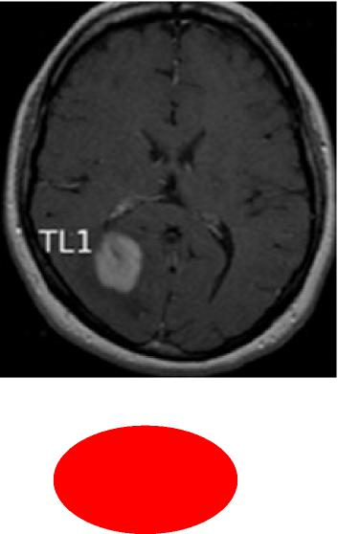
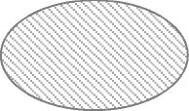
Active Lesion Evolution
Shadow Plaque: Remyelination over 100% of the lesion core
Chronic inactive: Core with variable degree of tissue injury
Chronic active: Core with variable degree of tissue injury surrounded by a rime of activated
microglia

Slide 14
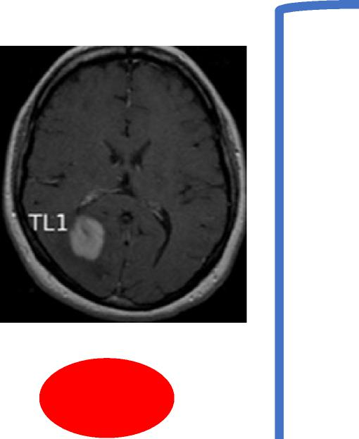
Active Lesion Evolution
Shadow Plaque: Remyelination over 100% of the lesion core
Chronic inactive: Core with variable degree of tissue injury
Chronic active: Core with variable degree of tissue injury surrounded by a rime of activated microglia

Slide 15
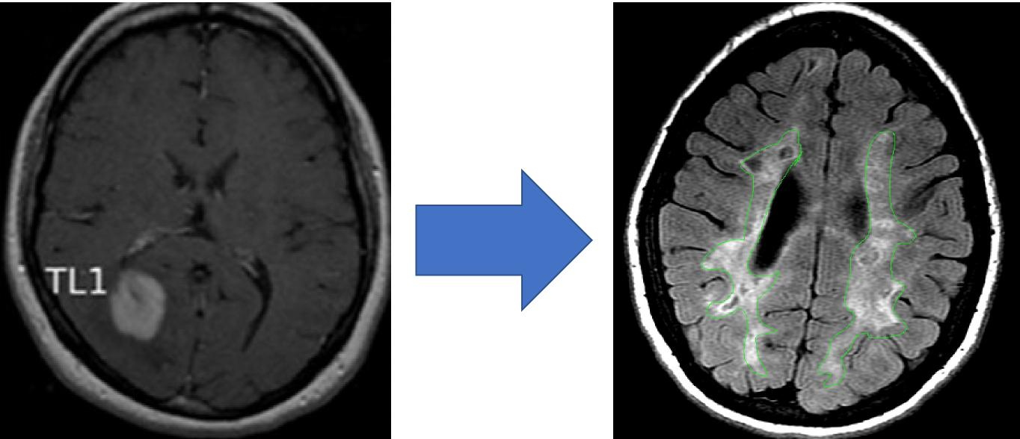
Active Lesion Evolution

Slide 16
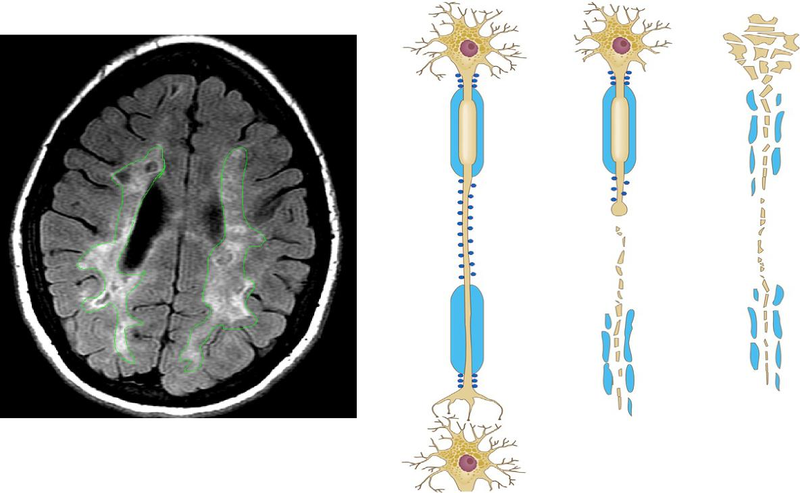
Chronic MS Plaques

Slide 17
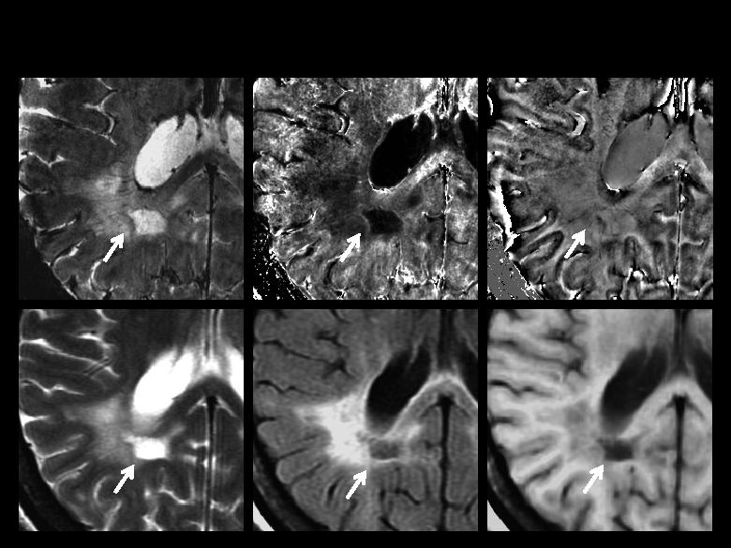
MRI at 7 Tesla: An Eye Opener
A B C
D E F

Slide 18
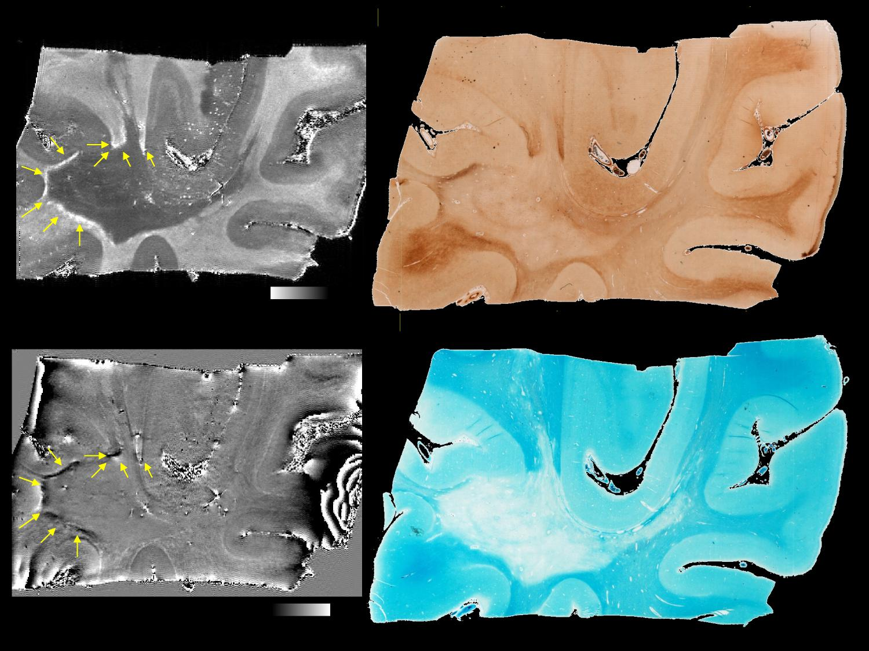
Iron stain (Perls DAB enhanced)
*
Myelin stain (Luxos Fast Blue)

Slide 19
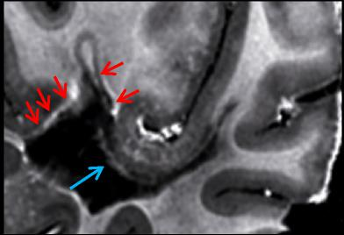
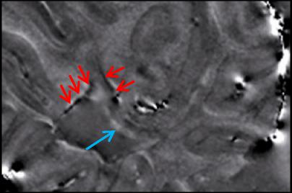
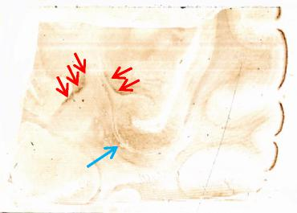
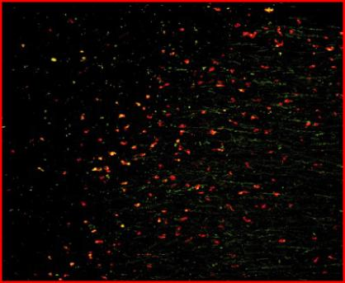
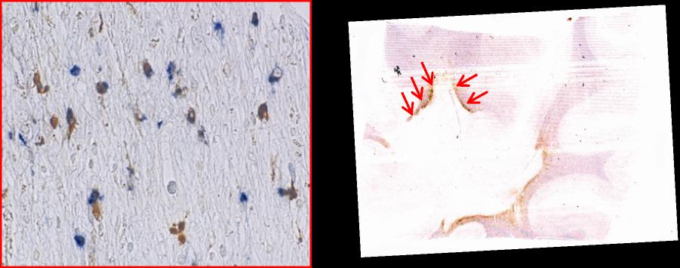
R2* GRE at 7T PHASE GRE at 7T Iron
 |  | CD68 IHC
WM-L
NAWM
B
Iron + Ferritin – 250x Iron + CD68 – CD68 – 200x
250x
Bagnato F, Hametner S, Yao B, van Gelderen P, Merkle H, Cantor FK, Lassmann H, Duyn JH. Tracking iron in multiple sclerosis: a combined imaging and histopathological study at 7 Tesla. Brain. 2011

Slide 20
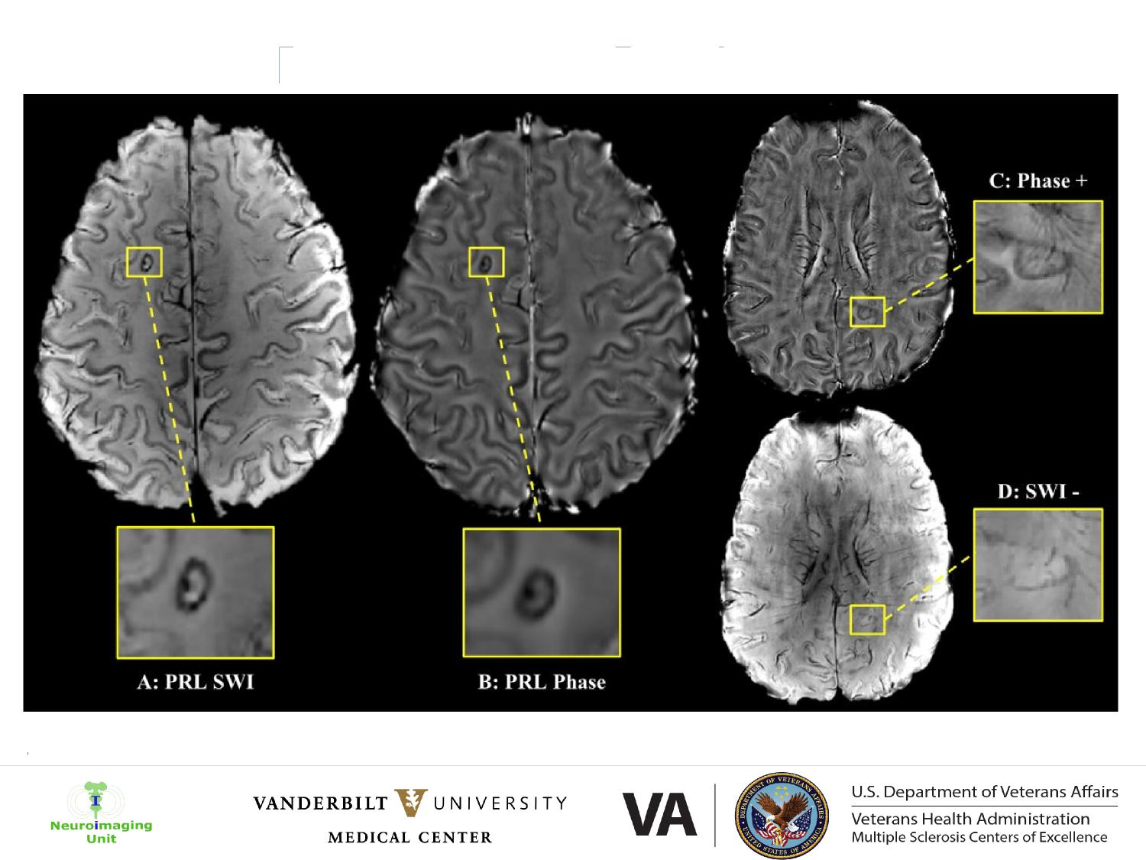
Paramagnetic Rim Lesions
Courtesy of Faraaz Kazimuddin

Slide 21
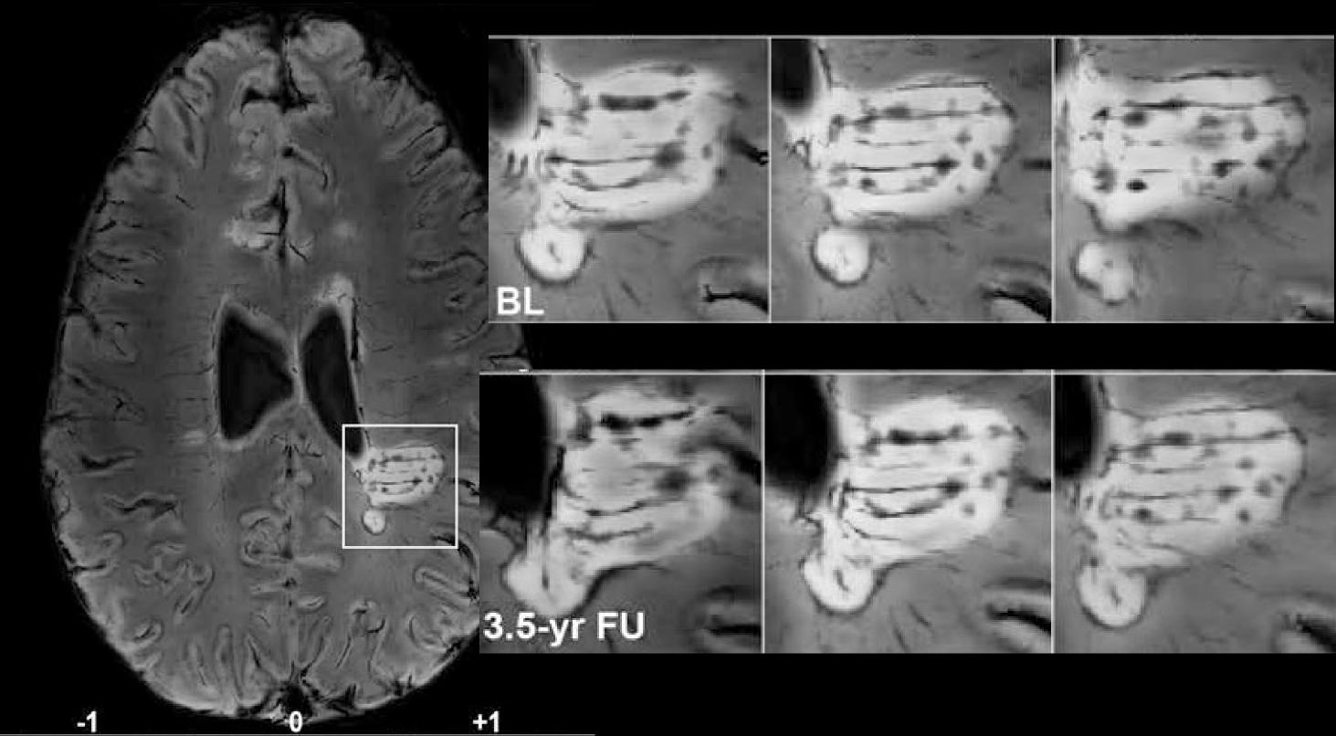
Paramagnetic Rim Lesions Slowly Enlarge
Dal-Bianco A, Grabner G, Kronnerwetter C, Weber C, Höftberger R, Berger T, Auff E, Leutmezer F, Trattnig S, Lassmann H, Bagnato F and Hametner S (equally contributing senior authors). Acta Neuropathologica 2017.

Slide 22
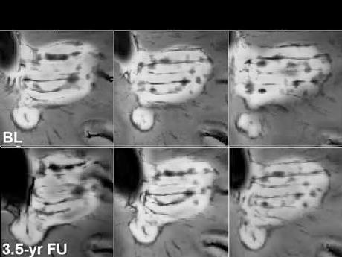
Paramagnetic Rim Lesions Slowly Enlarge

Slide 23
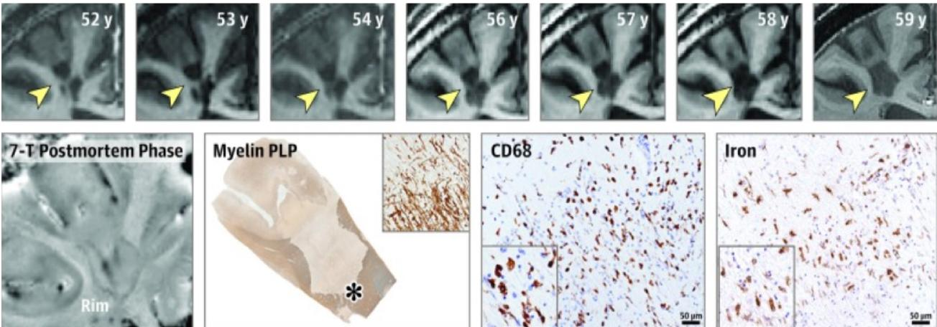
Paramagnetic Rim Lesions Slowly Enlarge
Absinta M, Sati P, Masuzzo F, Nair G, Sethi V, Kolb H, Ohayon J, Wu T, Cortese ICM, Reich DS. Association of Chronic Active Multiple Sclerosis Lesions With Disability In Vivo. JAMA Neurol. 2019

Slide 24
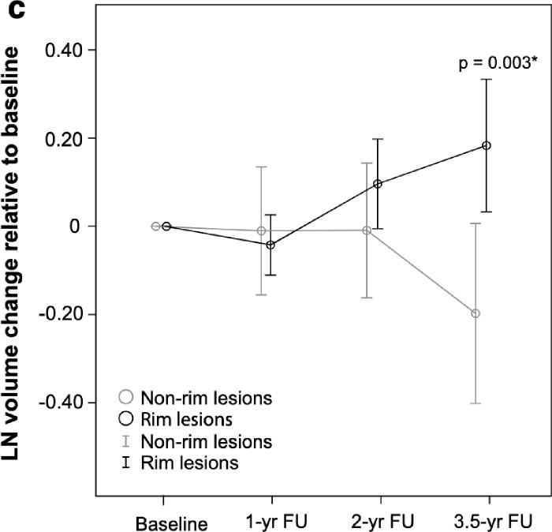
Paramagnetic Rim Lesions Enlarge and
Rimless Lesion Shrink over Time
Dal-Bianco A, Grabner G, Kronnerwetter C, Weber C, Höftberger R, Berger T, Auff E, Leutmezer F, Trattnig S, Lassmann H, Bagnato F and Hametner S (equally contributing senior authors). Acta Neuropathologica 2017.

Slide 25
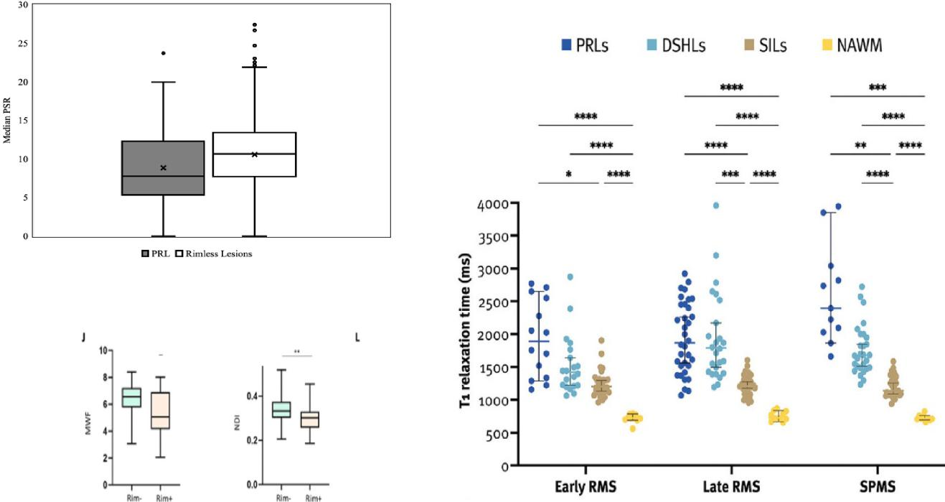
Paramagnetic Rim Lesions are Larger and
have a Higher Degree of Core Tissue Injury
Courtesy of Faraaz Kazimuddin (n=47)
Rahmanzadeh R. et al. Brain 2021 Krajnc N. et al. MSJ 2023

Slide 26
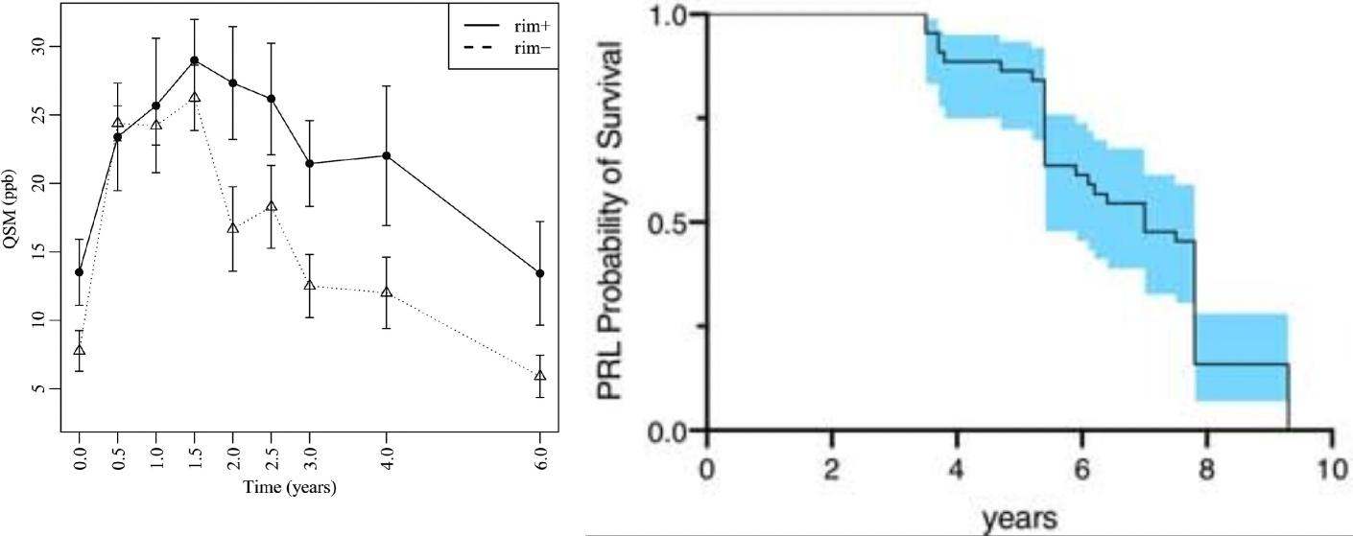
Eventually, every chronic active lesion
becomes inactive
Zhang, S. et a!. Quantitative Susceptibility Mapping of Time-Dependent Susceptibility Changes in Multiple Sclerosis Lesions. Ajnr Am J Neuroradio! (2019); Absinta, M. et a!. A lymphocyte–microglia–astrocyte axis in chronic active multiple sclerosis. Nature 597, 709–714 (2021).

Slide 27
More on the Clinical Value of PRL
Postmortem studies indicate that CAL predominate in pwMS and progressive
disease, particularly in those with a shorter time to disability accumulation.
PRL can be seen at any stage of MS as well as in radiologically isolated syndrome,
but they are often associated with a more aggressive clinical and radiological
course.
Studies report a consistently high specificity of PRL to MS diagnosis (>90%)
although the sensitivity to it remains low (~24%).

Slide 28
PRL are an Outcome Measure in Clinical Trials
https://clinicaltrials.gov/ct2/show/NCT03222973 (2017)
https://clinicaltrials.gov/ct2/show/NCT03523858 (2018)
https://clinicaltrials.gov/ct2/show/NCT04230174 (2020)
https://clinicaltrials.gov/ct2/show/NCT04695080 (2021)
https://clinicaltrials.gov/ct2/show/NCT04925557 (2021)
https://clinicaltrials.gov/ct2/show/NCT02784210 (2016)
https://clinicaltrials.gov/ct2/show/NCT04025554 (2019)
https://clinicaltrials.gov/ct2/show/NCT04742400 (2021)
https://clinicaltrials.gov/ct2/show/NCT04239820 (2021)

Slide 29
REVIEW OPEN ACCESS
Toward Precision Phenotyping of Multiple Sclerosis
David Pitt, MD, Chih Hung Lo, PhD, Susan A. Gauthier, DO, MPH, Richard A. Hickman, MD, Erin Longbrake, MD, PhD, Laura M. Airas, MD, PhD, Yang Mao-Draayer, MD, PhD, Claire Riley, MD, Philip Lawrence De Jager, PhD, Sarah Wesley, MD, MPH, Aaron Boster, MD, Ilir Topalli, PhD, Francesca Bagnato, MD, PhD, Mohammad Mansoor, BA, BS, Olaf Stuve, MD, PhD, Ilya Kister, MD, Daniel Pelletier, MD, Panos Stathopoulos, MD, PhD, Ranjan Dutta, PhD, and Matthew R. Lincoln, DPhil, MD, FRCP(C) Neurol NeuroimmunoI Neuroinflamm 2022;9:e200025. doi:10.1212/NXI.0000000000200025 | Correspondence Dr. Pitt david.pitt@yale.edu
VANDERBILT VUNIVE RSITY Neuroimaging Unit MEDICAL CENTER | VA |  | U.S. Department of Veterans Affairs
 |  |  | Veterans Health Administration Multiple Sclerosis Centers of Excellence

Slide 30
Figure 2 Multiple Sclerosis Clinical Phenotypes May Result From Different Axes Activity Profiles
Patient 1 Patient 2
Acute WM inflammation WM demyelination
Acute WM inflammation
Examples of the same clinical presentation (nonactive progression) caused by different pathologic axes activity profiles. Progression can be driven by chronic parenchymal in-flammation (chronic smoldering in-flammation in chronic active lesions) and axonal degeneration (patient 1) or by in-terstitial (meningeal) inflammation resulting in cortical demyelination and neuronal de-generation (patient 2). Indentation of axes indicates that activity occurs at later stage relative to others.
WM demyelination
Chronic parenchymal inflammation
Chronic parenchymal inflammation
C
0
Axonal degeneration Remyelination failure
Progression
Axonal degeneration
no
2 Neuronal degeneration
Remyelination failure
o_
Cortical demyelination
Neuronal degeneration
Cortical demyelination
Chronic interstitial inflammation
Chronic interstitial inflammation
Toward Precision Phenotyping of Multiple Sclerosis
 | VANDERBILT VUNIVE RSITY MEDICAL CENTER | VA |  | U.S. Department of Veterans Affairs
Neuroimaging Unit |  |  |  | Veterans Health Administration Multiple Sclerosis Centers of Excellence

Slide 31
1996 2013
With full recovery
from relapses Clinically
isolated syndrome (CIS)
Not active*
Active*,**
Relapsing-remitting disease (RRMS)
Not active*
With sequelae/ residual deficit after incomplete recovery
Relapsing-remitting
disease (RRMS)
Active*
 | VANDERBILT V U N I VE RS I TY MEDICAL CENTER | VA |  | U.S. Department of Veterans Affairs
Neuroimaging Unit |  |  |  | Veterans Health Administration Multiple Sclerosis Centers of Excellence

Slide 32
Progressive accumulation of disability from onset PP with or without temporary plateaus, minor remissions, and improvements
Progressive accumulation
Progressive of disability after initial disease SP relapsing course, with or without occasional relapses
and minor remissions
Progressive accumulation of disability from onset PR but clear acute clinical attacks with or without full recovery
Progressive accumulation of disability from onset
(PP)
Progressive disease
Active* and with progression**
Active but without progression
Not active but with progression
Not active and without progression (stable disease)
(SP)
Progressive accumulation of disability after initial relapsing course
I
 | VANDERBILT V U N I VE RS I TY MEDICAL CENTER | VA |  | U.S. Department of Veterans Affairs
Neuroimaging Unit |  |  |  | Veterans Health Administration Multiple Sclerosis Centers of Excellence

Slide 33
Today’s Overview
Objective 1: To learn about the role of conventional imaging in diagnosing and monitoring disease changes in multiple sclerosis (MS).
Objective 2: To learn about the role of non-conventional imaging in uncovering pathological changes leading to disease progression in MS.
Objective 3: To understand the role of precision medicine in MS.

Slide 34
Questions and Thank you
January 16, 2024

