Slide 1


Autoimmune Encephalitis Update
William Kilgo, MD
University of South Alabama
January 13-16, 2024
Key Largo, Florida

Slide 2
Disclosures
Contracted Research (Principal Investigators must provide information, even if received by the institution):
Genentech, EMD Serono, Alexion, Bristol Meyers Squibb
Honoraria: Octave Biosciences, TG Therapeutics
Speakers' Bureau: Genentech, Biogen, TG Therapeutics

Slide 3
Objectives
Review the most common subtypes of autoimmune encephalitis
Describe the clinical features that should raise concern for autoimmune encephalitis, with or without known antibody status
Review the diagnostic approach for autoimmune encephalitis
Review treatment options for autoimmune encephalitis

Slide 4
Autoimmune Encephalitis
What is autoimmune encephalitis (AIE)?
An immune-mediated inflammatory condition of the brain of many potential etiologies
  Syndromes due to:
    Antibodies against cell-surface or synaptic proteins (many)
    Antibodies against intracellular neuronal proteins (few)
  Can be purely immune-mediated or paraneoplastic
    Neuronal proteins tend to suggest a paraneoplastic association
    Cell-surface antibody-mediated syndromes are rarely paraneoplastic
  There are now numerous known antibody-mediated syndromes, many of which have been identified in recent years

Slide 5
Autoimmune Encephalitis
Diagnosing Autoimmune Encephalitis
Clinical suspicion is paramount
  Diverse, growing phenotypes
  Suggestive symptoms/syndromes
    Limbic encephalitis
    Psychosis
    Treatment-resistant seizures
    Brainstem encephalitis
Acute or subacute chronicity of symptoms
Associated risk factors for malignancy
Need to rule out mimics
  Infection, malignancy, inflammatory conditions, toxic/metabolic
Laboratory diagnosis is often delayed as antibody testing is sent out
Consider MRI, CSF testing, and a malignancy screen prior to empiric treatment

Slide 6
Autoimmune Encephalitis
Synaptic Proteins and Cell-Surface antigens
  GAD65
  NMDAR
  GABA-A & GABA-B
  AMPA-R
  VGKC complex associated proteins
    LGI-1
    CASPR2
  Anti-IGLON5
  Anti-DPPX encephalitis
  Anti-GlyR encephalopathy
  Anti-GFAP
  Anti-mGluR1 and mGluR5
Intracellular Targets
  ANNA-1, ANNA-2, ANNA-3
  CRMP-5
  Ma1 and Ma2
  PCA1 (Yo), PCA2, anti-DNER

Slide 7
Autoimmune Encephalitis
Diagnosing Autoimmune Encephalitis
Concurrent CSF and Serum testing is recommended when ordering broad antibody panels
Consider potential for false positive results
  Serum positive result alone with negative CSF should prompt careful consideration of if the clinical syndrome is consistent with the result
Diagnostic Criteria for Definite Autoimmune Limbic Encephalitis (expert consensus)
Subacute onset memory deficits, seizure, or psychiatric symptoms localizing to limbic system
Bilateral medial temporal lobe hyperintensities on T2/FLAIR MRI sequences
CSF Pleocytosis (>5 cells) OR abnormal EEG suggesting temporal lobe involvement
Exclusion of alternative causes

Slide 8
Autoimmune Encephalitis
Anti-NMDA receptor encephalitis
Most common etiology of AIE
Mostly impacts young adults and children (female predominance in ages < 45)
Often presents initially with psychiatric manifestations
  Bizarre behavior, psychosis
    Many patients will present first to a psychiatrist or psychiatric facility
  Memory deficits
  Movement disorders
    Dyskinesias (orofacial, choreoathetosis, dystonia, rigidity)
  Autonomic instability
  Treatment resistant seizures
  High association with ovarian teratoma in young females

Slide 9
Autoimmune Encephalitis
Anti-NMDA receptor encephalitis
Associated with:
  Normal Imaging (90%)
  Abnormal EEG (“extreme delta brush”)
  Abnormal CSF with pleocytosis or OCBs
Confirmation:
  CSF with Positive anti-NMDA IgG (anti-GluN1)
    Serum alone is less sensitive, so concurrent CSF preferred

Slide 10
Case 1
58 year old male
  Presents to hospital as a transfer from outside facility with several weeks of anterograde amnesia. He had been becoming more forgetful per his wife, who had been away on business. He was making mistakes at work, prompting their concern to contact her. He is aware of the memory issue and distressed by it.
  Local hospital admitted and discharged him after initial work-up. Patient re-presented to hospital at behest of his PCP and was transferred to our facility.
  He describes premonitory symptoms of an internal “rush” toward his face at times followed by involuntary movements of his face and left arm that occur at random, several times daily

Slide 11
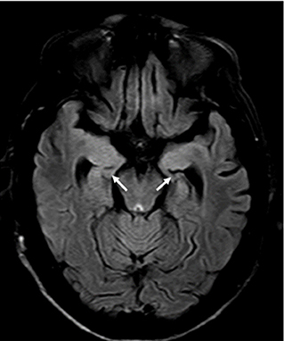
Case 1
58 year old male
  Work-up:
  MRI Brain—bilateral T2/FLAIR change affecting mesial temporal lobes
  EEG: focal temporal status epilepticus
  Initial labs: hyponatremia
  CSF: WBC, protein, glucose all normal
  Serum and CSF: (+) for anti-LGI-1
Treatment:
High dose steroids inpatient, single relapse within one year. Stable on oral mycophenolate
*representative image
Otiniano-Sifuentes R, Cuba Antezana A, De La Cruz Ramirez WF, Pacheco-Barrios K and Segura Chavez DA (2021) Case Report: Anti-LGI1 Limbic Encephalitis Associated With Anti-thyroid Autoantibodies. Front. Neurol. 11:620483. doi: 10.3389/fneur.2020.620483

Slide 12
Autoimmune Encephalitis
Anti-LGI-1 encephalitis
Most common form of AIE in patients over 50
Patients present with memory disturbances, confusion, and seizures
Cognitive symptoms may be preceded by characteristic movement disorder/seizure
  Faciobrachial dystonic seizures
Patients may present with rapidly progressive dementia without associated symptoms, MRI, or CSF abnormalities

Slide 13
Autoimmune Encephalitis
Anti-LGI-1 encephalitis
Imaging often normal
  If abnormal, shows characteristic findings of limbic encephalitis
CSF: +/- oligoclonal bands and pleocytosis. Often normal
Patients are responsive to early immunotherapy
Long-term cognitive effects may persist
Relapse may occur in 1/3 of patients
Diagnosis: anti-LGI-1 antibodies in blood/CSF (blood more common)
Tumor association: Thymoma is rare, other types are usually incidental.

Slide 14
CASPR2
Autoimmune Encephalitis
Anti-AMPA receptor
Component of VGKC complex (like LGI-1)
(+/-) Classical “Limbic Encephalitis”
Morvan Syndrome
  Neuromyotonia
  Memory loss
  Sleep disturbances
  Autonomic instability
Classical “Limbic Encephalitis”
AMPA-type ionotropic glutamate receptors
Female predominant
  Average age 50-60
2/3 of cases are paraneoplastic
  Lung, thymus, breast cancers most common

Slide 15
Anti-GABAA
Autoimmune Encephalitis
Anti-GABAB
Refractory seizures
50% of cases reported in pediatric patients
  Dyskinesias may suggest coexistent anti-NMDA-R
Associated tumor in 40% of patients (thymoma most common)
MRI: multifocal cortical/subcortical T2/FLAIR changes
Usually Limbic Encephalitis, but can vary:
  Rapidly progressive dementia
  Opsoclonus myoclonus
  Ataxia
  Refractory status epilepticus
50% of cases associated with Small Cell Lung Cancer
Good response to tumor treatment and/or immunotherapy

Slide 16
Case 2
65 year old male
  Presents to movement disorders clinic with progressive encephalopathy that has been worsening over the last 5-7 years.
  At onset patient developed new REM-sleep behaviors
  Gait ataxia, falls
  Cognitive change followed with hallucinations, confusion
  Hyperreflexic on exam, slowed saccades bilaterally
  Work-up:
  MRI Brain—generalized atrophy
  CSF: WBC, protein, glucose all normal
  Serum and CSF: (+) for anti-IGLON5 antibody

Slide 17
Autoimmune Encephalitis-Atypical Syndromes
Anti-IGLON5 Disease
Antibodies to IGLON5, a neuronal cell adhesion protein
Autoimmune process with superimposed neurodegeneration
Symptoms:
  REM and non-REM parasomnias
  Sleep-disordered breathing
  Progressive bulbar symptoms
  PSP-like syndrome
Median age of onset: 62
Prognosis is poor, often recognized late in disease course with permanent sequelae
  Pathology shows hyperphosporylated tau in brainstem tegmentum and hypothalamus
Mimics neurodegenerative disorders
Early recognition/treatment are needed
  First line immunotherapy: steroids/IVIG/PLEX
  Second line: cyclophosphamide/rituximab
Respiratory support often needed needed

Slide 18
Autoimmune Encephalitis-Atypical Syndromes
Anti-DPPX encephalitis
dipeptidyl-peptidase-like protein-6
Prodrome of symptoms
  Weight loss, diarrhea, autonomic symptoms
  Progressive in nature with development of encephalitic symptoms with hyperexcitability (myoclonus, agitation, seizures)
  Progressive encephalomyelitis with rigidity and myoclonus (PERM)
Anti-GlyR encephalopathy
PERM, hyperekplexia, stiff person syndrome (in SPS patients without GAD-65 antibodies)
Seen in other immune mediated processes
  Limbic encephalitis
  Optic neuritis
  Some patients with MS

Slide 19
Autoimmune Encephalitis-Treatment Approaches
Acute
Glucocorticoids
Intravenous Immunoglobulin (IVIG)
Plasmapheresis (PLEX)
Off-label anti-CD20
Identification and treatment of malignancy if paraneoplastic
Maintenance
May not be necessary if monophasic course
Some syndromes may have a relapsing course
Off label use of:
  Maintenance glucocorticoids
  Oral immune suppressants (mycophenolate, methotrexate, azothioprine)
  IVIG, anti-CD20 drugs
  IL-6 inhibitors (tocilizumab)
Investigational Therapies
Inebilizumab (Extinguish Trial for anti-NMDA-r encephalits)
Satralizumab for anti-NMDA and LGI-1
Rozanolixizumab for LGI-1 (many other targets)

Slide 20
Case 3
54 year old male
  Presents complaining of relatively rapid onset of speech changes over one month that started in May of 2022. He was having intermittent diplopia as well. He also began to develop trouble swallowing both solids and liquids within three months. His ability to walk began to decline as well concurrently, with “falling forward” upon standing. He has had progressive difficulty with coordination ever since onset of symptoms as well.
  No pertinent medical history. Previously healthy, worked as a police officer.
  Had been evaluated in our clinic years ago out of concern for a demyelinating process. Complained of leg weakness and upper extremity tremor. Symptoms have been static since onset in 2015, no changes until the above years later

Slide 21
Case 3, continued
Exam:
  Awake, alert, follows commands.
  Cerebellar scanning speech
  Moderate dysmetria in both arms and legs
  Unable to ambulate independently more than a few steps due to ataxic gait
  Normal reflexes and sensation to all modalities
Impression:
  Subacute onset cerebellar syndrome. Differential including autoimmune, paraneoplastic versus acquired causes. Consideration of genetic causes was present given prior symptoms in 2015 (unclear if related to current symptoms)

Slide 22
Case 3, continued
Workup:
  MRI and CSF studies in 2015: negative
    VEP at that time showed bilateral P100 prolongation
      AQP4 ab was negative
  Genetic panel (broad spectrum Ataxia panel) checked in 2022, results were never received, but eventually showed:
    (+) GCH1 mutation, seen in dopa-responsive dystonia
      Empirically trialed on carbidopa-levodopa with equivocal response, possibly some improvement in balance
  Does DRD make sense as his diagnosis?
  Further work-up performed upon evaluation in neuroimmunology clinic:
    Serologic testing was highly (+) for antibodies to Kelch-like protein 11

Slide 23
Case 3, continued.
Kelch-like protein 11 encephalitis
Largely a paraneoplastic encephalitis
  Testicular seminoma
  May have cross-over presentation with other autoimmune antibody syndromes (anti-NMDAr and anti-Ma2)
  Patients present with rhombencephalitis, cerebellar degeneration, sensorineural hearing loss, diplopia, gait ataxia
Management:
  Immunotherapy
    Corticosteroids, plasma exchange
    Cyclophosphamide +/- rituximab
  Identify and treat underlying malignancy
    Testicular/gynecologic ultrasound
    Full body CT scan
      If both of above are negative, FDG-Pet should be considered given high degree of oncologic association

Slide 24
Case 3, continued
Workup:
  Testicular ultrasound revealed a heterogeneous mass within the left testicle, presumed to be a testicular seminoma
  Referred for orchiectomy—treatment still in progress

Slide 25
Autoimmune Encephalitis
Take away points:
Clinical suspicion for autoimmune encephalitis is paramount to treatment success
  Low threshold for serum/CSF sampling in patients with subacute presentations, even if an atypical neurologic or seemingly neurodegenerative syndrome
Waiting for diagnostic confirmation should not preclude empiric treatment, especially in hospitalized patients with refractory symptoms such as treatment-resistant seizures
Antibody-specific syndromes can help guide treatment, especially when determining how to approach search for associated malignancy
Newly identified disease states are emerging, some that cross over with neurodegenerative disorders that may have protracted courses over years

Slide 26
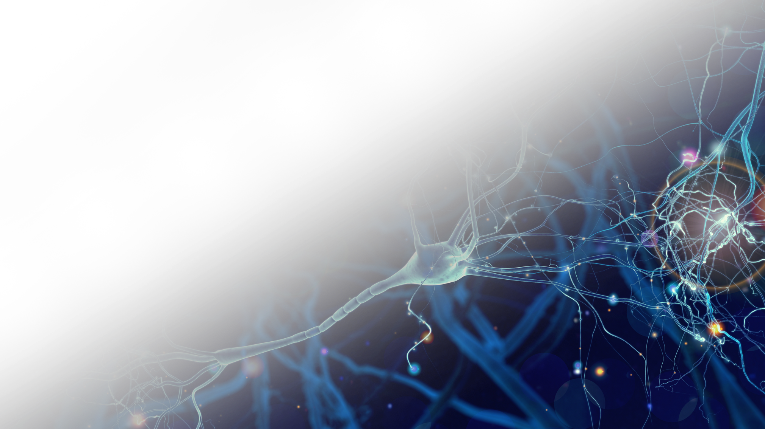
References
Subhead
Text
• Bullet
Dubey D, Wilson MR, Clarkson B, et al. Expanded Clinical Phenotype, Oncological Associations, and Immunopathologic Insights of Paraneoplastic Kelch-like Protein-11 Encephalitis. JAMA Neurol. 2020;77(11):1420–1429. doi:10.1001/jamaneurol.2020.2231
https://blogs.neurology.org/epearls/paraneoplastic-kelch-like-protein-11-encephalitis/
Lancet Neurol. 2016 Apr;15(4):391-404. Epub 2016 Feb 20.
Neurol Neuroimmunol Neuroinflamm. 2021;8(4) Epub 2021 May 18.
Graus F, et al. A clinical approach to diagnosis of autoimmune encephalitis. Lancet Neurol. 2016 Apr;15(4):391-404. doi: 10.1016/S1474-4422(15)00401-9. Epub 2016 Feb 20. PMID: 26906964; PMCID: PMC5066574.

Slide 27


Questions

