Slide 1


Update: Management and Differential, CIDP, MMN & Diabetic Polyradiculopathy (DPR)
Bassam A. Bassam, MD FAAN Professor of Neurology University of South Alabama
January 13-16, 2024
Key Largo, Florida

Slide 2
Disclosures
• UCB Pharma Company Speaker Bureau member
Argenx Biotechnology Company Speaker Bureau member
  Review clinical & electrodiagnostic features of CIDP
  Review updated evidence based treatments for CIDP
  Learn to differentiate CIDP variants and DM + CIDP
  Discuss proximal diabetic neuropathies.
OBJECTIVES

Slide 3
CIDP Clinical Features
Onset slowly progressive 8-10 weeks to months
  occasionally acute onset in relapsing form (<10%)
Patients present with motor > sensory symptoms
  Weakness is most disabling feature
  proximal and distal muscle groups
  usually symmetric (except in CIDP variants)
Weakness can be more prominent than muscle atrophy
Sensory deficit usually mild distal large > small fibers, legs > arms. Pain ± 20%, especially in sensory variant
Cranial nerves dysfunction in up to 15% (ophthalmoplegia, facial or bulbar weakness)
Tendon reflexes reduced or absent early in 90%
Occasional manifestations autonomic dysfunction & CNS features, papilledema, tremor
Sphincters are typically spared

Slide 4
Electrophysiology:
Variable slow motor & sensory conduction velocity among nerves (< 80% of lower limit of normal)
Conduction block, temporal dispersion, prolonged DL
F- waves prolonged and non-persistence
Amplitude of CMAP and SNAP correlates poorly with degree of axonal loss

Slide 5
Electrodiagnostic Criteria for CIDP
Definite; at least one of the following in 2 nerves;
  ≥ 50% prolongation of DL
  ≥ 30% reduced MCV
  ≥ 20% prolongation, or absent F-wave, (excluding tibial)
  ≥ 50% reduced proximal CMAP amplitude, or ≥ 30% proximal dispersion (excluding tibial nerve)
Probable:
  ≥ 30% reduced proximal CMAP amplitude in 2 nerves
  or in one nerve plus at least one other nerve with demyelinating parameter (excluding tibial nerve)
Possible;
  As in "Definite CIDP" but in only one nerve
  Testing of multiple limbs is more sensitive than only unilateral or lower limbs to optimize EDXs diagnosis.

Slide 7
12
34

Slide 8
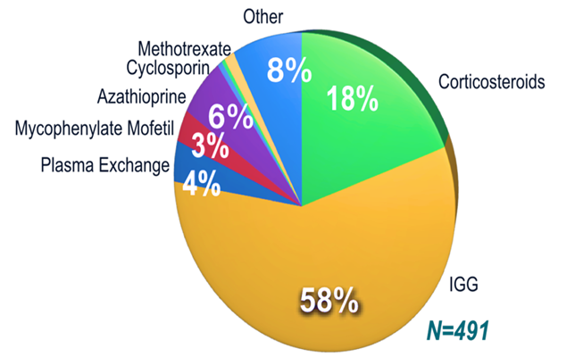
CIDP 1st Line Therapy with RCT Efficacy ;
Prednisone:
  Pred 60-100 mg/d x 2-4 wks, then 100 mg qod then re-evaluate at 3 months
  Or Methylprednisolone IV 1 g/d x 5 days then taper.
Plasmapheresis:
  PLEX 2-3 / week x 3-6 wks then re-evaluate
  IVIG ICE trial 1gm/kg Q 3 weeks:
  IVIG 2 gm/kg, then 1 gm/kg/mon then re-evaluate at 3 months, maintenance could be a lower dosage
Prednisone and PLEX are as effective as IVIG
SCIg: US FDA-approved March 2018 as maintenance therapy for CIDP and in Canada as of July 2018
Treatment of CIDP Patients with
Active Progressive Disease in 2010

Slide 9
Corticosteroids in CIDP
40-95% response rate with high dose prednisone
Onset at 2 months, peak at 3-6 months
Prednisone 60-100 mg/d x 2-4 wks, then 100 mg qod then re-evaluate at 3 months Maintenance dose of 5 – 15 mg is often necessary
Or pulsed oral Dexamethasone 40 mg/d for 4 days monthly
Or IV pulse methylprednisolone 1g x 5days then tapering to weekly, then to monthly
Dalakas & Engel Ann Neurol 1981, Dyck et al Ann Neurol 1982
Molenaar et al JNNP 1997, Lopate at al Arch N 2005 ,Muley et al Arch N 2008to

Slide 10
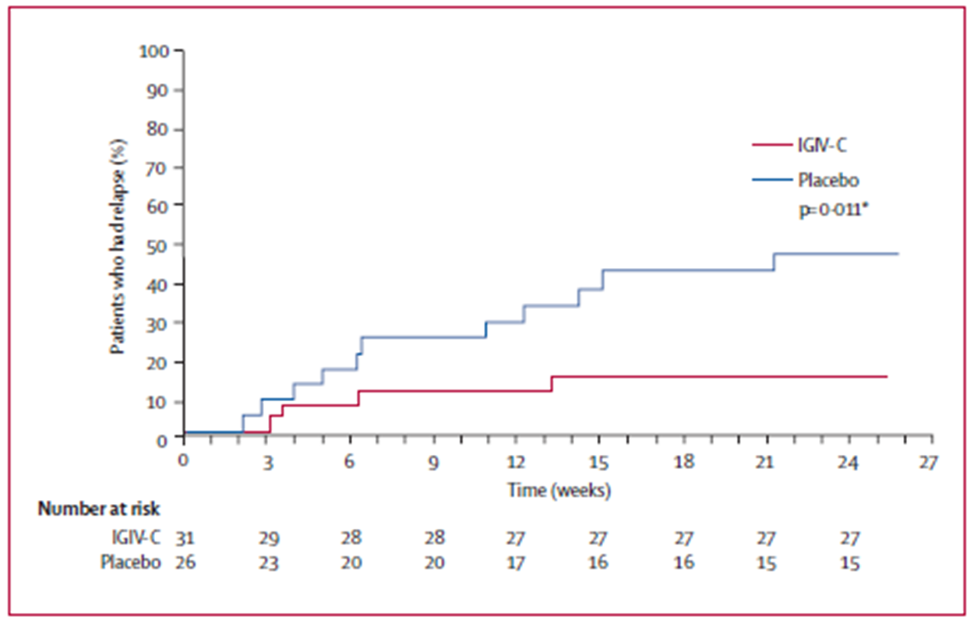
IVIG in CIDP
Pooled IgG from ≥5,000 blood donors
1 gram = 4 x 10¹⁸ antibodies recognizing 10⁷ antigens
Serum IgG declines by 50% at 3 days, back to baseline in 3 to 4 Ws.
Onset in 10 days - few weeks,
Short-term benefit lasting 2-6 weeks, or longer
63-76% response rate, up to 90% in selected cases
Remission rate 37% (PATH), 50% ICE trial - often requires chronic maintenance
Equivalent to prednisone – though no head-to-head comparison
Hahn et al Brain 1996:1067-77, Mendell et al Neurology 2001;56:445-9, Hughes et al. Ann N 2001;50:195-2001
Lancet Neurol. 2008 Feb;7(2):136-44, Lancet Neurol. 2018 Jan;17(1):35-46

Slide 11
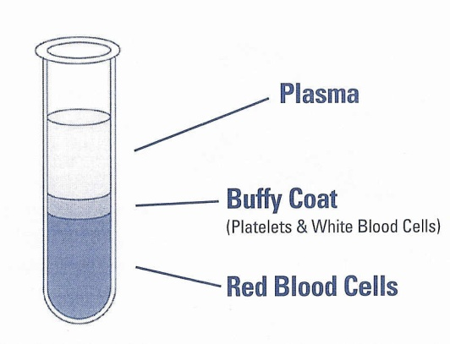
CIDP: Plasma Exchange (PLEX)
Each PLEX reduces IgG by 45%; 3-5 PLEX removes 90%
2 RCTs demonstrated transient clinical & NCS improvement
  Most responders relapsed in 3 weeks
Efficacy equivalent to that of IVIG – no head-to-head study
Risks of central venous catheter placement
Hypotension, cardiac arrhythmia, vasovagal
Allergy to albumin
Hypocalcemia, anemia, thrombocytopenia
Citrate toxicity (use heparin)
Dyck PJ et al NEJM. 1986:461-5
Hahn AF et al Brain 1996:1055-66
Dyck PJ et al Ann N 1994:838-45
Notes:
11

Slide 12
Subcutaneous IG in CIDP Treatment (PATH study)
PATH Trial RC parallel-group 3-arm study to investigate 2 different doses of SC IgPro20 compared with placebo (2% albumin) over 24 weeks
CIDP patients with active disease whom are responsive to IVIg therapy
  (Lancet Neurl. 2018 Jan; 17 (1): 35-46)
Approved in 2018 for CIDP maintenance therapy
Calculated weekly/biweekly equivalent to IV dose is 0.2 – 0.4 g/kg/w
Self administer, flexible schedule at home
1 or 2 infusion pumps each about 20 cc/hr/port
Stable Ig trough levels and avoid wear-off effects
Comparable efficacy and lower systemic Aes
Dose 1 : 1 as IVIG divided over weekly dose (0.33 g/kg/W versus 1 g/kg/3 Ws)
(Beydoun SR, Sharma KR, Bassam BA et al. Frontier in Neu 2021)

Slide 14
  2nd Line Therapy in CIDP
    Azathioprine 2 - 3 mg/kg/day
    Methotrexate* 25 mg/week
  3nd Line Therapy in CIDP
    Cyclosporine 3 -6 mg/kg/day
    Mycophenolate mofetil 2 – 3 gm/day
    Cyclophosphamide 1.5 – 2 mg/kg monthly IV pu 3 - 6lse
    Rituximab
Therapy in the pipeline
    ADHERE multicenter RBCT “efgartigimoid –hyaluronidase” SC reduce risk of CIDP relapse. (AANEM 2023 annual meeting)
RMC Trial Group Lancet Neurol 2009; 8: 158–64
J Neurol Neurosurg Psychiatry 2011;82:306-308

Slide 15
Immunosuppressive Agents
Are often used together with corticosteroids to reduce the need for IVIg or PE, or in none responders' patients.
No RCTs have been reported (class VI), except for Azathioprine
Azathioprine showed no benefit in 2 CTs when added to prednisone (Dyck et al., and Hughes et al.)
Cyclosporine 2.5 mg/kg/ day, then taper to minimum effective dose in refractory cases, or when prednisone is not indicated
Methotrexate; 7.5 to 25 mg p.o. on weekends
(RMC Trial Group Lancet Neurol 2009; 8: 158–64)
Cyclophosphamide; monthly IV pulse x 6; for refractory patients
β-Interferon in a large BPC study showed no benefit
(open label small study showed improvement in 56% (Vallat et al).
Oral Fingolimod study results negative (FORCIDP trial)
(Lancet Neurol. 2018 Aug;17(8):689-698)
Notes:
β

Slide 16
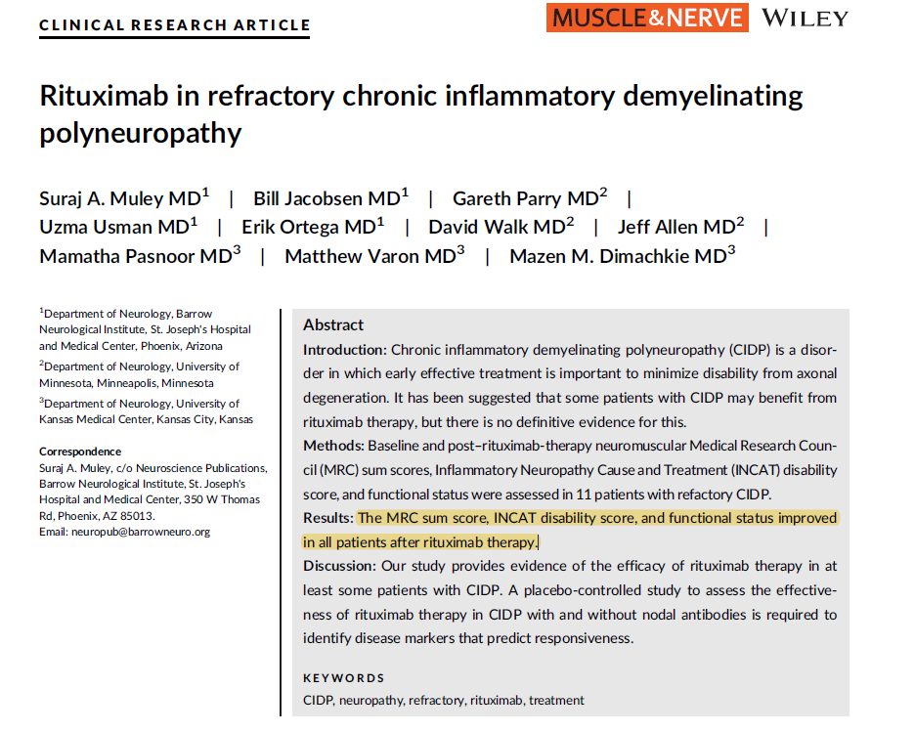

Slide 17
Measuring Treatment Effect in CIDP
In one study, 47% (N=27) of cases were misdiagnosed as CIDP
2/3 misdiagnosed cases reported subjective improvement with IVIg !
Since response to treatment is part of the supportive criteria for CIDP, it is important to employ objective, reliable and validated yardsticks
Start by asking about impact of CIDP on self care (ADLs )
Monitor with a combination of patient reported outcome measures and objective assessments
Selecting metrics that are easy to use and quick to administer is important in the clinical care such as ADLs and improved grip strength
Allen JA, Lewis RA. Neurology. 2015 Aug 11;85(6):498-504.
Allen JA, et al. Neurology. 2021;96(14):e1876–e1886.
Notes:
a Instrumental ADL refer to preparing meals, shopping for groceries or clothes, using the telephone, managing money, etc.
b Self care ADL refer to bathing, dressing and undressing, feeding self, using the toilet, taking medications, and not bedridden.

Slide 18
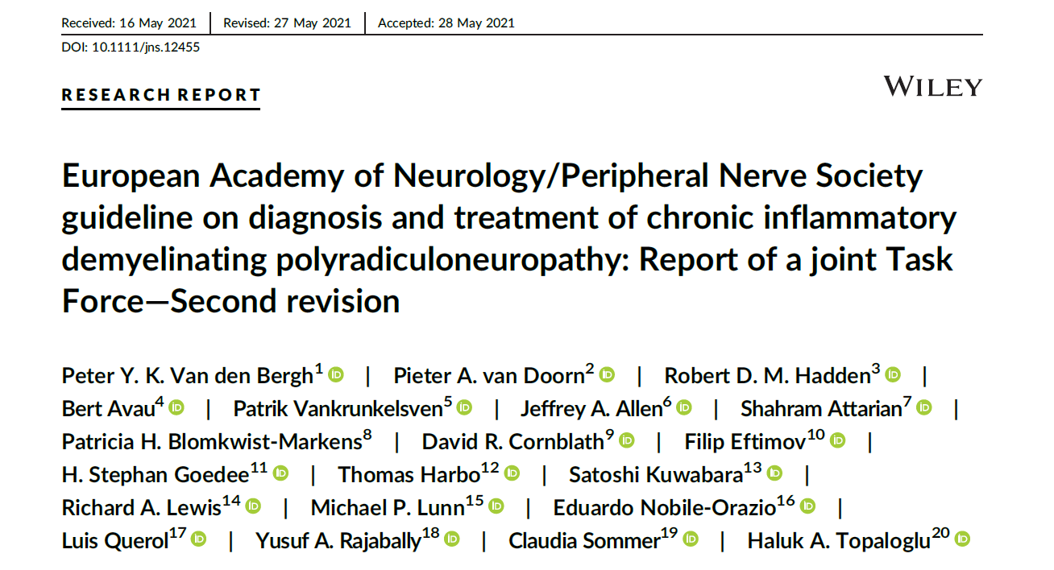
EAN/PNS guideline on diagnosis & treatment of CIDP
Van den Bergh PYK, van Doorn PA, Hadden RDM, et al. European Academy of Neurology/Peripheral Nerve Society guideline on diagnosis and treatment of chronic inflammatory demyelinating polyradiculoneuropathy: Report of a joint Task Force—Second revision. Eur J Neurol. 2021;1–28. https://doi.org/10.1111/ene.14959

Slide 19
EAN/EFNS 2021 CIDP Treatment Recommendation Summary
IVIg and oral or IV corticosteroids (CS) are strongly recommended as initial Rx in typical CIDP & CIDP variants
Plasma exchange strongly recommended if IVIg & CS are ineffective
IVIg should be considered as first-line treatment in motor CIDP
Induction treatment of IVIG 2g/kg followed by maintenance treatment, IVIg, SCIg or CS recommended
If IVIG is infective (no objective improvement) consider combination treatments or adding an immunosuppressant or immunomodulatory drug (Good Practice Point)
If pain is present, consider drugs against neuropathic pain & multidisciplinary management (Good Practice Point)
(Van den Bergh PYK, et al.Eur J Neurol. 2021;1–28. https: //doi.org/10.1111/ene.14959).

Slide 20
CIDP Variants
CIDP has typical and atypical phenotypes, only ≥50% patients have typical CIDP
Acute/subacute onset CIDP
Pure motor or pure sensory CIDP
CIDP with monoclonal gammopathy
CIDP with CNS features
Other heterogeneous phenotypic pattern;
Multifocal motor neuropathy (MMN)
Multifocal acquired demyelinating sensory and motor neuropathy (MADSAM, Lewis-Sumner syndrome)
Distal acquired demyelinating symmetric neuropathy (DADS)
Neuropathies with anti-ganglioside antibodies (nodo-paranodopathies)

Slide 21
Multifocal Motor Neuropathy (MMN)
Male > female 2 to 1, age mostly 30 -50 years, prevalence 1 : 100,000
Weakness in arm > legs; usually distal (87%), often in distribution of individual nerves, weakness > atrophy
Positive anti-GM1 antibodies in 52 to 85% of cases.
CSF protein normal (elevated in 9% < 100 mg/dL)
NCS; multifocal conduction block, variably slow NCV and variably prolonged DL.
Do not respond to corticosteroids or PLEX, but respond well to IVIg

Slide 22
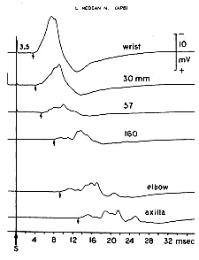

Slide 23
When to suspect nodo-paranodopathy?
Clinically | Acute/subacute onset predominantly distal motor NP; with rapid progressive severe disability, associated features of sensory ataxia, tremor, neuropathic pain, cranial neuropathies, autonomic dysfunction, or respiratory insufficiency.
Associated disorders | Nephrotic syndrome, IgG paraprotein lymphoproliferative disorder
Electrophysiology | Reduced motor conduction velocity, Markedly delayed distal motor and F-waves latencies, conduction block, and decreased CMAP amplitude, early axonal loss, positive anti-ganglioside antibodies (neurofascin NF155- NF186 and CNTN1).
Treatment | Less responsive to 1st line CIDP therapy, more sustained response to rituximab.
Radiology | Nerve root and plexus enlargement and enhancement
Histology | Axonal degeneration, nodal widening, paranodal myelin detachment. No inflammation or segmental demyelination. (An Indian Acad Neurol 2022;25 PMC9996523)

Slide 24
CIDP in Diabetic Patients Key Points;
Over 50% 0f diabetic has NP, however ≥80% are chronic length-dependent axonal diabetic sensorimotor polyneuropathy (DSNP)
Early studies suggested higher incidence of CIDP in DM, but epidemiological studies failed to confirm association, which is still being debated.
The diagnosis challenge remains is it CIDP in DM or Proximal Diabetic Neuropathy (Diabetic Amyotrophy, Radiculoplexus NP, Thoracic Radiculopathy)?
Diagnosis of CIDP in DM can be made mainly on the basis of clinical features, EDx criteria, CSF analysis. Imaging and neuropathology are occasionally helpful
Differentiate from few diabetics with slow NCV and less severe weakness due to poor glycemic control metabolic rather than inflammatory pathophysiology.
The amenability of CIDP in DM to treatment makes its identification important.
Rajabally et al. Nature Reviews Neurology, 2017; 13. Dunnigan et al. Brain and Behavior, 2013;3 .
Dyck et al. Jour of Peripheral Nervous Society, 2010;15

Slide 25
CIDP in Diabetes mellitus
Tend to have more axonal loss with more severe NP, yet may respond to therapy, with similarity and differences from CIDP and DSNP.
Differences from CIDP
  Older age - 67 years vs, 49 years in CIDP alone. (Gorson et al Muscle & Nerve.2000;23)
  EDXs show more axonal loss & and absent sural SNAP compared to CIDP.
  Autonomic dysfunction may be seen, whereas very uncommon in CIDP (McLeod et al. 1987)
  More gait imbalance and less magnitude of functional recovery
Difference from DSNP
  Slower and more severe CV out of proportion to axonal loss.
  Have better glycemic control, shorter duration of DM indicative of different pathophysiologal mechanism
  More prominent weakness, severe nerve injury and higher CSF protein
Treatment is guided by treatment of CIDP, with variable response to treatment and less responsive than CIDP alone (Corticosteroids 56%, PE 20% and IVIG 44%)
(Chan YC et al. Cochrane Database Systematic Review 2017

Slide 26
Proximal Diabetic Neuropathy
(Diabetic Lumbosacral Plexopathy, Diabetic Amyotrophy, Diabetic Radiculoplexus neuropathy, Bruns–Garland Syn)
Seen in ≥1% of DM II, males > females, over age 50 years
Usually involve the LS plexus, less commonly thoracic or cervical roots/plexus or nerves
Acute onset severe unilateral thigh pain, followed by weakness and atrophy of the involved muscles
Minimal sensory loss, depressed knee reflex, weight loss & associated sensory DNP
Monophasic and spontaneous slow recovery in most
Variants include; asymmetric bilateral lower limb, less common upper limbs (9 of 65 cases) thoracic and foot drop.
Inflammatory vasculopathy or ischemic basis
(Dyck JB et al. J Peripher Nerv Syst 2005;10)

Slide 27
Isolated Thoracic Radiculopathy
(Truncal radiculopathy, Diabetic thoracoabdominal NP)
Distinctive disorder, usually seen in DM type I or II, M > F older pts., poor DM control, and weight loss
Segmental chest or abdomen pain, allodynia, and sensory loss, that may not follow segmental pattern
± Focal muscle weakness (abdominal bulge)
Diagnosis is clinical and needle EMG testing
The pain intensity and location mimics medical, surgical or orthopedic conditions
Probable similar pathogenesis to PDN
Pain usually subsides in 4 – 12 months
Cutaneous sensory loss may persist lifelong.

Slide 28


Questions

