Slide 1


Steps Forward in Amyotrophic Lateral Sclerosis (ALS) Diagnosis and Treatment
Mohamed Kazamel, M.D.
Professor of Neurology
Division of Neuromuscular Diseases
The University of Alabama at Birmingham
January 13-16, 2024
Key Largo, Florida

Slide 2
Disclosures
None

Slide 3
Objectives
Review the clinical presentation of ALS
Explain the challenges faced during establishing the diagnosis of ALS
Discuss the updated management of ALS including some pipeline therapeutics

Slide 4
Outline
History of ALS
Pathology of ALS
Genetics and pathophysiology
Clinical picture and diagnosis
Management of ALS

Slide 5
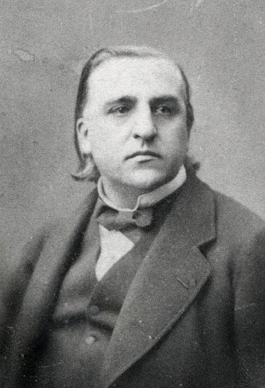
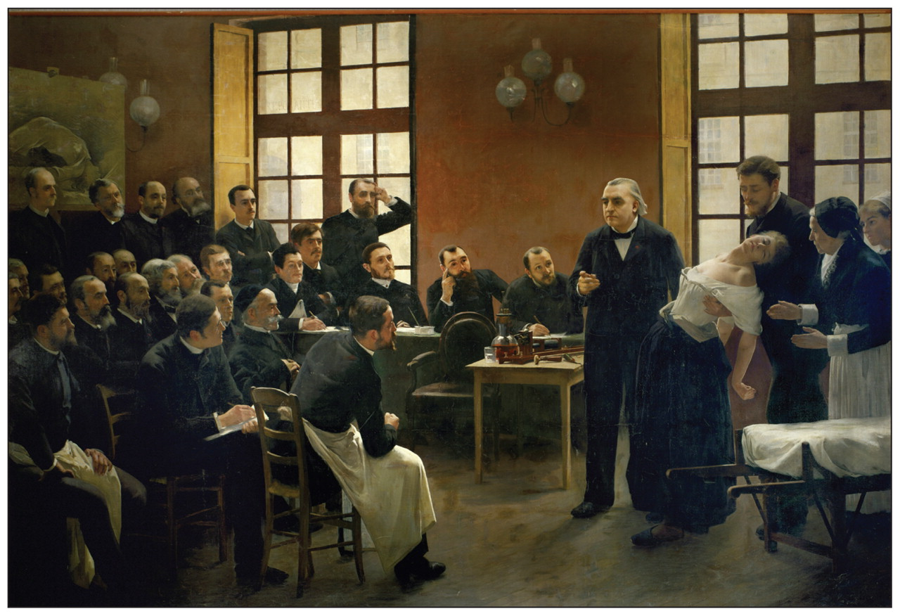
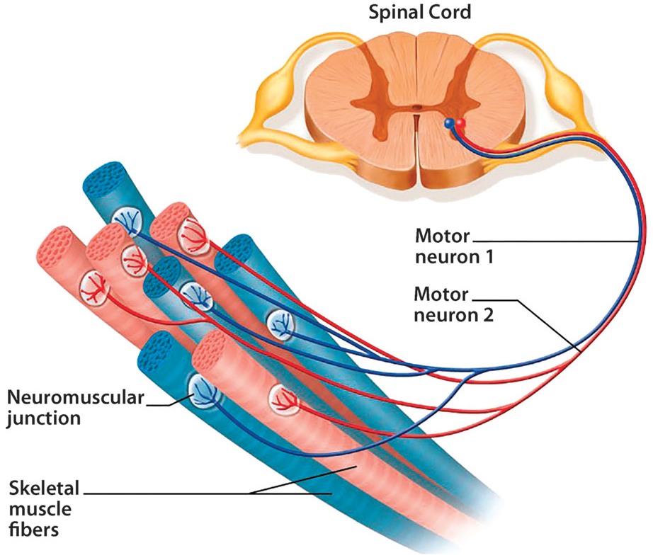
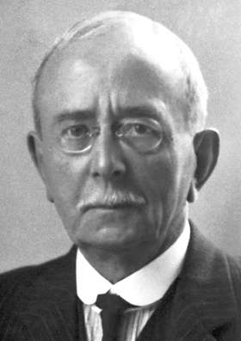
History of ALS
Jean Martin Charcot 1869
Sir Charles Sherrington 1857-1952
The motor unit

Slide 6
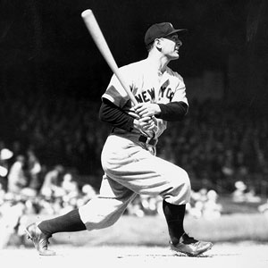
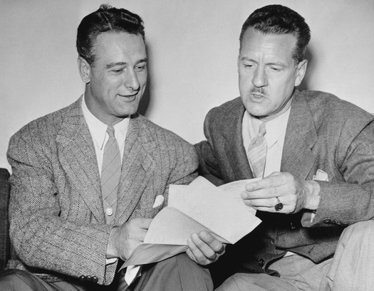
History of ALS: Lou Gehrig (1903-1941)
.340 batting average
Yankees captain 1935-1939
493 home runs
Nicknamed The Iron Horse
All Star 7 consecutive times
Six World Series Champion
Lou Gehrig and Rob Gilman, MD 1939
“The bad news is lateral sclerosis, in our language chronic infantile paralysis. There isn't any cure ... there are very few of these cases. It is probably caused by some germ ... Never heard of transmitting it to mates ... There is a 50–50 chance of keeping me as I am. I may need a cane in 10 or 15 years. Playing is out of the question”

Slide 7
Definition
Motor neuron diseases: various disease entities that result in progressive degeneration of motor neurons
Amyotrophic lateral sclerosis (ALS) is the most common disease in this category
The term motor neuron disease is sometimes used interchangeably with ALS

Slide 8
ALS
A neurodegenerative inexorable disease of motor neurons that causes progressive limb/bulbar weakness
Progress in severity of muscle weakness and extent of involved muscles is a key feature
A mixture of upper and lower motor neuron impairment is another hallmark of the disease

Slide 9
Epidemiological Aspects
6000-7000 patients are diagnosed in the US every year
Incidence: 1.5-2.7/100,000/ year
Prevalence 2.7-7.4/100.000
Average age of onset is 62
Male: female ratio 1.3-1.5:1
Survival
  Approximately three years from symptom onset
  20% of patients live past five years
  5% may live past 10 years

Slide 10
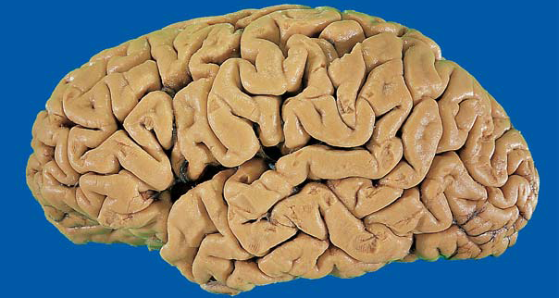
Pathology: Brain Gross Pathology
Ellison, D et al. Neuropathology: A Reference Text of CNS Pathology: Second Edition. Edinburgh, 2004. pp. 501-7.

Slide 11
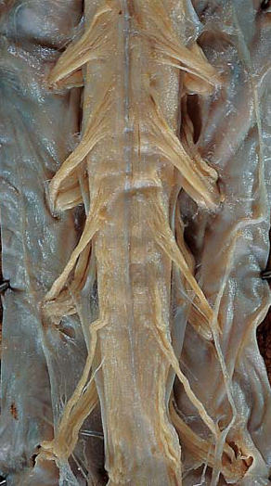
Pathology: Spinal Cord Gross Pathology
Normal
Atrophic
Ellison, D et al. Neuropathology: A Reference Text of CNS Pathology: Second Edition. Edinburgh, 2004. pp. 501-7.

Slide 12
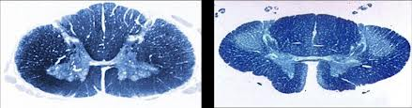
Pathology: Spinal Cord Pathology
King and Mitsumoto, 1996

Slide 13
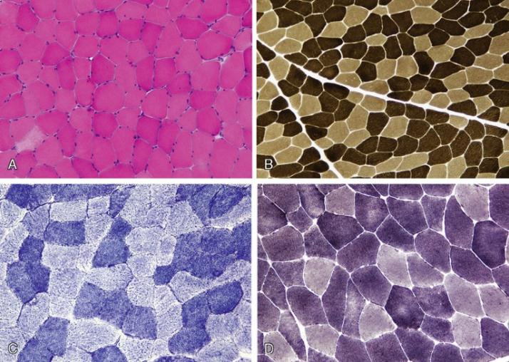

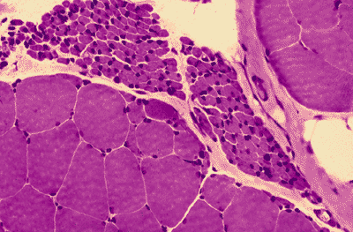
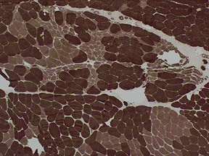
Pathology: Muscle Pathology in ALS
Normal
ALS
H&E
ATPase pH 4.3

Slide 14
Familial ALS
10-15% of patients could definitively point to a family history of the disease
Genes:
1) Superoxide dismutase 1 (SOD1)
  20% of familial ALS cases
  Autosomal dominant pattern of inheritance with strong penetrance
  Mutated SOD1 gene present with gain and loss of function mutations
  Earlier onset of disease with 1-2 year mean survival
  2) FUS
  FUS gene mutations were considered to be a pathogenic factor in a few cases of ALS
  Can be target for clinical trials
Nolan M, Talbot K, Ansorge O (2016) Acta Neuropathol Commun 4(1):99.

Slide 15
3) C9orf72
Largest proportion of inherited ALS in the US
A hexanucleotide repeat expansion (GGGGCC) in the noncoding region of chromosome 9 open reading frame 72
More than 30 repeats→ disease
ALS and frontotemporal dementia

Slide 16
4) TARDBP
5% of familial ALS
Indistinguishable from ALS due to other causes
Linked to frontotemporal dementia
Leads to missplice of the precursor mRNA of the stathmin-2 (STMN2) gene, which leads to loss of STMN2 protein (required for axon regeneration)
Pathologically characterized by accumulation of transactive response (TAR) DNA binding protein (TDP-43)
Giordana MT, et al. Neurol Sci 2011;32(1):9-16.

Slide 17
Pathophysiology
Neurodegeneration in ALS may be caused by:
  Glutamate excitoxicity
  Generation of free radicals
  Superoxide dismutase 1 (SOD1) enzymes
  Mitochondrial dysfunction
  Cytoplasmic protein aggregates
  Disruption of axonal transport processes through accumulation of neurofilament intracellular aggregates
Feldman EL, et al (2022). Lancet. 15;400(10360):1363–80.

Slide 18
Clinical Presentation
Symptoms:
  Patients will often report gradual onset of weakness
  They may or may not recognize the muscle wasting or fasciculations
  It is often described as painless disease, unless patient experiences muscle cramps
Signs:
  Upper and lower motor neuron findings typically coexist in one limb

Slide 19
Clinical Presentation: Mixed Clinical Findings by Region of Involvement

Slide 20
Diagnosis of ALS
El Escorial Criteria (1994)
The body is divided into four segments
Presence of:
  Mixed upper and lower motor neuron findings
  Progress or spread

Slide 21
Diagnosis of ALS: El Escorial Criteria (cont.)
Absence of
Electrophysiologic evidence of other disease processes that might explain the disease signs
Neuroimaging evidence of other disease processes that might explain the disease signs
Sensitivity: 57%
Specificity: 100%

Slide 22
Diagnosis of ALS: Diagnostic Certainty

Slide 23
Diagnosis of ALS: Laboratory Supported Probable ALS
Involvement of two regions is demonstrated by Electromyographic (EMG) findings rather than clinically
EMG signs of
  Active denervation: fibrillations or positive sharp waves
  Chronic denervation (Reinnervation): long duration high amplitude motor unit potentials

Slide 24
Gold Coast Criteria (2021)
Mixed upper and lower motor neuron signs in one limb
Lower motor neuron signs in 2 body regions
EMG involvement: presence of active and chronic denervation signs in 2 muscles supplied by 2 different nerves and 2 different myotomes
Fasciculations are considered a sign of active denervation
Sensitivity was 84-92%
Hannaford A, et al. Ann Neurol. 2021 May;89:979-86.

Slide 25
Diagnosis of ALS: Exclusion of ALS Mimickers
Every effort should be exhausted to rule out other potential differential diagnoses that look like ALS
Consider alternative diagnoses in
  Lack of progression over time → revise the diagnosis
  Presence of eye movement abnormalities
  Presence of urinary incontinence
  Presence of autonomic symptoms
In a patient with a classic presentation, it is more likely to be ALS than a mimic

Slide 26
Diagnosis of ALS: Testing for ALS Mimickers
MRI of the cervical spinal cord and/or the brain
Tropical spastic paraparesis →Human T-cell lymphotropic virus 1 (HTLV1) serology
Copper or vitamin B12 deficiency myelopathy →copper and zinc, vitamin B12 levels
Multifocal motor neuropathy →EMG and GM1 antibodies
West Nile virus → serology (serum, CSF)
HIV neuropathy → HIV antigen and antibody titers
Tay-Sachs disease → Hexosaminidase A activity

Slide 27
Diagnosis of ALS: Diagnostic Challenges in ALS
Variability in disease presentation and progression
The diagnostic criteria have been historically strict
Lack of a sensitive biomarker for the disease
Most patients may seek 2nd opinion after initial diagnosis
Diagnostic delay is one year on average
Some patients undergo unnecessary procedures before the correct diagnosis is established

Slide 28
Treatment of ALS
Disease modifying pharmacotherapy
Symptomatic treatmentMultidisciplinary approach to management
Multidisciplinary approach to management
Future therapeutics

Slide 29
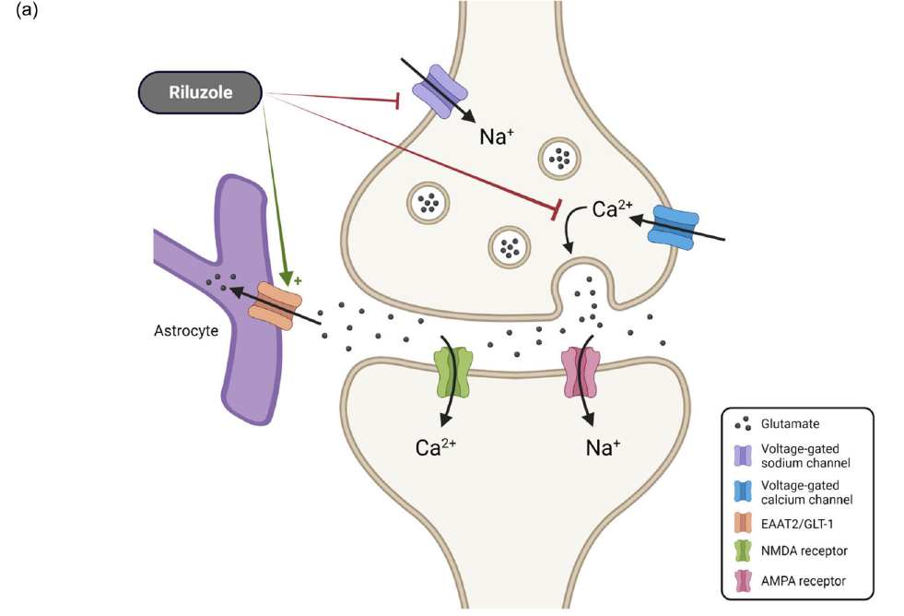
Treatment: Disease Modifying Pharmacotherapies
  Riluzole:
  Approved by the FDA in 1995
    Mechanism: glutamate antagonist
    Modest survival benefit: 3 months
    Dose: 50mg PO twice a day
    Cost is an issue
    Side Effects:
      Fatigue, GI upset, and dizziness
    Frequent monitoring:
      Liver function tests
      CBC/Differential to assess for neutropenia

Slide 30
2) Edaravone
FDA approved in May 2017
Mechanism of action:
  Mega amounts of antioxidants
  Possible anti-inflammatory properties
Slows progression of the disease on the ALSFRS scale
Survival benefit has not been proven yet
Dose
  60 mg daily infusion over one hour. Oral form is available (5mg)
  Two weeks on/ two weeks off alternative cycles
Side effects: skin bruising (15%), gait disturbance (13%), headache (10%)
Cost: 145K/year

Slide 31
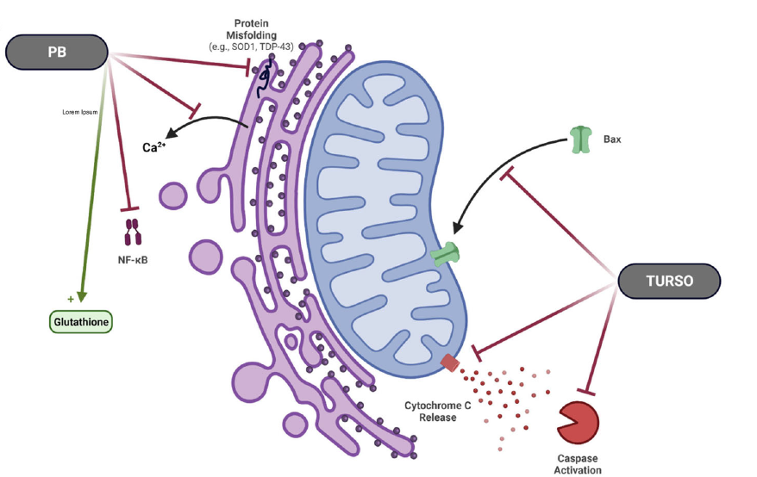
3) Sodium phenylbutyrate and taurursodiol
FDA approved in September 2022
It improves the health of endoplasmic reticulum → delay neuronal death
It slowed progression of the disease by quarter a point on the ALSFRS scale every month
Mean survival benefit of 6.5 months (25.0 months vs. 18.5 months placebo)
Prolonged tracheostomy free survival and delayed first hospitalization
Dose: 3 g sodium phenylbutyrate/1 g of taurursodiol, twice a day
Side effects: diarrhea, nausea, salivary hypersecretion, and abdominal discomfort

Slide 32
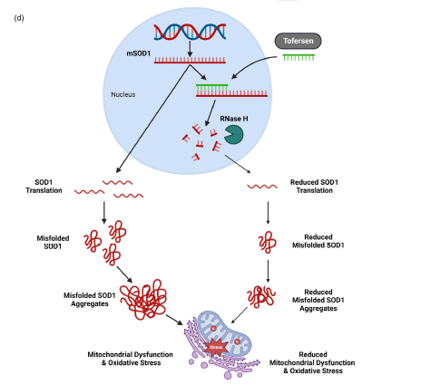
4) Tofersen
Approved by the FDA in April 2023
Antisense oligonucleotide (ASO) that reduces SOD1 protein synthesis by promoting degradation of SOD1 messenger RNA
Phase III results → 38% and 26% difference in CSF total SOD1 proteins between the tofersen and placebo groups in patients with faster and slower progression, respectively
Plasma Nfl differed 67% and 48% between tofersen and placebo in patients with faster and slower progression
Intrathecally administered, 100 mg per dose. Initial 3 doses at 14-day intervals, followed by a maintenance dose every 28 days
Vacchiano V, et al (2021). Front Aging Neurosc 13:753242

Slide 33
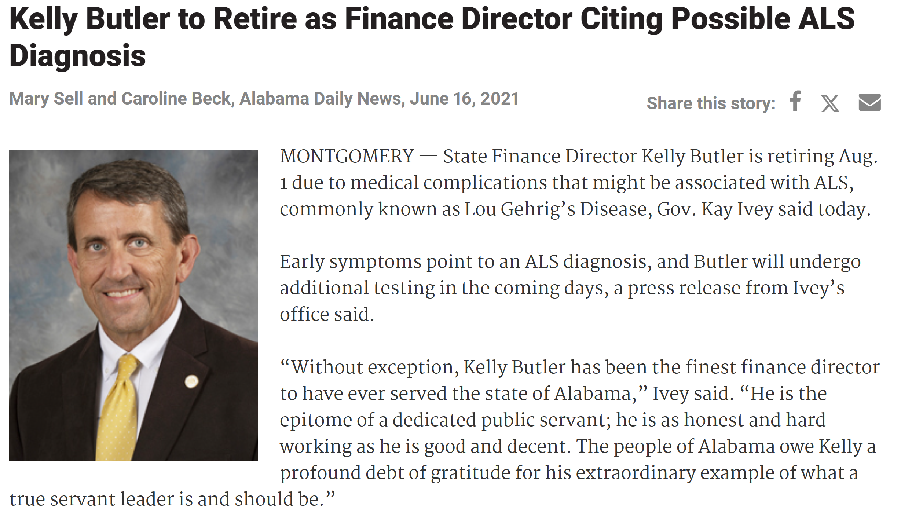
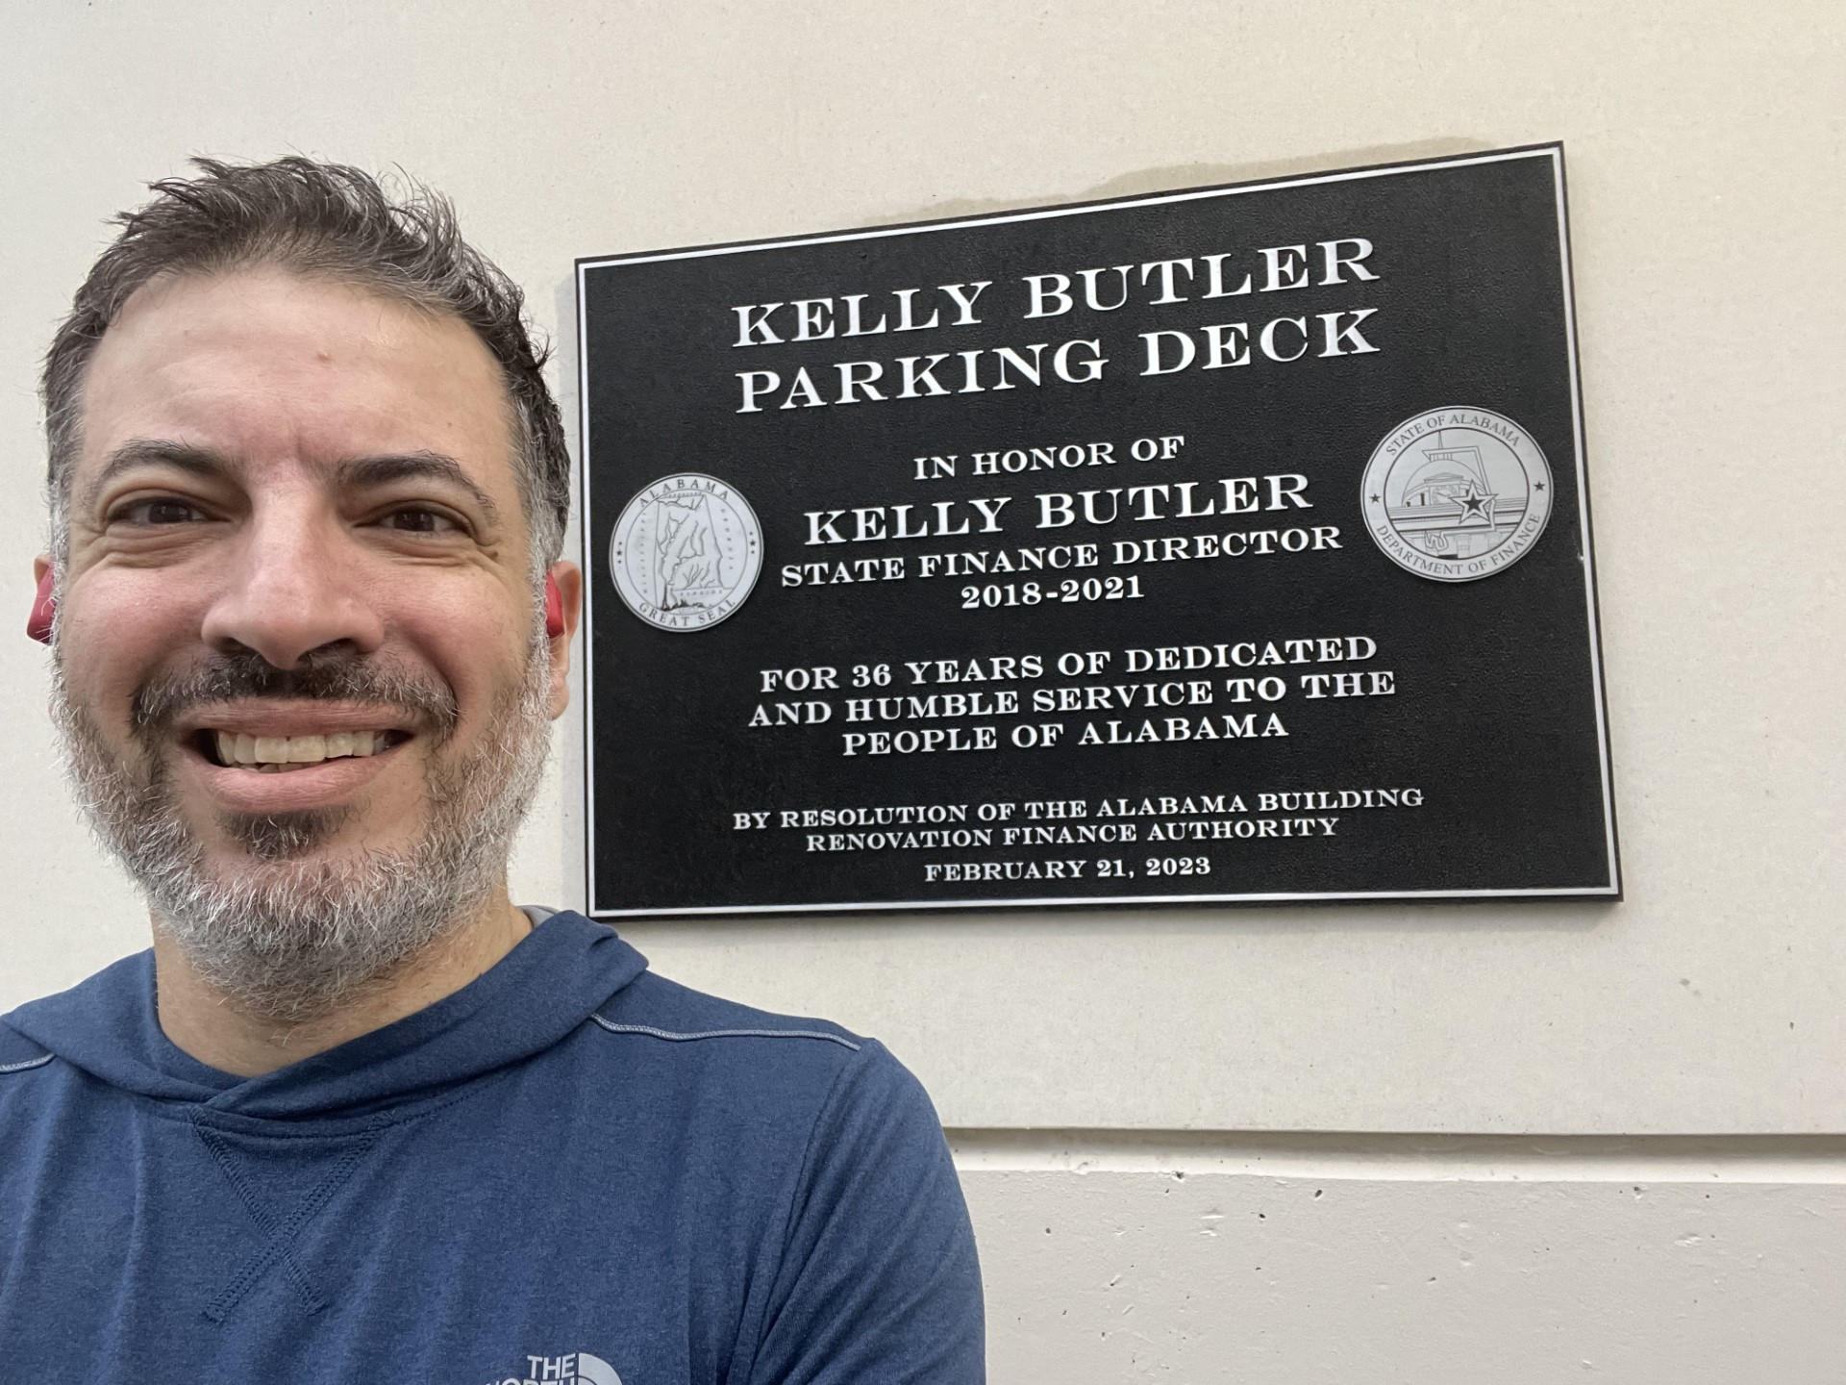
Treatment: Multidisciplinary Approach to Management
(ALS multidisciplinary clinics)
Prolonged survival and improved quality of life are important benefits of team-based way of management
ALS Clinic Personnel:
  Neurologist
  Nurse
  Physical Therapist
  Occupational therapist
  Speech therapist
  Respiratory therapist
  Nutritionist
  Social worker

Slide 34
  Treatment: Symptomatic Treatment
Fatigue: modafinil and NIV
Insomnia: zolpidem, amitriptyline, and NIV
Cramps: physical therapy and massage therapy
Spasticity: baclofen, tizanadine, dantrolene, benzodiazepines, stretch exercise, physical therapy
Increased saliva: glycopyrrolate, atropine, scopolamine, amitriptyline, botulinum injection to the parotid glands, radiation to salivary glands, portable suction devices
Constipation: hydration, fiber, docusate, senna, lactulose
Pseudobulbar affect: dextromethorphan/quinidine, tricyclic antidepressants, selective serotonin-reuptake inhibitors
Depression: amitriptyline (also for increased salivation), SSRI (also for pseudobulbar affect)
Anxiety: anxiolytics

Slide 35
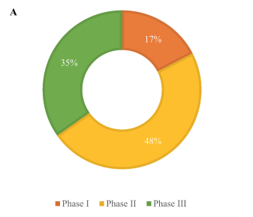
Future Directions
More than 90 novel treatments for ALS patients have been registered on ClinicalTrials.gov, ¼ is still in trial
Most of clinical trials for ALS are still in the Phase I and II, with some progressing to Phases III, possibly because:
  Pathogenesis is multifactorial, current models are not sufficient to predict the efficacy in heterogeneous human patients
  Pathogenesis is still unclear, effective drug targets for ALS cannot be determined at present
  Drawbacks of clinical trial design leading to late start of the medication and insufficient follow up times
  Lack of predictive biomarkers
Sun Z, Zhang B, Peng Y. Metab Brain Dis. 2023 Dec 11.

Slide 36
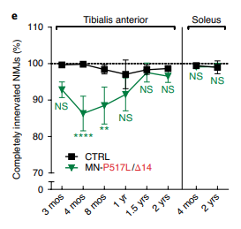
A) Gene therapies: 2- ION363
An ASO targeting FUS RNA that reduces FUS protein
production
Antisense-mediated reduction of mutant FUS proteins prevented motor neuron loss in a mouse model of FUS-associated ALS
Phase III trial is currently underway (NCT04768972) till June 2026
Most of the recruiting sites are on the west coast in addition to Johns Hopkins
Korobeynikov VA (2022). Nat Med 28:104–16

Slide 37
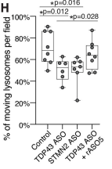
Gene therapies: 3- RL-201
Another ASO drug, containing the human STMN2 gene sequence, injected into a mouse model with TDP-43 dysfunction
It corrected splicing of STMN2 precursor mRNA, restore normal neuronal protein levels →axon regeneration
Phase I clinical trial (NCT05633459): Estimated completion: May 2025
Most recruiting sites are in Canada and Belgium
Baughn MW, et al(2023). Science 379(6637):1140–49.

Slide 38
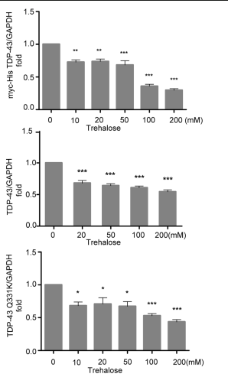
B) Drugs Targeting Protein Aggregates: 1- SLS-005
SLS-005 Trehalose: low molecular weight disaccharide
with a variety of uncertain drug action mechanisms:
  Modulation of autophagy
  Gut brain microbiome
  Targeting TDP43 mislocalization and accumulation
Phase II/III clinical trial (NCT04297683):
estimated completion July 2025
Recruiting sites over the Healey Network
Wang Y, et al. Neurotox Res 34:109–20.

Slide 39
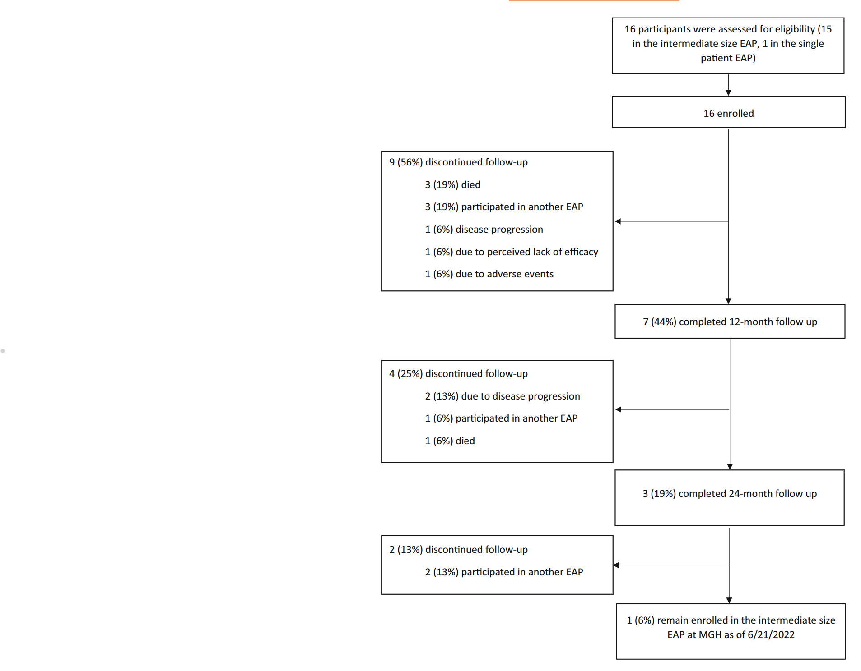
C) Drugs targeting oxidative stress: 2- RT001
Chronic oxidative damage is a major cause of mitochondrial dysfunction→oxidative stress and glutamate excitotoxicity
RT001 is the first drug in the new drug class deuterated polyunsaturated fatty acids (D-PUFAs)
It prevents mitochondrial lipid peroxidative damage leading to cell death
The most common adverse events were gastrointestinal, including diarrhea in 25%
Phase II, NCT04762589 study completion date not updated
All sites are in Europe
Yerton M, et al. Muscle Nerve 66:421–5.
Pallardó FV, et al. Transl Res 229:135–41.
Pang W, Hu F (2021). J Neurochem 157(3):334–50.

Slide 40
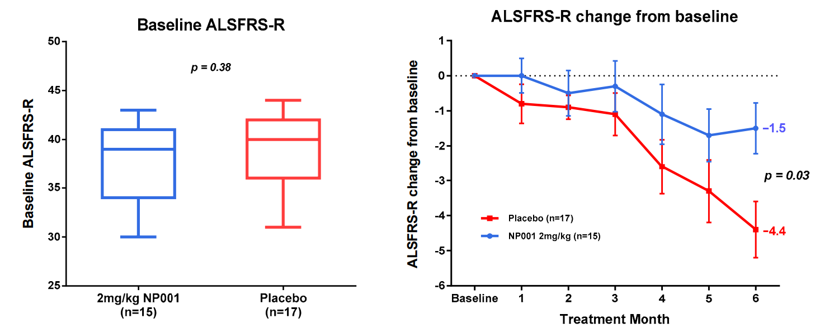
D) Drugs targeting neuroinflammation
Neuroinflammation in ALS features astrocyte and microglial activation, lymphocyte infiltration, and increased inflammatory cytokines
1- NP001
  A small molecule that modulates inflammatory cells, transforming macrophages and monocytes from an inflammatory phenotype to a basal phenotype
  NCT01091142, NCT01281631 and NCT02794857 clinical trials were completed
  Safe and well tolerated
  Showing positive trends in slowing disease progression, especially in patients 40–65 years of age
Liu J, Wang F (2017). Front Immunol. 2017;8:1005.
Zhang R, et al. Biomedicines 10:2907.

Slide 41
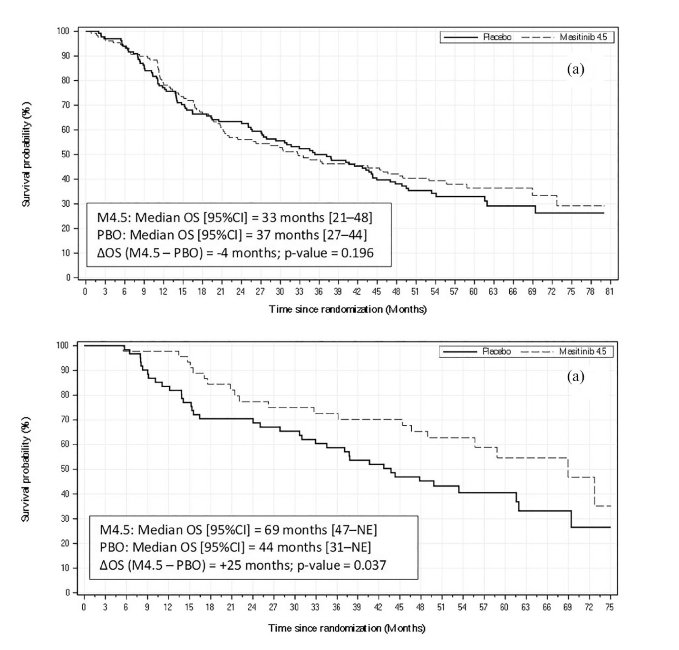
Drugs targeting neuroinflammation: 2- Masitinib
Tyrosine kinase inhibitor
Inhibits the activity of microglia, macrophages, and mast cells in both the CNS and PNS
Anti-tumoral, neuroprotective, and anti-inflammatory properties when taken orally
Survival benefit of 25 months (p = 0.037) and 47% reduced risk of death (p = 0.025) in patients receiving 4.5 mg/kg/day masitinib (n = 45) versus placebo (n = 62)
Mora JS, et al. Ther Adv Neurol Disord 19:14:17562864211030365

Slide 42
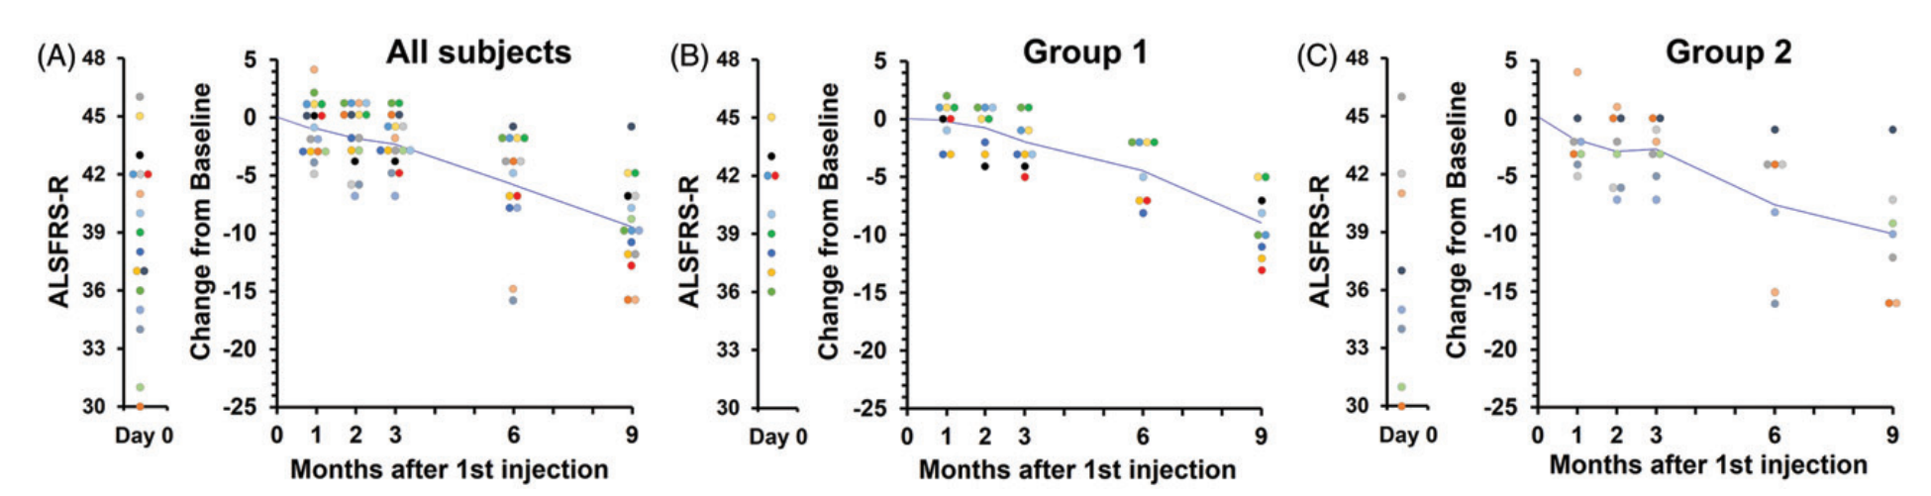
E) Drugs targeting excitotoxicity: 2- VM202
Excitatory toxicity of neuronal circuits can eventually lead to motor neuron death, and was found to be a common feature in ALS
Hepatocyte growth factor (HGF), a neurotrophic, acted on astrocytes in SOD1 mice to maintain excitatory amino acid transporter 2 (EAAT2) levels
EAAT2 is a glial-specific glutamate transporter that reduces glutamatergic neurotoxicity in motor neurons
VM202 reduce excitotoxicity in ALS patients by producing HGF in humans
Phase II clinical trials (NCT02039401) was just completed in sept 2023
Kukharsky MS, et al. Med Res re, 2021, 41(5):2804–22.
Funakoshi H, et al. Brain Nerve, 2007 59:1195–202
Sufit RL, et al. Amyotroph Lateral Scler Frontotemporal Degener 18(3–4):269–78.

Slide 43
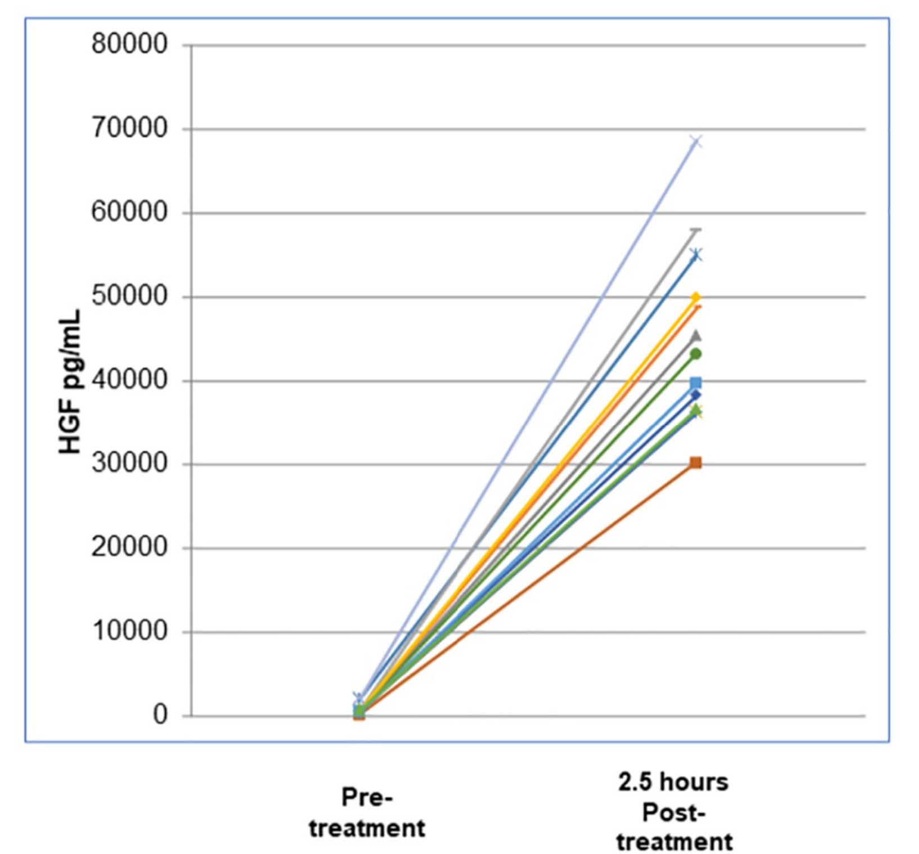
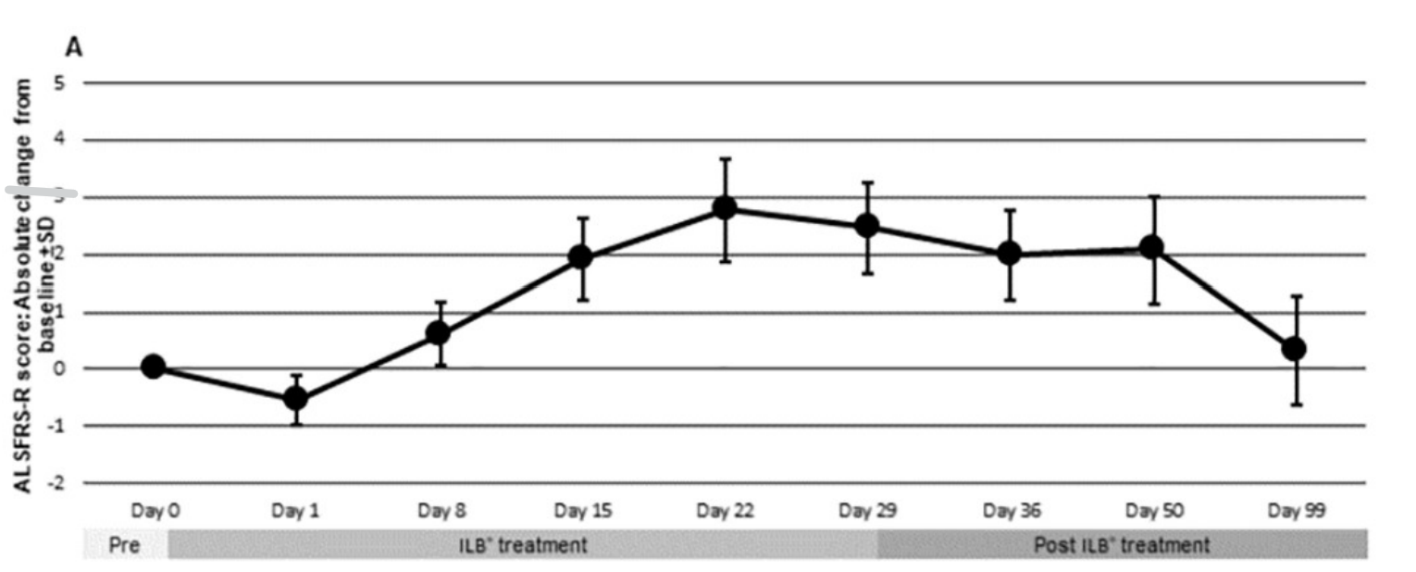
Drugs targeting excitotoxicity: 3- ILB
ILB promotes HGF protein production
Completed the phase II clinical trial (NCT03705390)
ILB improved clinical conditions and
decreased neuronal damage in ALS patients
Logan A, et al (2022). PLoS ONE 17(5):e0267183.

Slide 44
F) Drugs protecting the Endoplasmic Reticulum (ER): 2- Pridopidine
Sigma-1 receptor is expressed in motor neurons, mainly in close contact with cholinergic postsynaptic sites or ER
The sigma-1 receptor regulates calcium homeostasis, excitatory toxicity, and ER stress
Pridopidine, a Sigma-1 receptor agonist had a negative Phase II/III trial in ALS (NCT04297683)
It did not meet the primary endpoint of change from baseline to week 24 in the ALSFRS-R
Rapidly declining participants on pridopidine with definite or probable ALS who were early in the disease (less than 18 months from symptom onset) had substantially less decline in the ALSFRS-R total score (-7.51 points) compared to placebo (-12.71 points, p = 0.04)
Expanded access protocol is currently recruiting
Herrando-Grabulosa M, et al. Br J Pharmacol 178(6):1336–52.

Slide 45
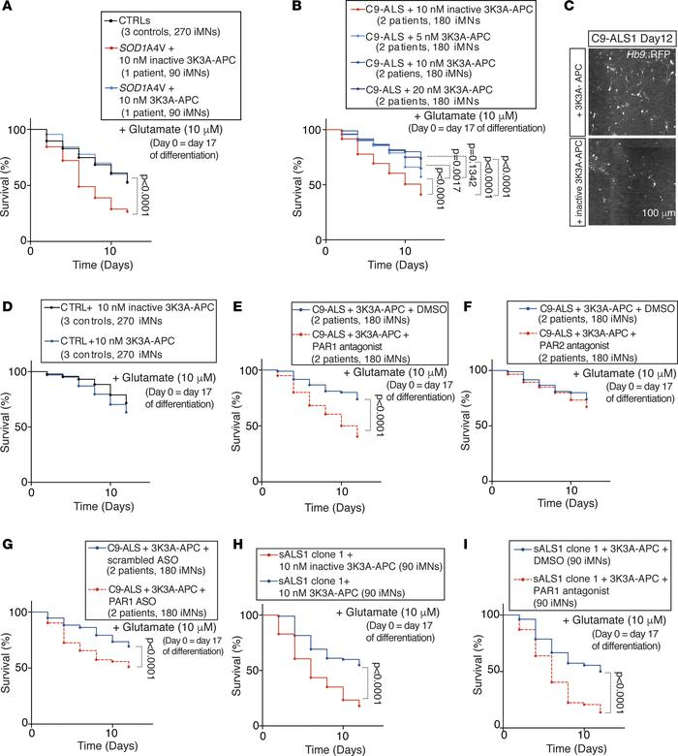
G) Other mechanisms: 1- 3K3A-APC
An anticoagulation-deficient form of activated protein C (APC), rescued defects in C9ORF72 associated ALS
It had the following effects:
  Reduced C9ORF72 dipeptide-repeat protein levels
  Restored nuclear localization of TDP-43
  Increased the survival of both C9ORF72 and sporadic ALS
The phase II clinical trial of 3K3A-APC Protein completed (NCT05039268)
Shi Y, et al (2019). JCI Insight 5(15):e127736.

Slide 46
Summary
Early diagnosis of the disease remains to be a challenge
Diagnosis should be suspected with gradual progressive painless limb weakness and/or atrophy
Management of ALS should ideally happen in an ALS multidisciplinary clinic
The heterogenous disease mechanism is a challenge to clinical trials design and drug of choice
Most clinical trials in ALS has not moved beyond phase II

Slide 47
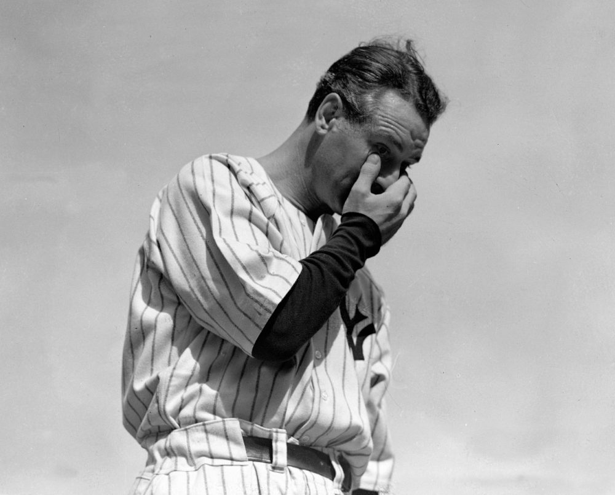
“ I might have been given a bad break,
but I've got an awful lot to live for”
-Farwell speech, 1939

Slide 48


Questions
mkazamel@uabmc.edu

