Slide 1


Highlighting New Treatments; Seropostive MG and DMD
Bassam A. Bassam, MD, FAAN Professor of Neurology University of South
Key Largo, Florida
January 13-16, 2024

Slide 2
Disclosures
• UCB Pharma Company Speaker Bureau member
Argenx Biotechnology Company Speaker Bureau member
  Review diagnostic clinical features of MG and DMD
  Discuss mechanistic therapeutic approach to MG and DMD
  Review established treatments for MG and DMD
  Highlight emerging approved treatments for MG & DMD
OBJECTIVES

Slide 3
Myasthenia Gravis (MG) Clinical Aspect
Occur at any age, peaks in 3rd and 6th decade
Female: male ratio 6:4 (age 10-30 y > in F, 50-70 y > in M)
Weakness and fatigability, proximal > distal, worse with exercise and later in the day
Initial symptoms ocular 53%, extremities and trunk 20%, bulbar 17%, generalized 10%
Most patient's illness progress
Progression from ocular to generalized MG occurs in 56% by 6 months and 92% by 3 years, 14% remains ocular.
75% has thymus pathology (60% hyperplasia, 15% thymoma)
(Review of 1,400 cases; 1 year after onset 40% ocular, 35% generalized, 10% extremities, and 15% bulbar ((Grob et. Al.)

Slide 4
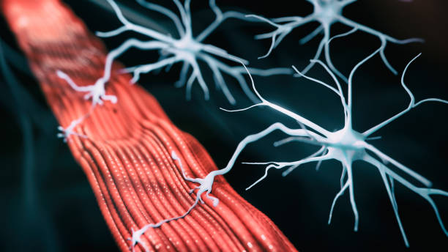
Generalized Myasthenia Gravis (gMG)
Prototypical autoimmune disease
IgG autoantibodies target receptors in the neuromuscular junction (NMJ)
Results in muscle weakness
  Generalized or localized
  Increases with exercise/repetitive movement
  May fluctuate from day to day or throughout the day
  Eye muscles almost always involved (diplopia, ptosis)
Dresser L et al. J Clin Med. 2021;10(11):2235.

Slide 5
Muscle Specific Kinase positive (MuSK) MG
30-50% of sero-negative GMG (& few ocular) have MMG
Affects mainly women, more blacks in USA
May present as “typical” MG, but more often as;
  predominant facial and pharyngeal weakness and atrophy
  restrictive weakness selectively affect neck, bulbar, respiratory or proximal UE muscles.
  Minimal or late ocular muscles weakness
      Thymus is usually normal and no role for thymectomy.
RNS, EMG & SFEMG may be abnormal only in weak muscles
Cholinesterase inhibitors frequently ineffective
Responds to PLEX, corticosteroids, NSIST’s, Rituximab, Rozanolixizumab-noli.

Slide 6
Antibodies in MG
Anti Acetylcholine receptor antibodies (AChR abs)
Anti muscle-specific tyrosine kinase receptor (MuSK abs).
Lipoprotein receptor-related protein 4 antibodies (LRP4 abs) (essential for agrin-induced activation of MuSK in concert with Dok-7)
Anti-striational muscle antibody.
Anti-titin antibody (more common in older pts. without thymoma, highly associated with thymoma in patients < 50 years).
Anti-Ryanodine antibody in ≥15 of all MG (≥ 80 associated with thymoma, rare in MG without thymoma).
Rarely Collagen Q, cortactin, and voltage-gated potassium channel Kv1.4 antibodies might be detected.
Antibodies of coincidental auto-immune disease

Slide 7
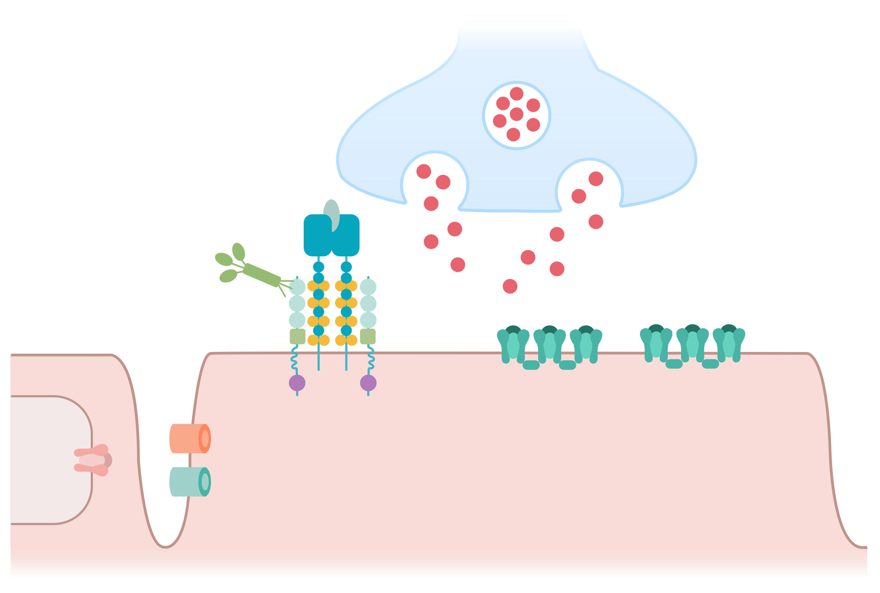
Autoantibody Subtypes in gMG
Major disease subtypes are defined by NMJ protein targets of pathogenic IgG autoantibodies¹⁻⁴
  AChR: ∼85% — most common
  MuSK: ∼5%-8%
  LRP4: ∼2%-9%
In ∼10% of patients, no known autoantibodies
can be found¹
Structure of the NMJ
Nerve terminal
Agrin
LRP4
ACh
AChE and/or ColQ
AChR
Muscle
MuSK
Rapsyn
VGSC
RyR
1. Fichtner ML et al. Front Immunol. 2020;27(11):776.
2. Lazaridis K, Tzartos S. Front Immunol. 2020;11:212.
3. Zisimopoulou P et al. J Autoimmun. 2014;52:139-145.
4. Rodolico C et al. Front Neurol. 2020;1:660.
Kv1.4
Sarcoplasmic
reticulum
Image adapted from: Gilhus NE et al. Nat Rev Dis Primers. 2019;5(1):30.
Notes:
gMG is an antibody-mediated disease, caused by autoantibodies targeting neuromuscular junction proteins. In the majority of patients (~85%) antibodies against the muscle acetylcholine receptor (AChR) are detected, while in 6% antibodies against the muscle-specific kinase (MuSK) are detected. In ~10% of gMG patients no autoantibodies can be found with the classical diagnostics for AChR and MuSK antibodies (seronegative MG, SN-MG), making the improvement of methods for the detection of known autoantibodies or the discovery of novel antigenic targets imperative. [Lazaridis 2020]
The figure illustrates the pathophysiology of anti-AChR+ gMG. The three major pathogenic mechanisms of AChR autoantibodies in gMG include complement activation at the neuromuscular junction, which causes the formation of MACs on the muscle membrane and destruction of the typical folds in the motor endplate; antigenic modulation that results in the internalization and degradation of surface AChRs; and binding of AChR antibodies at the AChR ligand binding site, which could directly block ACh binding and, consequently, channel opening.

Slide 8
Distinct Immune Mechanisms with AChR, MuSK, and LPR4 IgG Autoantibodies
 | AChR MG Subtype | MuSK MG Subtype | LRP4 Subtype*
Thymus | Hyperplasia (in a subset) | Normal | Hyperplasia (in some patients)
Autoantibody IgG subclass | IgG1 and IgG3 | IgG4 | IgG1 and IgG2
Role for complement | Yes | Not significant | Yes
B cell subtype responsible for autoantibody production | CD20^{neg} plasma cells | Plasmablasts | Unclear
*Scant data is available to characterize immune mechanisms for the LRP subtype
There are key autoimmune characteristics that differentiate AChR MG, MuSK MG, and LRP4
MG subsets — with possible implications for response to immunomodulating therapies
Fichtner ML et al. Front Immunol. 2020;27(11):776. Koneczny I, Herbst R. Cells. 2019(8):671.
Konoczny I et al. Autoimmun Rev. 2019;18(1):50-55. Takata K et al. Immunological Med. 2020;43(2);65-71.
Notes:
There are key autoimmune characteristics that differentiate AChR MG, MuSK MG, and LRP4 MG subsets — with possible implications for response to immunomodulating therapies.
For example, in the AChR MG subtype, thymectomy is beneficial whereas no benefit of thymectomy is seen in the MuSK MG subtype. Similarly, complement inhibitors have clinical benefit in the AChR MG subtype, but no clinical benefit would be expected for the MuSK MG subtype. However, clinical benefit with FcRn inhibition would be expected across subtypes.

Slide 9
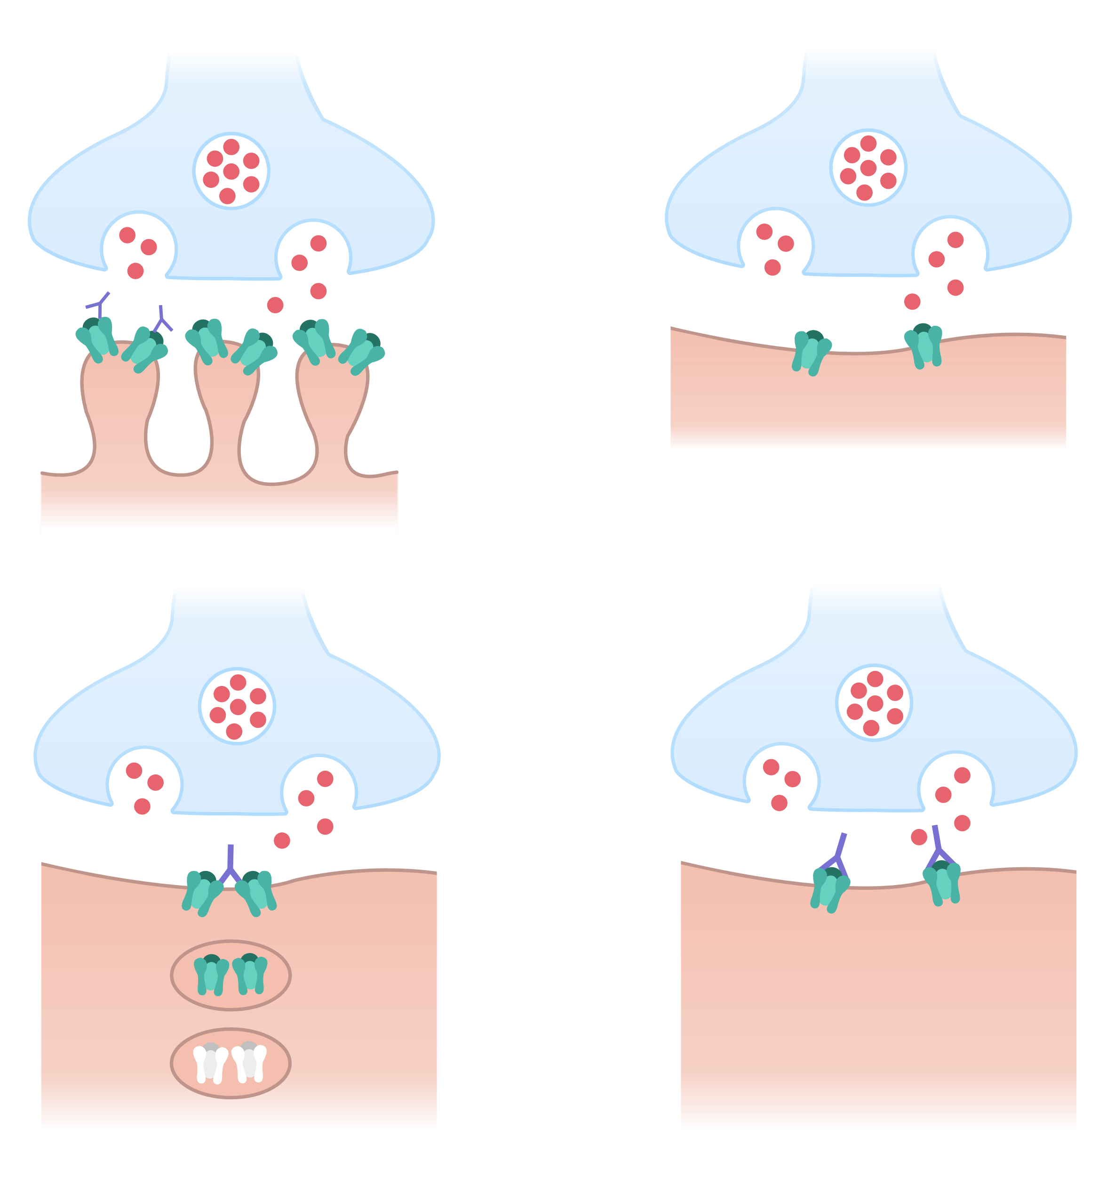
Impact of Anti-AChR Ab
1. Binding and complement activation at the NMJ
Nerve
Synaptic vesicle
IgG
ACh
IgG autoantibodies to AChR cause
Complement-mediated damage
Crosslinking and accelerated AChR degradation (antigenic modulation)
Functional AChR blockade
Leading to
Diminished structural integrity of the NMJ
Reduced number/function of AChRs
Failure of neuronal transmission
AChR
Destruction of muscle membrane morphology
2. Antigenic modulation
3. Functional AChR blockade
AChR autoantibody
AChR autoantibody
↓
AChR crosslinking
AChR
internalization
↓
AChR degradation
↓
Reduced muscle contraction
No muscle activation
Jacob S. Eur Neurological Rev. 2018;13(2):86-92.
Images adapted from Jacob S. Eur Neurological Rev. 2018;13(2):86-92.

Slide 10
Established Treatments For Myasthenia Gravis
Symptomatic to improve neuromuscular transmission;
    Cholinesterase inhibitors
Specific to suppress or modulate immune response;
    Traditional; steroids, immunosuppressants, IVIG
    New; IV and SC FcRn inhibitors, IV and SC Complement inhibitors monoclonal antibodies,
    Thymectomy
Remove antibodies;
    Plasmapheresis mostly used in MG crisis.
No single treatment regimen is best for every patient ,and 10 -20% of pts. Remains refractory to therapeutic intervention
Treat early and effectively and taper slowly
Assess treatment safety, efficacy, intensity and duration

Slide 11
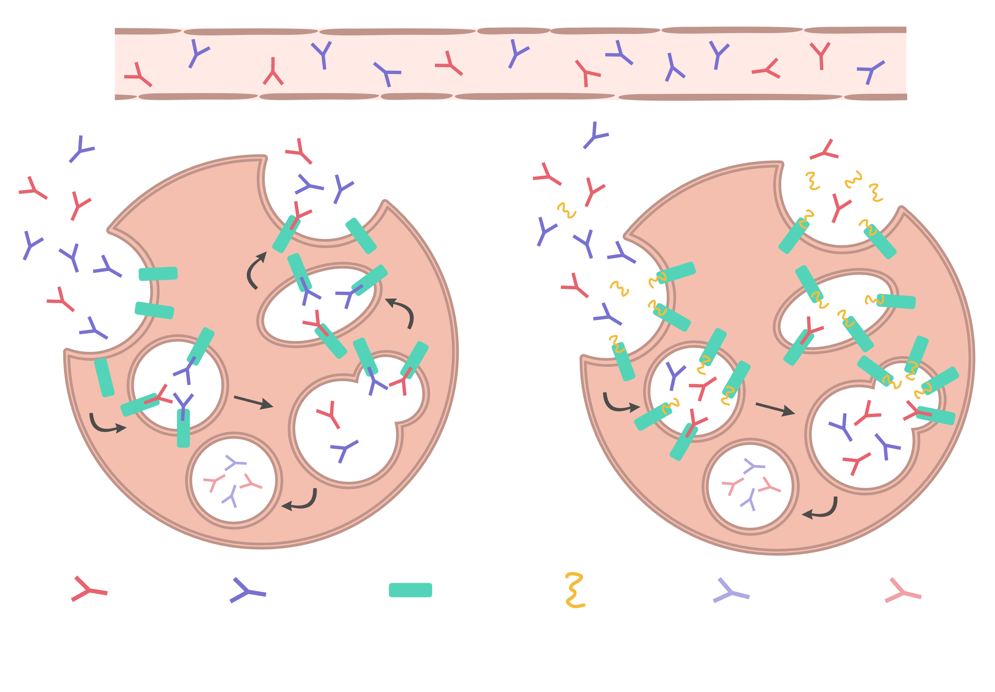
IgG Recycling and Mechanism of Action of FcRn Inhibitors in Patients with gMG
Physiologic FcRn mechanism
of action
FcRn inhibitor-mediated disruption
of IgG recycling
By protecting IgG from intracellular degradation, FcRn provides ∼21-day circulating IgG half-life and high IgG plasma levels¹
This mechanism can be blocked by agents that target and interfere with FcRn binding²
In gMG, inhibition leads to enhanced IgG catabolism and reduced overall IgG and pathogenic autoantibody levels³
Blood vessel
Extracellular (neutral pH)
Intracellular
Intracellular
①
⑤
Endosome
(acidic pH)
Endosome
④
②
Lysosome
③
Lysosome
Pathogenic IgG
autoantibody
IgG
FcRn
FcRn Inhibitor
Degraded IgG
Degraded pathogenic IgG autoantibody
1. Patel DD, Bussell JB. J Allergy Clin Immunol. 2020;146(3):467-478.
2. Keller CW et al. Int J Mol Sci. 2021;22(11):5755.
3. Wolfe GI et al. J Neurol Sci. 2021;430:118074.
Image adapted from: Vanoli F, Mantegazza R. TouchREVIEWS in Neurology. 2022;18(2):Online ahead of journal publication; Keller CW et al. Int J Mol Sci. 2021;22(11):5755; and Wolfe GI et al. J Neurol Sci. 2021;430:118074.
Notes:
Figure 4. Mechanism of FcRn targeting. Left: Physiological FcRn mode of action. Right: FcRn inhibitor-mediated disruption of IgG recycling.
The neonatal Fc receptor (FcRn), ubiquitously expressed in endothelial cells and in myeloid cells of
of IgG recycling. The neonatal Fc receptor (FcRn), ubiquitously expressed in endothelial cells and in myeloid cells of
the immune system, interacts with IgG and facilitates its internalization and subsequent recycling via a pH-dependent
mechanism. FcRn does not interact with IgG at a neutral pH of 7.4. The acidic environment of the endosome following pinocytosis allows for efficient binding of IgG to the receptor, which prevents endosomal transport of IgG to the lysosome for subsequent degradation. [Keller 2021]
FcRn-bound IgG is eventually recycled back to the cell surface and exocytosed. Exposure to a neutral pH facilitates release of IgG from the receptor. [Keller 2021]
This FcRn-mediated recycling mechanism ultimately leads to the half-life extension of all IgG subclasses and can be blocked by specific molecules that interfere with FcRn binding. [Keller 2021]

Slide 12
Efgartigimod Alfa – Phase III ADAPT Trial
Study Design
ADAPTª
Patients randomized 1:1 to receive cycles of 4 infusions at weekly intervals of 10 mg/kg efgartigimod alfa + CT or placebo + CT
Primary endpoint:
Percent of MG-ADL responders in treatment cycle 1 (AChR-Ab+ patients)
Key secondary endpoints:
Percent of QMG responders in treatment cycle 1 (AChR-Ab+ patients)
Percent of MG-ADL responders in treatment cycle 1 (overall population)
Key exploratory endpoint:
Percent attaining minimal symptom expression in treatment cycle 1 (AChR-Ab+ patients)
Key Inclusion Criteria
MGFA class II, III, IV
AChR-Ab positive or negative
MG-ADL score ≥5 (>50% nonocular)
On ≥1 stable gMG treatment^{b}
IgG ≥6 g/L
Efgartigimod alfa + CT: n=84
1:1
Placebo + CT: n=83
26 weeks (≤3 cycles^{c})
Initiation of new treatment cycles:
≥5 weeks between cycles
MG-ADL score ≥5^{d}
MG-ADL score within 2 points of baseline
Note: Rectangles within arrows indicate day of efgartigimod alfa IV infusion.
ªThe ADAPT study was started on August 22, 2018 and was completed on April 6, 2020.
^{b}Acetylcholinesterase inhibitor, steroid +/or nonsteroidal immunosuppressive therapy. Patients could not change concomitant therapies.
^{c}≤3 cycles dosed at ≥8 weeks after initial cycle. ^{d}With >50% from nonocular items.
Howard JF Jr et al. Lancet Neurol. 2021;20(7):526-536.
Howard J. Presented at: American Association of Neuromuscular & Electrodiagnostic Medicine (AANEM) 2022. September 21-24; Nashville, TN. Poster 108.
Notes:
Primary endpoint: proportion of AChR antibody-positive patients who were MG-ADL responders (≥2-point MG-ADL improvement sustained for ≥4 weeks) in the first treatment cycle.
Secondary endpoints, assessed in hierarchical order:
percentage of QMG responders (≥3 point improvement in the total QMG score for ≥4 consecutive weeks with the first improvement occurring by week 4 of cycle 1) in the AChR antibody-positive population;
percentage of MG-ADL responders in cycle 1 in the overall population (ie, AChR antibody-positive and antibody-negative patients);
proportion of time patients showed a clinically meaningful improvement in MG-ADL score in the AChR antibody-positive population, up to day 126;
time from day 28 (1 week after the fourth infusion in cycle 1) to not having clinically meaningful improvement in the AChR antibody-positive population;
proportion of early MG-ADL responders in cycle 1 (MG-ADL responders with first MG-ADL improvement of ≥2 points occurring by week 2)
The fifth secondary endpoint was not assessed because the fourth secondary endpoint was not significant.

Slide 13
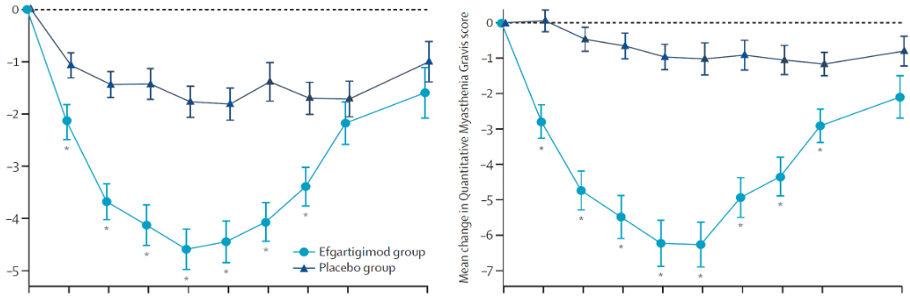
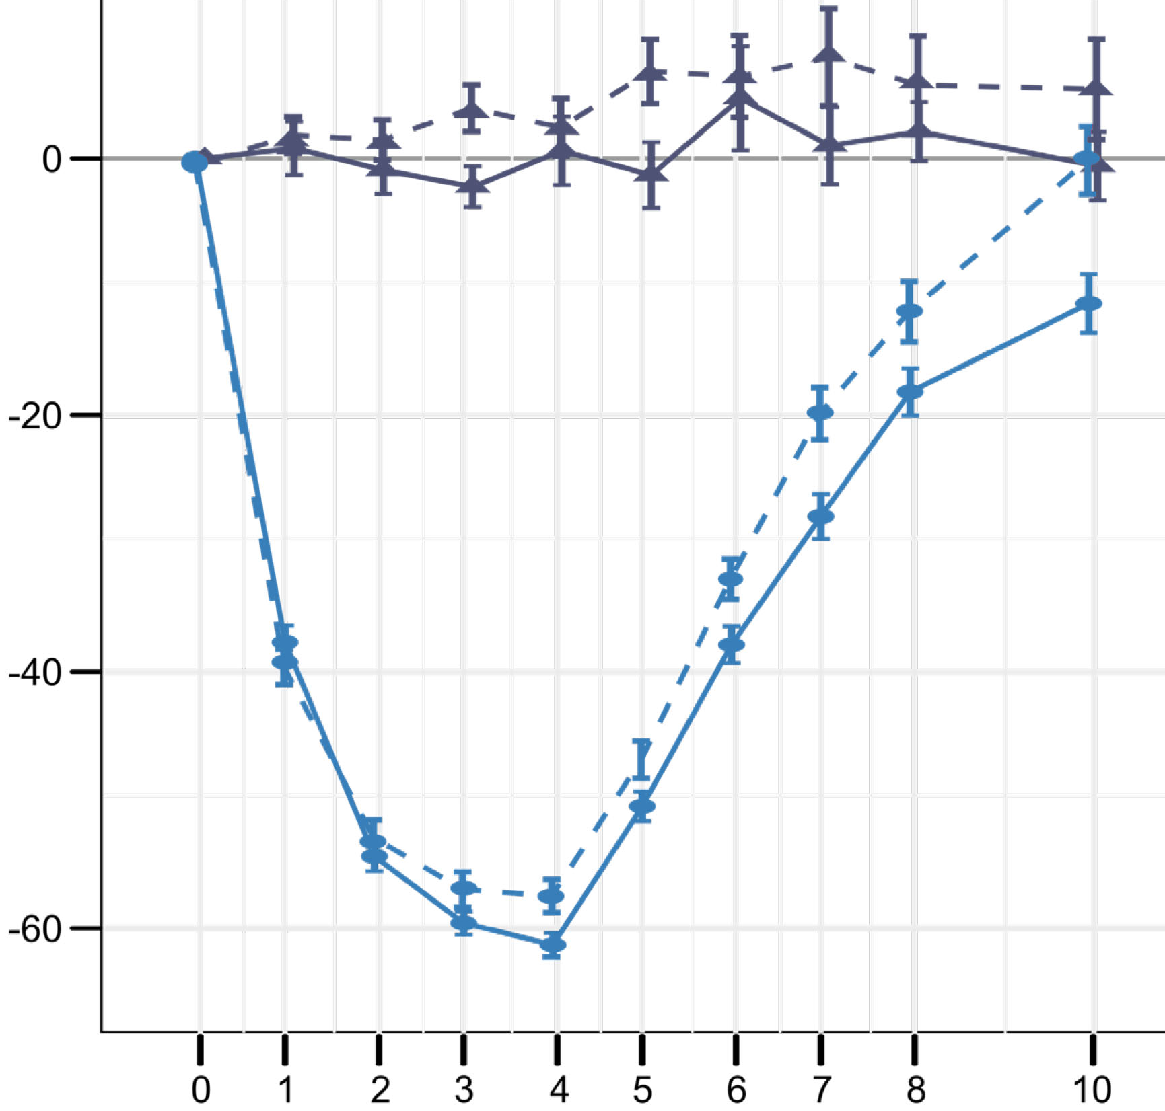
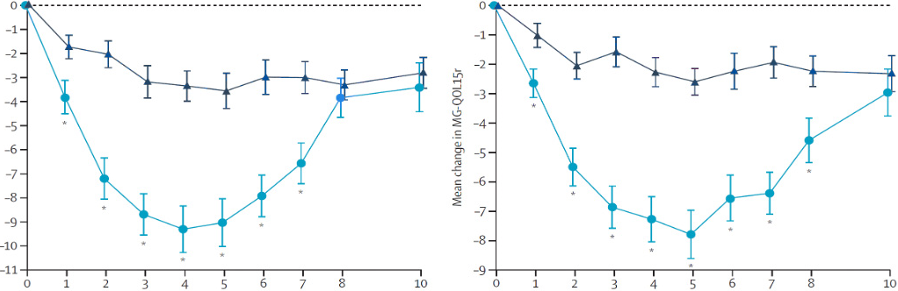
Efgartigimod Alfa – Phase III ADAPT Trial
Impact on MG-ADL, MGC, MGQOL15r, QMG, and Total IgG and AChR-Ab Levels
MG-ADL
MGC
Change in Antibody Levels
IgG, placebo + CT
AChR-Ab, placebo + CT
IgG, efgartigimod alfa + CT
AChR-Ab, efgartigimod alfa + CT
Efgartigimod alfa + CT
Placebo + CT
Mean Percent Change (± SE)
Mean Change
MG-QOL15r
QMG
Time Since Baseline (weeks)
Time Since Baseline (weeks)
*P<0.05.
Patients on efgartigimod alfa + CT vs placebo + CT had greater improvements in MG-ADL, QMG, MCG, and MG-QOL15r and consistent reductions in total IgG and AChR antibodies in cycle 1; statistically significant differences were observed week 1 through week 7 in all measures
Howard JF Jr et al. Lancet Neurol. 2021;20(7):526-536.
Notes:
Figure 2: Change in MG-ADL (A), Quantitative Myasthenia Gravis score (B), Myasthenia Gravis Composite scale (C), and MG-QOL15r (D) during cycle 1, in acetylcholine receptor antibody-positive patients
Patients in the efgartigimod alfa + CT group had greater total mean score improvements in MG­ADL, QMG, MCG, and MG­QOL15r in cycle 1, with statistically significant differences from baseline observed from week 1 and sustained through week 7 in all measures.
The maximum improvement in efgartigimod alfa + CT-treated patients occurred at week 5 for MG­QOL15r and week 4 for other measures.

Slide 14
ADAPT-SC Study Design
Phase III Randomized Trial
Objective: To demonstrate that the pharmacodynamic effect of efgartigimod PH20 SC is noninferior to that of efgartigimod alfa (IV)
All patients receive 1 treatment cycle
(4 weekly single injections or 1-hour infusions)
OLE: ADAPT-SC+
Efgartigimod PH20 SC (1000 mg)^{b}
110 adult patients with gMG
Inclusion criteria:
MGFA class II - IV
MG-ADL score ≥5
On ≥1 stable gMG treatmentª
105 patients from ADAPT-SC and 73 patients from ADAPT+ rolled over to the OLE
Time between treatment cycles was ≥28 d and based on the need for treatment as determined by the investigator
Ongoing
Primary endpoint: Percent change from baseline in total IgG levels at day 29
Key secondary endpoints: Percent change in total IgG levels, total AChR-Ab levels, and MG-ADL total score over time
1:1
Efgartigimod alfa (10 mg/kg)
Week
Baseline
1
2
3
4
5
6
7
8
10
Treatment cycle
7-wk follow-up period^{c}
ªAcetylcholinesterase inhibitors, steroids, and/or NSIST. ^{b}Coformulated with 2000 U/mL rHuPH20. ^{c}Patients could not receive treatment in the 7-week follow-up period, except rescue therapy (steroids, IVIg, and PLEX).
Howard JF. MG Foundation of America Scientific Session. American Association of Neuromuscular & Electrodiagnostic Medicine (AANEM) 2022. September 21; Nashville, TN.
Notes:
ADAPT SC is a randomized, open-label, parallel-group, multicenter study in patients with generalized myasthenia gravis (gMG), including participants who are seropositive and participants who are seronegative for the acetylcholine receptor binding autoantibodies (AChR-Abs).
After screening, patients were randomized to receive either efgartigimod intravenous (IV) (efgartigimod alfa) 10 mg/kg Q7D for 4 infusions or efgartigimod PH20 SC 1000 mg Q7D for 4 injections concomitant to their current gMG therapy.
After a participant completes the study, the participant will be allowed, if eligibility criteria are met, to roll over into the open-label extension (OLE) study to receive efgartigimod PH20 SC 1000 mg.
Slide Face
Study Design
argenx_ADAPT-SC_TLR_press_release/pg2/P3 (Phase 3 ADAPT-SC)
ADAPT-SC TLR Presentation/Slide 7
Inclusion criteria
ARGX-113-2001 CTP v2.0_for publishing/pdf pg29/section 5.1 inclusion criteria
Green callout, Open-label extension
Bullet 1, 10 patients
ARGX_113_2002 topline results/word pg 11/ section 2.1/P1
GX024-22B_Myology_ADAPTsc poster_v5.3_5Sep2022_Print Ready/objectives and methods section (client request to add in from source poster)
Primary endpoint
ARGX-113-2001 CTP v2.0_for publishing/pdf pg 25/section 3. Objectives and endpoints/primary
Slide Notes
Bullets 1-3, ADAPT–SC is a,
argenx_ADAPT-SC_TLR_press_release/pg2/P3 (Phase 3 ADAPT-SC)
ARGX-113-2001 CTP v2.0_for publishing/pdf pg 27/section 4.1 Overall design/ bullets 1, 4, 5, 6, 9
ARGX-113-2001 CTP v2.0_for publishing/pdf pg 37/section 6.6/P1

Slide 15
ADAPT-SC
Primary and Secondary Efficacy Endpoints, Overall Population
Secondary Endpoints: Change in Total IgG, AChR-Ab, and MG-ADL Total Score – Overall Population
Primary Endpoint: Change in Total IgG Levels – Overall Population
Efgartigimod PH20 SC
Efgartigimod PH20 SC
25
Day 29 (primary endpoint)
2
Efgartigimod alfa
0
0
-25
-2
Percent Change in Total IgG Levels, least squares mean %
-50
-4
Mean percent change in total IgG and AChR-Ab (±SE)
-6
-75
Efgartigimod alfa
Mean change in MG-ADL total score (±SE)
25
Day 29 (primary endpoint)
2
0
0
-25
-2
-50
-4
-75
-6
Baseline
1
2
3
4
5
6
7
8
10
Week
Total IgG (mg/L)
AChR-Ab (nmol/L)
MG-ADL Total Score
Howard JF. MG Foundation of America Scientific Session. American Association of Neuromuscular & Electrodiagnostic Medicine (AANEM) 2022. September 21; Nashville, TN.

Slide 16
Efgartigimod Indication, Dosing & AE’s
FDA approved Efgartigimod alfa Dec 2021 and efgartigimod alfa/hyaluronidase June 2023 for the treatment of AchR-Ab+ gMG in adult patients.
Dosing 10 mg/Kg IV weekly for 4 weeks, 1200 mg if weight ≥ 120 Kg (SC formula; 1 ml contains 180 Efgartigimod Alfa – 2000 U Hyaluronidase)
Duration of efficacy may vary among patients; thus, subsequent cycles based on clinical evaluation, with no less than 50 days from the start of the prior cycle.
AEs include headache, infections (UT, RE), nasopharyngitis, nausea, diarrhea.
Long-term side effects not established.

Slide 17
Rozanolixizumab-noli
Safety and efficacy of rozanolixizumab-noli in patients with generalized myasthenia gravis (MycarinG); randomized, double-blind, placebo-controlled, adaptive phase 3 study
Vera Bril ¹, Artur Drużdż ², Julian Grosskreutz ³, Ali A Habib ⁴, Renato Mantegazza ⁵, Sabrina Sacconi ⁶, Kimiaki Utsugisawa ⁷, John Vissing ⁸, Tuan Vu ⁹, Marion Boehnlein ¹⁰, Ali Bozorg ¹¹, Maryam Gayfieva ¹², Bernhard Greve ¹⁰, Franz Woltering ¹⁰, Henry J Kaminski ¹³; MG0003 study team
PMID: 37059507
DOI: 10.1016/S1474-4422(23)00077-7

Slide 18
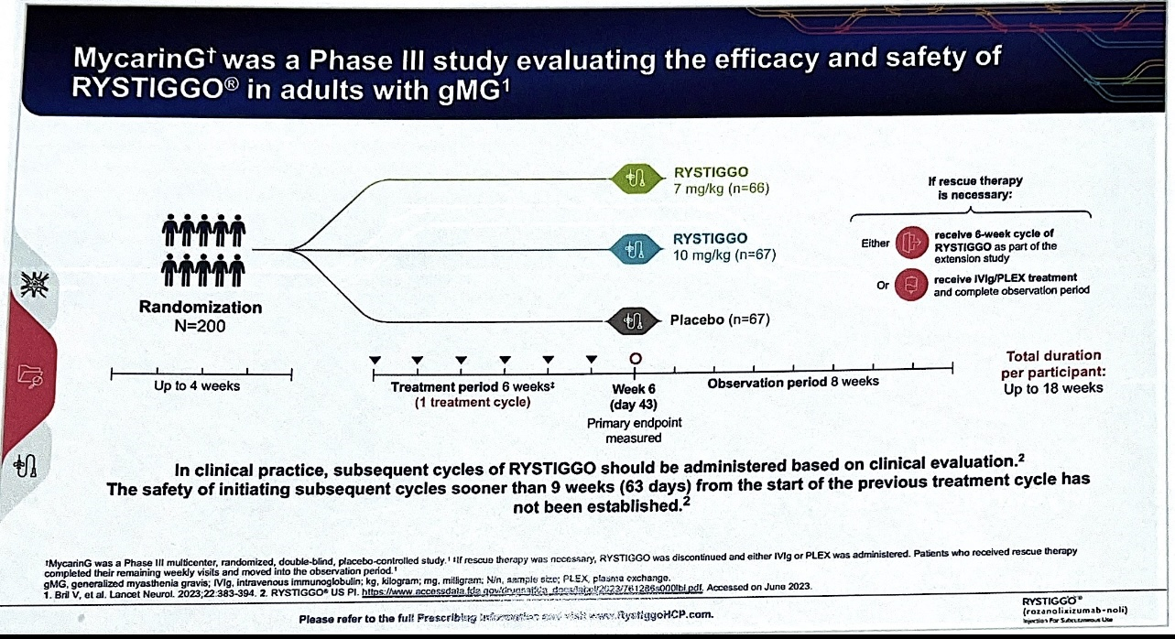




Rozanolixizumab
Rozanolixizumab

Slide 19
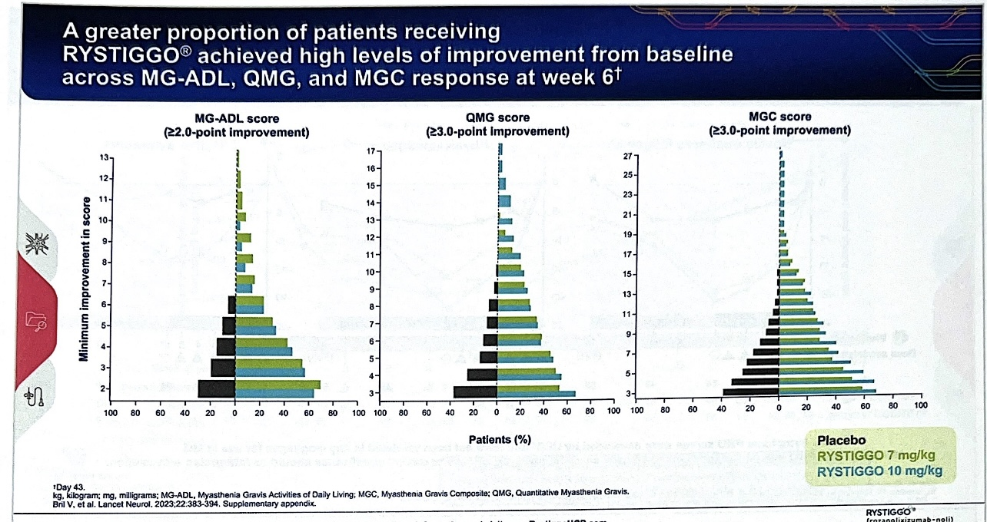









Rozanolixizumab

Slide 20
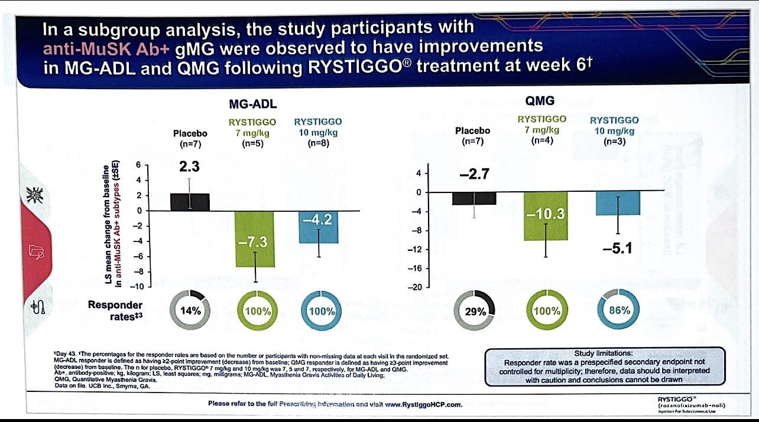








Rozanolixizumab

Slide 21
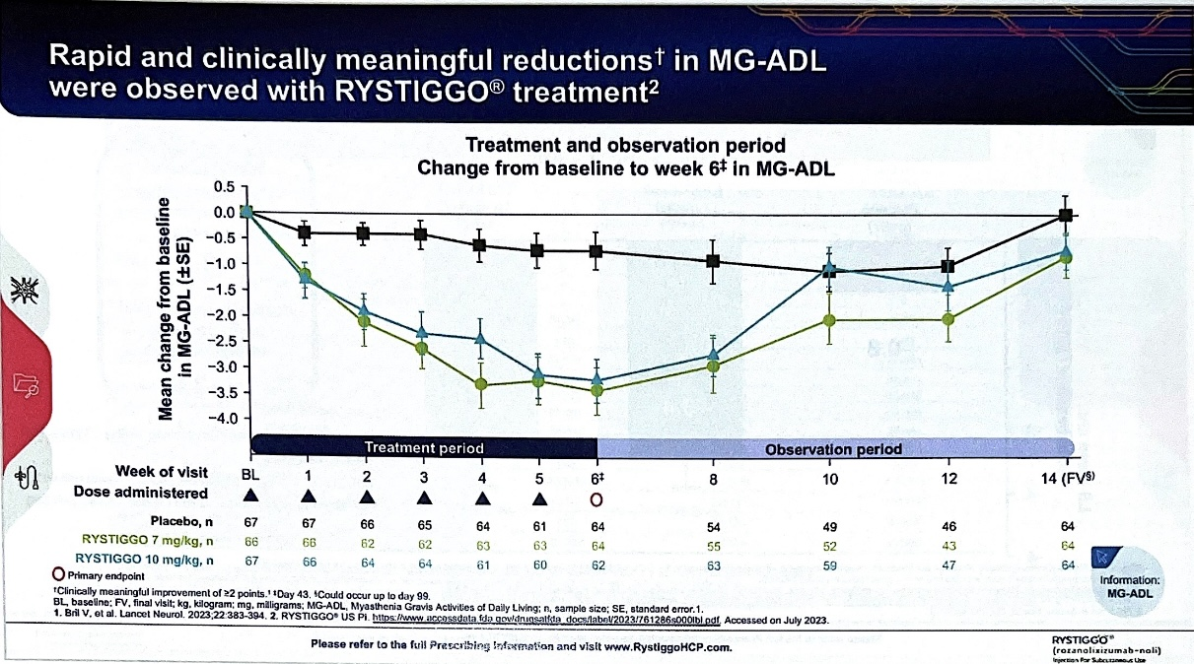










Rozanolixizumab

Slide 22
Rozanolixizumab-noli Indication, Dosing & AEs
FDA approval June 2023 for adult participants with AchR-Ab+ and MuSK-Ab+ gMG adult patients.
Dosing based on BW (≤50 kg 420 mg, 50 kg to <100kg 560 mg, ≥100 kg 840 mg) weekly SC injection administered in 15 minutes for 6 weeks.
The median time between treatment cycles was 8 weeks, and subsequent treatment cycles based on clinical evaluation.
The safety of initiating subsequent cycles less than 4 weeks from the last infusion of previous cycle has not been established
Most common AEs included; headache, infection, diarrhea, pyrexia, nausea , hypersensitivity reactions.
Patient monitoring during administration and for 15 minutes after completion for signs of hypersensitivity reactions.

Slide 23
Eculizumab
Eculizumab became FDA-approved in 2018 for refractory anti-AChR MG who failed other treatments based on the successful results of a RBPC phase 3 trial (REGAIN).
A monoclonal antibody that blocks the formation of complement complex by preventing cleavage of complement 5 (C5)
Dose 900 mg/wk for 4 weeks, followed by 1200 mg every 2 weeks
Improvement as early as 2- 4 weeks, determined by 12 weeks
Must receive meningococcal vaccination 2 weeks prior to treatment
AEs include; headache, nasopharyngitis, myalgia and meningococcal infection.
Limitations include significantly high cost and risk of infection.
James F Howard et al..Safety and efficacy of eculizumab in anti-AcHR Ab+ gMG (REGAIN): a phase 3, DBPCT r thelancet.com/neurology Vol 16 December 2017

Slide 24
Ravulizumab
FDA approval April 2022 for adult patients with AcHR-Ab+ gMG (CHAMPION Trial).
Binding of AChR -Ab leads to activation of the terminal complement complex that activates MAC with consequent destruction of the postsynaptic membrane of the NMJ structure.
Ravulizumab is a long acting humanized monoclonal antibody that specifically binds to C5 complement inhibiting MAC disruption of NMJ structure.
Dose 2400-3000 mg once based on weight, followed by 3000-3600 mg 2 weeks later, then every 8 weeks.
Must receive meningococcal vaccination 2 weeks prior to treatment.
AEs include headache, diarrhea, nausea, tendinitis and infections
Tuan Vu et al.Terminal Complement Inhibitor Ravulizumab in Generalized Myasthenia . NEMJ April 26, 2022 DOI: 10.1056/EVIDoa2100066

Slide 25
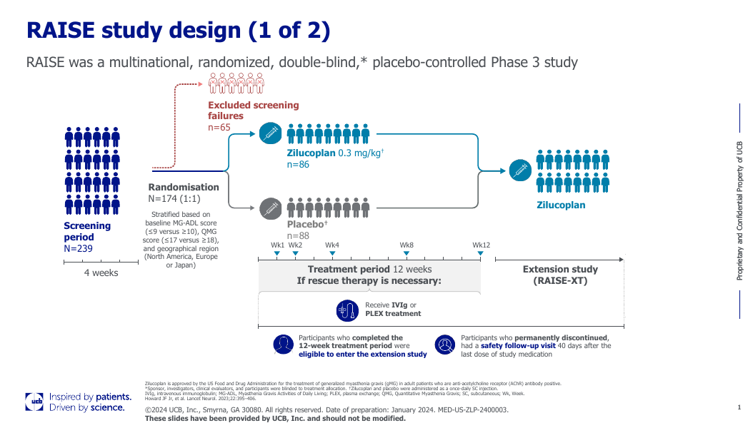

Slide 26
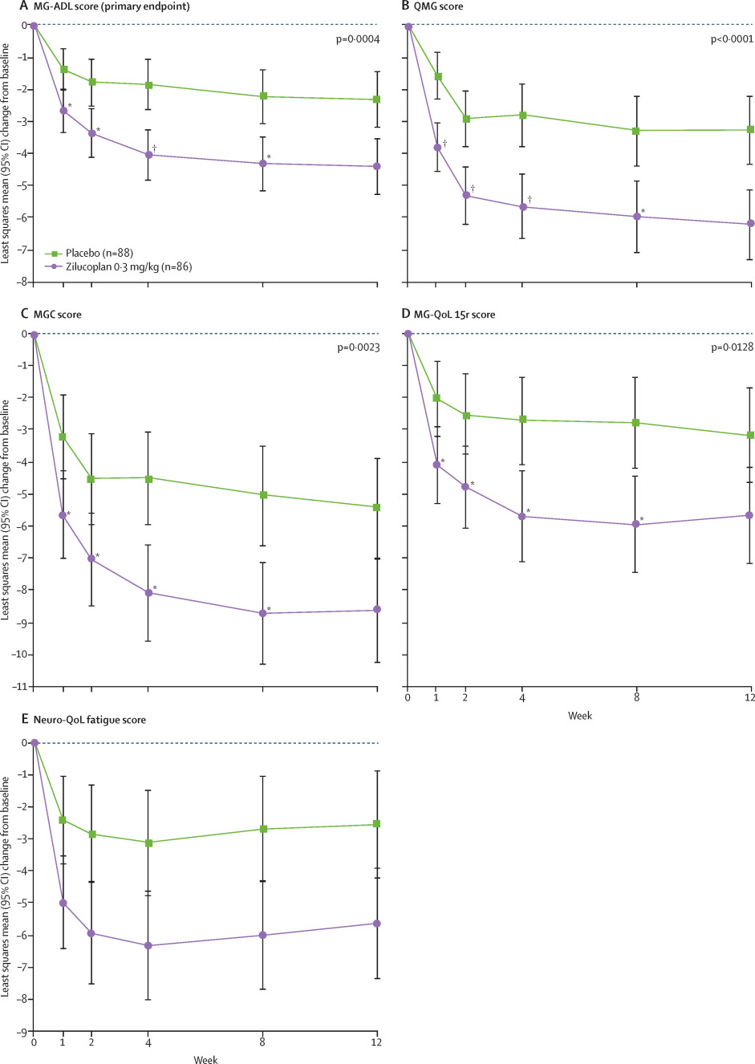
Howard JH et al. wwwthelancet.com/neurology Vol 22 May 2023

Slide 27
Zilucoplan
FDA approval for treatment of AcHR-Ab+ gMG Oct. 2023
Phase phase 3 RBPC study ((RAISE) showed significant improvement at week 12
( zilucoplan achieved a ≥3-point reduction in MG-ADL score compared with placebo (73% and 46% respectively; p=0·0005;), and ≥5-point reduction in QMG score compared with placebo, (58% and 33%, respectively; p=0.0012)..
A complement C5 inhibitor self administered SC 0.3 mg/kg daily injection
Meningococcal vaccine at least 2 weeks before starting this drug unless patient had meningococcal vaccine before,
Can be used concomitantly with IVIG or PLEX
AE’s include infection (27%), diarrhea (10%), injection-site bruising (16%), headache (15%), MG worsening (10%) and lipase increase.
(Howard JF et al. Lancet Neurol. 2023;22(5):395-406)

Slide 28
Rituximab
A monoclonal antibody to CD20 that leads to B-lymphocytes depletion
An option in anti-MuSK MG when standard immunosuppressive treatment is unsuccessful or refractory cases
A metanalysis of 169 cases with refractory MG reported 72% improvement in anti-MuSK MG, and 30% of anti-AChR MG
The treatment regimens were of varied dose, frequencies, number of repeat infusion cycles, and complication rates
A common dose is 375 mg/body surface area weekly for 4 wks.
Generally safe, however a single case of MFL was reported
(Chu S, et al. Neurol Neurosurg. 2018;18:494–500)

Slide 29
Thymectomy
First attempt at immunotherapy for MG (Blalock 1939)
The presence of thymoma is an absolute indication
A landmark trial in anti-AChR MG “ages 18 - 65 years with ≤ 5 years MG duration” showed better outcome of thymectomy plus prednisone and smaller prednisone dose vs. prednisone alone
Meta-analysis showed effectiveness in 50 to 70% of patients (remission rate; thymectomized 15% vs 8% none thymectomized)
More effective in first few years, less effective in older patients
Should be discussed with anti-AChR nonthymomatus MG.
No evidence of efficacy in anti-MuSK or anti-LRP4 MG
Gill Wolfe et al. N Eng J Med 2016; 375:511-522

Slide 30
Thymectomy
General consensus;
  Thymectomy between puberty and age 60 years in generalized MG
  Thymectomy in ocular MG is controversial
  Effects accumulate slowly (1 to 5 years)
  All newly diagnosed MG patients need a chest CT or MRI
Extended trans-sternal approach vs. less-invasive approach to avoid residual thymus tissue vs. shorter hospital stay
Operative risk, otherwise, no chronic side effects

Slide 31
Dystrophinopathy (DMD & BMD);
Dystrophin is a cytoskeletal protein that enables the strength, stability and functionality of myofibers, is absent in Duchenne (DMD) and insufficient in Becker muscular dystrophy (BMD).
Dystrophinopathy is an X- linked recessive disease caused by mutations in the dystrophin gene, with a spectrum of early rapid onset severe (DMD) or late, slow-onset mild (BMD).
Advances in pharmacology, cell biology, genetic and diagnostic studies all have enabled better understanding and enabled new classes and more targeted therapies.
Orphan Drug Act of 1983 accelerated development of novel treatments for rare NMD.
The goal is alerting you to what agents are approved or in the pipeline

Slide 32
Duchenne Muscular Dystrophy
X-linked muscular dystrophy
Chromosome Xp21; Recessive
Affects 1:3,500 live male births
Most common severe & fatal muscular dystrophy. Genetic testing provides confirmatory diagnosis.
Characterized by progressive weakness , motor delays, loss of ambulation, respiratory impairment and cardiomyopathy.

Slide 33
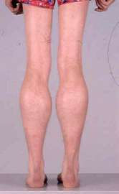
Becker Muscular Dystrophy
1:18,000-31,000
Later age of onset (5-15 years)
Same distribution of weakness as DMD but milder
Calf pain with exercise can be a presenting symptom
Neck flexors and facial muscles preserved early
Contractures less likely
Scoliosis less common

Slide 34
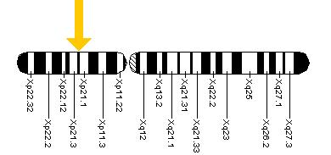
The DMD Gene
Chromosome Xp21
The largest gene in the human genome
79 exons and more than 2,500 kb
Encodes the dystrophin protein
  Skeletal muscle
  Cardiac muscle
  Smooth muscle
  Brain

Slide 35
DMD Treatment Progress
Several therapeutic approaches investigated;
- reduction of inflammation and fibrosis,
- calcium regulation
- muscle growth and protection
- mitochondrial support and cardiac protection
- dystrophin restoration and replacement (antisense oligonucleotide “ASO’s” & AAV mediated gene transfer therapy).
The FDA has approved 6 drugs in the last 7 years;
  Eteplirsen ASON for 51 exon-skipping therapy approved Sep. 2016
  Deflazacort corticosteroids option approved Feb. 2017
  Golodirsen 2019 ASON for 53 exon skipping mutation (high renal toxicity and infection).
  Viltolarsen 2020 ASON for 53 exon skipping mutation; increase dystrophin level from 0,6% to 5.9% of normal level, but a clinical benefit has not been established. (skin reaction, renal toxicity).
  Casmersen Feb. 2021 ASON for exon 45 skipping mutation
  SRP-9001 delandistrogene moxeparvovec-rokl gene therapy June 2023.

Slide 36
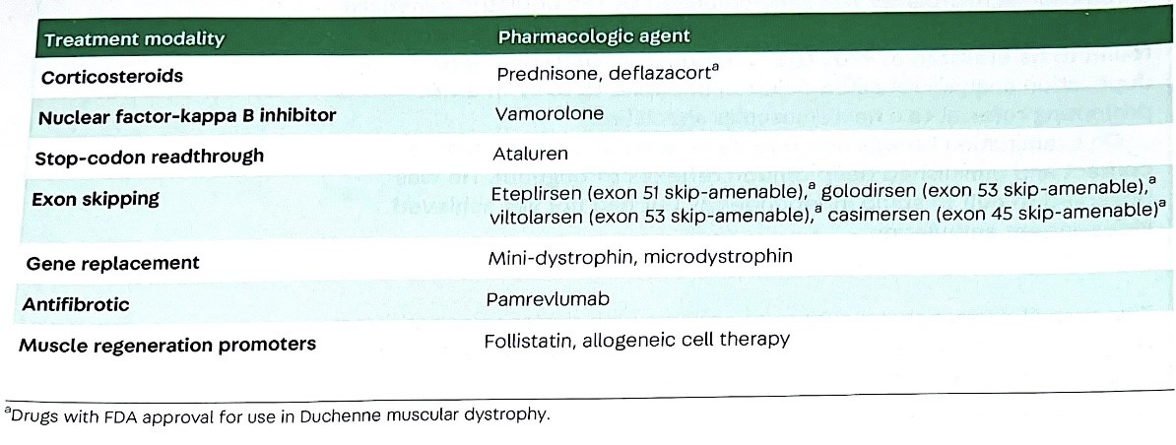
SRP – 9001 Delandistrogene moxeparvovec *

Slide 37
Deflazacort
FDA approved for DMD in 2017, but has been in clinical use for decades in other countries. Recommended dose is dose 0.9 mg/kg/day
Reduce inflammation and fibrosis by inhibiting the transcription factor NF-kB pathway.
Demonstrated delaying loss of ambulation by 2 – 3 years and pulmonary reduction
Less AEFs than Prednisone but the annual cost is $117,400, versus ≤ $1000 for prednisone
Can be prescribed to all Duchene patients regardless of genetic mutation
Steroids therapy should be started before motor decline, typically 3 to 5 years of age.
Deflazacort has higher risk for cataract and less for weight gain in a 12 months trial.
Bonifati MD et al. Muscle & Nerve 2000;23(9)
Rice ML et al. JAAPOS 2018;01.017

Slide 38
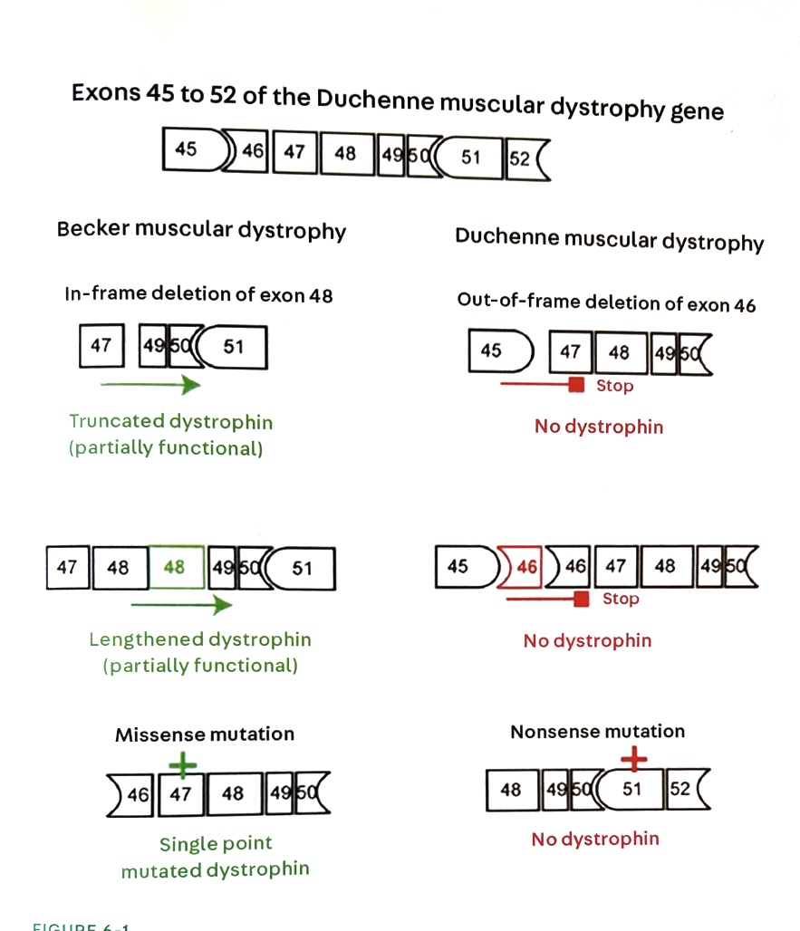

Slide 39
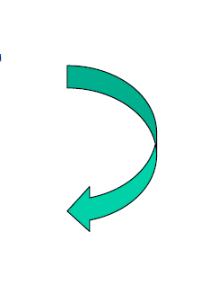
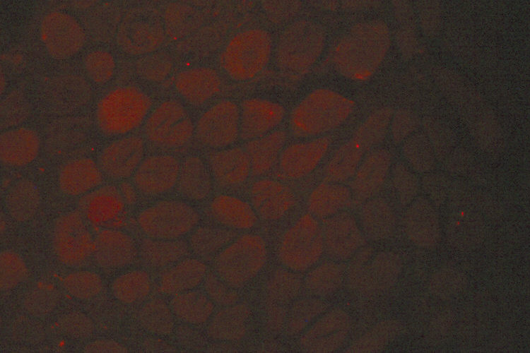
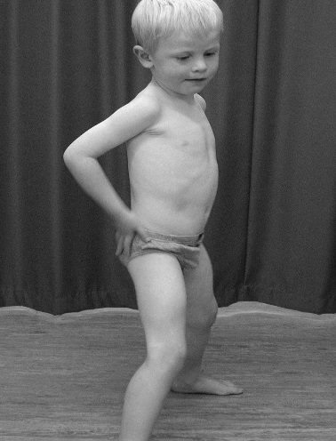
THE BIG RED DOG RAN AND SAT
THE BIR EDD OGR ANA NDS AT
Frameshift
mutation
Absent dystrophin
Duchenne
Out of frame mRNA
No dystrophin

Slide 40
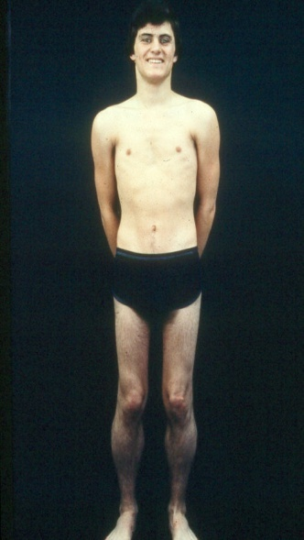
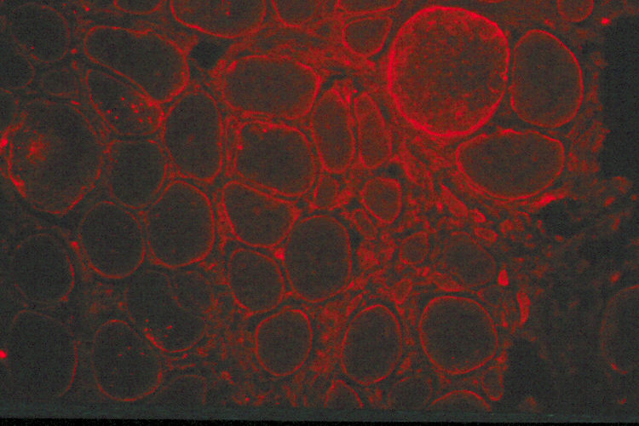
Reading Frame
THE BIG RED DOG RAN AND SAT
THE BIR EDD OGR ANA NDS AT
THE DOG RAN AND SAT
Inframe
mutation
Becker
Inframe mRNA
Reduced but functional dystrophin

Slide 41
Exon Skipping Genetic Therapy in DMD
ASOs selectively binds to targeted out-frame exon mutation of the dystrophin pre-mRNA , which causes exon skipping and restore the in-frame reading dystrophin mRNA and allows for a truncated but partially functional dystrophin.
Assessment based on mean increase of dystrophin positive fibers compared to pre-treatment, and effect on patient ambulation 6- minute walk test (6MWT)
Increased dystrophin positive muscle fibers range 30 – 50 % compared to pre-treatment, however amount of dystrophin in positive dystrophin fibers increased by 0.93%.
Effect on patient ambulation (6MWT) was limited

Slide 42
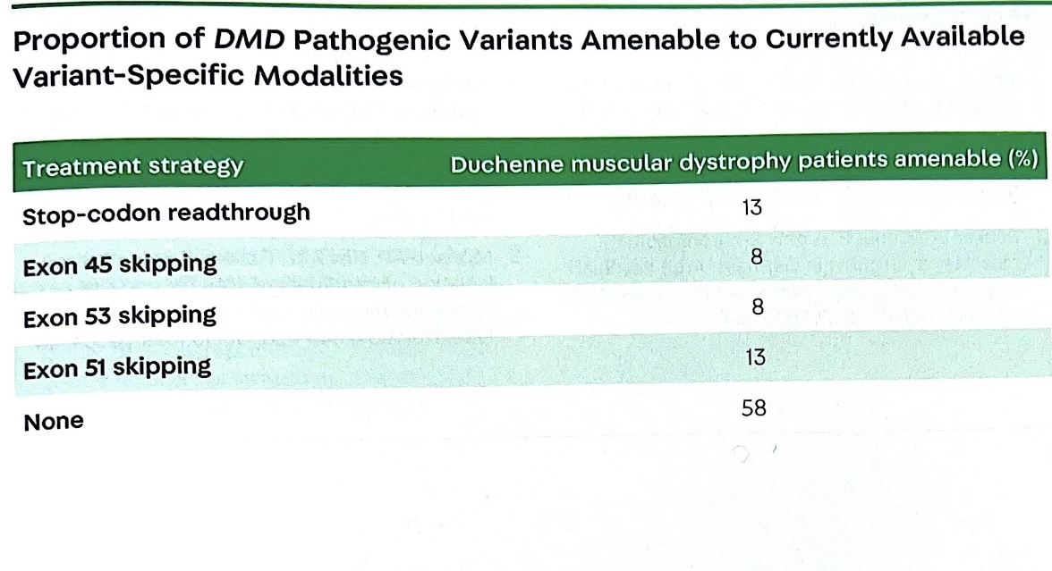

Slide 43
Current FDA Approved PMO Drugs for the Treatment of DMD
Name | Company | Target Exon | Applicability | Year of FDA Approval
Eteplirsen | Sarepta Therapeutics | Exon 51 | 14% of all patients with DMD | 2016
Golodirsen | Sarepta Therapeutics | Exon 53 | 8% of all patients with DMD | 2019
Viltolarsen | Nippon Shinyaku (NS Pharma) | Exon 53 | 8% of all patients with DMD | 2020
Casimersen | Sarepta Therapeutics | Exon 45 | 9% of all patients with DMD | 2021 PPM
PMO; Phosphorodiamidate morpholino oligomer

Slide 44
Eteplirsen
Administer 30 mg IV weekly for exon 51 skipping, price ≥ $1,000,000/year.
.Side effects include allergic reaction, vomiting, joint pain and imbalance.
Golodirsen
IV 30 mg/kg weekly infusion for exon 53 skipping, price $748,000/year.
AEs allergic reaction, renal toxicity, headache, fever, abdominal pain
Viltolarsen
IV infusion 80 mg/kg weekly for exon 53 skipping, price ≥$500,000/year
Side effects include proteinuria, eczema, nausea, HTN, respiratory infection
Casimersen
IV infusion 30 mg/kg once weekly for exon 45 skipping, price ≥$1,000,000/year.
Side effects include allergic reaction, headache, fever, joint pain and cough.
Zingariello CD et al. Neurology 2018;90(24):1091-1092.
Verhaart ICE et a. Nat Rev Neurol. 2019;15(7):373-386.
(PMID: 33861387 DOI: 10.1007/s40265-021-01512-2)

Slide 45
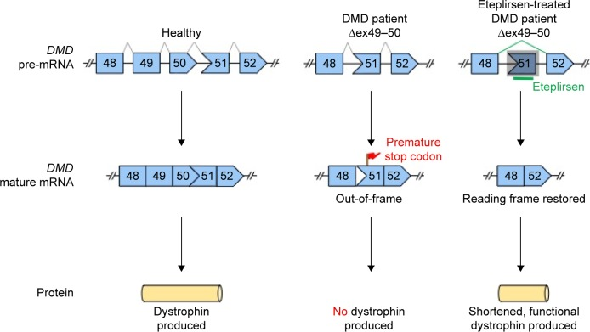










Slide 46
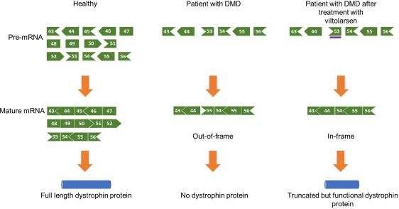

Slide 47
Viral Mediated Gene Transfer Therapy
Initial efficacy and safety of administration of a transgene encapsulated in an adeno-associated virus (AAV-9) studies is under investigation.
The large size of the DMD gene does not allow the use of an AAV vector as a carrier of the entire gene.
Various minidystrophin nucleotide have been developed from patients with BMD
Concerns include; potential cellular immunity,
Preexisting seropositivity to AAV
Lack of full functionality of truncated dystrophin
Durability of therapy and lack of potential for redosing
Concern regarding immunogenic toxicity to the transgene and/or the capsid.

Slide 48
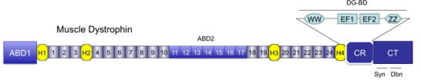

Strategy for Adeno-Associated Virus (AAV-9) Gene Transfer Therapy for DMD
14kb
Find miniaturized but functional versions of dystrophin, then package them in AAV
3.8kb
Ramos J and Chamberlain JS. Expert Opin Orphan Drugs. 2015;3:1255-66

Slide 49
Micro/MiniDystrophin Gene Therapy Programs for DMD
Phase 1
Phase 2
Phase 3
NCT03375164
“101”
NCT03769116
“102”
NCT05096221
EMBARK
SRP-9001
Sarepta
NCT04626674
ENDEAVOR
SGT-001
Solid Biosciences
NCT03368742
“IGNITE DMD”
PF-06939926
Pfizer
NCT03362502†
NCT04281485
“CIFFREO”
GNT 0004
Genethon
1st patient dosed
April 2021
SAEs, serious adverse events
https://clinicaltrials.gov
**https://www.pfizer.com/news/press-release/press-release-detail/pfizer-doses-first-participant-phase-3-study-Duchenne
# Study protocol will be amended to exclude patients with any mutation in exons 9 to 13 and deletion of both exon 29 and 30
Notes:
Notes to consider on each

Slide 50
Clinical Trial ENDEAVOR (NCT04626674)
SRP 9001-delandistrogene moxeparvovec
Cohort 1* (N=20)
Primary endpoint
  Protein expression increases at 12 weeks
  Other Key Endpoints
  Safety
  Functional increases (NSAA, 100MWR, 4 stair climb, time to rise, 10MWR
Key Inclusion Criteria:
≥ 4 to < 8 years old
Ambulatory
NSAA score >17 and ≤26
Stable on oral corticosteroids
rAAVrh74 ab titer ≤1:400
Mutations in exon 1-17 excluded **
Dosing
Open Label
Commercial process material
Single IV dose of 1.33x10¹⁴ vg/kg (linear qPCR))
12 weeks
Muscle Biopsy
*Other Cohorts include Cohort 2 (ambulatory ≥ 8-18), Cohort 3 (non-ambulatory), Cohort 4 (ambulatory ≥ 3 to < 4) Data pending
** Added to prevent SAEs
https://clinicaltrials.gov NCT04626674; Zaidman C. et al. 17th International Congress on Neuromuscular Diseases 2022
Notes:
Exploratory
Vector genome copies
Change in CK from baseline over 260 weeks
Evaluate cellular immune response to AAVrh74 and micro-dystrophin transgene as measured by ELISpot
Antibody titers to micro-dystrophin transgene

Slide 51
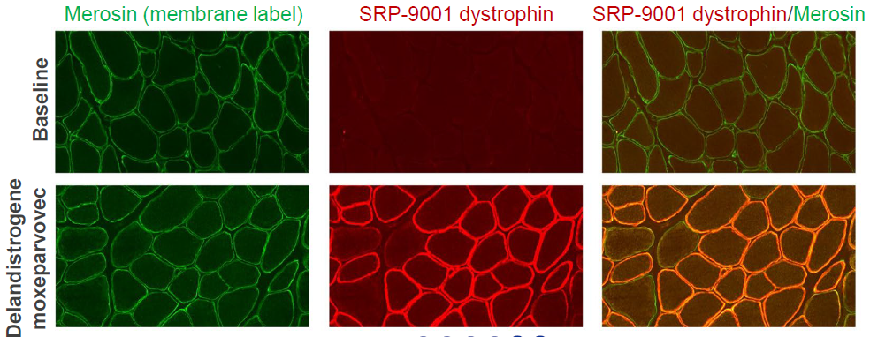
Protein Expression-Cohort 1
Protein expression
  Mean percent dystrophin positive fibers: 56.7%
  Mean protein intensity at sarcolemma: 98.4%
Dystrophin expression by immuno-fluorescence
12 weeks post infusion
Zaidman C. et al. 17th International Congress on Neuromuscular Diseases 2022

Slide 52
SRP-9001 delandistrogene moxeparvovec-rokl gene therapy
FDA granted accelerated approval in June 2023 for DMD patients aged 4-5 years
Primary outcome based on muscle biopsy assessment of micro-dystrophin expression
Secondary outcome based on NSAA assessment of motor function improvement (100 m timed test, 4-stair climb, time to rise), but not a cure
Can be associated with severe adverse events (liver, GI, cardiac and others)
Treatment cost around 3.2 million dollars.

Slide 53
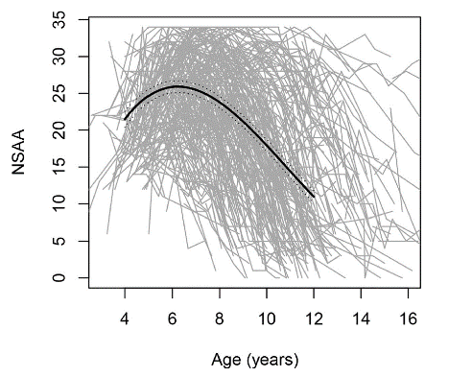
Functional Assessment in DMD
North Star Ambulatory Assessment (NSAA)
Natural History
NSAA in DMD patients
17 items assess motor function
Each item scored
  0 = unable to perform,
  1 = performed with difficulty,
  2 = able to perform
DMD patients average peak score of 26 at 6.3 years of age
Hop
Stand on heels
Rise from floor
Run
Jump
Lift head
Step up and down
Stand on one leg
Lie to sit
Stand from chair
Walk
Stand
Mayhew A et al. Dev Med Child Neurol. 2011;53:535-42, 2. Muntoni F et al. PLoS One. 2019;14:e0221097.
Notes:
Description of NSAA
TTR= Time to Rise
4 Stair Climb
10Meter
100 Meter
6Minute Walk Test

Slide 54
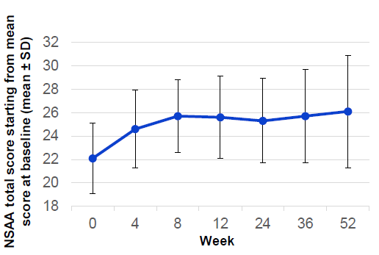
Functional Results-Cohort 1
NSAA total score 1 year post-infusion with delandistrogene moxeparvovec (cohort 1)
Gene therapy improved short-term functional outcomes
Other Functional results
Timed Function Tests | Mean change from baseline at Year 1 ± SD (seconds)
Time to rise | -0.5 ±1.5
10 meter walk/run | -0.8±0.8
Time ascend 4 steps | -0.8±0.9
100 meter walk/run | -12.0±18.4
Zaidman C. et al. 17th International Congress on Neuromuscular Diseases 2022

Slide 55
Summary of Viral Mediated Gene Transfer Therapy
Each gene therapy in DMD has a unique combination of vector, promotor, and transgene and should be evaluated carefully for future use in your patients
There are now 3–4 clinical trial programs using systemically administered AAV-mediated minidystrophin gene transfer that are actively recruiting patients
Data from muscle biopsies in first three programs demonstrate robust expression of the micro/minidystrophin transgene
Preliminary clinical data available to date indicates that treatment results in deviation from the natural history of DMD
Notes:
Review the key components of gene therapy for DMD, including vectors, promoters, and transgene constructs
Assess the prospective functional benefits of gene therapies in DMD and their potential to slow disease progression
Evaluate the latest results from clinical trials for gene therapies in DMD

Slide 56


Questions

